Slide 1

Re-Thinking Rehabilitation:
Structured Flexibility and the Development of Meaningful Life
Tim Feeney, Ph.D.
The Mill School and Belvedere Health Services
Winooski, VT USA
tfeeney@millschoolvt.org

Slide 2
The Guiding Principles for the Development of Supports that Will Help Everyone Create Meaning
We believe that structured flexibility is essential to the development of interventions for all students; we will experiment in an organized way and embrace creative, alternative and individualized approaches developed in collaboration with all.
We believe that change is progressive and iterative – we know that real change is incremental; we expect problems will assure that problems do not result in traditional negative discipline.
We believe that long term success is dependent on the development of social competence; we will help the people we support to learn how to be contributors to their communities;
We believe that long term success requires that students develop positive personal identities; we will provide frequent opportunities to participate in personally meaningful activities.
We know that long term success is dependent on the development of self-regulation, we will assure that all interventions include the opportunity to teach and learn self-regulation.

Slide 3
Reimagining Rehabilitation
  At what point do we shift from focusing on rehabilitation and start talking about helping people figure out how to live a life? (hint: sooner rather than later).
  It is the job of professionals to find the right balance between supporting short(er) term recovery and preparing for long term living.
  Rehabilitation is really a series of conversations with the person and key others that focuses on what helps and what does not help the person to create a meaningful life.
  Success is life results from using what you got, not talking about or evaluating or measuring what you don’t got.

Slide 4
“A GRAND UNIFIED THEORY OF SUCCESS IN LIFE”*
*apologies to Albert Einstein and Stephen Hawking

Slide 5
THERE ARE TWO FOUNDATIONAL PRINCIPLES OF
“THE GRAND UNIFIED THEORY OF SUCCESS IN LIFE”

Slide 6
THE FIRST PRINCIPLE:
NON
AGERE
CULUS

Slide 7


Slide 8
Don’t Be “Nice” – Be Kind
(see Maimonides’ Eight Levels of Charity)
Nice (empathic)
Acting in a manner to avoid hard or hurt feelings
Acting out of sympathy or empathy
Seeking emotional connection
Increasing biased thoughts
Avoiding conflict
Enabling
Kind (compassionate)
Acting in a manner that moves things forward – even if it hurts
Acting in a manner that shows you recognize what others are feeling – but staying above it.
Seeking a non-emotional way forward and recognizing biases
Accepting difficult conversations are an inevitable part of life
Helping

Slide 9
A true friend stabs you in the front, not the back.
- Oscar Wilde
It’s important that we have hard conversations.
Hard conversations require preparation, permission, “being ready”, and (frequently) multiple attempts before coming to some resolution.
I love you enough to say “no.”

Slide 10
THE SECOND PRINCIPLE:
Reject the Illusion of Control

Slide 11
The less I try to control things, the more control I have.
- Annette Smith
There are so many variables beyond our control. We need to accept this reality.
We need to stop thinking that we can control people and events - and accept that all we can really do is nudge people in a direction that we think is “good” for them.
This means we need to create options that reflect our lack of control and ensure we have concordance on those options.

Slide 12
A “GRAND UNIFIED THEORY” OF SUCCESS IN LIFE AS IT APPLIES TO REHABILITATION:
Any successful intervention requires the participation of the individual and important others

Slide 13
“I am their leader. I must follow them”*
“F**k You and Your ‘Rapport’”**
If you’re looking for “buy in” you’re wasting your time. “Buy in” implies that you’re trying to sell something. If your creating opportunities for collaboration, you’ve got a chance at long-term success because you’re not trying to sell an idea.
Whether you like it or not, the quality of the collaborations that you have with the individual and everyday others will have a significant effect on the success of your intervention:
  Intervention generation
  Fidelity of implementation
  Willingness to try new (and often opposing) ideas
  Openness to feedback
  *Alexandre Ledru-Rollin
  **Jason L.

Slide 14
A IMPORTANT CLAUSE IN THE THEORY:
Hope is an essential element of the development of successful support.

Slide 15
Notes:
re

Slide 16
Proverbs
“There is surely a future hope for you, and your hope will not be cut off.”
Torah
“. . . our hope is an anchor that is both secure and firm.”
Quran
“Do not lose hope, nor be sad.”

Slide 17
“Hope is a Discipline”

Slide 18
Hope is . . . “less about ‘how you feel,’ and more about the practice of making a decision every day, that you’re still gonna put one foot in front of the other, that you’re still going to get up in the morning. It’s work to be hopeful.”
- Mariame Kaba
Active Hope is a practice. Requiring:
A clear view of reality;
The identification of what we hope for - the direction we’d like things to move;
Taking steps to move ourselves in that direction.

Slide 19
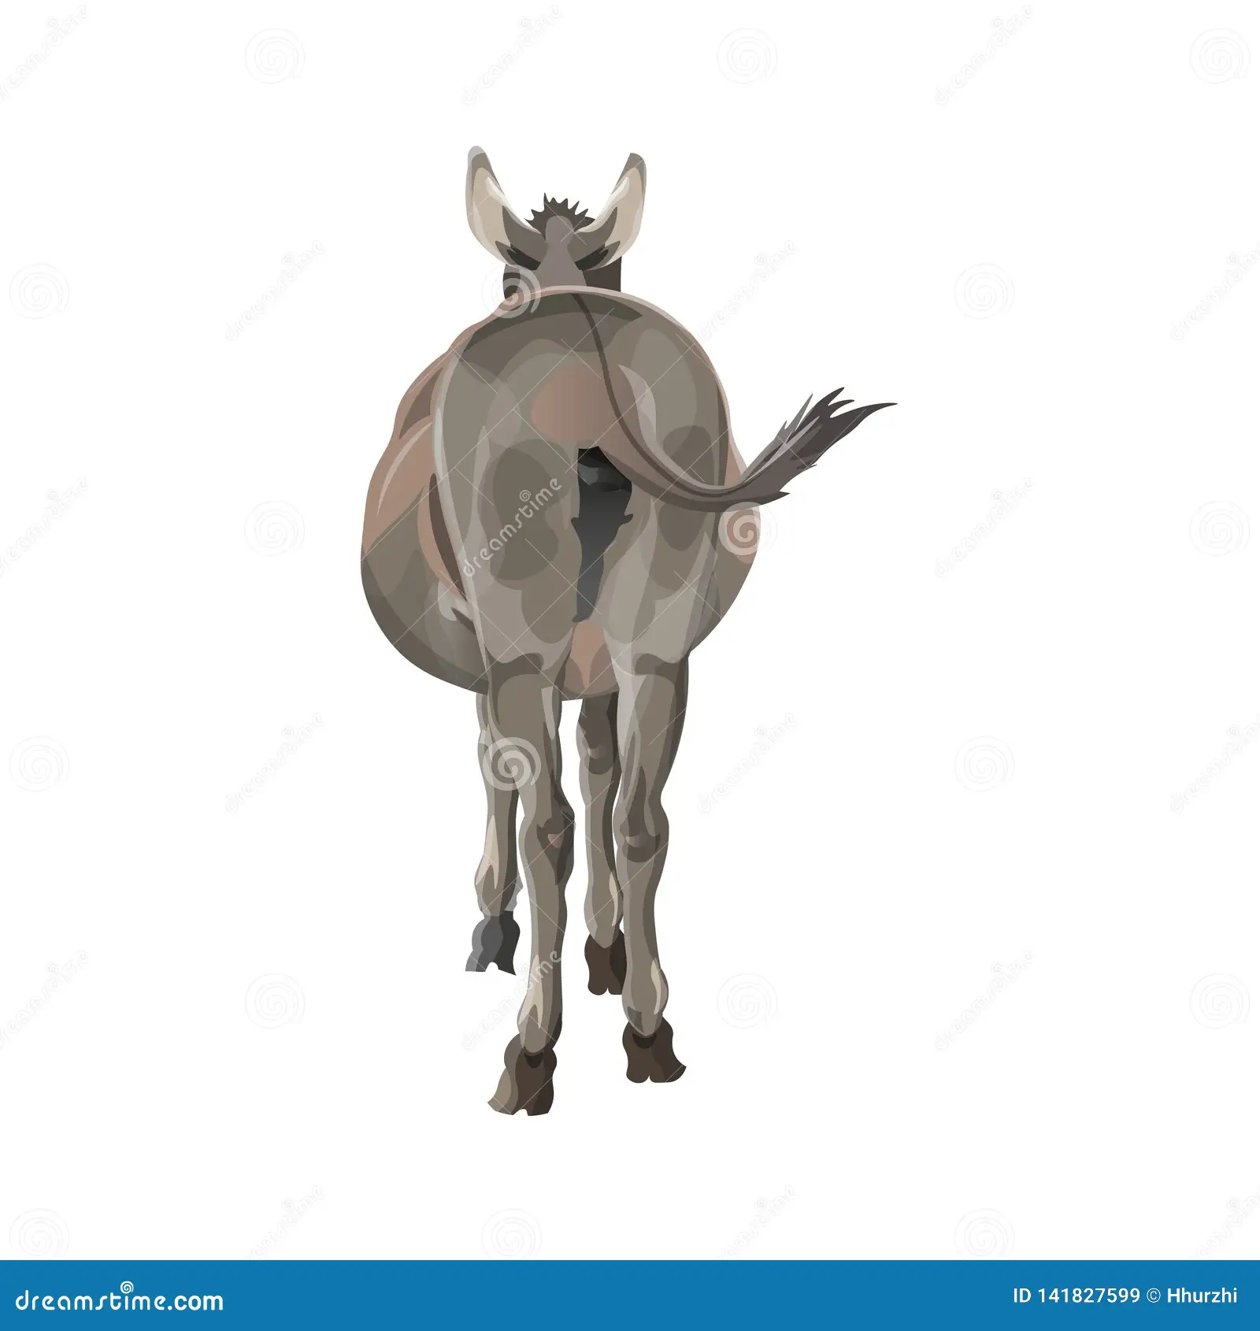

A Continuum of Hope and Optimism
People who:
Avoid collaboration
Use demeaning humor
Think that they’re right about everything
Are aggressive (or really passive)
Refuse to experiment
People who:
Collaborate under pressure
Can find humor
Have a hard time saying they’re wrong
Are cautious and guarded
Worry about experiments – but will
People who:
Collaborate
Have a sense of humor
Accept when they’re wrong
Are interested
Are experimental
HOPEFUL
OPTIMISTIC-ISH
HOPELESS

Slide 20
APPLYING
“THE GRAND UNIFIED THEORY OF SUCCESS IN LIFE”
TO WORKING WITH PEOPLE WHO STRUGGLE WITH LIFE

Slide 21
A FRAMEWORK FOR INQUIRY
Approaching Difficult Situations with Structured Flexibility
What’s the meaning? Where’s the meaning?
What is the reason to get out of bed in the morning?
Is this a can’t do? A don’t do? A won’t do?
What’s the valued outcome – a life defined as a “good life”? Then what are the goals?
How can be best define what help will look like? In the short-term? In the long-term?
How do we help an individual create a stable identity?
What do we want to do? What can we actually do?

Slide 22
Your Theory – My Theory
A General Approach to Any Problem
You’ve got an idea, I’ve got an idea, either one might work. Let’s test them out!
Before we start, how will we know if something is working or not?
We’ll stick with the winners and get rid of the losers

Slide 23
Your Theory – My Theory
A Script for Theory Assessment
Identify the “theory” – why do you think this is happening? How did it get this way?
Are you ready to hear my theory? Can you tell me your theory?
How did you reach this theory? Any evidence? What’s “good” about your theory?
How did I reach this theory? My evidence? What’s wrong with my theory?
How can we test your theory? My theory?

Slide 24
Fighting emotion with logic is like bringing a calculator to
a knife fight.
- Josh Sundquist
When someone – anyone – is acting out of emotion, our job is to shut up and listen and wait. Our job is not to help them reflect and respond.
We cannot logic emotions – doing so will likely make things worse.
We need to avoid the trap of offering solutions during times of upset. And wait.

Slide 25
Foundational Assumptions About the Purpose of Professional Involvement in the Lives of People with Brain Injury:
We need to do more than help people return or improve functions, we need to support people to figure out how to live life meaningfully.
We professionals are just a tiny part of a larger life so we should behave with that fact in mind.
As professionals our relationships are asymmetrical and nearly always short-term; therefore, it is critical to establish a respectful relationship that is sensitive to the reality that our job is to prepare people for life long after we’re out of the picture.
In other words: Our jobs are to teach people how to figure out ways live a life of meaning - using whatever individual competencies and interpersonal supports that they’ve got.

Slide 26
Implications:
(These will likely make some folks in this room pretty f***kng angry)
For Professionals: The quality of the relationships that you have with the individual and the people who are helping the person are far more important than the quality of your clinical education, clinical insights and intervention ideas. If you don’t act with humility and respect you kinda suck and will likely have minimal impact.
Barber, J. P., Sharpless, B. A., Klostermann, S., & McCarthy, K. S. (2007). Assessing intervention competence and its relation to therapy outcome: A selected review derived from the outcome literature. Professional Psychology: Research and Practice, 38(5), 493.

Slide 27
Implications:
For Families and Individuals with Brain Injury: Most professionals have the best intentions and want to help; but most us are kinda winging it. There is no simple solution. There is some evidence to support what we’re doing – but it might not apply. And it’s a good thing when we are honest about winging it. I’m winging it right now.
McKenna, K., Leykum, L. K., & McDaniel Jr, R. R. (2013). The role of improvising in patient care. Health Care Management Review, 38(1), 1-8.

Slide 28
Implications:
For Everyone: All of us are smarter than any one of us. You can have the most impressive credentials in the world, you might care deeply and be committed to making things better; however, if you can’t work with people, you’re fairly superfluous to the creation of positive outcomes. And, if you won’t work together with people who you don’t necessarily like, life will just be worse for you and everyone in it.
Johnson, D. W., & Johnson, R. T. (1987). Learning together and alone: Cooperative, competitive, and individualistic learning. Prentice-Hall, Inc.

Slide 29
ANOTHER CLAUSE IN THE THEORY:
Figuring out life is about figuring out who you are and who you want to be
(and this is especially true for people with brain injury)

Slide 30
To live is to choose.
But to choose well, you must know who you are and what you stand for, where you want to go, and why you want to get there.
- Kofi Annan

Slide 31
An Unspoken Reality
Once you enter any kind of helping setting, you lose your identity.
You’re not Bob or Sue, you’re a “client” or the “person with . . .”
You often lose your sense of self as a result of your diagnosis and we often expedite your loss of your self by the way we behave.
A care plan is a list of all that’s wrong with you.
You become a consumer. Consumers have no social capital. Most people want to be producers not just consumers.

Slide 32
Establishing a sense of self is a daily act that starts with finding an answer to this question:
“What is my reason for getting out of bed today?”
Getting out of bed is the first act of hope for the day

Slide 33
Old ‘Me”
New “Me”
New-New “Me”
and/or
New-New “We”

Slide 34
Helping People to Create the “New-New Me” and the “New-New We”
Without Making Them Helpless
Focusing on Valued Outcomes – not on “goals”.
  What, where, who do I want to be 5 years from now?
  Being aspirational.
Building support that focuses on self-regulation
  To be successful you’ve got to be good at understanding:
    Big Deals and Little Deals
    If I’m Ready or Not Ready to start and sustain engagement
    If what I’m going to need to do is Hard or Easy for me.

Slide 35
DALE AND IDENTITY
Old ‘Me”
Independent
Fun
Loyal
Hardworking
Successful
New ‘Me”
Dependent
Depressed
Loyal
Follower
A “patient”
New New ‘Me”
Impacting
Positive
Loyal
Accepting help
Just Dale

Slide 36
ANOTHER ANOTHER CLAUSE IN THE THEORY:
Anything that is done successfully requires a long view of what we’re doing and why we’re doing it.

Slide 37
Making Things Work for People Who Struggle in Life
Life can be hard and frustrating so the work will difficult. That’s OK! It took a while to get this way. It’ll take a while to make sustainable change.
We expect we’ll get to the 2nd (and 3rd and 4th) ideas before we’ll have sustainable success. So, we’ll keep a long view.
We know that there’s always something that works. And we will keep working to find it.
In the face of overwhelming difficulties, we are always hopeful. We owe the people with work with and their families our hope.
We never give up. We recognize that – in many ways – hope is critical to any long-term success.

Slide 38
Assumptions for Professionals:
We need to do more than help people return or improve functions, we need to support people to figure out how to live life meaningfully.
We professionals are just a tiny part of a larger life so we should behave with that fact in mind.
As professionals our relationships are asymmetrical and nearly always short-term; therefore, it is critical to establish a respectful relationship that is sensitive to the reality that our job is to prepare people for life long after we’re out of the picture.
In other words: Our jobs are to teach people how to figure out ways live a life of meaning using whatever it is that they’ve got.

Slide 39
In Order to Make Meaningful Goals
(Designed to Help the Person Become the Person They Want to Be)
You’ve Got to Know How to Make “Choices”
We live in a world where everyone talks about people’s choices, that the people we work with have the right to choose. Because we believe in the right to choose, our programs are based on choices. This is a good thing; however, its critical to make sure that people are really making choices – and not responding in an impulsive way.
AN IMPLUSE IS NOT A CHOICE.

Slide 40
Responding out of frustration or impulsiveness is
an act of hopelessness
Choosing a response or action is an act of hope

Slide 41
Choice and the People We Support
What may have started as a choice often does not end as a choice!
For many people there is a momentum (or a compulsion/obsession or perseveration) to behavior that results in people losing control of their behavior
When this happens we roll with it. We don’t terminate our services or suspend, we work to help people to overcome or change the pattern. We keep on trying. That’s who we are, that’s what we do.

Slide 42
“Goals?!? What the F%$k Are Those?”
(So Many Goals are Fairly Meaningless to the Person We’re Supporting)
We work with people who don’t know how to make goals, were/are often impulsive, or were/are not very successful at achieving goals or never learned how to make goals.
So why the f$*k are we so focused on goals?

Slide 43
“Goals?!? What the F$%k Are Those?”
We need to shift from talking about “goals” to thinking about valued outcomes – a 3D picture of my immediate and long term future, a great day in my life, a clear understanding of what I really want to do, a reason to get up in the morning, a reason to do the hard stuff that often has to be done to make any real change.
Who do I want to be 5, 10, 15 years from now? And build from there.

Slide 44
The Paradox of Choice
“Learning to choose is hard. Learning to choose well is harder. And learning to choose well in a world of unlimited possibilities is harder still, perhaps too hard.”
“But knowing what we want means, in essence, being able to anticipate accurately how one choice or another will make us feel, and that is no simple task.”
― Barry Schwartz (2004). The Paradox of Choice: Why More is Less

Slide 45
It is essential that the person being offered the choice have the information necessary for making a meaningful decision . . . without such information, being given a choice will feel more like a burden than a support for autonomy.
Edward Deci, 1995
Why We Do What We Do

Slide 46
A Hierarchy of Learning How to Make Choices:
Anything Goes!
(Free Choice)
Choose from A Predetermined Group
(Fixed Choice)
Either - Or Choice (Forced Choice)
Cause and Effect Learning
(Feeling and remembering the natural results of what you do)

Slide 47
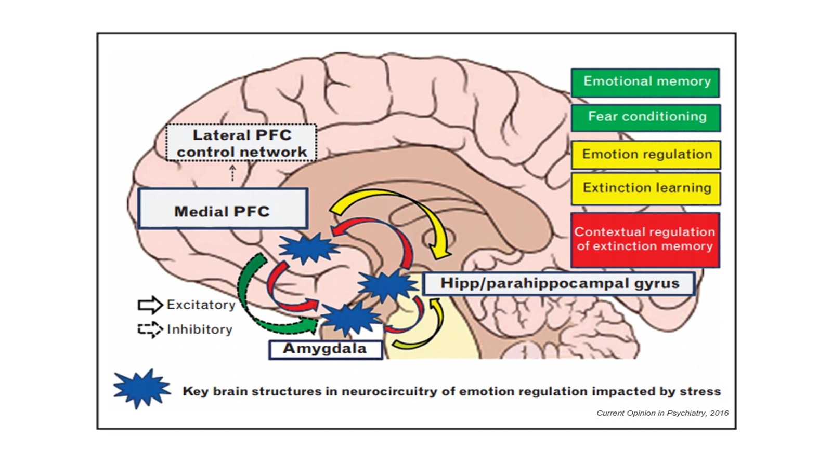
OBLIGATORY SCHEMATIC OF A BRAIN WITH IMPORTANT REGIONS HIGHLIGHTED

Slide 48
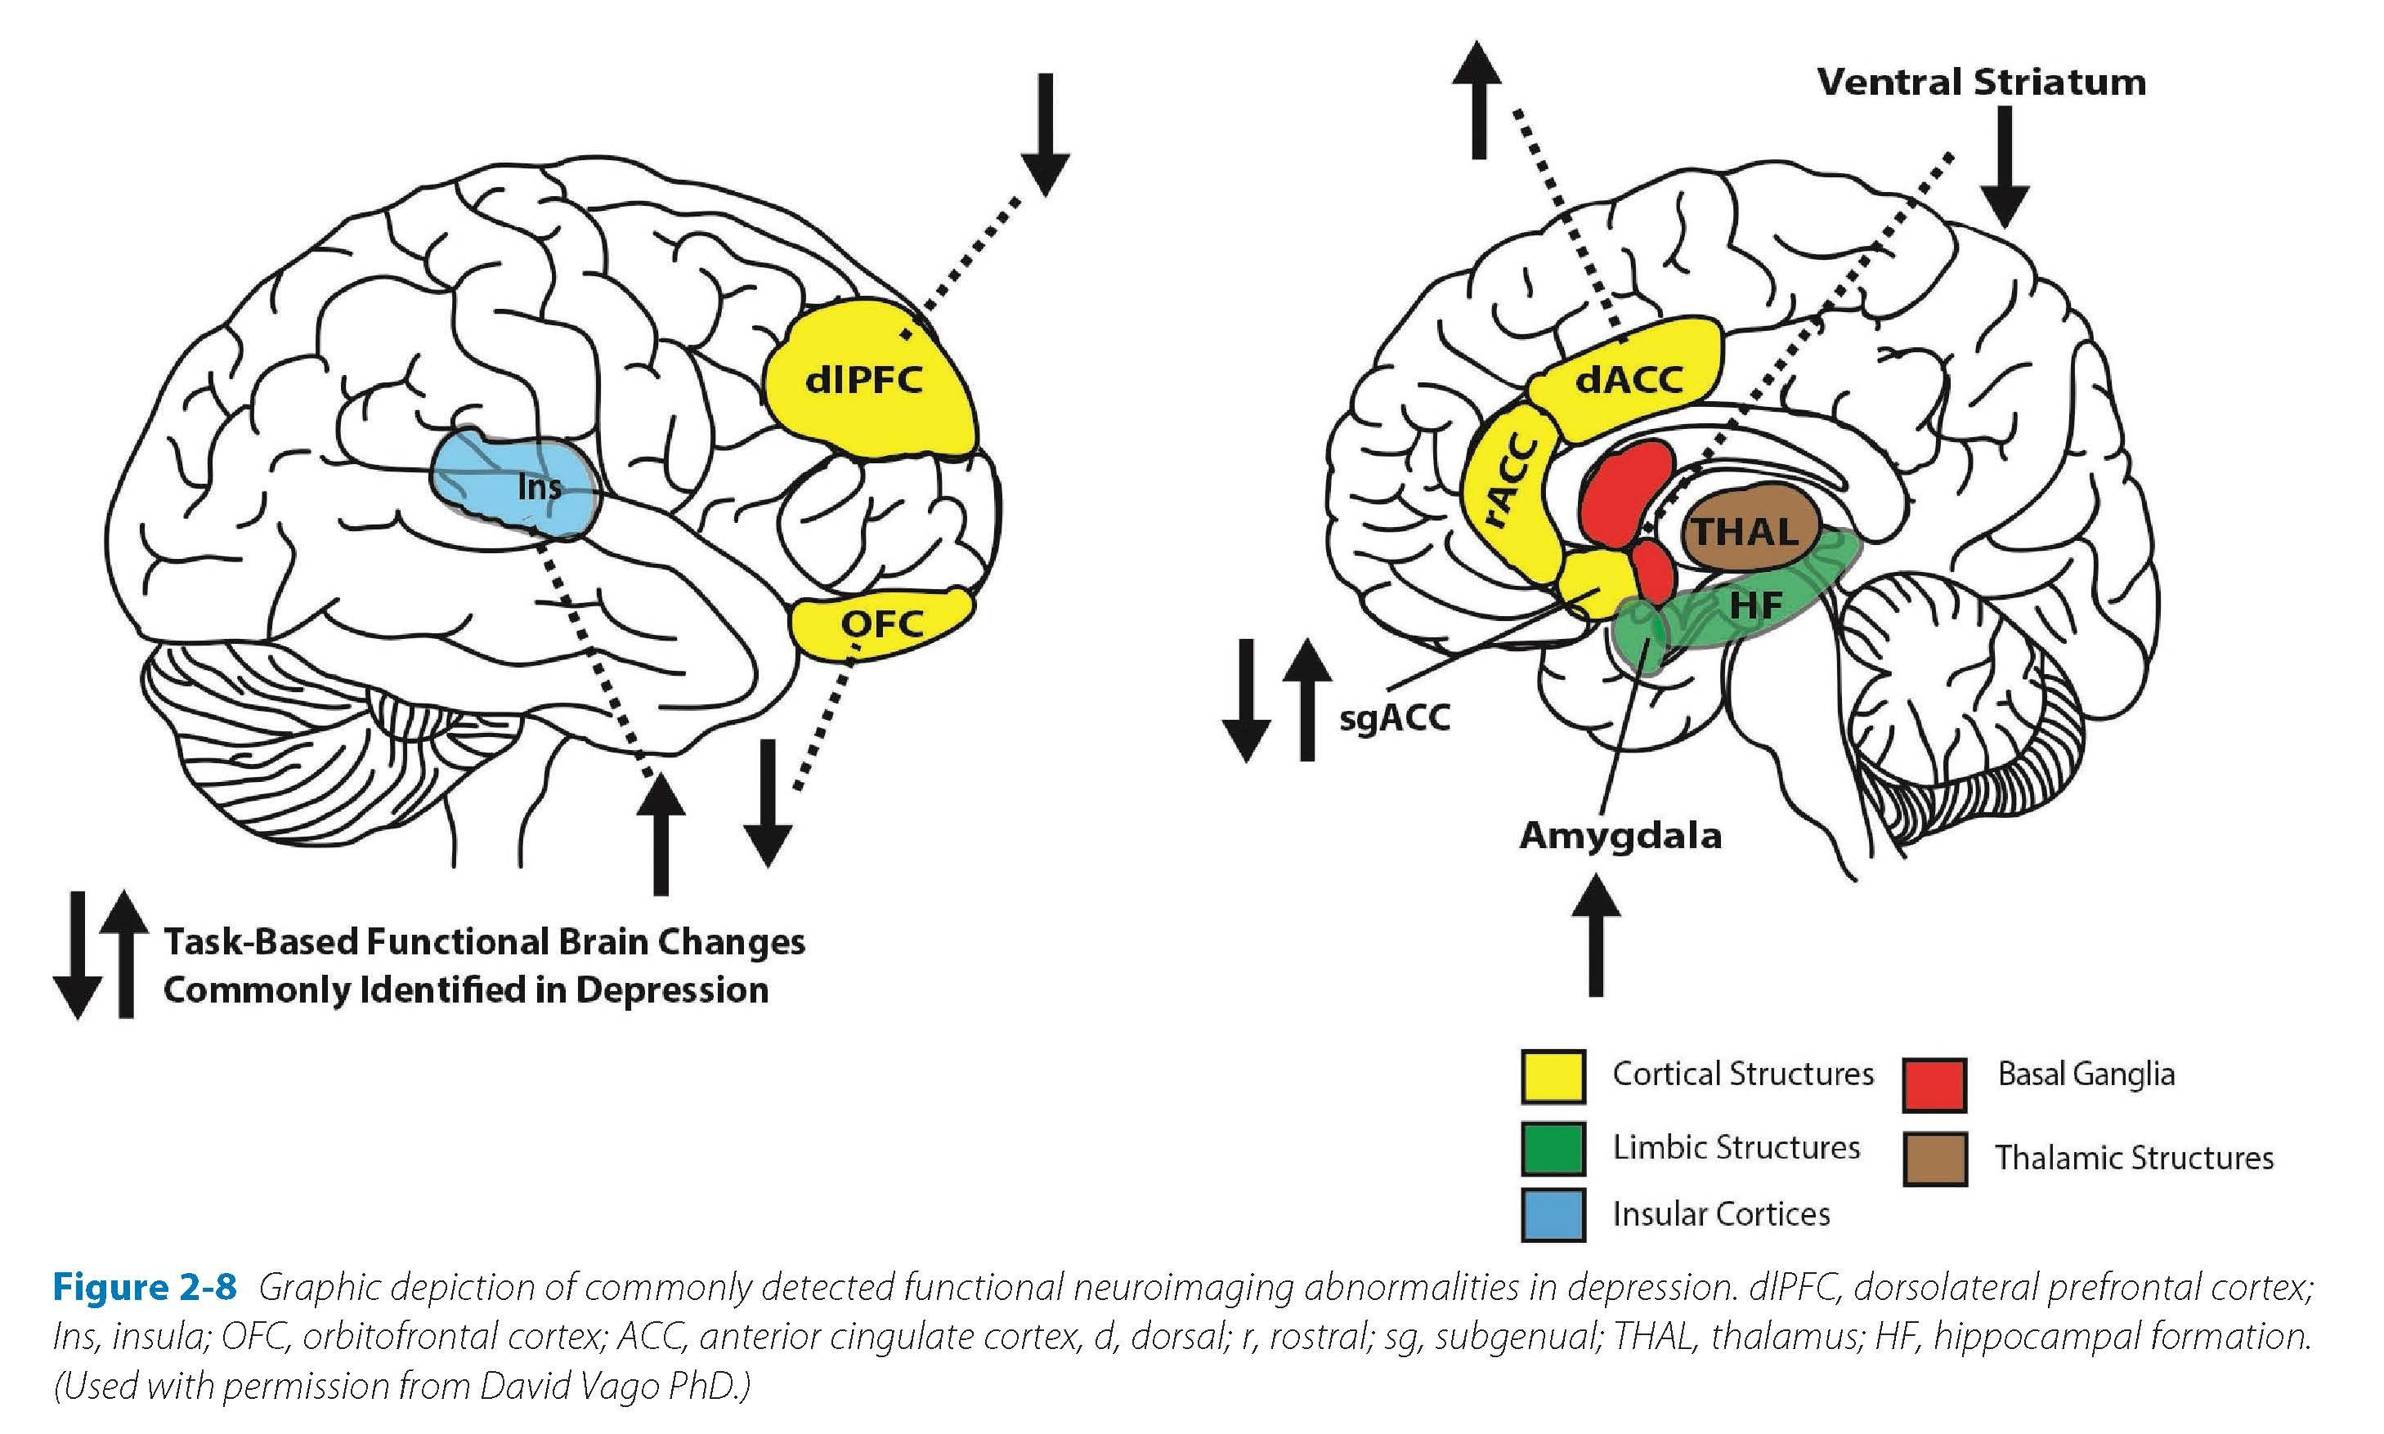
Bursky & Silbersweig, 2024)

Slide 49
Tom and Identity (and some other stuff)
Tom
Outcomes
1st Idea: I’m never going to school, I’ll just get a GED at some point.
2nd Idea: Graduate from an adult ed course – it’ll help me learn to be a student again.
3rd Idea: Make a school plan
Outcomes:
0 incidents of problem behaviors
95% attendance in HS upon return
Completed diploma/graduated
Started a punk band (they suck)
3rd year at NVU – studying engineering

Slide 50
Your “Me”
My “Me”
The “Me” I
Want to Be

Slide 51
We're blind to our blindness.
We have very little idea of how little we know.
- Daniel Kahneman
  The Dunning-Krueger Effect is (probably?) real – and applies to us all.
  Useful evaluation is ongoing, individualized, collaborative and context sensitive
  Assessments are done to satisfy a statutory or fiscal requirements, evaluations are done to determine the effect of what we’re doing.
  “Weighing a pig doesn’t make it any fatter.” – John Dewey, 1919

Slide 52
TOM AND IDENTITY
Their “Me”
My “Me”
Autistic Kid
“Brain Injured”
“Weirdo”
Bad with people
Smart
Hard to be with
Smart
Loaner
Unappreciated
Happy to be angry
The “Me” I
Want to Be
Smart
Recognized
Helpful
Family’s pride
College student
Dog owner
PRODUCER PROJECTS:
Math tutor
Help a neighbor farmer
Start a chess tournament
Volunteer at shelter
Build solar panels

