Slide 1
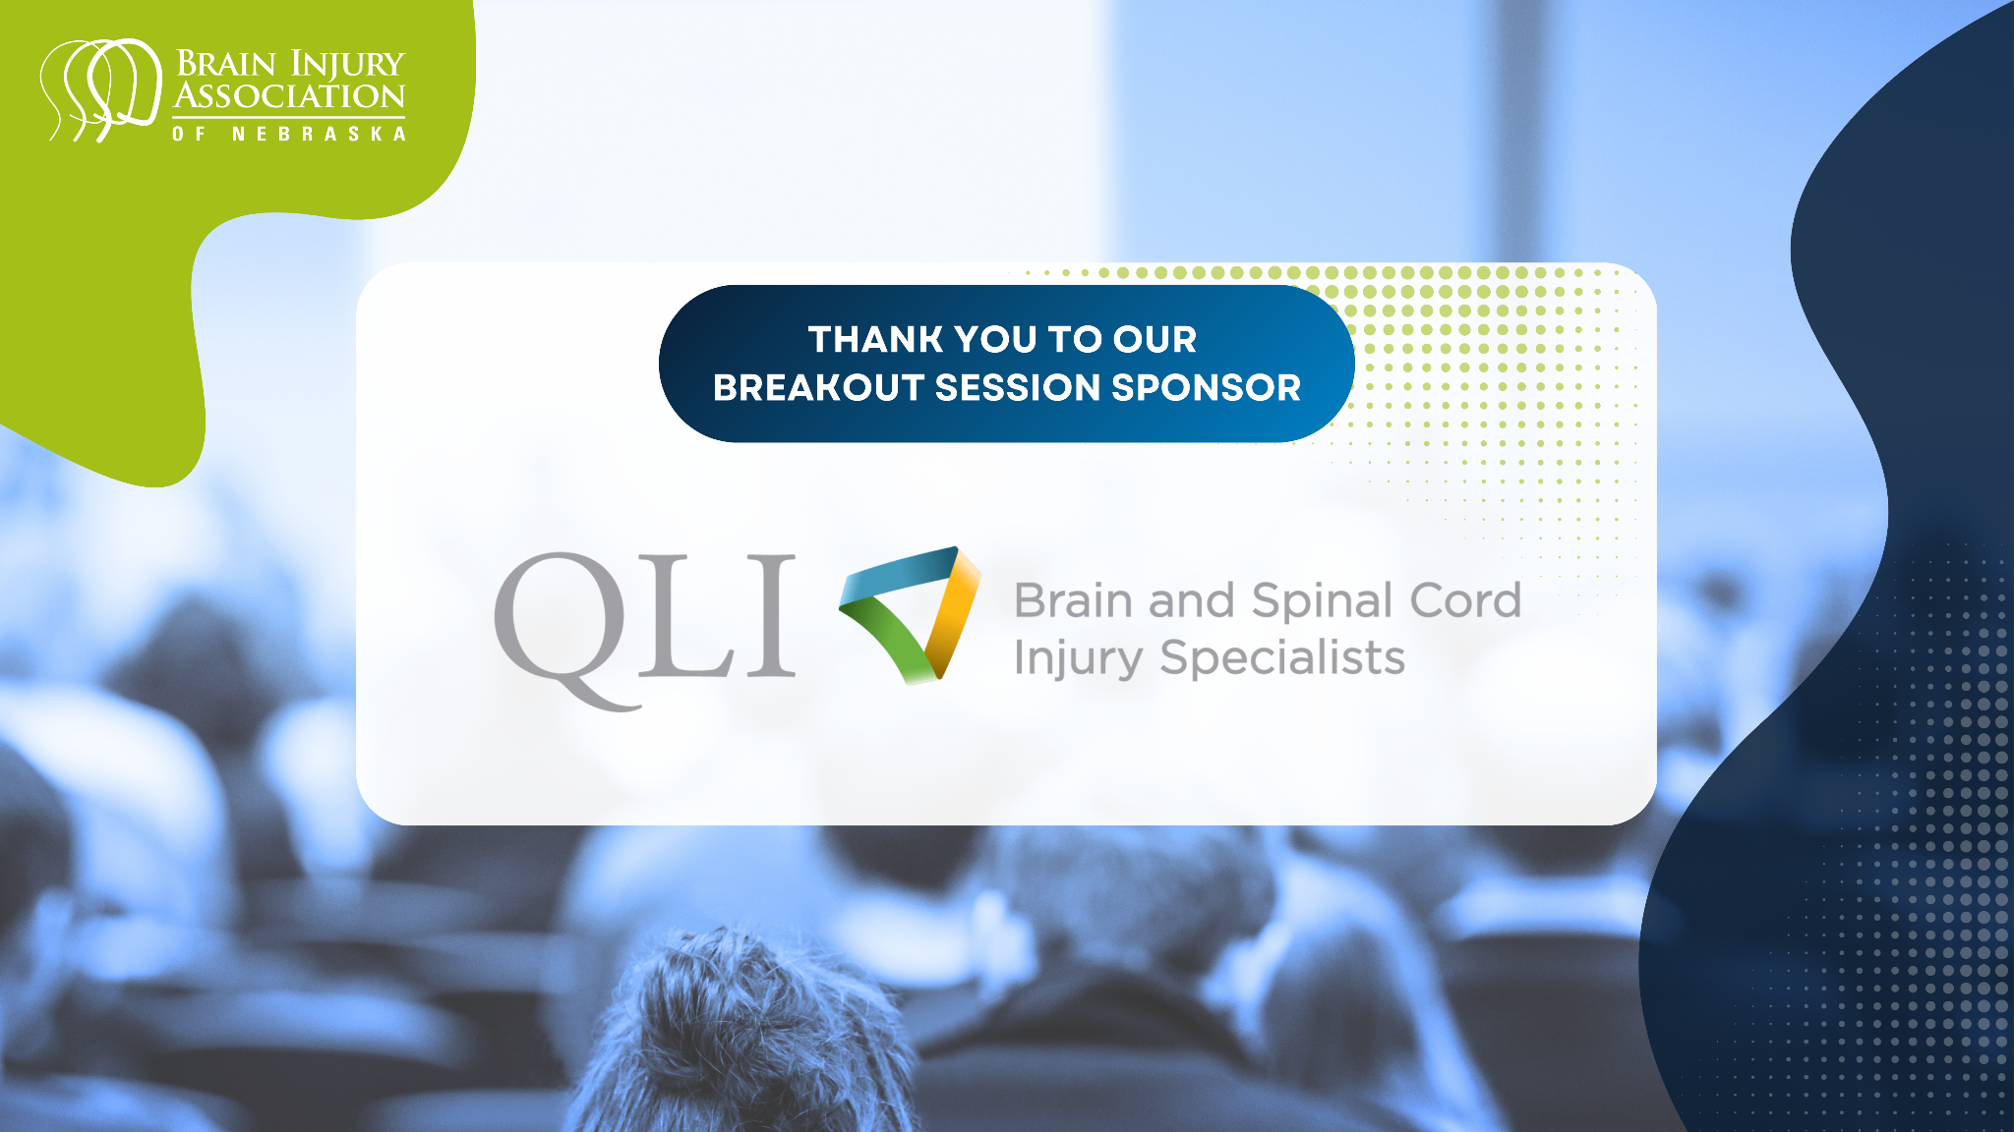

Slide 2
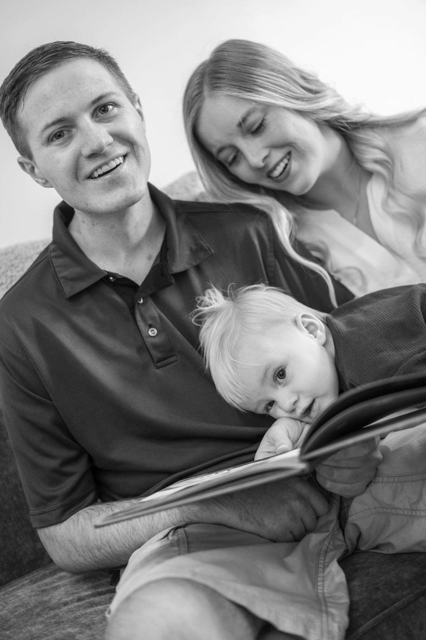

Sexual Health:
Let’s Talk About Sex…No Really, Let’s Talk About It.
QLIomaha.com @QLIrehab
Notes:
LAURA—BRING SPEAKER?
LET’S TALK ABOUT SEX playing over speakers- do we want this and how to incorporate
Family Services roles-about 40 years with residents and last 8 or so specifically with family members and supports…in that time we see our own teams ebb and flow with their comfort level with this topic,
we ourselves are not sex therapists or sex educators but feel strongly that the topic of sexuality is a piece of who we are as human beings, and central to who we all are…
if we are committed to our residents and families we need to be committed to their whole being, and in such, integrate this topic into our work, just as we do their morning routine, their bowel programs, etc.
we are holding the assumption that we are here today bc we believe this topic is important and that sex matters- but this topic always carries weight
- be kind to yourself- think about ppl who you might connect with after the presentation should tough feelings arise
-ask people to have open minds moving through this topic
our interests in relationship to sex may not be the same, but that doesn’t mean they aren’t valid…

Slide 3
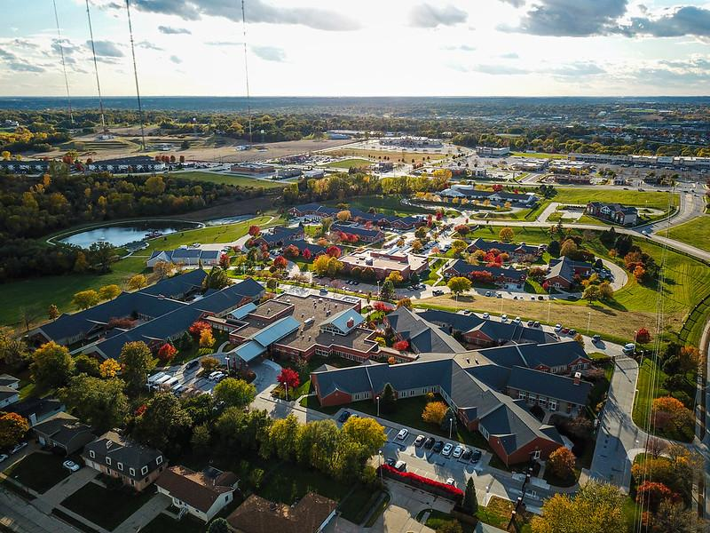
QLI
Omaha, NE
Post Acute Rehabilitation and Outpatient Telerehabilitation
Traumatic Brain Injury
Spinal Cord Injury
Chronic Pain
Limb Loss
Stroke
Notes:
LAURA
QLI is located in Omaha. We have been around since ____ and rehabilitation services to individuals with TBI, SCI and stoke, primarily. As we mentioned briefly, we work very collaboratively with the other members of our rehab teams, including PT, OT, SP, nursing, and our Life Path colleagues who focus on getting people back to life which fits in very well with incorporating sexual health….

Slide 4
Objectives
Increase motivation and competence in addressing sexual health
Identify and acknowledge potential biases
Destigmatize myths surrounding sexual health
Review models that promote sexual health
Increase comfort of the entire support system
Increase familiarity with relevant resources
Notes:
WENDY
A few goals today:
-feel a little more competent talking about sexual health and less intimidated perhaps
-spend some time thinking about our own stuff-we all have our own biases that may impact our approach to sexuality after injury
-explore some of the myths that surround this topic
- touch on a few models that we can use to promote sexual health
- get more comfortable with the idea of being “the who” to discuss it
-share a few resources
----------------------------------------------------------------------------------------------------------------------------------------------------
Let me ask you this…
How many of you have sat in a meeting with a resident, often with their loved ones…maybe even a case manager, there are likely team members lined up along the wall listening with great focus as we discuss the great progress in their bowel programs or continence- EVERYBODY Poops-and everybody is a sexual being- wouldn’t it be nice if we could get to a place where we are more confident and at ease in supporting people in their sexual health and wellness as easily?
Let’s dive in…

Slide 5
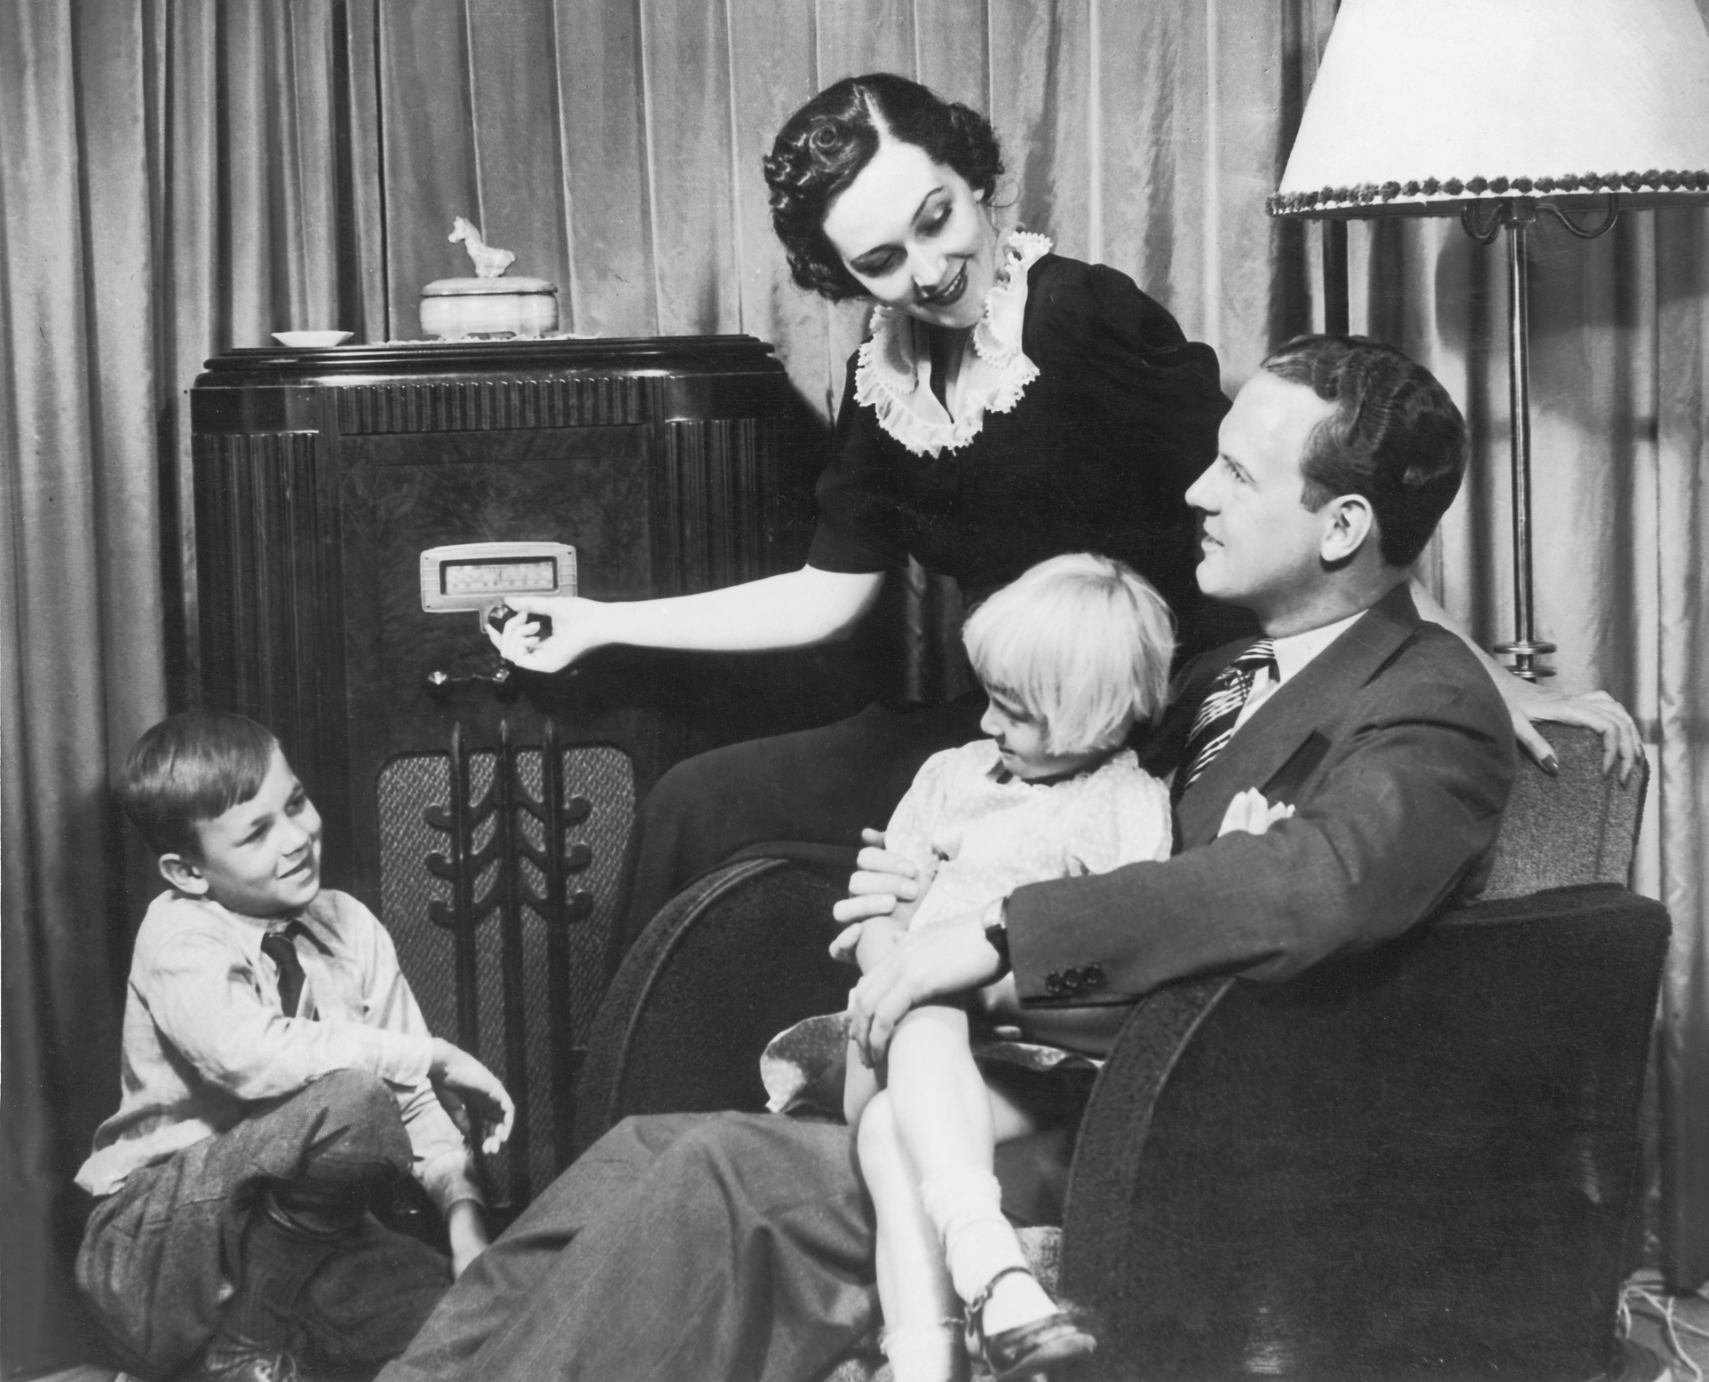
Normal Sexual Intercourse
1926
2 sexually mature people of opposite sexes
Voluptuous sensations
Ejaculation of semen into vagina
Nearly simultaneous orgasm of both
Th. H. Van de Velde, M.D. Ideal Marriage It’s Physiology and Technique
Notes:
LAURA
Th. H. Van de Velde, M.D. Ideal Marriage It’s Physiology and Technique
normal sexual intercourse…takes place between
2 sexually mature individuals of OPPOSITE sexes…
Voluptuous sensations
Concluding with the ejaculation of the semen into the vagina
WITH THE NEARLY SIMULTANEOUS CULMINATION or orgasm of
BOTH Partners
A lot to live up to!! ;) very narrow, may lead one to feel broken, inadequate if this is not what things look like.. We tend to be very intercourse and orgasm focused – the mechanics are important, but for the purposes of our conversation today we want to expand even further…

Slide 6

“
Sexual health is a state of physical, emotional, mental and social well-being related to sexuality; it is not merely the absence of disease, dysfunction or infirmity.
World Health Organization
Notes:
LAURA
For the purposes of today we may use the term Sexual Health as an umbrella term including:
emotional intimacy
Human connection,
Love, relationships, dating
self esteem, body image, confidence
Gender expression and identity
Reproduction/fertility
- So let’s shift now to the why…

Slide 7

Why SHOULD we talk about sex within the context of recovery and rehab?
Notes:
WENDY
Why Should We Talk About Sex?
As Laura commented, we know that that purposefully including sexual health is consistent with the whole-person, back-to-life philosophy that we value at QLI.
We should also talk about it, b/c the individuals we serve, people going through recovery after injury, tell us that it’s important to them and this is backed up by research.
As an example, in a recent study out of Sweden (Ek, Holmstrom, & Elmerstig, 2023), individuals w/brain injury were surveyed about sexuality post-injury—with the vast majority (91%) indicating the importance of sexuality in their lives and relationships. On the flipside, only a small percentage of these individuals reported that sexuality was addressed as a part of their rehab experience. Numerous other studies report similar findings with most people after injury wanting issues of sexuality—from sexual function to navigating relationships and intimacy—that broader definition of sexual health that Laura talked about---addressed in some manner as part of their rehab program.
Independent of dx (TBI,SCI, other life changing diagnoses e.g., in cancer survivors), sexuality and intimacy are brought up as important quality-of-life factors by most.
across demographics-independent of gender
whether partnered or not
independent of age
So, we should talk about sex b/c people are looking for guidance on how to navigate sexuality and relationships after injury.
Likewise, healthcare professionals also tell us that addressing sexuality as part of a comprehensive rehab program is important. Studies focused on the perspective of clinicians, show that we agree that sexuality should be a part of a whole-person centered approach to rehab and recovery. In an international study from 2017, 97% of the 324 rehab professionals surveyed thought that sexuality issues should be included, but only about 36% did include information about it with their clients.
A couple of years ago, we did a really informal study at QLI with our own clinicians and found very similar results—that we feel addressing sexuality is very important but things were getting in the way of consistently including sexual health as part of our rehab programming.
Now, Laura, I can’t imagine what those things would be….Our society has such a healthy approach when it comes to talking about sexuality, right? Like if you think back to sex ed in school, I’m sure it was a beautiful, comprehensive learning experience. Maybe something like this?

Slide 8
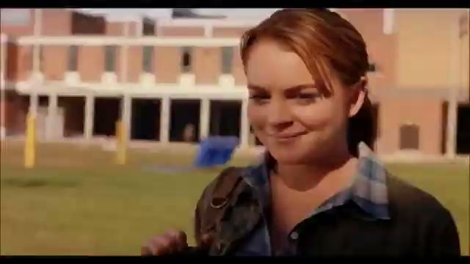

Slide 9
Recognizing the Challenges
Personal/Societal Factors
Professional Interferences
Cognitive Interferences
Notes:
Laura- very brief here just taking note that there are plenty of reasons this is not easy- lets explore a few of the barriers that could be holding us back …

Slide 10
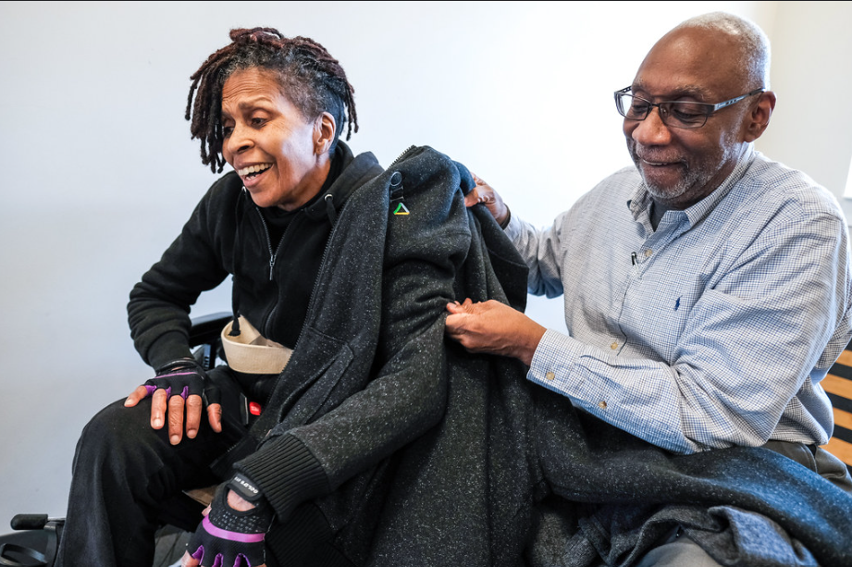
Personal/Societal Factors
Notes:
Personal interferences-
Potentially, lots of conflicting messages.
We all have our own history/our own stories re: sex and the messages we received about our bodies and sex in all kinds of environments-
-be a lady in the streets BUT freak in the sheets
-you’re damaged goods if you’ve got multiple partners or a slut if you like it BUT inadequate/frigid or a prude if you haven’t mastered every position, don’t watch porn or have a vibrator…
- don’t criticize your body… BUT if we love and accept our body we are conceited
- don’t talk about it, acknowledge it, you will die! BUT here’s a condom.
Pretty damn confusing!
it is likely most of us are uneasy about this topic and given all of this- it makes sense -at the beginning of this presentation did you find yourself feeling uncomfortable when you heard word “ejaculation”?,
whats our comfort level with the language around sex and sexuality? One of the first steps to supporting others- be mindful of our own “stuff”
negative sexual culture has trained us to be critical/self critical- our own insecurities may interfere with our own sexual well being- nonetheless the support of someone else’s… we carry so may conflicting messages about sex and sexuality as un-injured beings…imagine what it might feel like for the newly injured person…now navigating a different body after sci/stroke/ tbi.
recognizing our own responses can help us come from a place of openness…
… neutrality, non judgmental stances to others-…there is no “normal” when it comes to sex and sexuality-your body,again- your interests (so long as all participants are consenting) are valid-

Slide 11
Professional Interferences
I’m Not an Expert
Time Constraints
Lack of Organizational Support
Notes:
these interferences likely sound familiar – because they did for us- even in putting together this presentation wendy and I struggled with how we can stand up and talk about a topic we didn’t feel like experts in – we aren’t sex educators/sex therapists, but
- we are hopeful that by the end of today you will start to take some of this pressure off…and that you might feel (like we did) the reassurance that we don’t have to be sex educators/therapists to be supportive- -simply opening the door can help normalize and validate our residents and patients.
-We ARE “the who” ! And actually, sex educators can’t do what we do- shout out to you speech therapists, nurses, physical therapists and OTs, RT’S…, and what you do every day- promoting independence in real world settings.
TIME CONSTRAINTS
- this is real- we don’t want to minimize that people in all areas may feel stretched for time this only drives home further the idea that sexual health should be an integrated, multidisciplinary approach within our teams–not solely falling on one individual or team (more on this later)… if addressing the whole person results in better outcomes-there is value in committing the resources up front on resources, training, and becoming more skillful in these areas…we commitment will be well worth the investment.
goal here is we are not taking this on alone as one individual but that we’ve all got sexual health in mind and we work together- this should bust up that time constraint barrier
So think about a starting point- how might you both individually as a professional, as well as within your team take a step in the direction of integrating sexual health into your programs

Slide 12
Cognitive Interferences
How will the individual/family perceive the discussion?
I’m planting ideas in their head
It’s too early
Notes:
-Research shows some professionals are avoiding the topic bc of a worry that the patient or family may view them as offensive should they bring up the topic- maybe the provider and patient are of opposite sexes or younger in age…others fear that bringing up the topic may someone “put the idea in their head”…
The research ALSO shows as wendy touched on- people are thinking about it whether we ask and talk about it or not- they want and need a safe space to ask these questions and find information to navigate this
WE want to promote a safe space to ask questions or be supported around sexuality…we’ve had plenty of residents who even with impulsivity and cognitive impairments have with support found safe/healthy ways to express or explore sexuality after injury…support, or environmental structure to navigate things. We are doing a disservice not to address it.
Our experience is that people are on a continuum when it comes their desire to address this in rehab/after injury. Timing may be a factor…we’ve had family members share that it was the last thing on their mind and they aren’t near the point of wanting additional information, and others who noted they had been intimate in the ICU well before coming to QLI- runs the gammet…don’t assume, and let the resident/patient if able, or family/support person guide you.
its never to early to normalize that we sexuality is part of who we are as humans, and it’s ok to ask questions/talk about it…
….what’s the worst that can happen- most people are appreciative that the question was asked, even if they are not ready or interested in discussing it…also provides that permission to come back to the topic at a later time if and/when they are ready

Slide 13
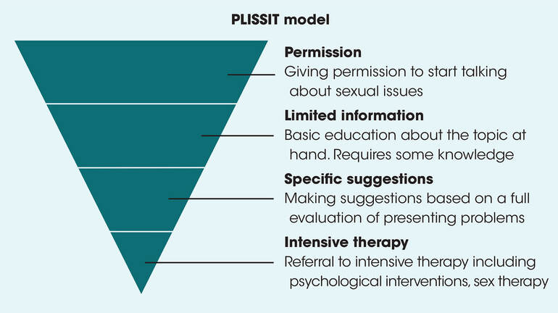
Conversation Frameworks
The Permission Framework (PLISSIT & Ex-PLISSIT)
Notes:
WENDY-do we rename “Talking About Sexual Halth or do we like c’sational framework?
Image URL: https://otguidetosexualhealth.weebly.com/addressing-sexuality.html
Ex-PLISSIT model makes the framework cyclical by continuing to ask for feedback and confirm permission to continue the conversation.
Conversation Frameworks – The Permission Framework
The PLISSIT framework is a widely used model to guide sexual health conversations in rehab. It helps clinicians provide care at the level they are comfortable with, while still addressing patient needs.
Permission (P):
The first step is simply giving the patient permission to talk about sexual health.
Normalize the topic and let them know it’s safe to discuss concerns without judgment.
Limited Information (LI):
Provide basic, targeted information relevant to their injury or situation.
This could include education about physical changes, safety, or normal sexual function post-injury.
Specific Suggestions (SS):
Offer practical, individualized strategies tailored to the patient’s goals, abilities, and context.
Examples include positioning strategies, communication tips, or adaptive equipment recommendations.
Intensive Therapy / Referral (IT):
Some patients may need specialized intervention beyond the clinician’s scope.
Referrals could include sexual health specialists, psychologists, physicians, or other team members.
Key takeaway:
The PLISSIT/Ex-PLISSIT framework gives providers a stepwise, safe way to address sexual health without overstepping boundaries and ensures patients get the right level of support.
Ways to gain permission:
Mention that the presenting condition may impact sexual activity
Ask permission to discuss the topic
Give permission to discuss the topic
Listen
Be direct, but appropriate with language
Consider patient’s body language
Feel personally comfortable or don’t bring it up
Limited Info:
Effects of Injury
Medication interactions
Sexual response cycle
Anatomy
Providing general outlines
Specific Info:
Based on what they are wanting info on – period management, positioning, tools/devices, specific medication that can help,
Intensive Therapy – this is referral out to sex therapist, pelvic floor therapist, another specialist like urologist
Before sliding in levels of the model, say this:
Recognizing that there are real challenges,…
How Do We Talk about Sex? Existing models can help be our guide. One model that we have found helpful is the PLISSIT model created in the 1970s by Jack Annon. It was intended for sex therapists, but is a great framework to use when addressing sexuality, in general. So again, we do NOT have to be sex experts to use PLISSIT. The simplest way to describe the PLISSIT model is that it provides a way to introduce sexuality as part of rehab.
Overview: The PLISSIT model refers to four different levels when addressing sexuality: Permission (P), limited information (LI), specific suggestions (SS), and intensive therapy (IT). We’ll talk about each level briefly, but focusing more on Permission as it is what we want to achieve with everyone we serve which is to give permission to talk about sexuality and normalize it as a topic after injury as important as any other facet of rehab.
If we had 100 people…--
most are going to have issues related to sexuality resolved at the PERMISSION level. Again, at this level, we are opening to door to address sexuality as part of the rehab process, normalizing it—we’ll give some specific examples of how to open that door on the next slide, but many people may respond with …
Next, LIMITED INFORMATION-let’s say about 50 people may best at this level where we are providing limited information related to their injury, if they have questions and want to further discuss. Could be providing some resources-websites, written info, etc.
SPECIFIC SUGGESTIONS:
More of a problem-solving level—around 20 out of that 100 may be trying to figure out things and asking questions. Examples might include questions about Positioning options or how to manage a catheter during intercourse Could also be helping someone problem-solve how to best use dating websites—what information to share, etc.
INTENSIVE THERAPY-only a handful of people are going to land here and this is where it makes sense to refer to a sex therapist (more persistent mental or emotional aspects of sex-related issues such as communication between partners, sexual trauma, etc)
M&M’s:
100 people- many can resolve with permission-
50- need limited info
20- specific suggestions
Only a Handful need intensive therapy
Slide takeaway:
PLISSIT model offers some guidance and breaks down ways we can talk about sexuality
Some description of the descending design of the PLISSIT model? The shape of this model indicates that most people most people will identify at the levels of Permission and Limited Information, much fewer for Specific Suggestions and a small percentage at the Intensive Therapy level.
Additional models out there to mention that reinforce some of the concepts we’ve already touched on:
EX-PLISSIT model
Extension of the PLISSIT model expanded in 2006 by Taylor and Davis.
Focus on permission as a central concept, so with any conversation about sexual health with your client, asking permission throughout.
So, more of a dynamic and not so linear as the original PLISSIT model.
Reviewing and reflecting are concepts that are included in the EX-PLISSIT model and includes reflecting on our own awareness of where we’re regarding topics related to sexual health.
EX-PLISSIT Model (Taylor & Davis, 2006)
Recognition Model (Couldrick, Sadlo, & Cross, 2010)
Create “an atmosphere of ‘permissive discussion’”
(Barrett, Ho, & Finley, 2022)
The Recognition Model
Developed by OTs in 2010 (qual study)
Some core concepts of this model include:
Recognizing that all people are sexual beings
Emphasizes a team approach-all clinicians
Create “an atmosphere of ‘permissive discussion’”
Taken directly from a study by Barrett and others in 2022 that focused on identifying what hinders and what helps HCPs addressing sexual health in rehab
Including sexual heath as part of assessments, like we would any other area
Sexuality resources that are readily available and accessible for clients
books, videos, etc that clients can access on their own
offered at multiple times, as part of assessment, during, and at d/c
and anything that will embed and normalize sexuality education into our organization and culture. SO HOW ARE WE INTERGRATING SEXUAL HEALTH THROUGHOUT REHAB PROGRAMMING?
This is something that we feel is worth exploring…how DO we create an atmosphere of “permissive discussion” at QLI? This is something that we hope to continue to pursue…
Slide takeways from our perspective:
The Ex-PLISSIT and Recognition Models reinforce some of the concepts we have already touched upon.
The importance of addressing sexual health as part of service delivery (rehab/intervention after injury). Normalize it!
Permission-giving that sexual health is an important part of a holistic approach to rehab and service delivery and we as clinicians need to actively bring up sexual health while also respecting the privacy of the individual.
People are sexual beings is an assumption
A team approach-we all have a role to play in addressing sexual health and have areas of expertise (e.g., medically, OT and positioning)
Next, we want to introduce the Tri-Dimensional Model that we use at QLI and provide some concrete examples of …..

Slide 14

Permission
“It’s normal to have questions about sexuality after injury.
If that’s something you’d like to talk more about, or if questions come up along the way”
“How are you feeling about your relationship since injury?”
Notes:
LAURA AND WENDY
PERMISSION-So again, most people after injury will be at PERMISSION level-meaning that they are simply looking for that introduction—or an invitation-- and the message that it is normal to have questions about and talk about sexuality as part of their recovery from injury. We are giving the message that sexual health is part of rehabilitation and a part of getting back to life.
On this slide are some examples of language we can use to “open the door” and there are many more ways to invite discussion about this topic that you all have found effective.
Looking at one of these examples…“It’s normal to have questions about sexuality after injury. Are there any issues that you’d like to discuss?” And depending on where that person is “at” when it comes to sex, they may be “I’m good, thanks” or “great, I’ve been wondering about this and have some questions” etc., Some topics that residents/families might raise could include, ways to emotionally connect after injury, how meds may affect sexual function, etc. I’m sure there are more topics that you have encountered being brought up by residents.
We are giving the message that sexual health is part of rehabilitation and a part of getting back to life.
**foreshadow we have several slides at the end of the presentation with additional scripst- can look through and identify those that feel more comfortable for you, or may be more related to your particular role, etc.

Slide 15
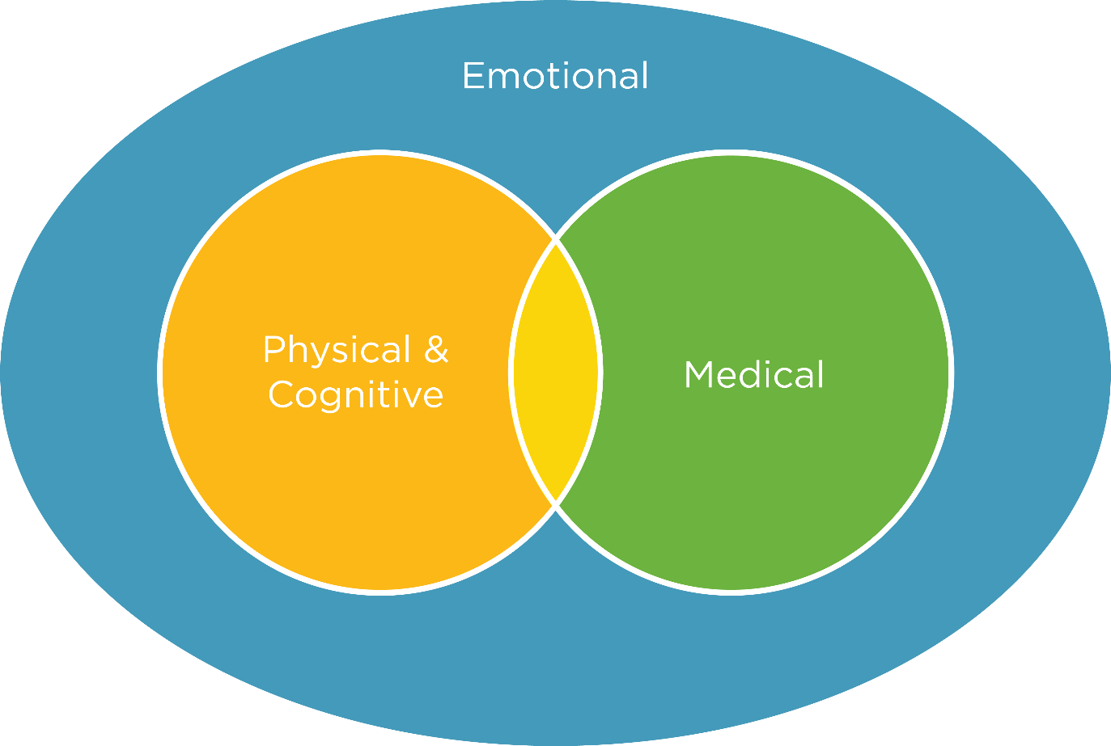
Person Centered Rehab Model
A Multidisciplinary Approach
Notes:
LAURA AND WENDY
we as a collaborative team are always striving to learn more, and certainly in this particular area.. we’re going to chat a bit about some of our experiences supporting others around this topic… we also acknowledge and everyone in this space will have their own experience/models/set ups
Bits and pieces may fit, others may not- hopeful you may find some takeaways that speak to you and your organization
Addressing sexual health is a team approach….and we want to highlight how we incorporate it into our own service delivery model.
Health and safety a key component in our model provided by our medical providers, nurses and Rehab trainers, overlapping with physical and cognitive skill building with our OTS, PTs, etc. but encompassing all we do is the emotional piece of recovery- often spearheaded by our LifePath and Psychology teams- our teams are grounded in our mission to tap into purpose and meaning in the individuals we serve, and to keep this at the core of their therapy program.
As we address the topic of sexual health we are often collaborating and integrating this into multiple disciplines. We will share a few examples of how this might look in our program.
SCI injury case study- WENDY TO COVER
Making a plan with an SCI resident to connect again with his partner. Collaboration with nursing and lifeskills on medication piece- use of Viagra, placement of pills and finding containers that they could access more independently, provide for most dignity- not having to ask for assistance, working with PT/OT on positioning and practicing transfers to regular bed- planning with LPS for time up at family housing to simulate time to connect with partner, have a date day/night, took hoyer up to FH. This was a collab bt dim 1, 2, and 3 in our model
-also note that not everyone has access to a FH- different settings-can start smaller- even in a hospital setting could be more about a focus on providing privacy/offering space, asking if people would appreciate uninterrupted time together. Maybe planning in advance around med times, giving them permission to plan for time together/or for someone simply to have alone time.
#2 Jacki- focus more communication side, aphasia, using her device, and birth control
Not all partners may be on the same page, another example was…
#3 Young Wife and Husband- wife opened up to speech that she was struggling- wanted him to feel supported, wanted, etc. but wasn’t ready for physical intimacy. He was perseverating on it…detail on how we supported both- focus on emoitnoal connection and her being open, yet acknowledging his desires and how can they come up with a plan to work on that intimacy and connection to start in a different way…
Now shifting to someone who was not partnered after injury:
#EC resident- further out from injury, use of social media, dating apps, open about self pleasure, topics covered over a period of time, with a trusted counselor, also within ou structured environment, - physical and emotional piece/focus-
Then shift into self confidence and self image- becoming more familiar with our new body- usually earlier on, a huge piece of what our folks might tbe experiencing- OT examples, managing a catheter, what makes them feel more like themselves, learning to navigate new bodies, hair and makeup, etc.
Then shift into the Sexual Health Team as another tool, before wrapping up with the casey video to close on.
then shift into the Sexual Health team

Slide 16
QLI Sexual Health Team
Building trust
Bringing concerns to the team
Cross-discipline collaboration
Notes:
Who takes this slide? And do we like the content of slide?
Building trust first is critical—patients are more likely to disclose sensitive information if they feel safe and respected.
Flagging issues for the team:
Once a concern is identified, it should be communicated across disciplines so everyone is aware and can provide consistent support... so an example of this might be:
Cross-discipline collaboration examples: individual with aphasia and paralysis
SLPs may notice communication or cognitive barriers (initiation/awareness) affecting consent, while OTs/PTs may see physical challenges impacting sexual activity (positioning, wedges, adapt equipment, etc.)
Working together, the team can develop strategies that address multiple domains at once.
QLI’s Sexual Health Team example:
At QLI, we hold ongoing discussions about improving workflows and supporting sexual health across disciplines.
This ensures patients receive comprehensive, coordinated care rather than isolated interventions.
Key takeaway:
Structured workflows, early screening, trust-building, and open communication help make sexual health a routine, team-based part of rehabilitation, rather than an afterthought.

Slide 17

Notes:
Wendy- roll into the video- Casey
5) Video of Casey- a nice representation of how we might focus on intimacy, connection through functional, real world therapy.

Slide 18
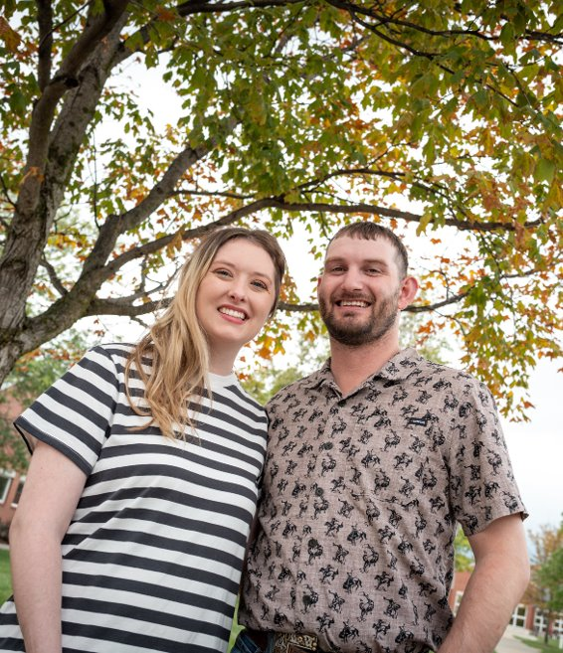
Takeaways
Sexual Health is part of holistic rehab
We ARE the WHO and all disciplines can contribute
Models exist that can guide our conversations
Conversations can be simple, focusing on giving permission
Notes:
WENDY-how do these takeaways fit in to what we have talked about prior? Borrow from Sara and Zoey takeaways on p.30
-spend some time thinking about our own stuff-we all have our own biases that may impact our approach to sexuality after injury. We recognize that this is a process for us all and doesn’t happen overnight, but wanting to keep the conversation about sexual health on the forefront of our minds.
Everyone is a sexual being and how that is expressed prior—and after injury—is individual. Focusing on a broad definition of sexual health that encompasses
emotional intimacy
Human connection,
Love, relationships, dating
self esteem, body image, confidence
Gender expression and identity
Reproduction/fertility
Get more comfortable with the idea of being “the who” to discuss it. Again, it doesn’t mean that you have to have all the answers
Let’s get more familiar with resources, research, and what’s out there to help us get better at including sexual health
Working on this was nerve-racking b/c we are certainly not experts, but was re-energizing about this topic…

Slide 19
Resources
OT After Dark podcast (otafterdark.com)
Cole & Charisma - Youtube (@coleandcharisma)
www.sexualitysci.org
Take Look at this Heart (film)
Facingdisability.com
Come as You Are by Emily Nagoski, Ph.D.
The Ultimate Guide to Sex and Disability by Miriam Kaufman, Silverberg, and Odette

Slide 20
Conversation Frameworks
Gentle Permission Statements
"Many people with injuries like yours notice changes in sexual function. Is this something you'd like information about?"
"Part of whole-body wellness includes intimacy. If you ever want to discuss it, I am here to support you."
"If this is ever something you want to talk about, it's absolutely appropriate in rehab."
"You don't have to discuss it now, but I want you to know it's a safe topic here."
"We care about quality of life, and that includes intimacy."
Notes:
Conversation Frameworks
Sample Opening Lines
TBI/Stroke:
"As part of holistic rehab, we also check in about relationships and intimacy. Would it be okay if we spent a minute on that?"
"Changes in communication can affect romantic relationships too. How has that been for you?"
"Do you feel like it has been harder to talk about personal or intimate topics since your stroke?"
"Brain injuries can affect emotions and relationships. I want to make sure we're supporting all areas of your life."
"Have there been any changes in how you feel about dating since your injury?"
"Partners often have questions too. Would it be helpful to bring them into this conversation?"
"Rehabilitation and recovery can sometimes shift roles in a relationship. How are you both navigating that?"
Conversation Frameworks
Sample Opening Lines
SCI:
"Do you feel comfortable in your body?"
"Are there any parts of your typical morning/hair/makeup routine you wish you could complete?"
"Is your wardrobe important to you? Are there any items of clothing you miss wearing that we should trial with dressing?"
"Do you feel comfortable about your posture and positioning?"
"Do you feel comfortable and confident having open and honest dialogue with your partner about sexual health and intimacy after injury?"
"Is this something on your mind at all?"
"Something tied closely to bowel and bladder function is sexuality. How informed do you feel on this topic and how your injury has impacted it?"

Slide 21
Conversation Frameworks
Sample Opening Lines
TBI/Stroke:
  "As part of holistic rehab, we also check in about relationships and intimacy. Would it be okay if we spent a minute on that?"
  "Changes in communication can affect romantic relationships too. How has that been for you?"
  "Do you feel like it has been harder to talk about personal or intimate topics since your stroke?"
  "Brain injuries can affect emotions and relationships. I want to make sure we're supporting all areas of your life."
  "Have there been any changes in how you feel about dating since your injury?"
  "Partners often have questions too. Would it be helpful to bring them into this conversation?"
  "Rehabilitation and recovery can sometimes shift roles in a relationship. How are you both navigating that?"

Slide 22
References
Annon, J.S. (1976). The PLISSIT model: A proposed conceptual scheme for the behavioral treatment of sexual problems. Journal of Sex Education Therapy, 2(1), 1-15.
Arango-Lasprilla, J., Olabarietta-Landa, L., Ertl, M., & Stevens, L. (2017). Provider perceptions of the assessment and rehabilitation of sexual functioning after Traumatic Brain Injury. Brain Injury 31(5), 1-7.
Barrett, O., Ho, A., & Finlay, K. (2022). Supporting sexual functioning and satisfaction during rehabilitation after spinal cord injury: Barriers and Facilitators identified by healthcare professionals. Journal of Rehabilitation Medicine, 54, 1-9
Bryant, C., Aplin, T., & Setchell, J. (2022). Sexuality and Disability, 40(3), 409-423.
Bryant, C., Gustafsson, L., Aplin, T., & Setchell, J (2022). Supporting sexuality after spinal cord injury: A scoping review of non-medical approaches. Disability and Rehabilitation, 44 (19), 5669-5682.
Couldrick, L., Sadio, G., & Cross, V. (2010). Proposing a new sexual health model of practice for disability teams: The Recognition Model. International Journal of Therapy and Rehabilitation,17(6), 290-299.
Dyer, K., & dasNair, R. (2013). Talking about sex after traumatic brain injury: Perceptions and experiences of multidisciplinary rehabilitation professionals. Disability and Rehabilitation, 36(17), 1431-1438.
Eglseder, K., & Demchick, B. (2017). Sexuality and spinal cord injury: The lived experiences of intimate partners. OTJR: Occupation, Participation and Health, 37(3), 125-131.

Slide 23
References
Ek, A., Holmstrom, C., & Elmerstig, E. (2023). Unmet need for sexual rehabilitation after acquired brain injury (ABI): A cross-sectional study concerning sexual activity, sexual relationships, and sexual rehabilitation after ABI. Sexuality and Disability, 41, 387-410.
Elliot, S., Hocaloski, S., & Carlson, M. (2017). A multidisciplinary approach to sexual and fertility rehabilitation: The sexual rehabilitation framework. Topics in Spinal Cord injury Rehabilitation, 23(1), 49-56.
Fritz, H., Dillaway, H., & Lysack, C (2015). “Don’t think paralysis takes away your womanhood”: Sexual intimacy after spinal cord injury. American Journal of Occupational Therapy, 69(2).
Jorgensen, S., Hedgren, L., Sundelin, A., & Lexell, J. (2021). Global and domain-specific life satisfaction among older adults with long-term spinal cord injury. Journal of Spinal Cord medicine, 44, 322-330.
Spaseska, C., Lynch, C., Joosten, A., & Josefsson, K. (2022). Experience of recently graduated occupational therapists in addressing sexuality with their clients. Sexuality and Disability, 40, 769-783.
Taylor, B & Davis, S. (2006). Using the extended PLISSIT model to address sexual healthcare needs. Nursing Standard, Nov 22-28; 21 (11), 35-40.
Wolford, L. (2024). The SLP sex talk. The SPICE Institute. https://www.spiceinstitute.org/

Slide 24

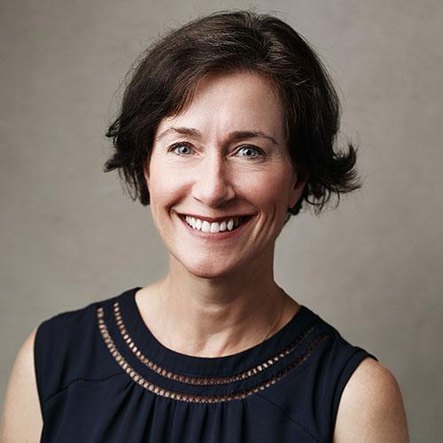
Contact Us
Laura Bergevin
Family Services Coordinator
lbergevin@QLIomaha.com
Wendy Sully
Psychologist
wsully@QLIomaha.com

