Slide 1


Slide 2
Aging with (and without) Brain Injury
Judy Harvey PhD CCC-SLP
March 20, 2026

Slide 3

Judy Harvey, Ph.D., CCC-SLP
Associate Professor of Practice
University of Nebraska - Lincoln
judy.harvey@unl.edu
https://cehs.unl.edu/secd/faculty/judy-harvey-0/
Speaker Disclosure
  I have no financial conflicts with the resources, concepts, or interventions I am discussing today

Slide 4
Learning Objectives
Understand cognitive changes with typical aging
Understand concerns about aging with brain injury
State 3-5 behaviors that contribute to healthy cognition as we age

Slide 5
Spoilers for today’s presentation…
Every common-sense cure you’ve heard of for healthy aging is true no matter if you are aging with (or without) a brain injury …
  Exercise
  Eat a nutritious diet
  Get good sleep
  Socialize
  Try to manage stress
Notes:
Move your body
Use your brain
Eat the rainbow
Get a good night’s sleep
Follow your doctor’s orders to maintain your health as well as you can

Slide 6
Why are we here?
With age, thinking skills (cognition) change
There are NO exceptions!
These changes begin in late middle age and include:
  Slower processing of information
  Memory
  Word Retrieval

Slide 7
Causes of Dementia
60-80% of all dementias are Alzheimer’s type
Alzheimer’s is caused by abnormal protein plagues and tangles
Other causes of dementia include
  Decreased blood flow – Vascular dementia
  Loss of brain cells in the frontal and temporal lobes of the brain – Fronto-temporal dementia
  Build up of proteins in the brain called Lewy Bodies – Lewy Body Dementia

Slide 8
Dementia is not a natural part of aging.

Slide 9
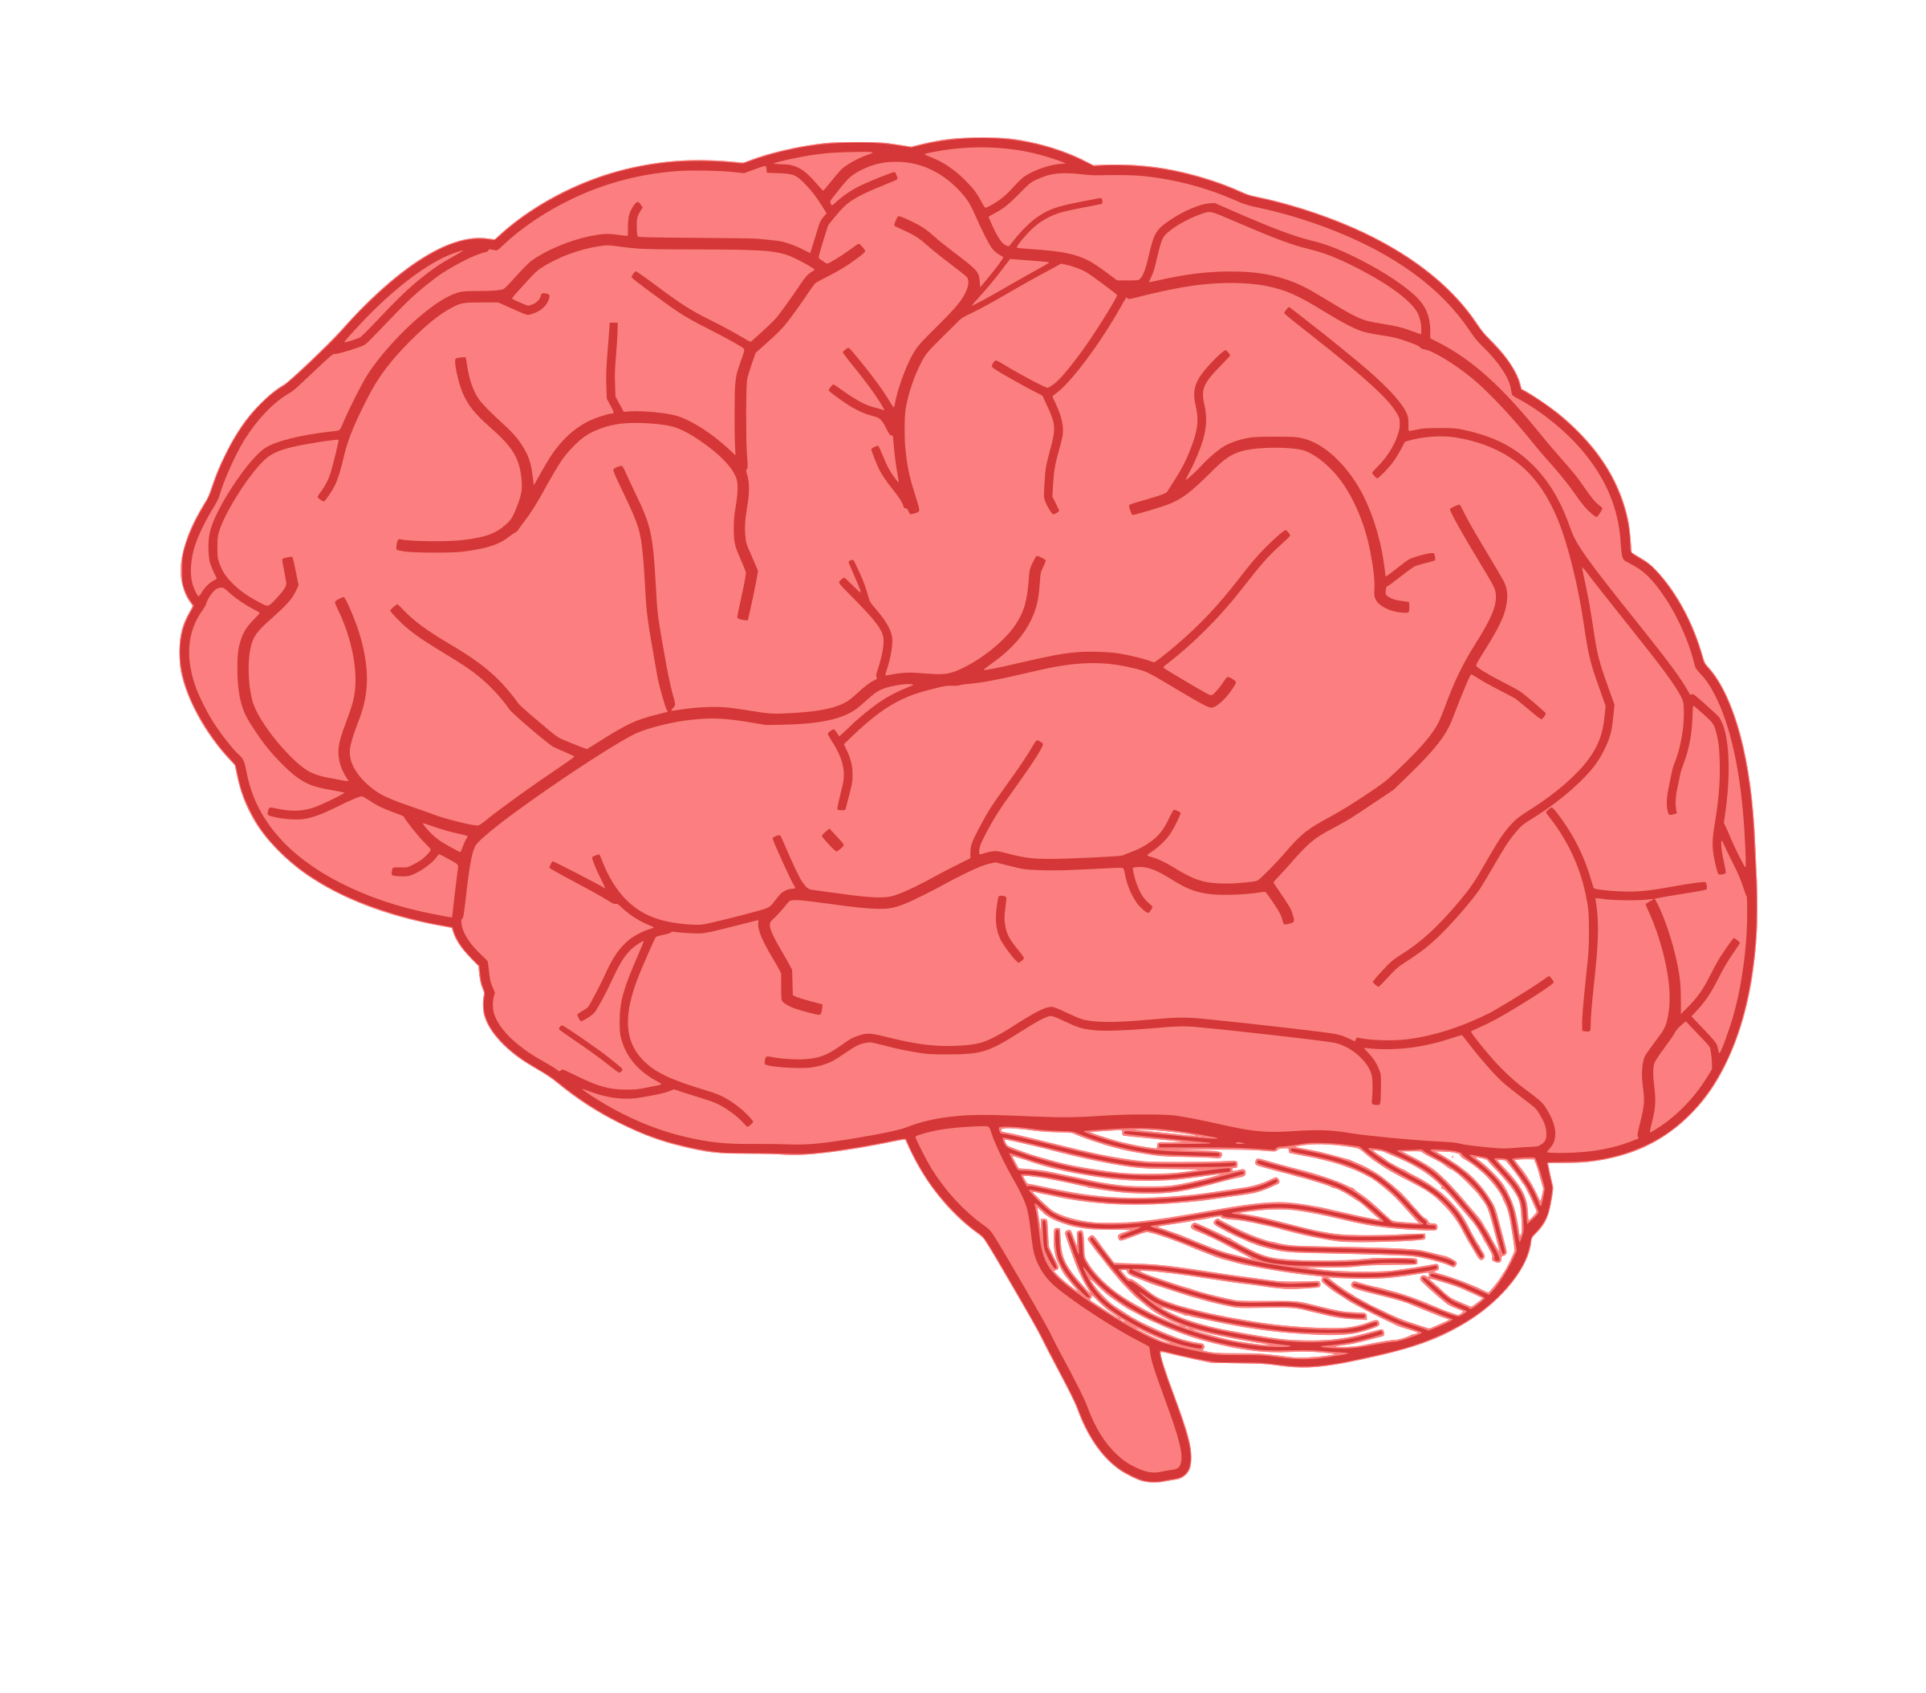
What about aging with a
Brain Injury?

Slide 10
Common cognitive characteristics
Typical Aging | Brain injury | Alzheimer’s Disease
Slower processing of information | Attention | Attention
Memory | Slower processing of information | Slower processing of information
Word finding | Memory for new information | Memory for new information
 | Word fluency and word finding | Word fluency and word finding
 | Executive functions | Executive functions
 | Emotional regulation | Emotional regulation
Notes:
These symptoms vary in type and severity.
No one person with dementia is the same as another
AND with Alzheimer’s and other dementias, they typically get worse with time

Slide 11
Does Brain Injury cause Dementia?

Slide 12

A population at Risk

Slide 13
Statistics and facts
2.8 million Americans acquire a brain injury each year
11.4 million Americans live with TBI related disability
Older adults are vulnerable to stroke and falls
Individuals with TBI have a 4 X higher risk of dementia than individuals without TBI
The proportion of the U.S. population over 65 years of age is growing
TBI symptoms in older adults are often missed, or overlap with, or are misdiagnosed as dementia or normal aging
Notes:
Situationship

Slide 14
Age does not discriminate

Slide 15
Brain Injury and Aging
For individuals with TBI, the cognitive effects of aging, combined with cognitive effects of brain injury, may result in earlier and faster decline in cognitive functioning compared to individuals without brain jury

Slide 16
Age Related Symptoms

Slide 17

Add Dementia to the picture

Slide 18
Brain injury and aging with Dementia
Alzheimer’s Disease is not highly hereditary, although family history is a risk factor. Other risk factors include age, lifestyle, and a gene called APOE
An individual who has a history of brain injury, AND develops Alzheimer’s, is likely to have more severe and more rapidly declining cognitive symptoms like word finding and word fluency.
Notes:
apolipoprotein E

Slide 19
Does Brain Injury Cause Dementia

Slide 20
Brain Injury and risk of Alzheimer’s
Amyloid-Beta and Tau are the proteins that cause neuro-degeneration in Alzheimer’s
All individuals have these proteins.
For some individuals, these proteins accumulate and cause neuro-degeneration
Scientists are learning that both individuals BI and AD are susceptible to the accumulation of these proteins.
Notes:
Veterans study

Slide 21


Slide 22
Timing
Neuro-imaging studies have demonstrated that the protein build up is present many years before cognitive symptoms occur
Individuals may be slowly adapting to brain changes over time without realizing cognitive decline is occurring
The lesson here is start habits of healthy aging before you start to notice decline

Slide 23
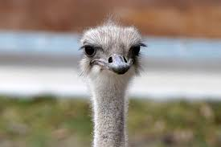
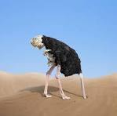
This news seems bad, I’d really rather not talk about it
Notes:
Some folks really don’t want to talk about cognition and aging. Especially if you have dementia in your family, were a caregiver, or see some red flags in your own or a loved on’es behavior.

Slide 24
Not all cognitive changes are due to Dementia
Hearing
Vision
Recurrent TBI
Other medical conditions
Medication interactions or overmedication
High stress levels
Poor sleep
Depression
Notes:
12% of Older medicare beneficiaries with TBI experience recurrent TBI within 5 years
Other med conditions – UTI, normal pressure hydrocephalus are examples

Slide 25
Reasons to talk to your physician about your concerns…
You might be experiencing memory loss because of something other than dementia and it may be treatable
There are several types of dementia that have different characteristics and expected outcomes and treatments to manage symptoms
New medications and treatments are coming out all the time
You may be eligible for an experimental medication trial
You may benefit from adding medical professionals to your careteam (e.g. psychology, physical therapy, speech therapy, dietician…etc.)
Knowledge is power and knowing your medical situation helps you be a part of the decision making

Slide 26
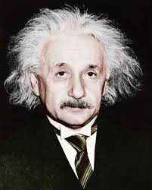
Tips to improve cognition

Slide 27

Cognitive Activity
Hearing
Social Interaction
Family History and genetics
Diet and nutrition
Brain Health
Socio-economic
Status
Physical Activity
Disease
Medication
Education
Stress and Emotions

Slide 28
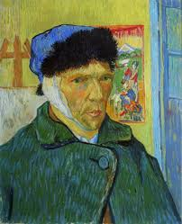
Check your Hearing
According to 2013 Johns Hopkins Study…
“Older adults with impaired hearing had 30-40% steeper declines in cognitive function than those with normal hearing.”
Notes:
It all starts with the eyes and the ears. If you never perceive information, you can’t do anything with it.
Continued research has only supported this finding. Hearing loss is a risk factor for dementia

Slide 29
Think about Attention
Anticipate activities that require your attention
  Cards, noisy restaurants, big social events …etc.
Schedule cognitively demanding tasks during optimal times of day for you if possible
Manage the environment to optimize attention
  Turn off the TV during conversations
  Ask speaker to slow down, repeat
  Take a trusted friend or family member with you to office visit as a “second pair of eyes and ears”
  What else?

Slide 30

Question:
Do computer games and crossword puzzles improve my attention and memory?
Notes:
The answer is yes and no. You get better at any activity with practice. So, your attention and performance should improve on these activites. But the skill does not necessarily transfer. So for instance, if you have concerns about a loved one driving safely. Working on computer games is not going to improve driving skills.

Slide 31
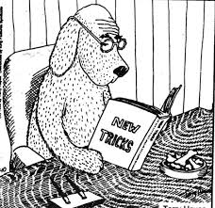
What can I do to improve attention and memory?
Stay cognitively active
Learn new things
Continue to gain experiences
Socialize

Slide 32
Work on Memory
PROCEDURAL memories are habits and routines
They are formed through repetition
PROCEDURAL memories are the most resistant to change in the human brain

Slide 33
Procedural Memory
You likely learned to perfect these activities through repetition…
Tying your shoe
Directions to a familiar place
Playing the piano
What else???

Slide 34
Can you purposefully build and improve procedural memory?
YES

Slide 35

New PROCEDURAL memories can be developed through conscious repetition and rehearsal
Notes:
Sculpt ice
French poetry
Play the pianol
Learns CPR
Also learns empathy, responsibility, and how to make human connections

Slide 36
How to build procedural memory
Be thoughtful – what should be made into a routine (“I always lose my glasses, I can never remember my passwords, I don’t know how to sync my car with my phone….”)
Be purposeful – take extra time to follow your routine
Be consistent – don’t quit. Follow your routine
Make adjustments – if something isn’t working about your routine, make needed changes
Keep trying
Notes:
Studies have shown that individuals with severe AD can learn procedures though routine and repetition in a very prescribed method called “spaced retrieval”

Slide 37
Practice makes…
Procedure

Slide 38

Examples of procedures…
Establishing a “home” for your gadgets (phone, wallet, keys, glasses, cane, garage door opener…etc.)
Taking medications at the same times every day (pair it with another activity you already do, like meals)
Paying bills on the same day of the week
Learning to use a new remote control, phone, app, ….etc.
Set a standing monthly get-together with friends
Introduce a new exercise into your routine or tack a few minutes on
Change one thing about your diet
What else?
Old dog, new tricks

Slide 39
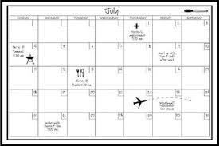

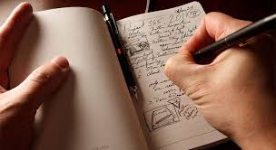
Add this procedure…
Write it down
Calendars and journals not only provide a record and a reminder, they provide multisensory input and generate recall.

Slide 40
A word about words

Slide 41
Word finding
A common complaint of individuals over 50 (it’s actually thought to begin as early as in your late 30s, we just don’t notice it, or attribute it with age at that time)
It is typical for individuals who have not had a brain injury
It is common for individuals who have had a brain injury
It is frustrating
There is no known “cure”

Slide 42
Can’t come up with the word you want
Prime by rehearsing people you might see OR a story or anecdote you might tell at a social event
Use another word
Describe
Ask your listener to help you
Use the alphabet to see if a first letter cue helps
Let it go and come back to it
(and finally….Yell the word out in the shower when you think of it far too late and no one is around to share your success 😊)

Slide 43
A word about stress
Understand that stress may compete for your attention and interfere with memory and other cognitive functions
Manage stress if you can
  Socialize
  Exercise
  Hobbies/interests
  Meditate
  Counseling
  What else???

Slide 44

Socializing is good for cognition!
Engages brain connectivity
Combats isolation
Social engagement shows both immediate and long term effects of cognitive performance

Slide 45

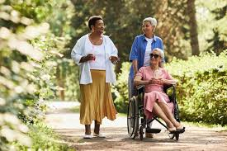


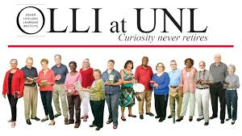
How to be social
On-line support groups
Re-connect with an old friend
Join an in-person or on-line class
Volunteer
What else?

Slide 46
You knew it, but didn’t want to admit it…
A healthy diet and daily exercise is essential to good cognitive health
A Mediterranean style diet is good for your heart and brain
  Rich in fruits, vegetables, whole grains, nuts, legumes, and olive oil, with moderate low fat proteins
There is literally no downside to daily exercise and everyone can start somewhere
  Improves circulation which is good for the heart and brain, helps with weight control, reduces risk of chronic diseases

Slide 47
Can I get therapy for cognitive decline?
Maybe …
Speech therapists may be able to assist with cognitive strategy training
Physical therapists may help with starting an exercise program
Neuropsychological assessment can help determine cause of cognitive decline
Have a goal in mind and speak with your physician
🪄 Remember there is no silver bullet, no magic cure, improving and maintaining cognitive health takes some time and effort

Slide 48
Age happens to all of us with (or without) brain injury
  Build procedures and routines into your daily schedule
  Practice mindfulness
  Journal
  Exercise
  Eat a nutritious diet
  Get good sleep
  Socialize
  Try to manage stress
Remember, even if you have cognitive issues like poor memory, or attention, or word finding… you are still you! Live your life with as much enjoyment as you can!

Slide 49
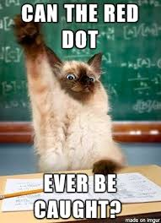
Thanks for Attending!
Questions?

