Slide 1


Slide 2

Smart Technology in the New Era:
Empowering Individuals with Traumatic Brain Injury (TBI)
QLIomaha.com @QLIrehab
Notes:
Today we’ll be discussing how smart technology can empower individuals with traumatic brain injury (TBI) across daily environments.
We’ll focus on practical, real-world tools and technology can easily integrate into daily use.

Slide 3
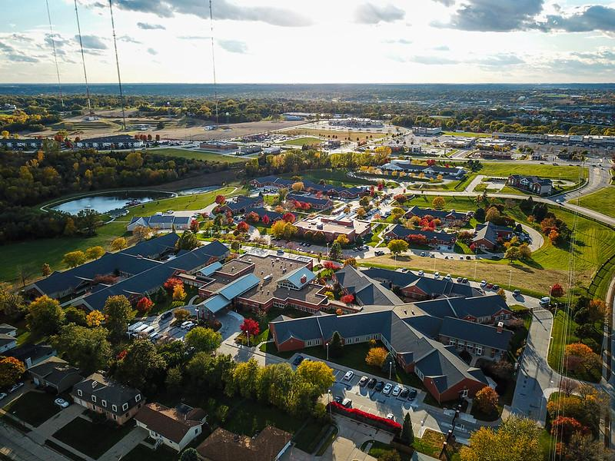
QLI
Omaha, NE
Post Acute Rehabilitation and Outpatient Telerehabilitation
Traumatic Brain Injury
Spinal Cord Injury
Chronic Pain
Limb Loss
Stroke
Notes:
Kelsey

Slide 4

Raise your hand if you've ever used...
Siri
Voice-to-text
Reminders on your phone
GPS
Alexa, Echo Dot
Subtitles
ChatGPT
Notes:
Kelsey --
I want to do a quick show of hands.
Raise your hand if you’ve ever used Siri, voice-to-text, a reminder on your phone, GPS, a smart speaker, captions on a show and/or movie, or AI.
Now keep your hand up if that tool made something easier, faster, or less frustrating.
Congratulations—you’ve just identified yourself as an assistive technology user.
We wanted to start with this to normalize use of assistive technology.
Many of the tools we consider “assistive” are already mainstream.
The difference is not the tool — it’s the intention behind its use.
For individuals with TBI, these tools can shift from convenience to compensatory strategy.

Slide 5
Disclosures
We are full-time employees of and receive salaries from Quality Living Inc., in Omaha, NE.
We have no other financial or nonfinancial conflicts of interest to disclose.
The products referenced in this presentation are shared based on our professional experience and what we have found to work well in practice. We have no financial relationship with, receive no compensation from, and derive no benefit from the promotion of any specific products, brands, or companies mentioned.
All names in today’s case studies have been altered to ensure confidentiality. Permission has been granted to share these cases for educational purposes.
Notes:
Olivia

Slide 6
Objectives
Examine the role of assistive technology (AT) in supporting individuals with traumatic brain injury (TBI) across functional environments, including writing, return to work or school, home management, community participation, and safety.
Identify practical, high-usability AT solutions through real-world case examples.
Implement AT in everyday life for individuals navigating recovery after TBI.
Notes:
Olivia

Slide 7
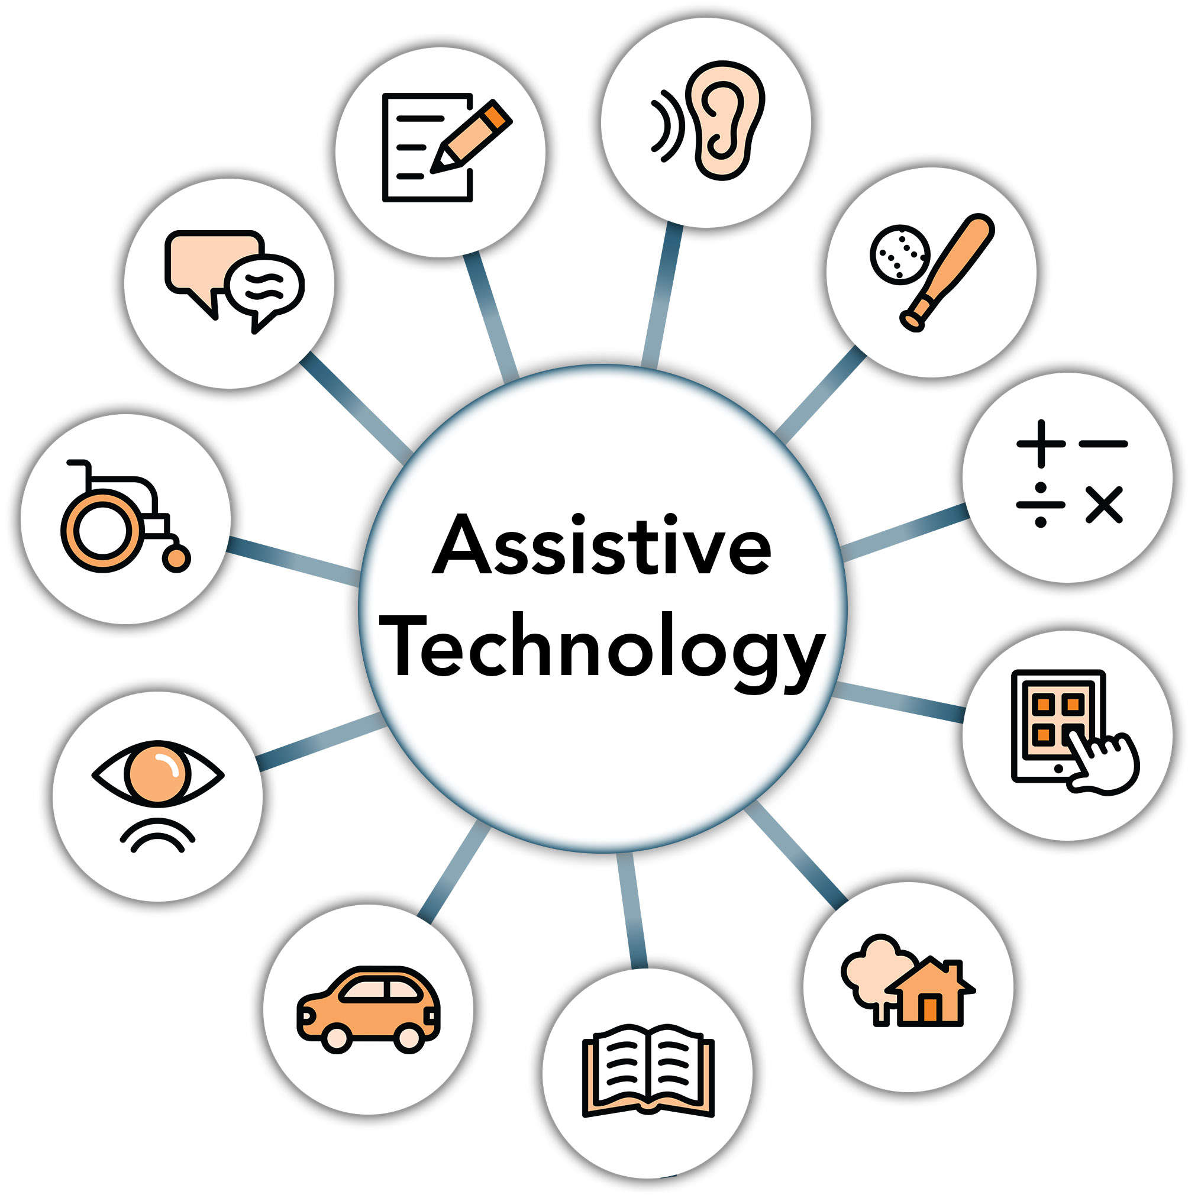
Assistive Technology
Any item, equipment, software, or system that helps people increase, maintain, or improve their functional abilities.
Notes:
Kelsey
Before we get started, we probably need to review the “textbook definition” of assistive technology, so what is it? Any device, software, or adaptive system that compensates for, supports, or enhances functional performance for an individual.

Slide 8
Writing and reading
Return to school and work
Community and safety supports
Home monitoring
Enviromental controls
Recreation
Notes:
Kelsey
Today’s presentation organizes assistive technology into six functional domains. Throughout the session, you’ll see how AT can support individuals across each of these areas – writing and reading, return to school and work, community and safety supports, home monitoring, environmental controls, and recreation.

Slide 9
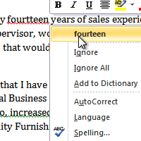
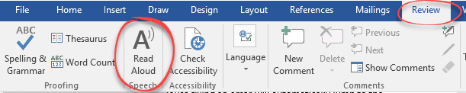

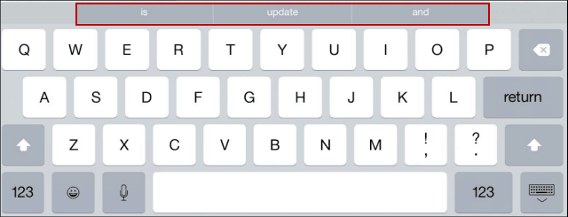
Writing and Reading
Word Prediction Software
  Built-in accessibility feature
  Supports written expression and spelling
  Reduces typing demand and cognitive load
Spelling and grammar checkers
  Provides real-time feedback
  Supports accuracy and independence
Text-to-speech conversion
  Converts written text into spoken output
  Supports reading comprehension, attention, and fatigue management
Natural Reader
  AI integrated
  Converts documents, PDFs, books, and web content into audio to support comprehension and accessibility
Word predication software
Spelling and grammar checkers
Text-to-speech conversion
Reading and writing support (Free/premium plans)
Notes:
Kelsey
Writing and reading can be impacted after TBI due to cognitive fatigue, processing speed, attention, and executive functioning. With these ATs we’re reducing cognitive demand — not lowering expectations.
Word prediction software reduces cognitive load during written expression. This can seen in Word or Google Documents in “Read Aloud”
Built-in spelling and grammar checkers provide immediate feedback — supporting independence.
Text-to-speech helps with reading comprehension and fatigue management.
Natural Reader integrate AI to read multi-formats (reading books, PDFs, documents, scanned physical documents) for an individuals while also supporting different abilities through highlighting text, font size, and playback speed.

Slide 10
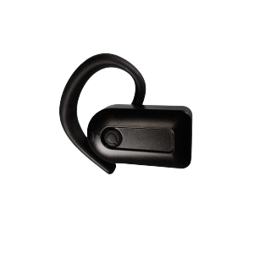
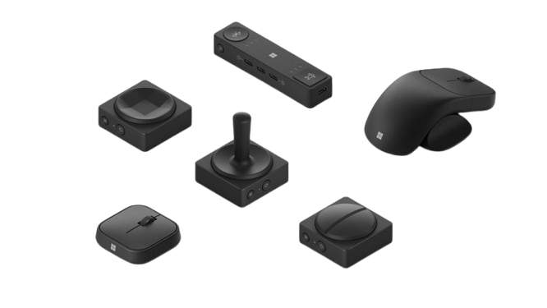
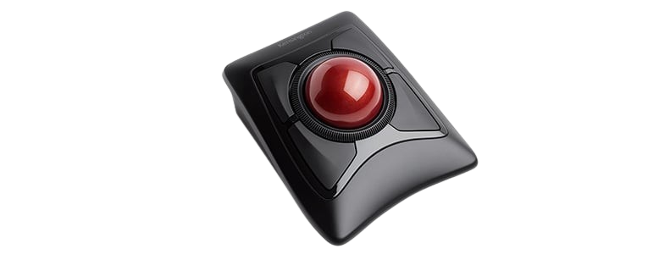
Computer Access
Return to Work/School Tools
Head Tracking
  Variety of products ranging from ear clips to glasses
  Hands Free Operation of Devices
  Bluetooth Connection
  Switch Integration
Adaptive Mouses
  Multiple styles
    Vertical Mouse
    Roller Mouse
    Joystick Mouse
  Programmable and Customizable
Head Tracking ($250-1200)
Microsoft Adaptive Mouses ($15-30)
Kensington ExpertMouse ($95)
Notes:
Olivia
Head tracking devices can be beneficial for many individuals, but a few examples of who I commonly recommend headtracking for are individuals with limited to no use of BUE, individuals that are non-verbal or have speech patterns that voice control does not consistently recognize. Head tracking works as a mouse via blue tooth and follows an individual's head movement to move the mouse cursor. The majority that I use it with pair it with dwell time to select an item, but head tracking can also be paired with a variety of switches, including proximity switches, soft click, hard click, and bite clicks. Most recently I have used it with an individual with a dual diagnosis of an SCI and a TBI. He uses it for complete iPad navigation and AAC. Head tracking can work with PC, Mac, cell phones, and tablets (as long as they have blue tooth)

Slide 11

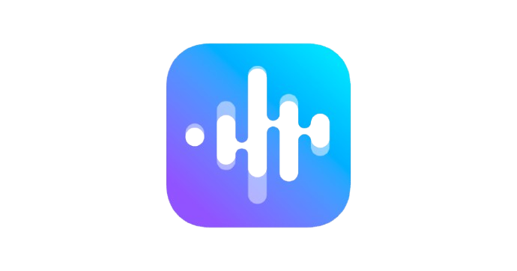

AI Tools
Supporting Return to Work & School Settings
Genio (formerly Glean)
  School focused
  Transcription, quizzes, summaries, searches, etc.
Jamworks
  School focused
    AI integrated
    Transcriptions, quizzes, summaries, Q&A, etc.
ChatGPT
  AI integrated
  Designed to be more conversational
  A tool to support critical-thinking
Genio ($144/yr)
Jamworks ($228/yr)
ChatGPT (Free versions available)
Notes:
Olivia
Return to work and school are a huge focus of mine from an AT perspective. Work and school are a large part of our identities and also our purpose, so returning to them are important to many individuals following an injury. With AI growing, these tools are becoming more commonplace and easier to obtain. A couple of my favorites for school are Genio and Jamworks – both are similar in nature and provide AI assistance for notetaking. The lectures are transcribed, summarized, and can be broken down for content focuses. Jamworks has quizzing features and an AI chatbot. Both allow the student to flag content during lectures with different symbols and allow for notetaking within the transcription. Return to work options include ChatGPT – I am sure we are all at least vaguely familiar with it, Otter AI, and AI incorporated into web meetings. Chat allows for the user to give specific prompts and feedback to the source and ChatGPT will expand on the topic. Otter AI works similarly to Genio and Jamworks, but on a more professional level without content quizzes and checkpoints. Most schools and places of employment see these as reasonable accommodations and provide to the student or employee for free.

Slide 12




Case Study: Paul
Spelling and Grammar checks
  Assistive technology supported:
    Transition back to work-related tasks
    Integration of technical reading and writing demands
    Return to meaningful hobbies and leisure activities
Word prediction
Speech to text conversion
NaturalReader
Notes:
Kelsey
Paul is a great example of how smart technology doesn’t just compensate — it restores identity. His goals were not simply ‘improve cognition,’ but to return to work-related thinking and meaningful hobbies after his TBI.
Paul is a probation officer so at the time of his recovery when discussing goals he mentioned returning to work while also reintegrating back into his hobbies which included non-fiction reading.
Because of his injury, he experienced:
cognitive fatigue
reduced efficiency with reading technical material
slowed written output
difficulty sustaining attention for complex tasks
Because Paul’s work required technical reading and written responses. We implemented:”
Word prediction to reduce cognitive load
Built-in spelling/grammar tools for independence
Text-to-speech for proofreading
AI-supported summarization for dense reading
“He also valued leisure activities that required reading and planning.”
Used text-to-speech for long documents
Voice-to-text when fatigue increased
AI tools for idea organization
The assistive tech we chose expanded endurance — it allowed him to engage longer without cognitive shutdown.”

Slide 13
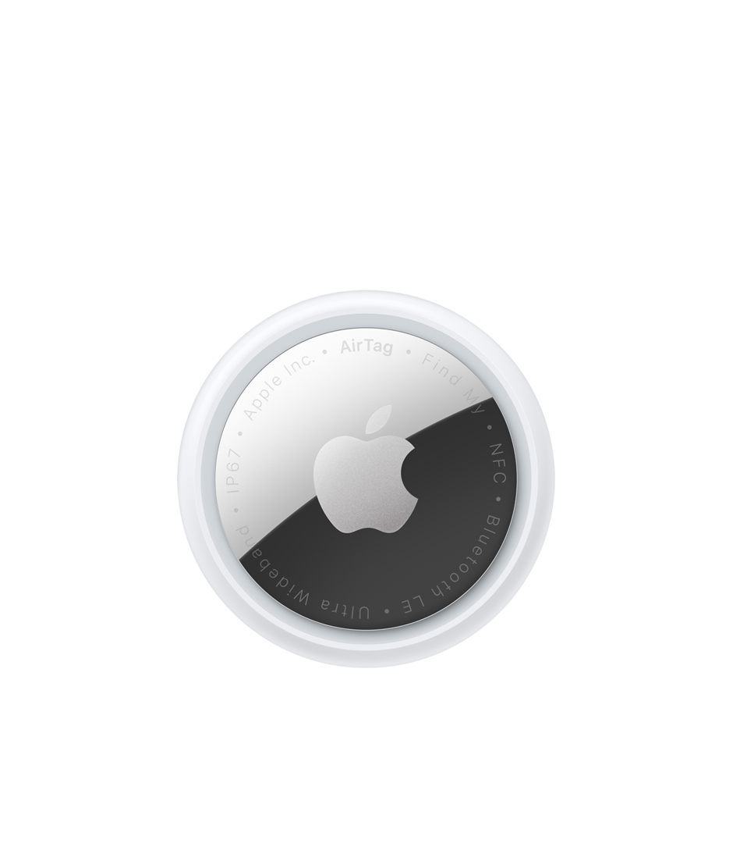
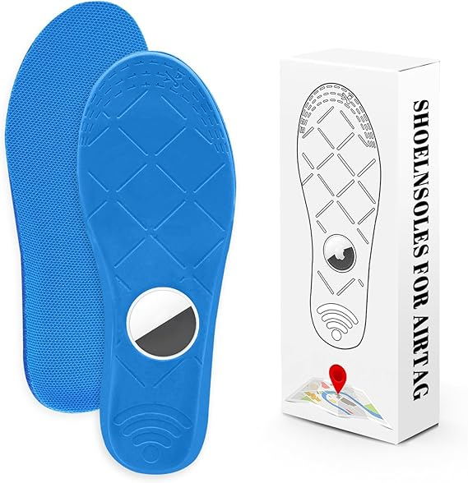
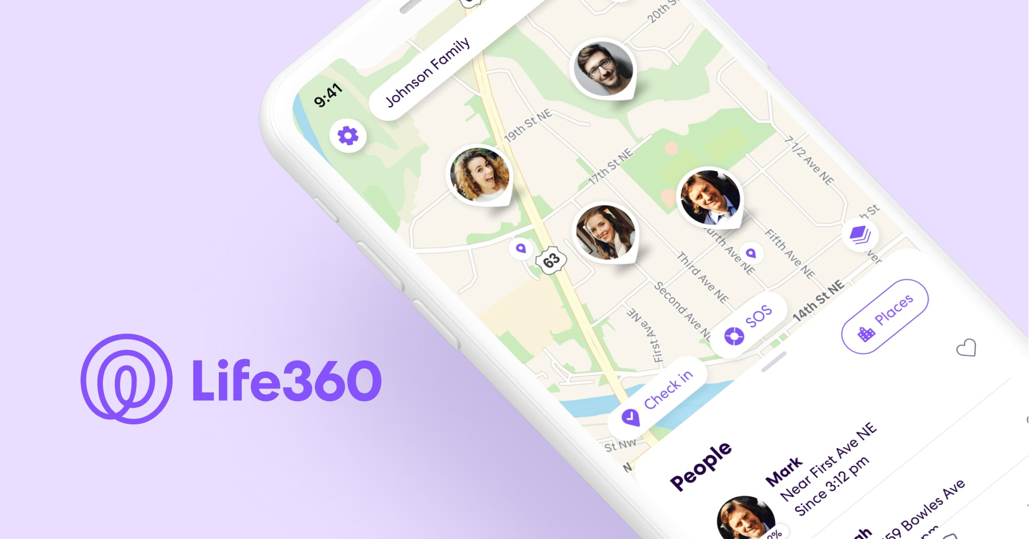
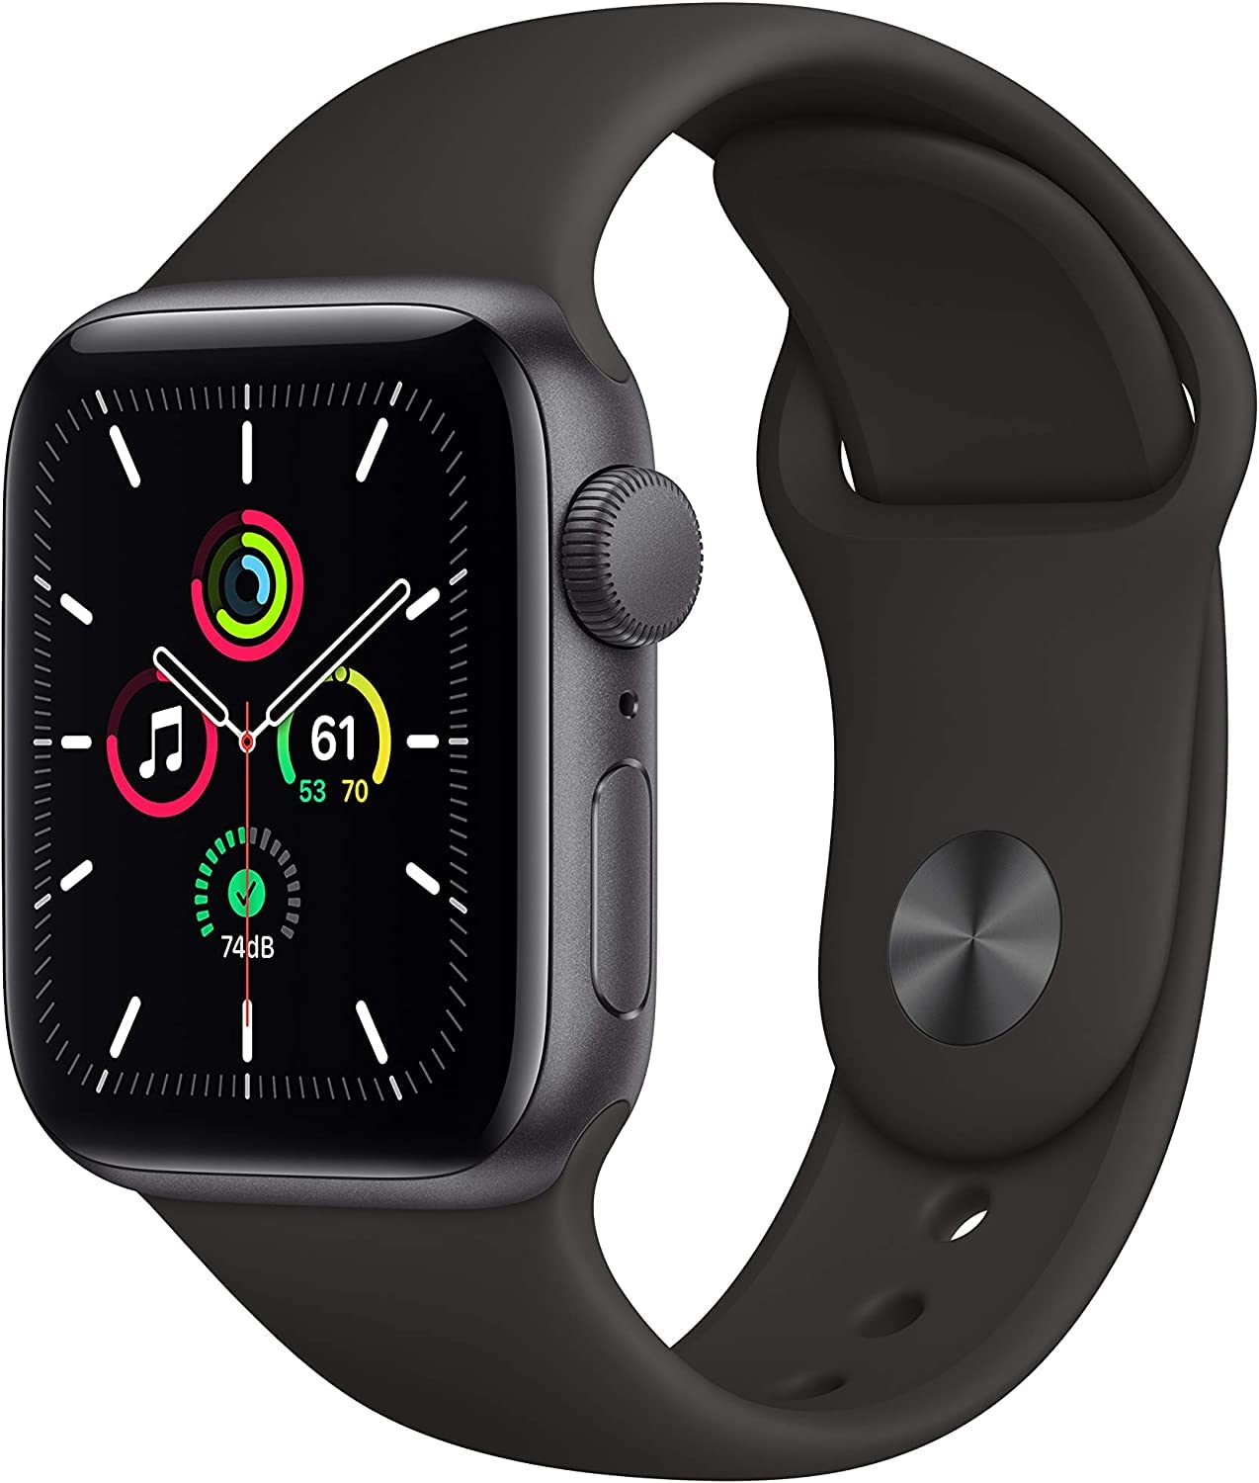
Community and
Safety Supports
Air Tag
  Monitors location
  Uses Apple Find My Network
Air Tag Insoles
  Footwear tracking
  Discreet Airtag holder
  Supports safety and wandering monitoring
Life360
  Family safety application
  Real-time location sharing
  Alerts, location history, check-ins
Apple Watch
  Wearable safety device
  GPS, Fall Detection, SOS
  Health & Location Monitoring
Air Tag Insoles ($9-$17)
Air Tag ($29)
Life 360 (Free and paid plans)
Apple Watch ($299+)
Notes:
Kelsey
Safety and community access are major concerns post-TBI.
These supports promote autonomy while reducing caregiver anxiety.
The goal is not surveillance — it’s supported independence.
AirTags provide opportunity for monitoring location remotely while using find my friends options connected to Apple products
Airtag insoles provide discreet tracking support.
Life360 offers family-based monitoring with real-time check-ins and alerts. With paid options it provides options like roadside assistance (great for individuals who are returning to drive after a TBI!)
Apple Watch integrates fall detection and SOS features with additional features like heart rate, respiratory rate and sleep tracking.

Slide 14
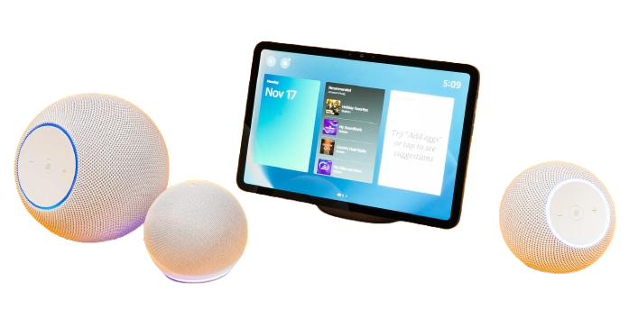
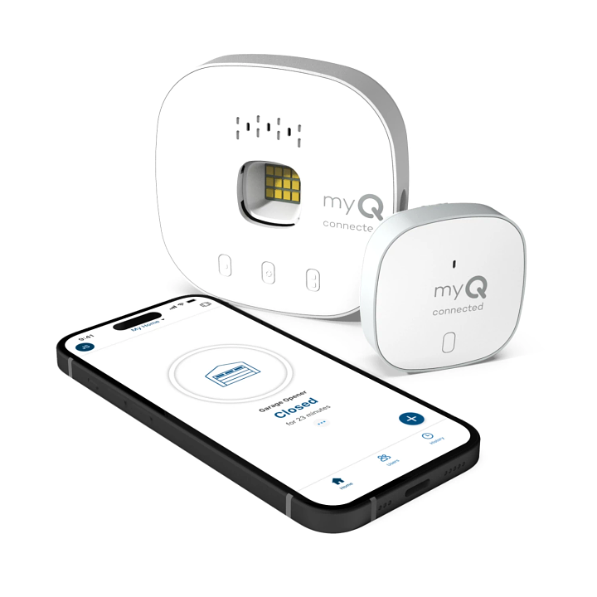
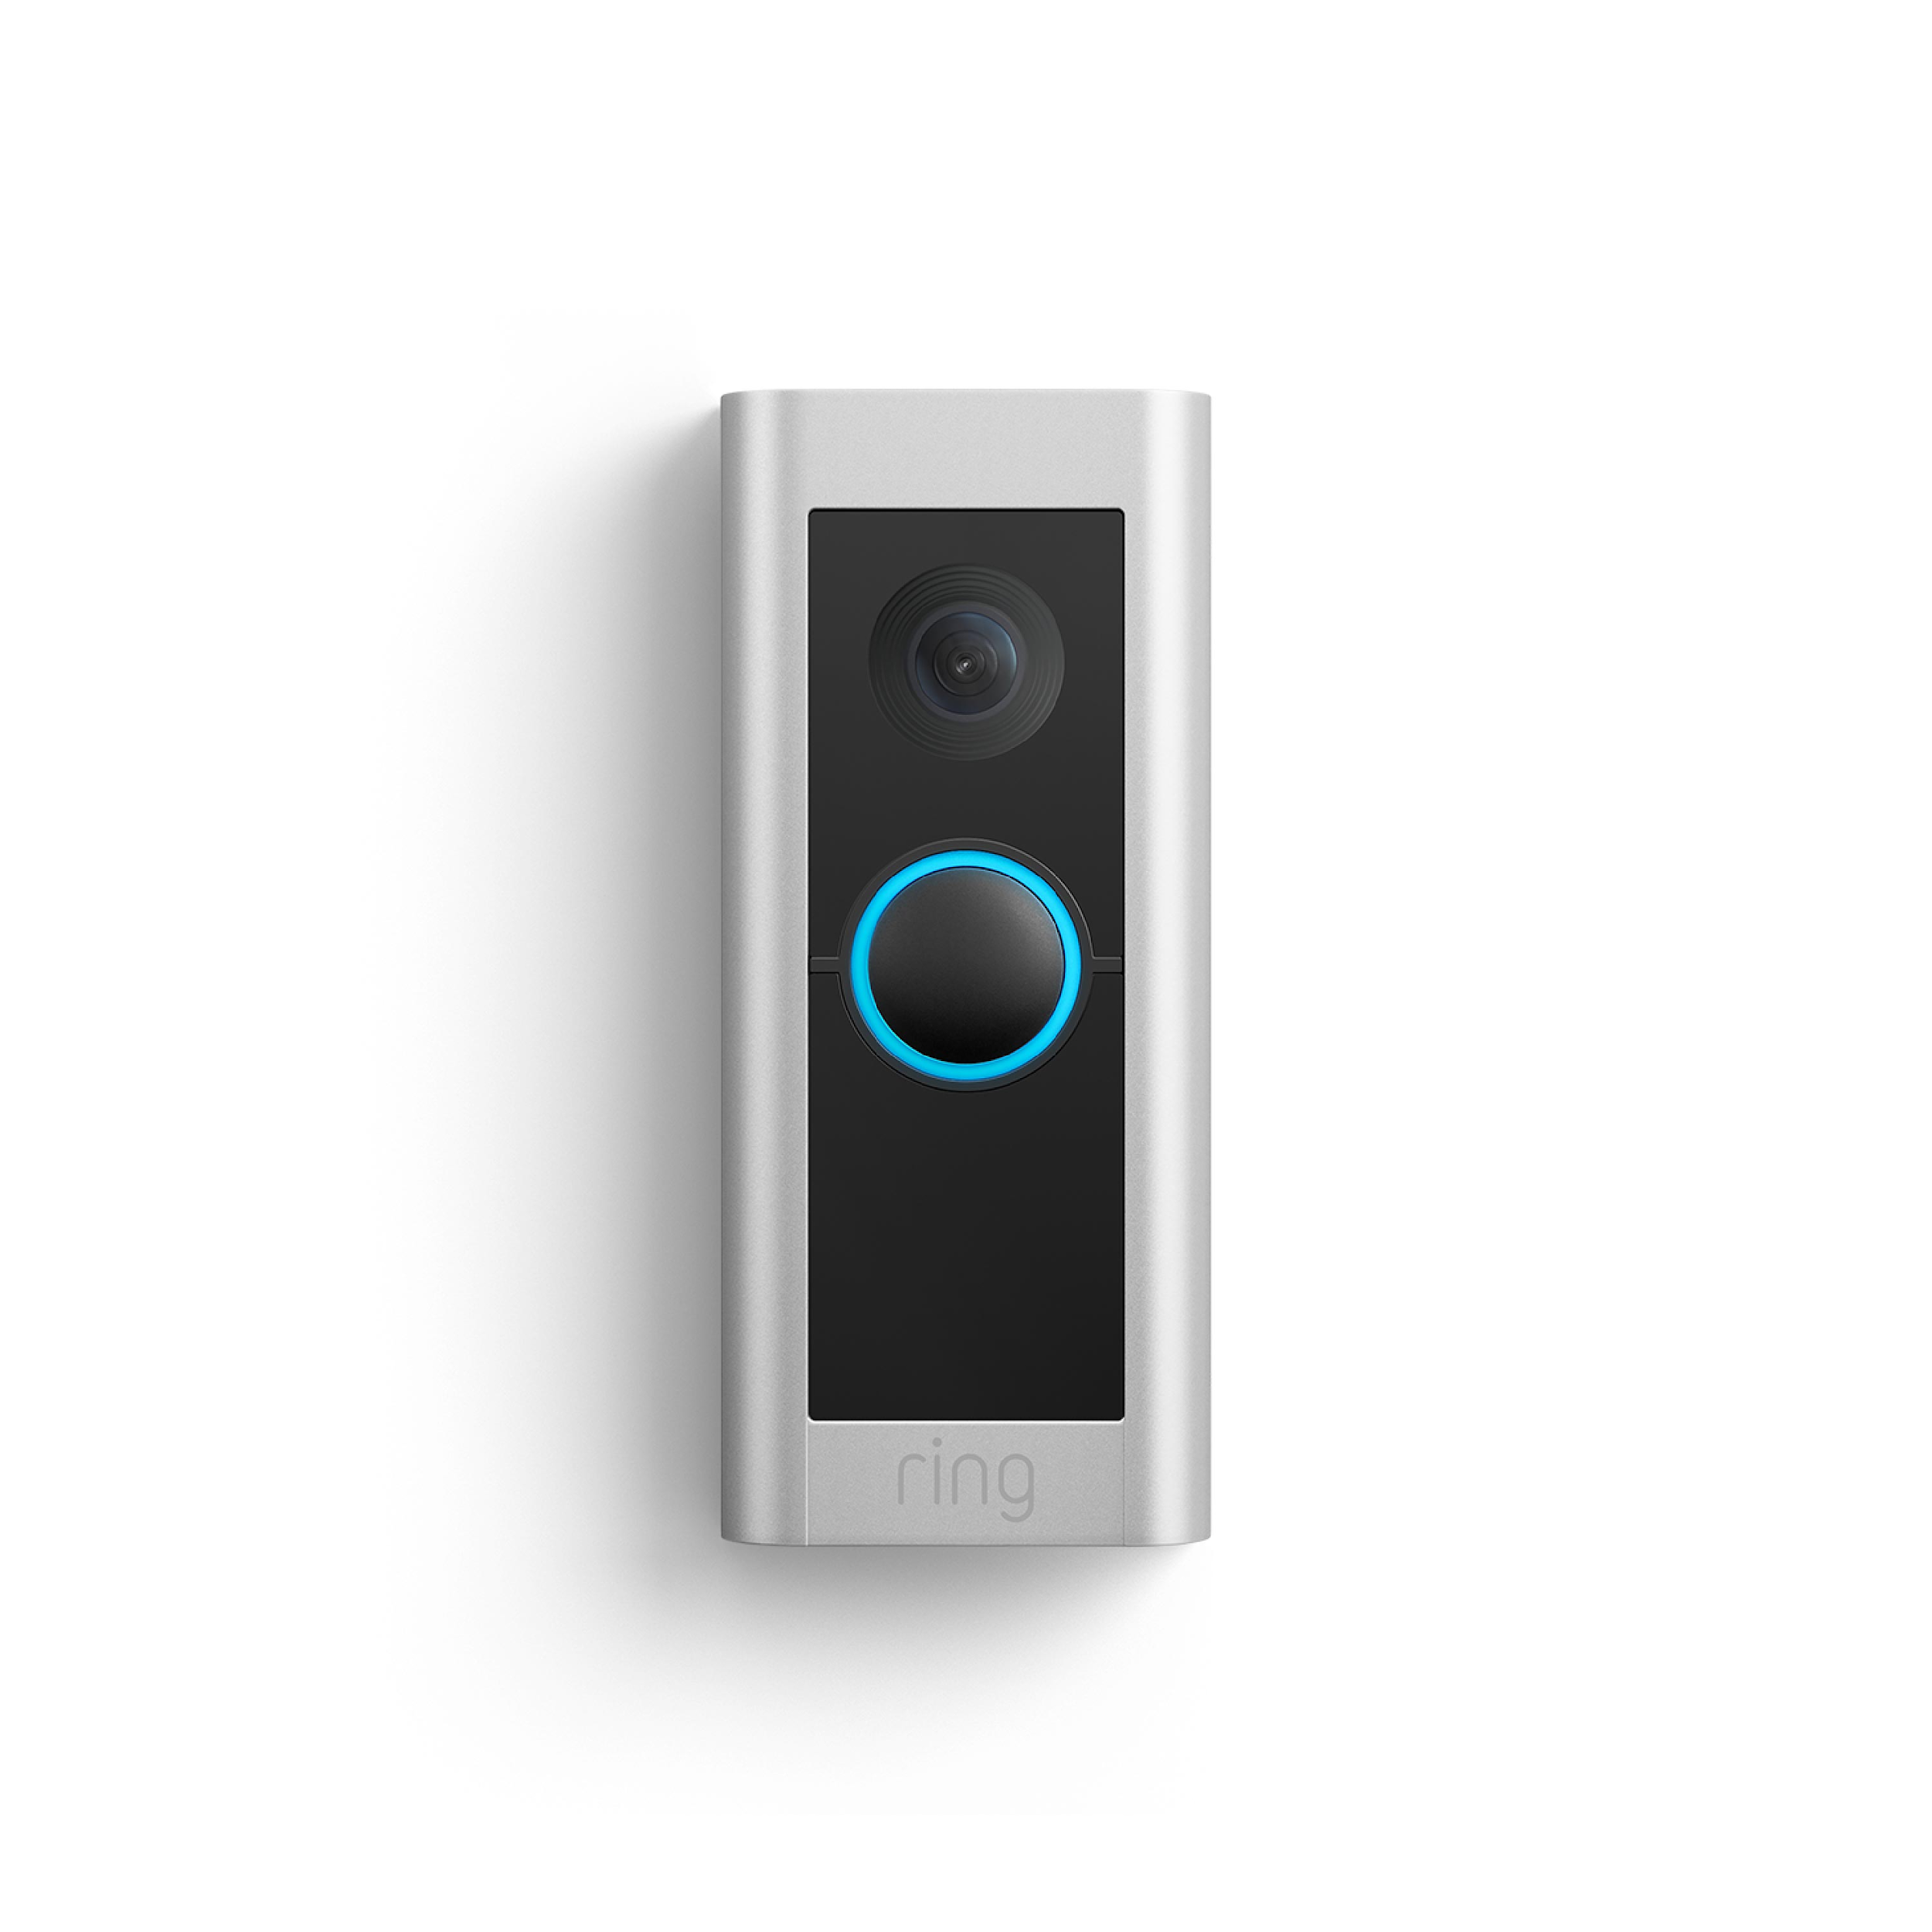
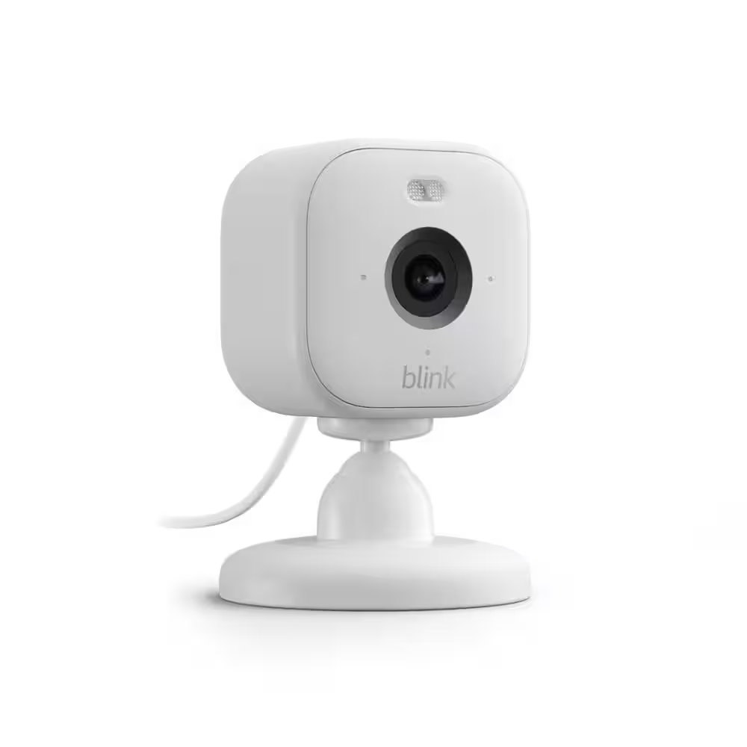
Home Monitoring
Alexa devices
  Voice-activated smart technology
  Hands-free control and reminders
  Supports daily reminders and safety
Ring Doorbell
  Smart home security
  Video doorbell with alerts
  Monitors visitors and deliveries
Blink Camera (Indoor)
  Indoor security camera
  Motion detection and live view
  Supports remote home monitoring
MyQ
  Smart garage door system
  Remote open/close and alerts
  Monitors garage door activity
Alexa devices ($50+)
MyQ ($30)
Blink Camera Indoor ($50)
Ring Doorbell ($50)
Notes:
Kelsey
Smart home devices can significantly increase independence.
These tools are especially helpful for individuals with memory deficits, impulsivity, or reduced safety awareness.
They also reduce caregiver burden.
Alexa supports reminders, hands-free control, and routine building (reminders, remote to-do lists, event details).
Ring and Blink cameras enhance safety and environmental awareness. They provide live video and two-way audio.
MyQ allows remote monitoring of garage doors. MyQ doesn’t disable the physical control so someone can still open the garage manually bit its add smart control. Allowing you opportunity for notification, scheduling access and sharing access with others.

Slide 15




Case Study: Don
Ring Doorbell
Assistive technology supported:
  Promote increased independence
  Reduce caregiver burden
  Support monitoring and management of impulsivity
MyQ
Life360
AirTag Insoles
Notes:
Kelsey
Don’s case centers around impulsivity and reduced safety awareness in community and home transitions. The goal was not to restrict independence, but to create safeguards that allowed him to function more independently while providing reassurance to caregivers.
Don demonstrated impulsive decision-making, particularly related to leaving the house, responding to external stimuli, and limited awareness of safety risks. Rather than constant supervision, we implemented layered smart technology supports.
We were supporting independence – but with some guardrails
Ring Doorbell allowed caregivers to monitor who was at the door and when Don interacted with visitors
Increased safety with unexpected visitors
Reduced need for caregiver physical proximity
MyQ provided remote monitoring of garage door activity. If Don left impulsively or opened the garage unexpectedly, caregivers were notified immediately.
Alerts when garage door opens/closes
Ability to remotely close door
Activity tracking
Life360 provided real-time location tracking when Don was in the community. Rather than restricting Don’s ability to leave, this allowed him community access while maintaining a safety net.
GPS monitoring
Location history
Geofencing alerts
AirTag Insoles offered discreet location monitoring embedded in footwear. For individuals with impulsivity and limited insight, discreet tracking adds an additional layer of safety without increasing stigma.
Non-intrusive
Difficult to misplace
Supports wandering safety concerns

Slide 16
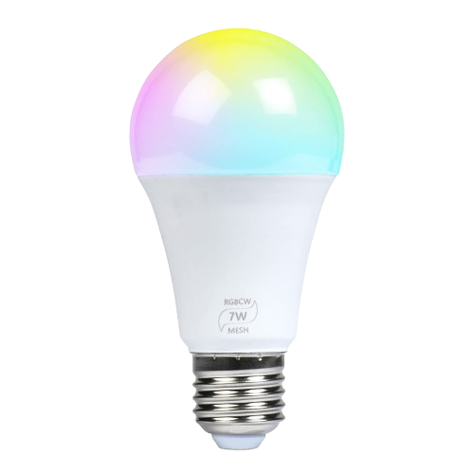
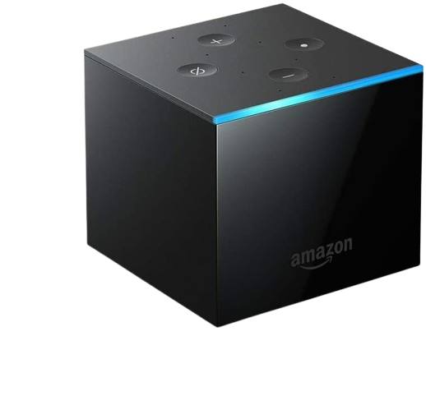
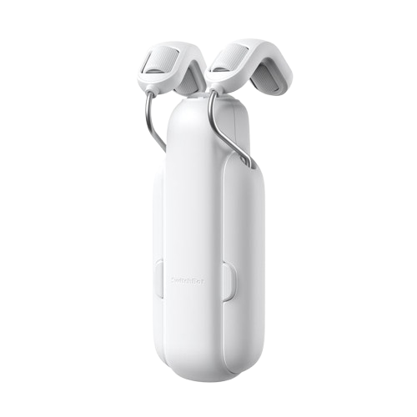
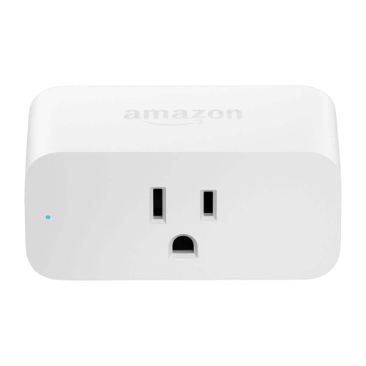
Environmental Controls
Voice & App Activation Within the Home
Lighting Controls
  Smart plugs
  Smart bulbs
  Smart switches
Curtain/Shade Controls
  Bluetooth
Door Operators
Voice and/or App controlled
Climate Controls
  Voice & App controlled
TV Controls
  Voice & App controls
Fire TV Cube ($140)
Smart Bulb ($10-$15)
Curtain/Shade Control ($100)
Smart Plug ($15-$25)
Notes:
Olivia

Slide 17



Case Study: Reid
Apple Watch
Assistive technology supported:
  Increase independent time within the home
  Enhance safety awareness
  Lessen reliance on caregiver support
Echo Dot
Blink Mini Camera
Speech Assistant Application on phone
Notes:
Olivia

Slide 18
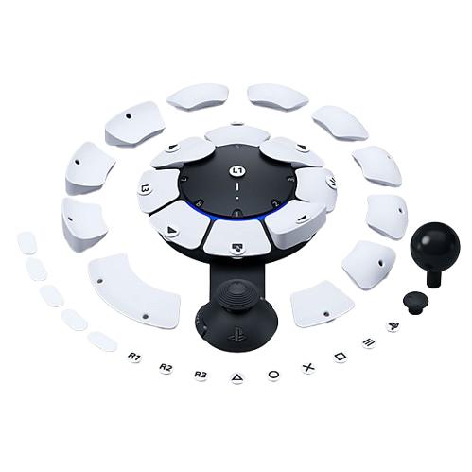
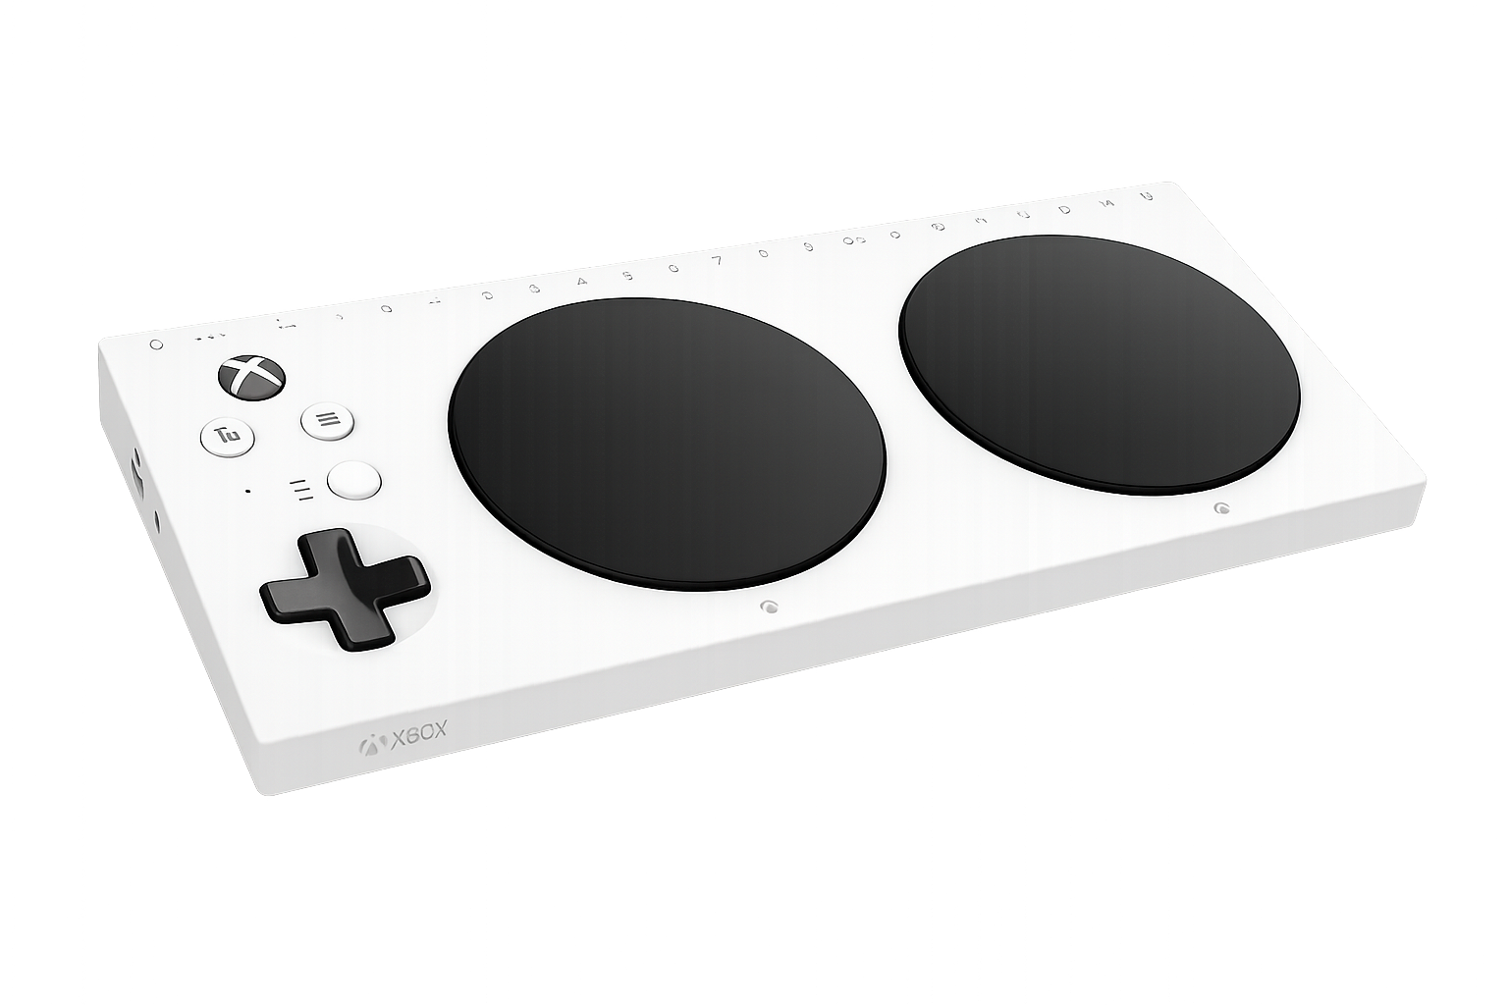
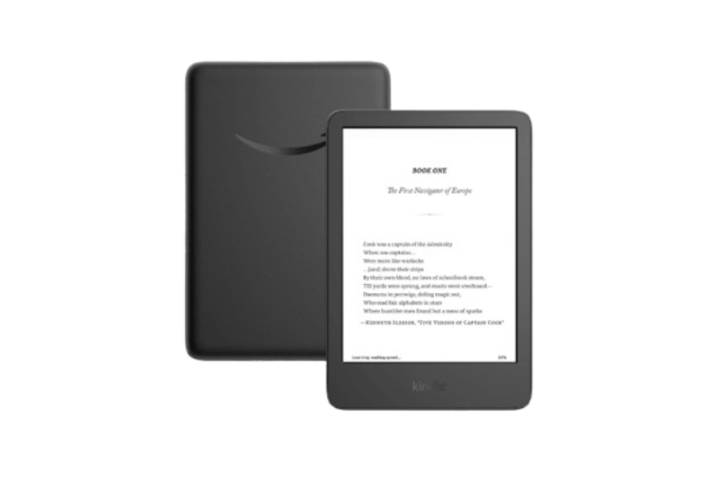
Recreation
Adaptive Video Gaming
  Xbox Adaptive Controller
  PlayStation Access Controller
Kindle with use of Echo Dot
  Paired for Read-Aloud via Echo Dot
Xbox Adaptive Controller (~$200 total)
PlayStation Access Controller ($89)​
Amazon Kindle (Starting at $90)
Notes:
Olivia

Slide 19
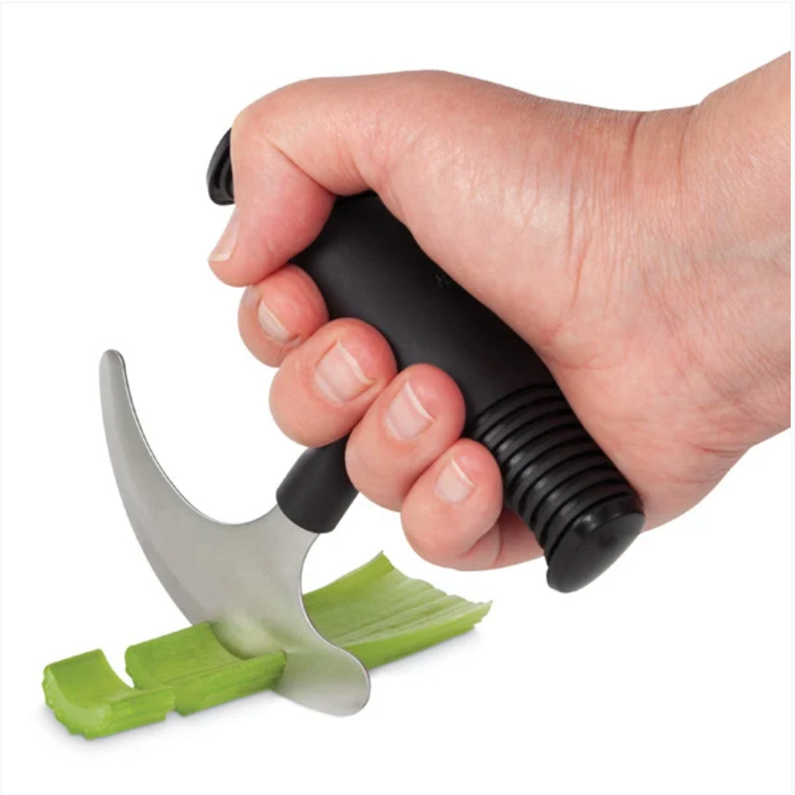
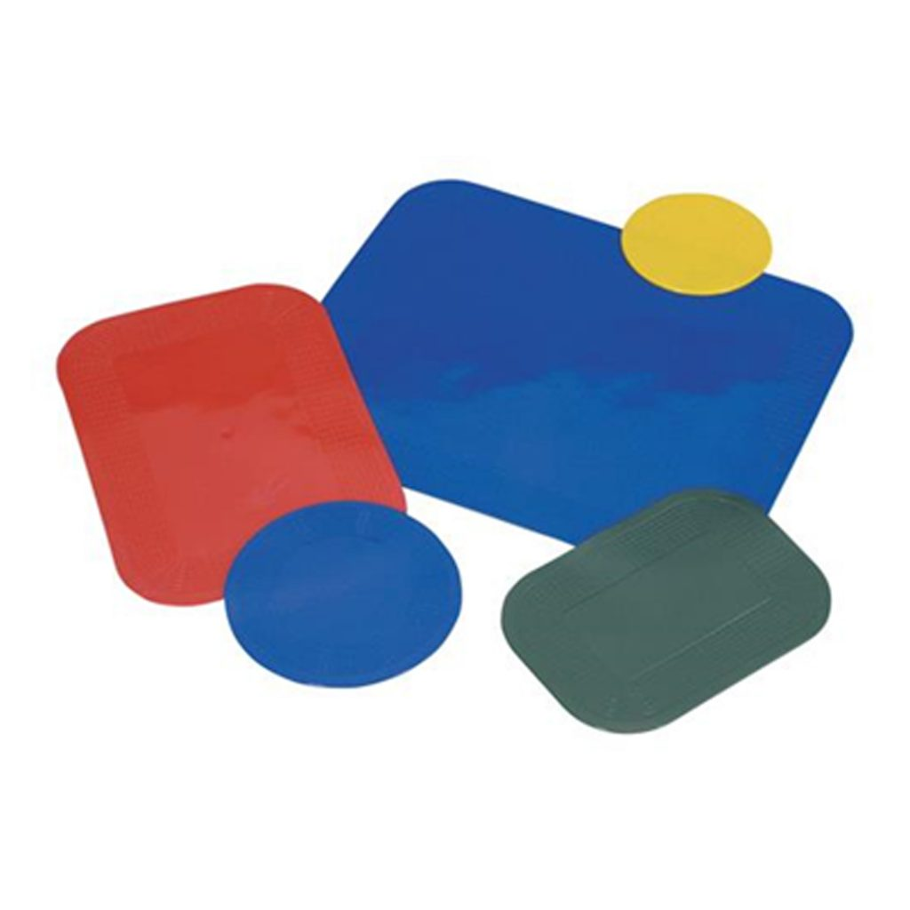
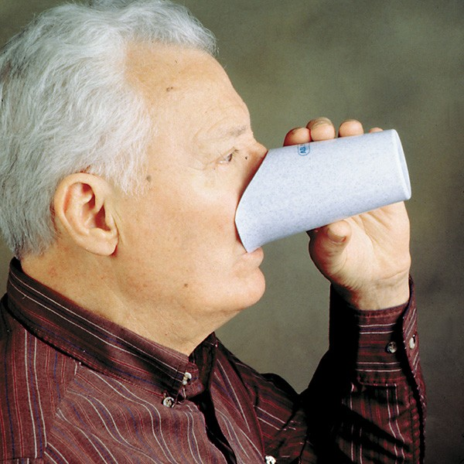

Kitchen
Non-slip mats
  Adaptive safety aid
  Prevents sliding
  Supports independence in eating and ADLs
Nosey cups
  Adaptive drinking cup
  Designed for limited head tilt
  Promotes safe, independent drinking
Rocker knives
  One-handed cutting design
  Meal preparation
IGuardStove
  Safety technology
  Automatic stove shut-off
  Prevents fire and burn risks
Rocker Knife ($17)
Non-slip mat (starting at $15)
IGuardStove (TBD)
Nosey Cup (starting at $11)
Notes:
Olivia
The kitchen allows us to explore many high and low tech options for users. A few of my favorites are the rocker knife: this allows for safer cutting, one handed use, and a gross grasp.
Nonslip/dycem mats allow for the user to cut, scoop, and stab at a plate without the plate or bowl slipping (super multi-functional!)
Nosey Cups – safe drinking minus the head tilt!
IGuard – stove shut off

Slide 20
Recreation
Xbox | PlayStation
Flexibility in Layout | Dual Button Assignments
Switch Ports | Switch Ports
Joystick Purchase Options | Joystick Included
Copilot Mode | Co-controller Options
Cross Compatible w/adapter | PS5 Compatible
Notes:
Olivia ***

Slide 21
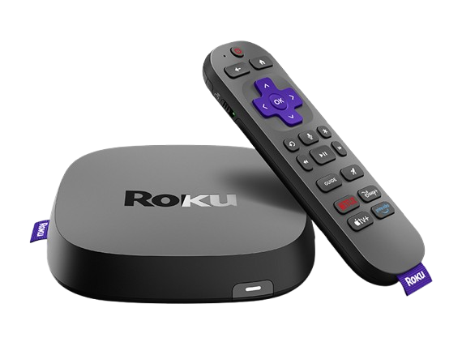
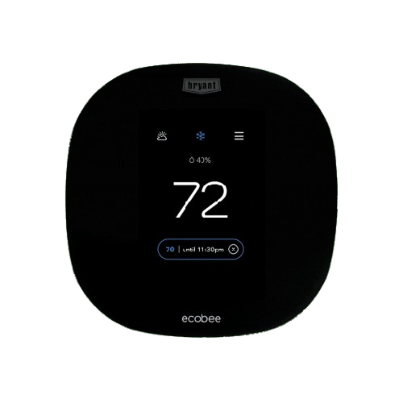
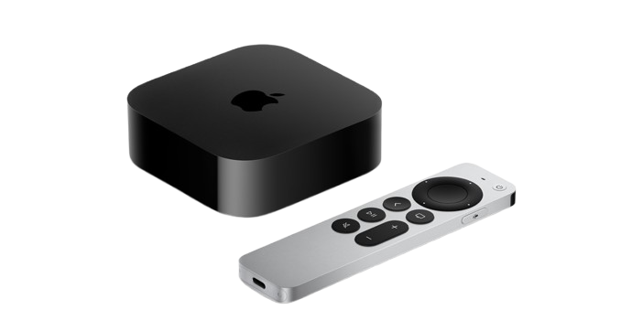
Environmental Controls
Voice & App Activation Within the Home
  Fire TV Cube
    Voice & App Controlled
  Roku
    App Controlled
  Apple TV
    Voice & App Controlled
Smart Thermostat ($70+)
Roku ($25-$80)
Apple TV ($180)
Fire TV Cube ($140)

Slide 22
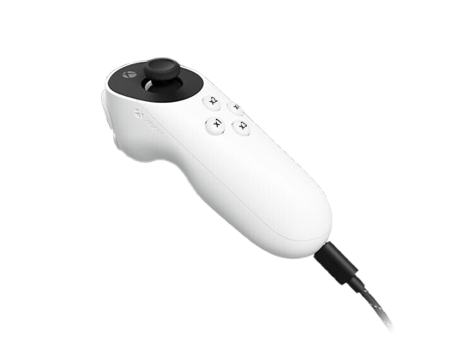
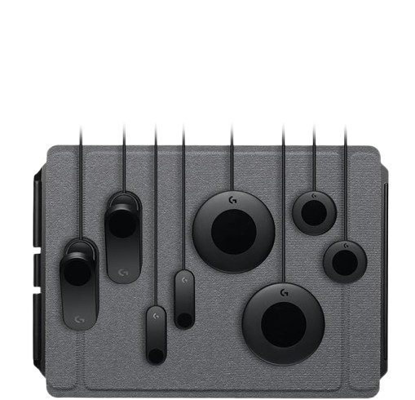
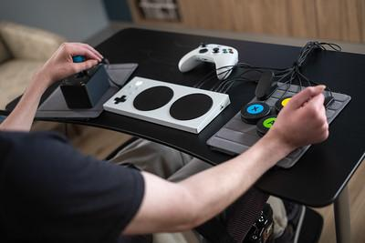
Xbox
Adaptive Joystick ($30)
Adaptive Controller ($99)
Logitech Adaptive Switches ($99)
Notes:
Work in progress slide

Slide 23
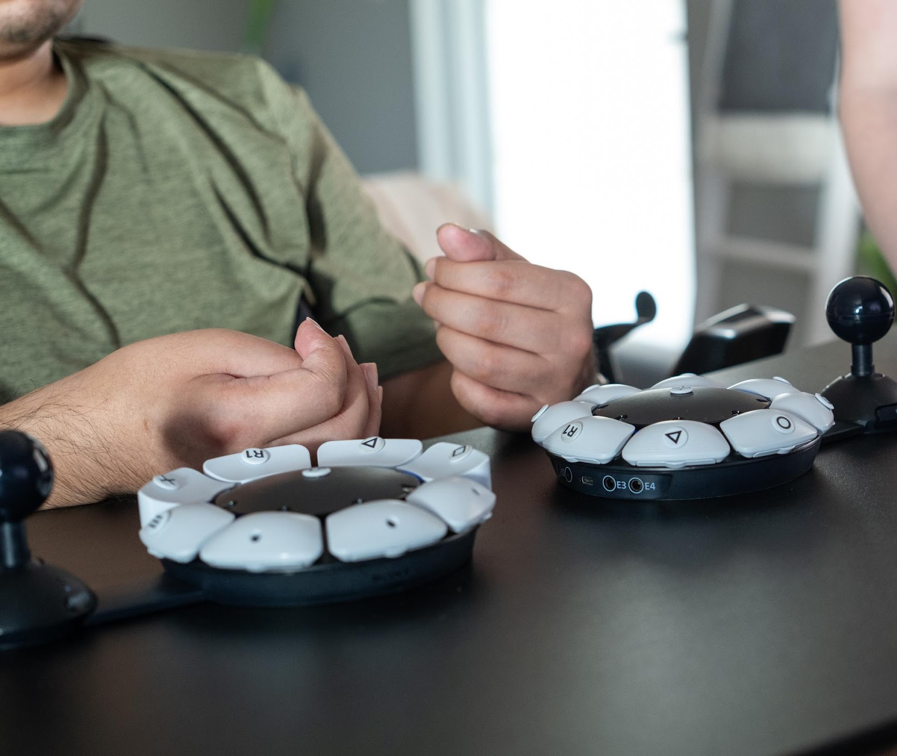
PlayStation
Adaptive Controller
Access Controller ($90)

Slide 24
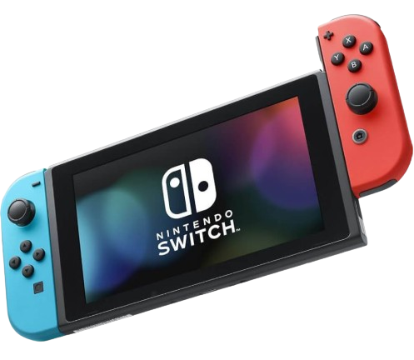
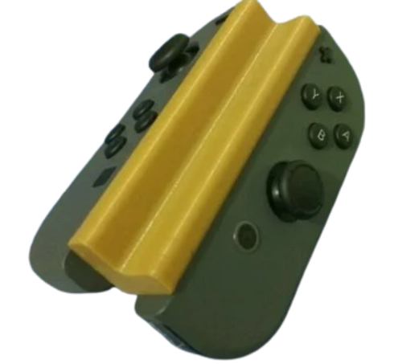
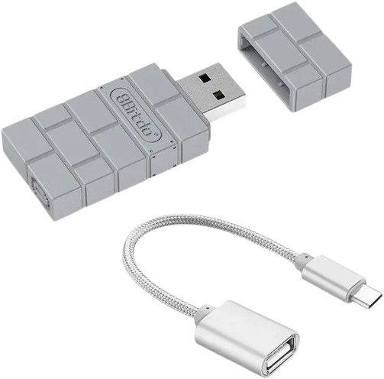
Nintendo Switch
Adaptation Options
Remapping Options
Adapters
3D Print Controller Adaptations
3D Print Adaptation ($0.50)
8BitDo USB Adapter ($20)

Slide 25

Applying What We’ve Learned
Select the most appropriate assistive technology for the following case study.
Notes:
Kelsey
Now we want to move from information to application.
Selecting assistive technology requires clinical reasoning.
Consider:
The individual’s cognitive strengths and weaknesses
The assistive technology we discussed so far
Your own experiences
Chime in!

Slide 26



Case Study: Wyatt
Concerns:
Forgets to turn off the oven after preparing a meal
History of falls but has been cleared by physical therapist to walk around his property
Exhibits impulsive behaviors, such as leaving the house without informing anyone
Notes:
Kelsey
When reviewing Wyatt’s case, think:
What is the primary concern? Safety? Wandering? Impulsivity?
Is the need preventative or responsive?

Slide 27
IGuardStove (TBD)
Apple Watch ($299+)
Air Tag Insoles ($9-$17)
Notes:
Kelsey
IGuardStove addresses kitchen safety.
Apple Watch supports fall detection and emergency contact.
AirTag insoles support location tracking.

Slide 28
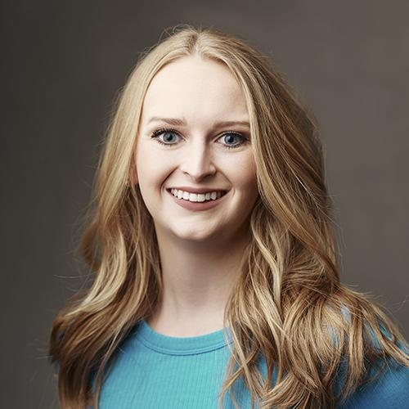
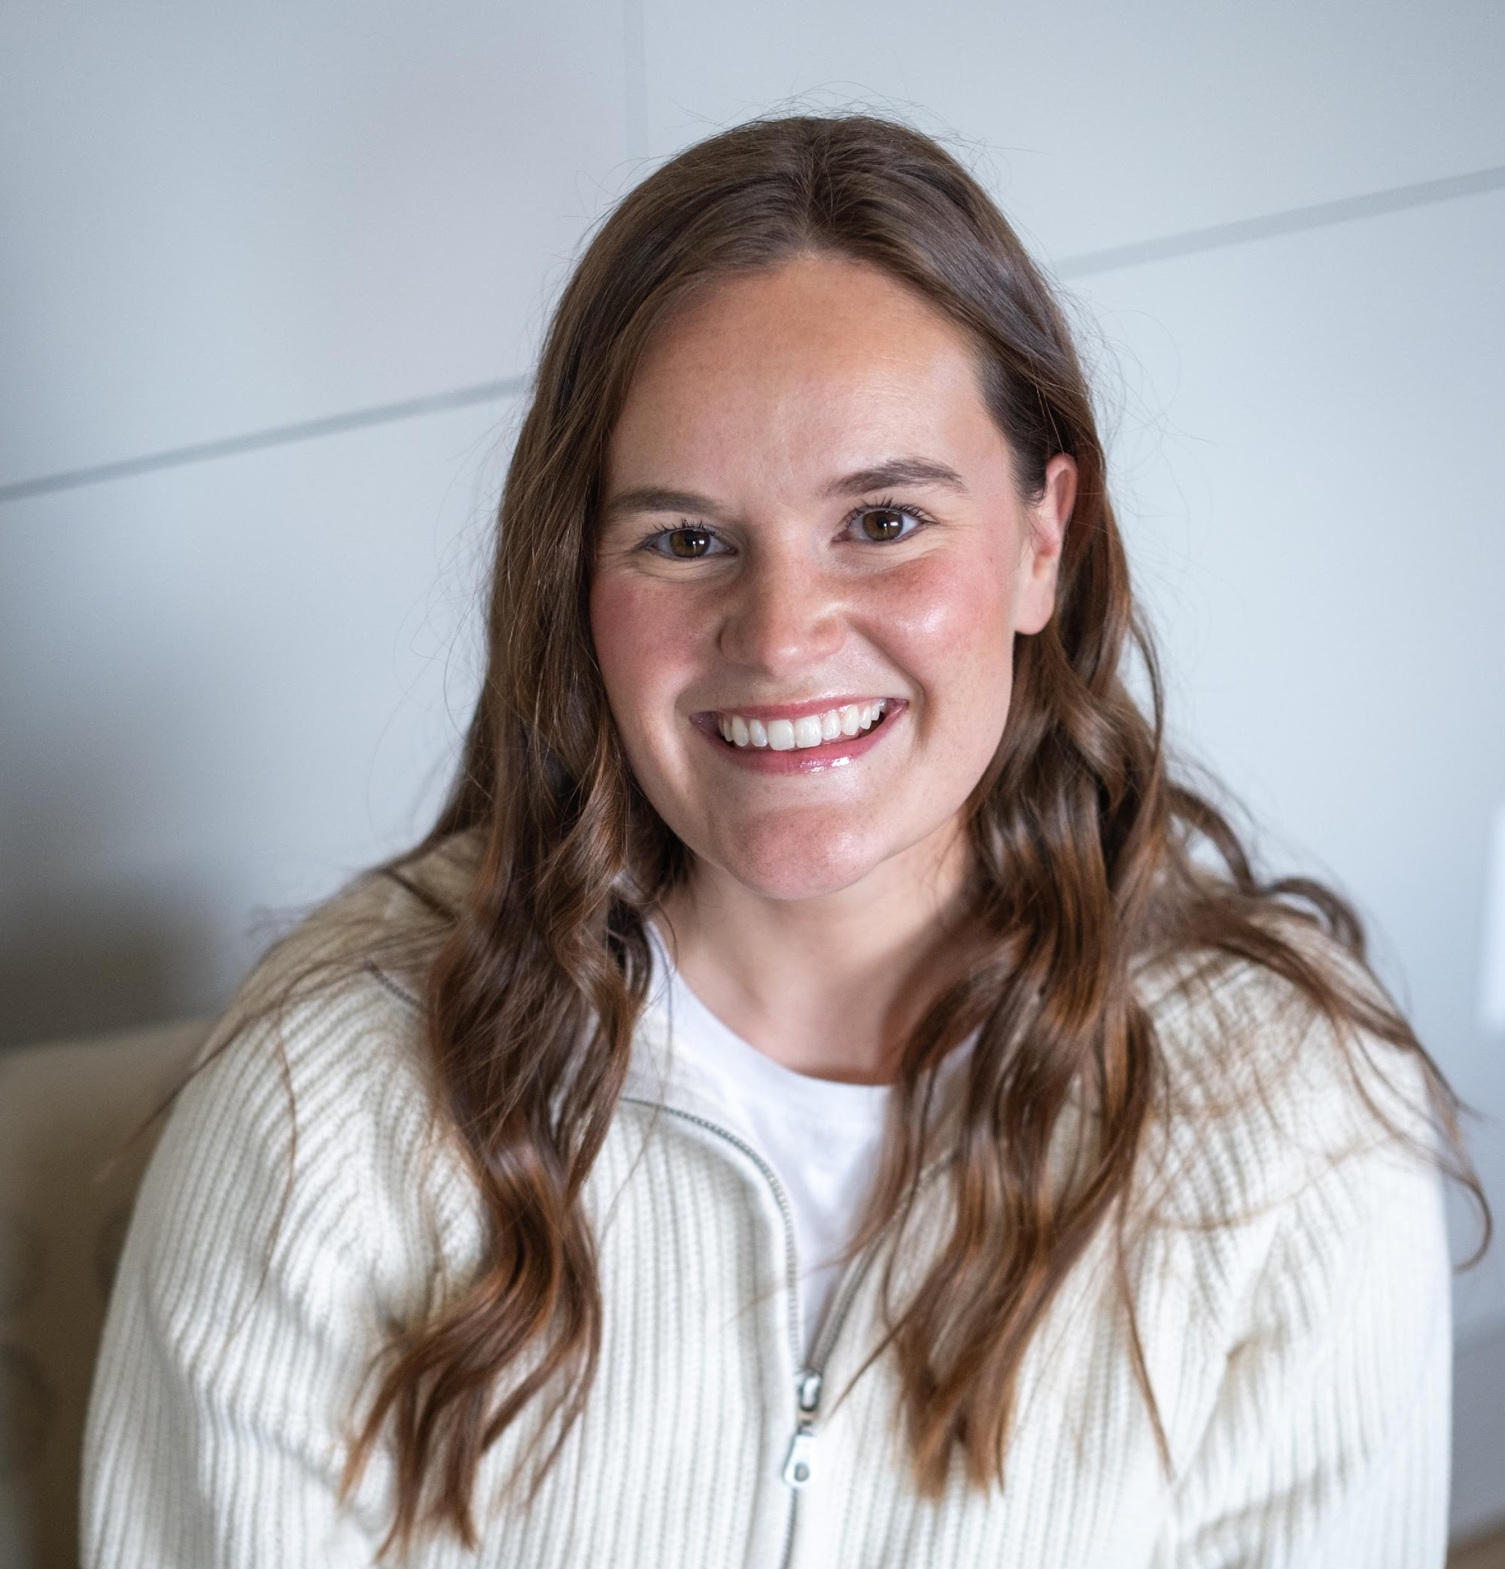
Thank you!
Olivia Ollis, MOT, OTR/L
Occupational Therapist
Assistive Technology Specialist
Kelsey Wagner, M.S., CCC-SLP
Speech-Language Pathologist
Notes:
Olivia
Thank you so much for attending our presentation today. Hopefully this gave everyone ideas of AT that can be beneficial for yourself, loved ones, or individuals you work with.
Please feel free to ask any questions!

Slide 29


  Resources
Notes:
Olivia
We have also included a resource list of some of the AT devices listed in today's presentation.

