Slide 1


Slide 2

The Importance of Cervical Spine Evaluations for Concussions and Traumatic Brain Injuries
The Role of Chiropractic Care in Treating Brain Injuries
Mark Knoll, DC
Director of Educational Outreach & Public Advocacy
Notes:
Last year my organization, the Nebraska Chiropractic Physicians Association, was fortunate to be a vendor here at the Nebraska Brain Injury Conference. This allowed me the opportunity to attend all the sessions and have some great conversations with people at our booth. I was very impressed by the excellent presentations and especially the humility each presenter displayed.
One important takeaway I had is how this subject matter is constantly evolving. This conference is a great forum to keep up to date.
My topic for today is:
The importance of Cervical Spine Evaluations for Concussions and Traumatic Brain Injuries and the role of Chiropractic Care in Treating Brain Injuries

Slide 3
Presentation Overview
Introduction
Nebraska Chiropractic Scope of Practice
Advances in the Chiropractic Profession
Concussion in Sport Group
The role of the cervical spine in concussion management
Evidence that supports chiropractic treatment of neck pain
Safety of chiropractic care
Chiropractic Care as part of the interprofessional treatment for concussion/mTBI management
Interprofessional Collaboration
Bibliography

Slide 4

Professional Experience
Nebraska Chiropractic Physicians Association
  Director of Educational Outreach & Public Advocacy: 2024-present
SecureCare (Independent Physician Association)
  Board Member: 1999-2016
  Part-time Medical Director: 2005-2016
  Chief Medical Officer: 2016-2024
  Credentialing Committee Member
    Blue Cross Blue Shield of Nebraska: 2001-2024
    Nebraska Total Care: 2019-2024
Solo Practice: Omaha, NE: 1986-2016
Graduate: Logan College of Chiropractic: 1983
  Internship & Associate Doctor: 1984-85
2
2
Mark Knoll, DC
3

Slide 5

Nebraska Chiropractic Scope of Practice
Includes:
Does Not Include:
  Evaluation & Management Services
  Diagnosis
  Use of Diagnostic X-rays
  Routine Lab Procedures
  Treatments:
    Spinal Manipulation
    Passive & Active Therapies
    Nutrition & Dietary Guidance
  Use of Drugs or
  Surgery
2

Slide 6
Advances in the Chiropractic Profession
Notes:
Over the past 25 years, there have been significant advances in the chiropractic profession. Today, I am going to focus on 2 areas: The Veterans Administration (VA) and chiropractic research.

Slide 7
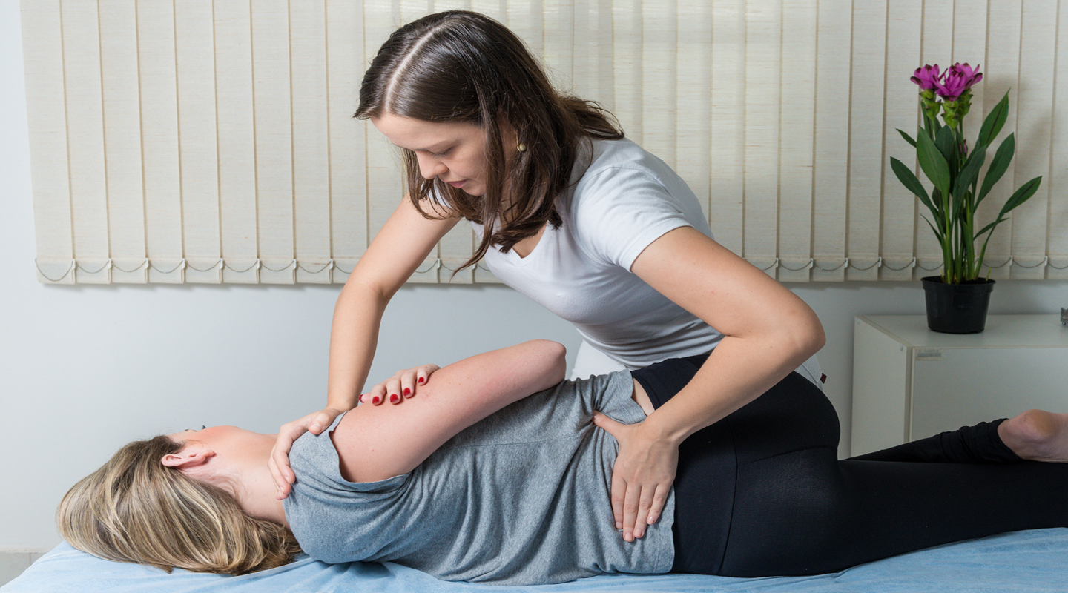
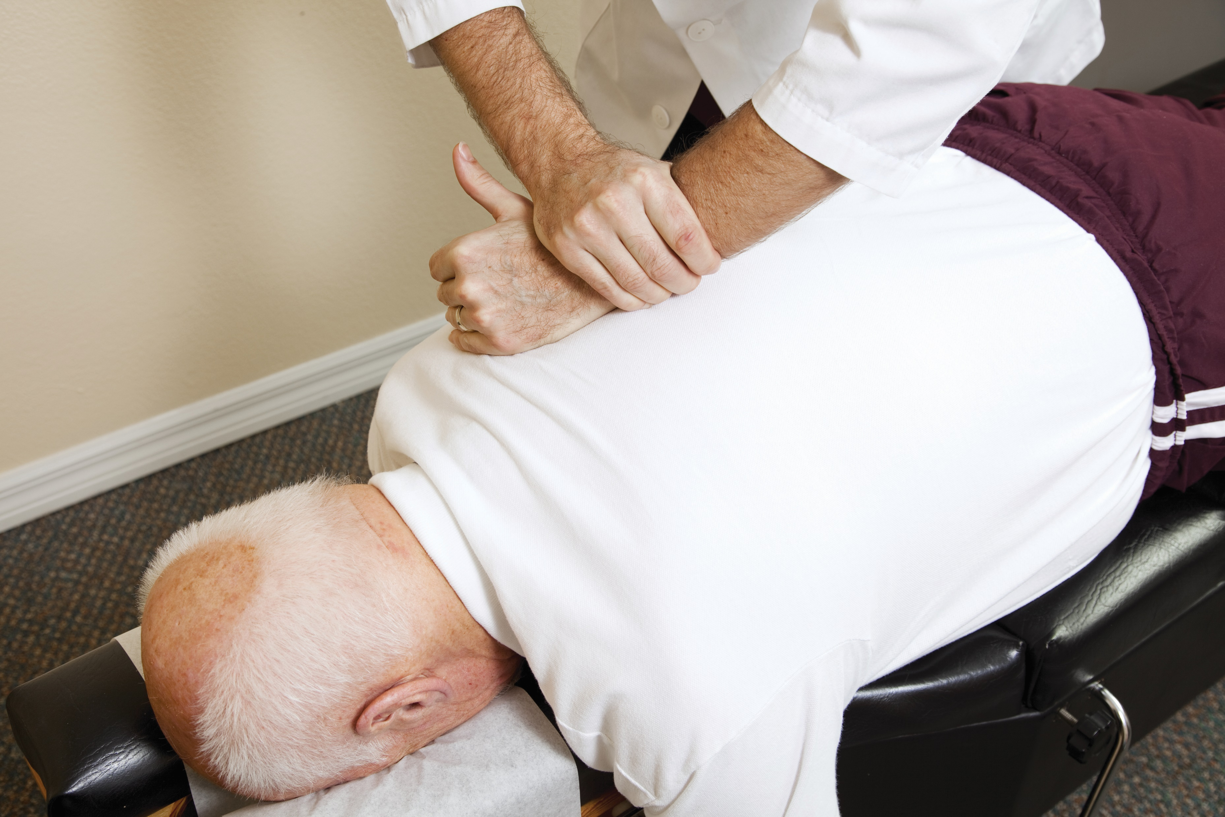

Chiropractic in the Veterans Health Administration
  Onsite chiropractic care began in 2004 at Veteran’s Affairs (VA) facilities.
  Primary conditions treated are low back pain, neck pain, headaches.
  Currently, there are 500 treating doctors of chiropractic (DCs) at 221 sites.
  DCs are located in Nebraska VA hospitals in Omaha, Lincoln, Grand Island.
Notes:
The chiropractic VA program was rolled out in the late 1990’s and onsite chiropractic care began in 2004. Chiropractors at the VA are involved in 3 aspects of healthcare: Patient care, Research and healthcare training.

Slide 8

Chiropractic in the Veterans Health Administration
  The VA is an interdisciplinary healthcare system where chiropractic care is a valued part of patient care plans.
  Chiropractic residency program available in VA.
  70% of medical physicians rotate through the VA during their careers.
  Chiropractic use projected to double between
  2022-2027.
2
2
3

Slide 9


Chiropractic Research at Universities &
Academic Institutions
Duke University
Yale University
Osher Center for Integrative health at Harvard Medical School
University of Pittsburgh
  First university-based chiropractic program
  https://www.shrs.pitt.edu/academics/chsrs/chiropractic/
Troy University
  Second university-based chiropractic program
Miami of Ohio University
Dartmouth College
Medical College of Wisconsin
Palmer Center for Chiropractic Research
2
2
3
Notes:
When I began my current position at the NCPA, I began digging into the chiropractic research that is being published. And I was amazed by the volume of quality research.

Slide 10
Concussion in Sport Group
Notes:
Since 2001, the concussion in sport group has worked to analyze, aggregate and interpret the world’s scientific literature for the evaluation, management and prevention of sports-related concussions. This group meets every 4 years to update their consensus statements and assessment tools, ensuring that the latest scientific understanding is integrated into clinical practice.

Slide 11
Concussion Research
Background
  The concussion in Sport Group (CISG) focus is on Sports related concussion (SRC)
    Driven by sporting bodies needing to have clear and practical guidelines for recovery and safe return to play for athletes
  Lessons learned from research for non-sporting mild Traumatic Brain Injury should inform the understanding of SRC and vice-versa
  Arbitrary separation of sporting versus non-sporting TBI should not be viewed as opposing views of TBI
2
2
3
Source: British Journal of Sports Medicine (2018) Consensus statement on concussion in sport-the 5th international conference on concussion in sport held in Berlin, October 2016

Slide 12
Concussion Research
11 R’s of Sport related concussion management:
  Recognize
  Remove
  Re-evaluate
  Rest
  Rehabilitation
  Refer
  Recovery
  Return to sport(RTS)
  Reconsider
  Residual effect and Sequelae
  Risk Reduction
2
2
3
Source: British Journal of Sports Medicine (2018) Consensus statement on concussion in sport-the 5th international conference on concussion in sport held in Berlin, October 2016

Slide 13
Concussion Research
Rehabilitation
  Historically, no focus on early concussion interventions because most patients with SRC seem to clinically recover in a short period
  For individuals with persistent symptoms or ongoing impairments after 10-14 days, Concussion in Sport Group (CISG) now opines that the data supports interventions including:
    Psychological rehabilitation
    Cervical Rehabilitation
    Vestibular Rehabilitation
2
2
3
Source: American College of Sports Medicine (2018) Zurich to Berlin-Where are we now with the concussion in Sport Group?

Slide 14
Concussion Research
Refer
  Persistent Postconcussive Symptoms (Definition):
    Failure of normal clinical recovery, that is symptoms that persist beyond expected timeframes:
      10-14 days in adults
      Over 4 weeks in children
  Treatment of individuals who have ongoing impairments exceeding the above timeframes should include a multidisciplinary team of healthcare providers with experience in treating SRC
    Targeted physical therapy in patients with cervical spine or vestibular dysfunction
2
2
3
Source: American College of Sports Medicine (2018) Zurich to Berlin-Where are we now with the concussion in Sport Group?

Slide 15
Concussion Research
Overview
  This 6th statement summarizes the process and outcomes of the 6th international conference on concussion
  The 11 R’s were developed by the 5th conference in Berlin
  2 additional R’s were developed during the 6th conference
    Retire: to address issues related to potential career-ending decisions
    Refine: to highlight the need to embrace ongoing strategies to advance the field
  Rehab and Refer are expounded upon for this 6th conference
2
2
3
Source: British Journal of Sports Medicine (2023) Consensus statement on concussion in sport: the 6th International Conference on Concussion in Sport-Amsterdam, October 2022

Slide 16
Concussion Research
13 R’s of Sport related concussion management:
  Recognize
  Reduce: prevention
  Remove
  Refer
  Re-evaluate
  Rest & exercise
  Rehabilitation
  Recovery
  Return to learn/return to sport
  Reconsider
  Residual effects
  Retire
  Refine
2
2
3
Source: British Journal of Sports Medicine (2023) Consensus statement on concussion in sport: the 6th International Conference on Concussion in Sport-Amsterdam, October 2022

Slide 17
Concussion Research
Refer
  Key Point
    The SRC clinician network may include:
      Sports Medicine Physicians Physiatrists
      Athletic trainers/therapists Psychologists
      Physiotherapists Psychiatrists
      Occupational therapists
      Sports Chiropractors
      Neurologists
      Neurosurgeons
      Neuropsychologists
      Ophthalmologists
      Optometrists
2
2
3
Source: British Journal of Sports Medicine (2023) Consensus statement on concussion in sport: the 6th International Conference on Concussion in Sport-Amsterdam, October 2022

Slide 18
Concussion Research
Rehabilitation
  Key Points
    Cervicovestibular rehabilitation is indicated for symptoms that persist in adults more than 10 days:
      Neck pain
      Dizziness
      Balance Problems
    If symptoms persist beyond 4 weeks in children and adolescents, active rehabilitation and collaborative care may be of benefit
2
2
3
Source: British Journal of Sports Medicine (2023) Consensus statement in sport: the 6th International Conference on Concussion in Sport-Amsterdam, October 2022

Slide 19
The Role of the Cervical Spine in Concussion Management
Notes:
I am going to review some of the current research related to the role of the cervical spine in concussion management. I hope you will find this as fascinating as I do.

Slide 20
Concussion Research
Objective
  To examine the prevalence of cervical spine injuries among children and adolescents referred with suspected and diagnosed sports-related concussion (SRC) and evaluate the effect of cervical spine dysfunction (CSD) on physician documented clinical recovery following SRC
Results
  33% had CSD
  Patients with CSD post SRC took longer to achieve physician-documented clinical recovery
    28.5 days vs. 17 days
    4 times more likely to experience delayed clinical recovery
Conclusion
  CSD may be a risk factor for delayed clinical recovery in SRC
2
2
3
Source: Journal of Head Trauma (2019) Cervical spine dysfunction following pediatric sports-related head trauma.
Notes:
In this section, we are going to review 9 studies. Each study was 10-15 pages long. I have distilled the findings down to one or two slides. The format for each slide is similar: Objective, Results and Conclusion. While the information may seem cumbersome, I want you to follow along with me to see if we notice a pattern in the research.

Slide 21
Concussion Research
Objective
  To assess people with persistent symptoms post-concussion, determine whether the neck has also been injured and evaluate the potential of the neck to contribute to their symptoms
Results
  Patients were evaluated 7.5 weeks post-concussion
  90% were considered to have a neck problem by their clinician contributing to their symptoms
Conclusion
  Multiple findings indicated concurrent neck injury
  These findings are important to recognize:
    May contribute to persistent symptoms post-concussion
    May respond to neck treatment
2
2
3
Source: Journal of Orthopedic Sport Physical Therapy (2019) Can the neck contribute to persistent post-concussion? A prospective descriptive case series.

Slide 22
Concussion Research
Objective
  Examine the effect of current neck or shoulder pain on concussion outcomes
Results
  More than 50% of patients reported current neck or shoulder pain at initial evaluation
  Neck or shoulder pain was associated with longer symptom resolution time
Conclusion
  Experiencing neck or shoulder pain during initial post-injury evaluation was associated with worsened clinical outcomes
  Clinicians may consider referral to early rehabilitation following concussion with neck or shoulder symptoms
2
2
3
Source: Journal of Child Neurology (2020) Presence of neck or shoulder pain following sports-related concussion negatively influences recovery.

Slide 23
Concussion Research
Objective
  To characterize the type, frequency and severity of cervical impairments in children and adolescents referred for physical therapy after concussion
Results
  90% of patients demonstrated impairments in at least 3/5 assessment categories related to the cervical spine
  Posture, myofascial impairment and joint mobility demonstrated highest impairment
Conclusion
  High prevalence of cervical spine impairments were observed in the subjects of this study
  This study supports the use of a cervical spine evaluation tool on children and adolescents following concussion
2
2
3
Source: International Journal of Sports Physical Therapy (2019) Characterization of cervical spine impairments in children and adolescents’ post-concussion.

Slide 24
Concussion Research
Objective
  Provide a comprehensive report on the clinical prevalence, diagnostic methods and potential treatment options for cervicogenic symptoms during acute and chronic phases following a concussion
Results
  Prevalence of cervicogenic symptoms in the acute stage ranged from 7-69%
  Prevalence of cervicogenic symptoms increased to 90% in patients experiencing persistent post-concussion symptoms (PPCS)
  Treatment using a graded cervical manual therapy reduced time to symptom resolution and medical clearance
2
2
3
Source: Sports Medicine (2021) The role of cervical symptoms in post-concussion management: A systematic review.

Slide 25
Concussion Research
Conclusion
  Cervicogenic symptoms are prevalent in the acute and chronic stages following concussion
  If this condition is not diagnosed properly, it increases the likelihood of Persistent Post-Concussion Syndrome (PPCS)
  More RCTs are necessary to evaluate the effectiveness of cervical specific treatment programs for PPCS
2
2
3
Source: Sports Medicine (2021) The role of cervical symptoms in post-concussion management: A systematic review.

Slide 26
Concussion Research
Objective
  To describe the cervical spine findings and outcomes of treatment in a series of patients with persistent post-concussion symptoms
  Describe the clinical characteristics of a cervicogenic component when it is present
Results
  32/46 patients reviewed had a cervicogenic component on examination
  Physiotherapy treatment of the cervicogenic component achieved improvement in function and pain
2
2
3
Source: Musculoskeletal Science and Practice (2017) Clinical characteristics and outcomes of treatment of the cervical spine in patients with persistent post-concussion symptoms: A retrospective analysis.

Slide 27
Concussion Research
Conclusion
  Clinical characteristics described gave preliminary support to the idea that the cervical spine may contribute to persistent post-concussion symptoms
  Highlights the value of physiotherapy assessment and treatment of the cervical spine following a concussive injury
2
2
3
Source: Musculoskeletal Science and Practice (2017) Clinical characteristics and outcomes of treatment of the cervical spine in patients with persistent post-concussion symptoms: A retrospective analysis.

Slide 28
Concussion Research
Objective
  To explore the prevalence of acute neck pain in high school athletes following SRC and to examine the role of acute neck pain in modifying or amplifying concurrent concussive symptoms
Participants
  High school athletes who suffered a SRC between 2011 and 2019 academic years from the National Athletic Treatment, Injury and Outcome Network Study
2
2
3
Source: Clinical Journal of Sports Medicine (2022) Prevalence of acute neck pain following sports-related concussion in high school athletes.

Slide 29
Concussion Research
Results
  138/401 or 34% of athletes indicated acute neck pain
  Those with neck pain reported significantly more symptoms overall relative to their non-neck pain counterparts
Conclusion
  Data suggests that acute neck pain is a frequent acute symptom following SRC
  Prospective studies should seek to assess the benefit of cervical therapy in the early stages of SRC patients with neck pain to reduce the risk of persistent post-concussion symptoms
2
2
3
Source: Clinical Journal of Sports Medicine (2022) Prevalence of acute neck pain following sports-related concussion in high school athletes.

Slide 30
Concussion Research
Background
  Neck pain in a concussion population is an emerging area of study that has been shown to have a negative influence on recovery. The effect has not yet been studied in collegiate athletes
Results
  A total of 2163 injuries were studied
  New or worsened neck pain was reported with 47% of injuries
  New or worsened neck pain was higher in female athletes
  The presence of new or worsened neck pain was associated with delayed recovery
2
2
3
Source: The American Journal of Sports Medicine (2024) The prevalence and influence of new or worsened neck pain after a sports-related concussion in collegiate athletes.

Slide 31
Concussion Research
Conclusion
  This study shows that neck pain was:
    common in collegiate athletes sustaining a concussion
    Influenced by many factors
    Negatively affected recovery
2
2
3
Source: The American Journal of Sports Medicine (2024) The prevalence and influence of new or worsened neck pain after a sports-related concussion in collegiate athletes.

Slide 32
Concussion Research
Objective
  To determine the frequency of neck pain in patients presenting to a level 1 trauma center Emergency Department with mild traumatic brain injury
Results
  Frequency of reported neck pain was:
    68% within 72 hours
    51% at 8 days
    49% at 15 days
    42% at 45 days
Conclusion
  A sizable percentage of patients presenting to a level 1 trauma center ED with mTBI report neck pain
  Neck pain is commonly rated as similar to or worse than other mTBI symptoms
  These findings support identifying cervical injury as an important concurrent dx in patients with mTBI
2
2
3
Source: Archives of Physical Medicine and Rehabilitation (2020) Frequency of primary neck pain in mild traumatic brain injury/concussion patients.

Slide 33
Evidence that supports chiropractic treatment of neck pain
Notes:
The studies in the previous section show a common theme: the importance of evaluating the cervical spine for concussions or mTBI. I want to review the literature that supports chiropractic as an effective treatment for neck pain.

Slide 34
Neck Pain Management Research
Objective
  Purpose of this study was to develop best-practice recommendations for chiropractic management of adults with neck pain
Results
  The following are covered in this paper:
    Assessment (History & Examination)
    Evaluate for red flags
    Diagnosis
    Treatment Planning and Implementation
    Informed Consent
    Concurrent Management
    Referral
Conclusion
  For uncomplicated neck pain, including neck pain with headache or radicular symptoms, chiropractic manipulation and multimodal care are recommended
2
2
3
Source: Journal of Manipulative & Physiological Therapeutics (2019) Best Practice Recommendations for chiropractic management of patients with neck pain

Slide 35
Neck Pain Management Research
Background
  Spinal Manipulative Therapy (SMT) is frequently used to manage neck pain; however, its efficacy and safety in treating acute neck pain (ANP) remains uncertain
Objective
  This study aims to comprehensively evaluate the efficacy and safety of SMT in the treatment of ANP
Results
  8 Randomized Controlled Trials (RCT’s) with 965 patients were included
  Analysis showed that SMT was better than the control in reducing pain, improving cervical range of motion (CROM) and reducing disability scores
  No serious adverse events were reported
Conclusion
  The evidence supports the use of SMT as an effective and safe intervention for reducing pain, improving CROM and decreasing disability in patients with ANP
2
2
3
Source: Systematic Reviews (2025) Efficacy and safety of spinal manipulative therapy in the management of acute neck pain: a systematic review and meta-analysis

Slide 36
Neck Pain Management Research
Background
  Acute neck pain is common and usually managed by medication and/or manual therapy
  General practitioners hesitate to refer to manual therapy due to uncertainty about adverse events
Objective
  Review RCTs assessing the effectiveness of spinal manipulative therapy (SMT) for acute neck pain
Results
  6 studies were included
  Overall pool size for neck pain was large
  SMT was favored
  No serious adverse events were reported
Conclusion
  SMT alone or in combination with other modalities was effective for acute neck pain
2
2
3
Source: Journal of Clinical Medicine (2021) Spinal Manipulative Therapy for Acute Neck Pain: A Systematic Review and Meta-Analysis of Randomized Controlled Trials

Slide 37
Concussion Research
Objective
  Describe the chiropractic management of 6 patients with post-concussion syndrome
Clinical Features
  Six patients ranging in age from 39-82 with a history of post-concussion syndrome with a duration of at least 6 weeks were evaluated
  Confirmation of head/neck trauma leading to a concussion was established
  Previous treatment for concussion included: physiotherapy, vestibular therapy, massage therapy, craniosacral therapy, OTC medications
Intervention & Outcome
  The patients received low force chiropractic adjustments to the upper cervical spine over a 12-week period
Conclusion
  Improvements in all patients were demonstrated
  Results suggest an encouraging relationship between upper cervical chiropractic treatment for post-concussion patients
2
2
3
Source: Journal of Contemporary Chiropractic (2019) Chiropractic Management of the Craniocervical junction in post-concussion syndrome: A case series

Slide 38
Safety of Chiropractic Care
Notes:
Over the past number of years, there have been news stories either on TV or in the newspaper that have questioned the safety of chiropractic treatment for the neck. I want to show you what current research shows us.

Slide 39
Patient Safety Research
Background
  Chiropractic manipulation is a popular treatment for neck pain and headache, but may increase the risk of cervical artery dissection and stroke. Patients with carotid artery dissection can present with neck pain and/or headache before experiencing a stroke. These are common symptoms seen by both chiropractors and primary care physicians (PCP).
Results
  Positive associations were found for both chiropractic and PCP visits and subsequent stroke in patients less than 45 years of age.
Conclusion
  Study found no excess risk of carotid artery stroke after chiropractic care. Associations between chiropractic and PCP visits and stroke were similar and likely due to patients with early dissection-related symptoms seeking care prior to developing their stroke
2
2
3
Source: Journal of Stroke and Cerebrovascular Disease (2017) Risk of carotid stroke after chiropractic care: A population-based case crossover study

Slide 40
Patient Safety Research
Background
  Case reports have suggested an association between chiropractic neck manipulation and cervical artery dissection (CAD), but a causal relationship has not been established
Results
  Search yielded 253 articles. The meta-analysis revealed a small association between chiropractic care and dissection.
Conclusion
  While the analysis does show a small association between chiropractic neck manipulation and cervical artery dissection, there is no convincing evidence to support a causal link between chiropractic manipulation and CAD
2
2
3
Source: Cureus (2016) Systematic Review and Meta-Analysis of Chiropractic Care and Cervical Artery Dissection: No evidence for causation

Slide 41
Patient Safety Research
Background
  There is controversy surrounding the risk of manipulation, which is often used by chiropractors, with respect to its association with vertebrobasilar artery system (VBA) stroke. The objective of this study was to compare the associations between chiropractic care and VBA stroke with recent primary care physician care and VBA stroke.
Results
  The findings showed no significant association between chiropractic visits and VBA stroke in both the commercial and Medicare Advantage population, irrespective of age.
Conclusion
  No significant association between chiropractic care and the risk of VBA stroke. Conclude that manipulation is an unlikely cause of VBA stroke. The positive association between PCP visits and VBA stroke is most likely due to patients seeking care for symptoms (headache and neck pain) of arterial dissection.
2
2
3
Source: Chiropractic & Manual Therapies (2015) Chiropractic care and the risk of vertebrobasilar stroke: results of a case-control study in U.S. commercial and Medicare Advantage populations

Slide 42

Safety of Chiropractic Care
Data on chiropractic malpractice costs/claim activity:
Typical Nebraska doctor of chiropractic malpractice premium: $1,000/year.
Claim activity
  Credentialing experience in
  four-state midwestern region
  (NE, IA, SD, MN)
2
2
3

Slide 43
Safety of Chiropractic Care
Takeaways
  Based on published research, cervical spine manipulation is a safe treatment for neck pain
  However, all healthcare providers need to be vigilant during their patient history and examination to screen for potential arterial dissection and make proper referrals when necessary
2
2
3

Slide 44
The chiropractic profession as part of the healthcare team in TBI
Notes:
I’m hopeful that my presentation today has opened your mind to the possibility of chiropractic treatment as part of the healthcare team for treatment of concussions or mTBI. I want to review what DC’s need to do as part of this team.

Slide 45
Team-based approach
Practice as part of a team, not in isolation
Ensure all red flags are ruled out prior to implementation of treatment
Co-manage
Practice evidence-based care
2
3

Slide 46
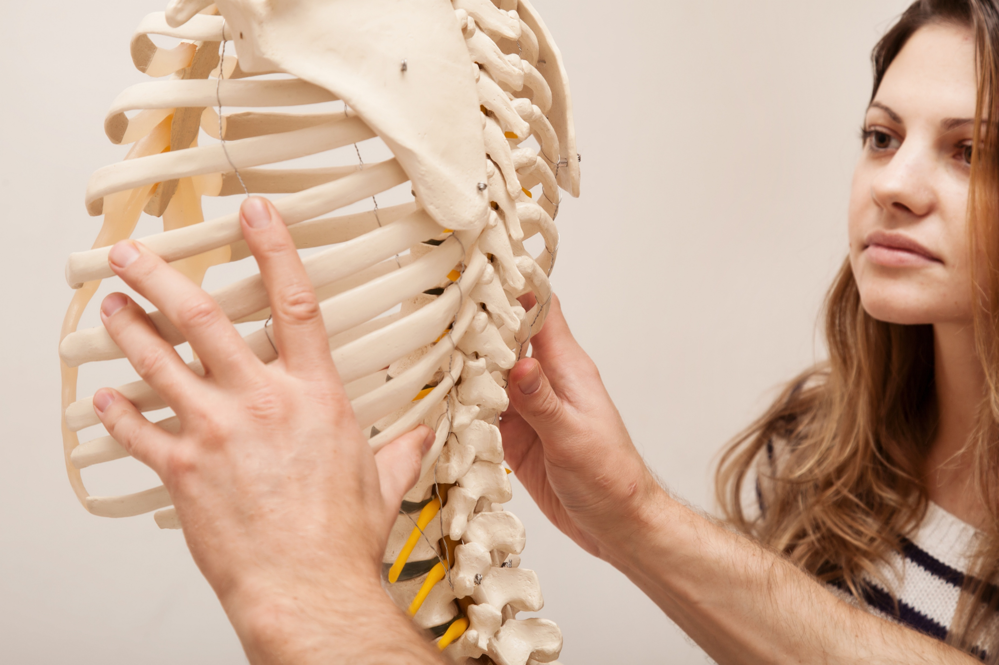
Proper Assessment
Evaluate patient
  Assess for red flags, refer if appropriate.
  Image only if necessary.
  Use baseline and serial outcome assessment tools (OATs).
  If examination warrants treatment, place on care plan.
Begin care trial
  Re-evaluate a minimum of every 12 visits.
  If patient is not progressing:
    Alter treatment
    Consider further diagnostic testing
    Refer to another provider
Discharge when appropriate
2
2
3
  Source: Topics in Integrative Health Care (2012). Algorithms for the chiropractic management of acute and chronic spine-related pain.

Slide 47
Highlights & Recommendations
Cervical spine injuries are prevalent after concussions or mild Traumatic Brain Injuries
For cervical symptoms beyond 10 days in adults or 4 weeks in children, cervical rehabilitation is recommended
Sports chiropractors are one of the recommended healthcare providers
Evidence supports chiropractic care as a safe and effective treatment for cervical spine conditions
Chiropractors should be included as part of the interprofessional team used to treat concussion and mTBI conditions
2
3

Slide 48
Interprofessional Collaboration
Notes:
The NCPA has taken and is taking steps to collaborate interprofessionly with other groups and organizations.

Slide 49
Interprofessional Collaborative Efforts
Nebraska Medical Association
APTA NE
NE Spine + Pain Center
Nebraska Hospital Association
UNMC
Creighton University
2
3

Slide 50
Goals of Interprofessional Collaboration
Focus on common goals
Work together for the betterment of patients
Develop referral relationships
Ensure patients are in the best setting for care
Education related to best evidence
2
3

Slide 51
Bibliography
Baker GA. Algorithms for the chiropractic management of acute and chronic spine-related pain. Ronald J. Farabaugh. 2012 December; 3(4).
Cade AE, Turnbull PRK. Effect of Chiropractic Intervention on Oculomotor and Attentional Visual Outcomes in Young Adults With Long-Term Mild Traumatic Brain Injury: A Randomized Controlled Trial. J Manipulative Physiol Ther. 2024 Jan-Jun;47(1-4):1-11. doi: 10.1016/j.jmpt.2024.08.003. Epub 2024 Nov 4. PubMed PMID: 39503641.
Carmichael JP, Staton EW, Blatchford PJ, Stevens-Lapsley J. EPIDEMIOLOGY of NECK INJURIES ACCOMPANYING SPORT CONCUSSIONS in YOUTH OVER a 13-YEAR PERIOD IN a COMMUNITY-BASED HEALTHCARE SYSTEM. Int J Sports Phys Ther. 2019 Jun;14(3):334-344. doi: 10.26603/ijspt20190334. PubMed PMID: 31681492; PubMed Central PMCID: PMC6816290.
Cassidy JD, Boyle E, Côté P, Hogg-Johnson S, Bondy SJ, Haldeman S. Risk of Carotid Stroke after Chiropractic Care: A Population-Based Case-Crossover Study. J Stroke Cerebrovasc Dis. 2017 Apr;26(4):842-850. doi: 10.1016/j.jstrokecerebrovasdis.2016.10.031. Epub 2016 Nov 21. PubMed PMID: 27884458.
Chaibi A, Stavem K, Russell MB. Spinal Manipulative Therapy for Acute Neck Pain: A Systematic Review and Meta-Analysis of Randomised Controlled Trials. J Clin Med. 2021 Oct 28;10(21). doi: 10.3390/jcm10215011. Review. PubMed PMID: 34768531; PubMed Central PMCID: PMC8584283.
Cheever K, McDevitt J, Phillips J, Kawata K. The Role of Cervical Symptoms in Post-concussion Management: A Systematic Review. Sports Med. 2021 Sep;51(9):1875-1891. doi: 10.1007/s40279-021-01469-y. Epub 2021 Apr 23. PubMed PMID: 33891292.
Cheever K, King J, Swan AA, Kawata K. Prevalence of Acute Neck Pain Following Sports-Related Concussion in High School Athletes. Clin J Sport Med. 2022 Nov 1;32(6):e556-e561. doi: 10.1097/JSM.0000000000001047. Epub 2022 May 20. PubMed PMID: 36315823.
2
3

Slide 52
Bibliography
Cheever KM, King J, Guan J, Gliedit J, Broglio S, Pasquina PF, Hazzard JB Jr, Clugston JR, Feigenbaum LA, Miles CM, Buckley TA, Benjamin HJ, Master C, Kontos AP, Port N, Cameron K, Mihalik JP. The interaction between neck pain and known determinates of delayed return to play among NCAA student-athletes: a CARE consortium study. Brain Inj. 2025 Dec;39(14):1262-1267. doi: 10.1080/02699052.2025.2551163. Epub 2025 Aug 27. PubMed PMID: 40873050.
Church EW, Sieg EP, Zalatimo O, Hussain NS, Glantz M, Harbaugh RE. Systematic Review and Meta-analysis of Chiropractic Care and Cervical Artery Dissection: No Evidence for Causation. Cureus. 2016 Feb 16;8(2):e498. doi: 10.7759/cureus.498. PubMed PMID: 27014532; PubMed Central PMCID: PMC4794386.
Diao Y, Liu Y, Pan J, Chen J, Pan J, Liao M, Liu H, Liao L. Efficacy and safety of spinal manipulative therapy in the management of acute neck pain: a systematic review and meta-analysis. Syst Rev. 2025 May 1;14(1):97. doi: 10.1186/s13643-025-02855-7. PubMed PMID: 40312450; PubMed Central PMCID: PMC12044948.
Ellis MJ, McDonald PJ, Olson A, Koenig J, Russell K. Cervical Spine Dysfunction Following Pediatric Sports-Related Head Trauma. J Head Trauma Rehabil. 2019 Mar/Apr;34(2):103-110. doi: 10.1097/HTR.0000000000000411. PubMed PMID: 30045221.
Kennedy E, Quinn D, Chapple C, Tumilty S. Can the Neck Contribute to Persistent Symptoms Post Concussion? A Prospective Descriptive Case Series. J Orthop Sports Phys Ther. 2019 Nov;49(11):845-854. doi: 10.2519/jospt.2019.8547. Epub 2019 Jun 1. PubMed PMID: 31154952.
Kennedy E, Quinn D, Tumilty S, Chapple CM. Clinical characteristics and outcomes of treatment of the cervical spine in patients with persistent post-concussion symptoms: A retrospective analysis. Musculoskelet Sci Pract. 2017 Jun;29:91-98. doi: 10.1016/j.msksp.2017.03.002. Epub 2017 Mar 14. PubMed PMID: 28347935.
2
3

Slide 53
Bibliography
King JA, Nelson LD, Cheever K, Brett B, Gliedt J, Szabo A, Dong H, Huber DL, Broglio SP, McAllister TW, McCrea M, Pasquina P, Feigenbaum LA, Hoy A, Mihalik JP, Duma SM, Buckley T, Kelly LA, Miles C, Goldman JT, Benjamin HJ, Master CL, Ortega J, Kontos A, Clugston JR, Cameron KL, Kaminski TW, Chrisman SP, Eckner JT, Port N, McGinty G. The Prevalence and Influence of New or Worsened Neck Pain After a Sport-Related Concussion in Collegiate Athletes: A Study From the CARE Consortium. Am J Sports Med. 2024 Jun;52(7):1845-1854. doi: 10.1177/03635465241247212. Epub 2024 May 14. PubMed PMID: 38742422.
King JA, McCrea MA, Nelson LD. Frequency of Primary Neck Pain in Mild Traumatic Brain Injury/Concussion Patients. Arch Phys Med Rehabil. 2020 Jan;101(1):89-94. doi: 10.1016/j.apmr.2019.08.471. Epub 2019 Sep 4. PubMed PMID: 31493383; PubMed Central PMCID: PMC6930963.
Kosloff TM, Elton D, Tao J, Bannister WM. Chiropractic care and the risk of vertebrobasilar stroke: results of a case-control study in U.S. commercial and Medicare Advantage populations. Chiropr Man Therap. 2015;23:19. doi: 10.1186/s12998-015-0063-x. eCollection 2015. PubMed PMID: 26085925; PubMed Central PMCID: PMC4470078.
McCrory P, Meeuwisse W, Dvořák J, Aubry M, Bailes J, Broglio S, Cantu RC, Cassidy D, Echemendia RJ, Castellani RJ, Davis GA, Ellenbogen R, Emery C, Engebretsen L, Feddermann-Demont N, Giza CC, Guskiewicz KM, Herring S, Iverson GL, Johnston KM, Kissick J, Kutcher J, Leddy JJ, Maddocks D, Makdissi M, Manley GT, McCrea M, Meehan WP, Nagahiro S, Patricios J, Putukian M, Schneider KJ, Sills A, Tator CH, Turner M, Vos PE. Consensus statement on concussion in sport-the 5(th) international conference on concussion in sport held in Berlin, October 2016. Br J Sports Med. 2017 Jun;51(11):838-847. doi: 10.1136/bjsports-2017-097699. Epub 2017 Apr 26. PubMed PMID: 28446457.
Moore J. Chiropractic management of the craniocervical junction in post-concussion syndrome: A case series. Journal of Contemporary Chiropractic. 2019 February; 2(1).
2
3

Slide 54
Bibliography
Patricios JS, Schneider KJ, Dvorak J, Ahmed OH, Blauwet C, Cantu RC, Davis GA, Echemendia RJ, Makdissi M, McNamee M, Broglio S, Emery CA, Feddermann-Demont N, Fuller GW, Giza CC, Guskiewicz KM, Hainline B, Iverson GL, Kutcher JS, Leddy JJ, Maddocks D, Manley G, McCrea M, Purcell LK, Putukian M, Sato H, Tuominen MP, Turner M, Yeates KO, Herring SA, Meeuwisse W. Consensus statement on concussion in sport: the 6th International Conference on Concussion in Sport-Amsterdam, October 2022. Br J Sports Med. 2023 Jun;57(11):695-711. doi: 10.1136/bjsports-2023-106898. PubMed PMID: 37316210.
Provance AJ, Howell DR, Potter MN, Wilson PE, D'Lauro AM, Wilson JC. Presence of Neck or Shoulder Pain Following Sport-Related Concussion Negatively Influences Recovery. J Child Neurol. 2020 Jun;35(7):456-462. doi: 10.1177/0883073820909046. Epub 2020 Mar 19. PubMed PMID: 32192408.
Pusateri ME, Hockenberry BJ, McGrew CA. Zurich to Berlin-"Where" Are We Now with the Concussion in Sport Group?. Curr Sports Med Rep. 2018 Jan;17(1):26-30. doi: 10.1249/JSR.0000000000000444. PubMed PMID: 29315106.
Schneider KJ, Meeuwisse WH, Kang J, Schneider GM, Emery CA. Preseason reports of neck pain, dizziness, and headache as risk factors for concussion in male youth ice hockey players. Clin J Sport Med. 2013 Jul;23(4):267-72. doi: 10.1097/JSM.0b013e318281f09f. PubMed PMID: 23391986.
Sutton M, Chan V, Escobar M, Mollayeva T, Hu Z, Colantonio A. Neck Injury Comorbidity in Concussion-Related Emergency Department Visits: A Population-Based Study of Sex Differences Across the Life Span. J Womens Health (Larchmt). 2019 Apr;28(4):473-482. doi: 10.1089/jwh.2018.7282. Epub 2018 Dec 28. PubMed PMID: 30592685; PubMed Central PMCID: PMC6482894.
2
3

Slide 55
Bibliography
Tiwari D, Goldberg A, Yorke A, Marchetti GF, Alsalaheen B. CHARACTERIZATION OF CERVICAL SPINE IMPAIRMENTS IN CHILDREN AND ADOLESCENTS POST-CONCUSSION. Int J Sports Phys Ther. 2019 Apr;14(2):282-295. PubMed PMID: 30997280; PubMed Central PMCID: PMC6449018.
Whalen W, Farabaugh RJ, Hawk C, Minkalis AL, Lauretti W, Crivelli LS, Wyatt L, Sheppard M, Walters SA. Best-Practice Recommendations for Chiropractic Management of Patients With Neck Pain. J Manipulative Physiol Ther. 2019 Nov;42(9):635-650. doi: 10.1016/j.jmpt.2019.08.001. Epub 2019 Dec 20. PubMed PMID: 31870638.
2
3

Slide 56
Questions?
Mark Knoll, DC
Director of Educational Outreach & Public Advocacy
mknoll@nebraskachiropractic.org | 402-677-6081
Learn more at: www.NebraskaChiropractic.org

