Slide 1


Slide 2
Back to Work, Forward with Support: Navigating Accommodations
After Brain Injury

Slide 3
Who we are:
Keri Bennett, MSEd, CBIS
Program Director for Acquired Brain Injury
Nebraska Communities
Cassy Kvasnicka
Business Account Manager
Serving Kearney, North Platte, and Surrounding Communities
Rich McFall, PHR
Business Account Manager
Serving Omaha and Surrounding Communities
Notes:
Keri start:
We we are and territory

Slide 4
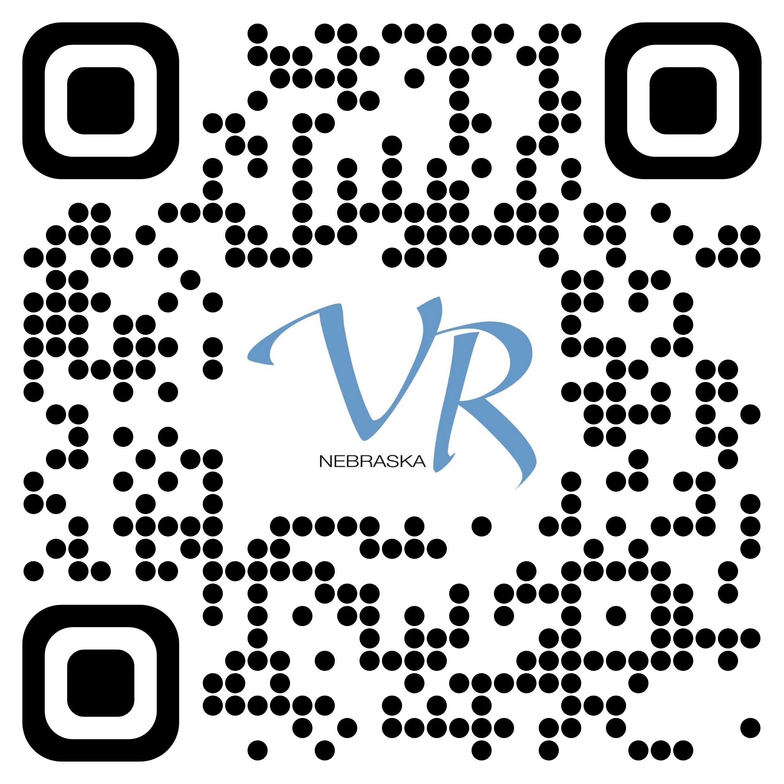
Nebraska VR: Where your future begins
We help people with disabilities prepare for, find, and keep jobs.
We also help businesses recruit, train, and retain employees with disabilities.
Learn more: https://vr.nebraska.gov/
Notes:
Keri:
Some individuals come to us with a disability they acquired at birth,
some come to us with a disability that came to them later in life.
For example, we could be working with:
a student who has an intellectual learning disability,
a veteran who has anxiety and PTSD,
or even an adult who acquired a traumatic brain injury or physical injury during a car accident.
People come to us with all levels of skill, experience, and intellect, so it is not a one-size-fits-all program.

Slide 5
Today’s Objectives
Understand the rights of individuals with brain injury under the ADA Title I in employment settings.
Identify examples of reasonable workplace accommodations and compensatory strategies for individuals returning to work after a brain injury.
Learn strategies for initiating and navigating the accommodation conversation between employer and employee.
Discover how Nebraska VR supports both individuals and businesses throughout the return-to-work process.
Notes:
Keri:

Slide 6
Understand the rights of individuals with brain injury under the ADA Title I in employment settings.
Notes:
Cassy:

Slide 7
ADA Title I
ADA Title I protects qualified individuals with disabilities from discrimination in employment.
It applies to employers with 15 or more employees, including private employers, state and local governments, and employment agencies.
Brain injury from any source can qualify as a disability if it substantially limits one or more major life activities.
Notes:
Cassy:
Protection from Discrimination and Retaliation
Employers cannot:
Refuse to hire, promote, or retain someone because of a brain injury.
Penalize an employee for requesting accommodations.
Employees are protected from retaliation for asserting their ADA rights.

Slide 8
Brain Injury as a “Non-Visible” Disability
Many effects of brain injury (memory, attention, fatigue, emotional regulation, processing speed) are not immediately obvious.
Because of this, employees may face misunderstanding or incorrect assumptions about performance or motivation.
ADA protections apply even when the disability is not visible.
Notes:
Rich / Keri

Slide 9
Who Is a “Qualified Individual”?
A person with a brain injury is considered “qualified” if they:
  Meet the skill, experience, and education requirements
  of the job, and
  Can perform the essential functions of the job, with or without reasonable accommodation.
The focus is on ability, not diagnosis.
Notes:
Cassy:
Discuss slide-
It is important to remember that the ADA is an equal opportunity law. The ADA does not promise you a job, but if you have the skills and capacity to perform the ‘essential functions’ of a job—in other words, you are ‘qualified’—then the ADA mandates that employers provide reasonable accommodations to remove barriers that interfere with your ability to perform the work.
Once you have determined the you are a Qualified Individual then you can discuss reasonable accommodations. Employees have the right to request reasonable accommodations that help them perform their job. (Transition to Keri )

Slide 10
Identify examples of reasonable workplace accommodations and compensatory strategies for individuals returning to work after a brain injury.
Notes:
Keri

Slide 11
Accommodation Versus Strategy
Accommodation
  Requires employee disclosure
  Interactive process with employer
  Typically limited to work environment and job description
Compensatory Strategy
  Personal
  Can be generalized to other environments
  Typically does not require employer involvement or permission
Notes:
Keri:
When you're thinking of making a request for accommodation from an employer, you really need to know how your brain injury impacts you, and how it might impact your performance on job tasks. That can be hard. You might need to get honest input from the people who know and care for you the most. Then you can start thinking about accommodations and compensatory strategies that will help you improve function. Most people with brain injury will benefit from a combination of strategies and accommodations to meet their individual needs.

Slide 12
Accommodations - Examples
Accessible work areas, sit/stand work area
Job restructuring or customization
Modified or flexible work schedule
Modified break schedule
Rearranged work areas
Assistive technology for physical and cognitive needs
Quiet place for ‘cognitive breaks’
Non-fluorescent or alternative lighting
Established employees; Telework, remote work
Notes:
Keri:
Reasonable accommodations fall into three categories:
Changes in the job application process when you are looking for work. These accommodations could include things like providing an alternate way to submit a job application if the online system is inaccessible or modifying the assessment techniques if nonessential aspects of a test are inaccessible (e.g., a test requires vision but measures mathematical skill).
Changes in the work environment or the way a job is typically performed after you have been hired. These accommodations could include things like changes to the facility to make them accessible, job restructuring, modified work schedules, or providing qualified American Sign Language (ASL) interpreters.
Changes that enable you to enjoy the benefits and privileges of the job like employer sponsored trainings, services (e.g., cafeterias, shuttles), company parties or social functions.

Slide 13
Compensatory Strategies - Examples
Color coded files
Task flow chart
Written instructions or ’step cards’ for various tasks
Calendar, day planner, organizer
Timer, alarm
Noise-cancelling headset or earbuds
Note-taking apps
Notes:
Keri:
Compensatory Strategies are more personal. These are tools you can typically take with you, or have at home and at work and most of them need very little training to start using them. Your smartphone is loaded with possibilities for compensatory strategies and there are countless other options on the market. You just might need help from someone with the Assistive Technology Partnership or another expert to help identify the right strategies and tools for you and your situation.

Slide 14
Questions to Consider
What specific challenge is impacting learning or daily functioning?
How does this challenge affect participation in activities and work?
Can the challenge be addressed with a compensatory strategy?
Is a formal accommodation needed to support success?
What documentation or communication is required for the accommodation?
How will you monitor whether the strategy or accommodation is effective?
Who needs to know about the support plan?
Do coworkers need training to help implement the accommodation effectively?
Notes:
Keri:
I would start by gathering as much information as possible about your specific challenges and how they impact your ability to work. Here are a few questions to help guide your exploration.
What specific challenge is impacting learning or daily functioning?
(e.g., memory, attention, fatigue, organization)
How does this challenge affect participation in class or community activities?
(Think about academic tasks, social interactions, or job readiness skills.)
Can the challenge be addressed with a classroom or personal strategy?
(Examples: visual schedules, step-by-step instructions, quiet space for breaks.)
Is a formal accommodation needed to support success?
(Examples: extended time, modified assignments, assistive technology.)
What documentation or communication is required for the accommodation?
(IEP, 504 Plan, or employer communication for transition planning.)
How will you monitor whether the strategy or accommodation is effective?
(Regular check-ins, observation, feedback from the individual.)
Who needs to know about the support plan?
(Teachers, paraprofessionals, family, or employer during transition.)
Do staff need training to implement the accommodation effectively?
(Consider professional development or coaching for consistency.)

Slide 15
Learn strategies for initiating and navigating the accommodation conversation between employer and employee.
Notes:
Rich

Slide 16
Accommodation Conversations Matter
Accommodations are tools for success, not special treatment.
For individuals with brain injury, needs may be invisible, evolving, or misunderstood.
Early, open conversations reduce misunderstandings, performance issues, and turnover.
When done well, accommodations benefit both the employee and the employer.
Notes:
Rich

Slide 17
Common Barriers to the Conversation
Fear of stigma or being viewed as “less capable”.
Uncertainty about when or how much to disclose.
You may not see how your condition is affecting your work performance.
Employers’ lack of understanding about brain injury.
Changes in symptoms over time (fatigue, memory, processing speed, emotional regulation).
Notes:
Rich:

Slide 18
Understanding Rights & Responsibilities
Employees have the right to request reasonable accommodations under the ADA.
Employers are responsible for engaging in the interactive process.
Disclosure does not require sharing a diagnosis—only functional limitations.
Focus should always be on job-related needs and performance.
Notes:
Cassy:
The Interactive Process
ADA requires an interactive process—a collaborative conversation between employer and employee.
The goal is to identify effective accommodations, not to “prove” disability.
Medical documentation may be requested, but only when it is job-related and consistent with business necessity.

Slide 19
Preparing for the Accommodation Conversation (Employee Perspective)
Identify specific job tasks that are challenging.
Connect challenges to functional needs, not medical details.
Come prepared with possible solutions, not just problems.
Practice the conversation to build confidence.
Example:
“I’m having difficulty prioritizing tasks when interruptions occur. A written task list and/or scheduled check-ins would help me stay productive.”
Notes:
Rich:

Slide 20
Initiating the Conversation
Prepare and practice
Choose the right person (supervisor, HR, disability coordinator)
Pick an appropriate time—private, calm, and proactive
Use strengths-based language
Keep the focus on job performance and outcomes
Key message:
“I want to do my job well, and this support would help me succeed.”
Notes:
Rich:
Prepare and practice
If working with VR, discuss with your counselor or other trusted person
Come solution focused with suggestions

Slide 21
Navigating Challenges and Resistance
Reframe accommodations as productivity supports
Emphasize low-cost, high-impact solutions
Ask for a trial period to test accommodations
Revisit the conversation as needs change
Key reminder:
Accommodations are not “one and done”—they are an ongoing dialogue.
Notes:
Rich:
Make sure to note Employers cannot:
Refuse to hire, promote, or retain someone because of a brain injury or a disability
Penalize an employee for requesting accommodations.
Employees are protected from retaliation for asserting their ADA rights.

Slide 22

Workplace Accommodation Toolkit
The Toolkit provides guidance and resources for developing or updating accommodation policies and processes while leveraging best and emerging practices for creating an inclusive workplace and accommodating people with disabilities during all phases of the employment life cycle.
Recruiters and Hiring Managers
Supervisors and Managers
Information Technology Team
Employees with Disabilities and their Allies
Learn more: https://askjan.org
Notes:
Rich:
Don’t skip your HR, start there – then reach out to JAN if necessary.
Timing and amount shared can make a huge impact on results
We recommend avoiding AI (LLM) for research or asking for assistance

Slide 23
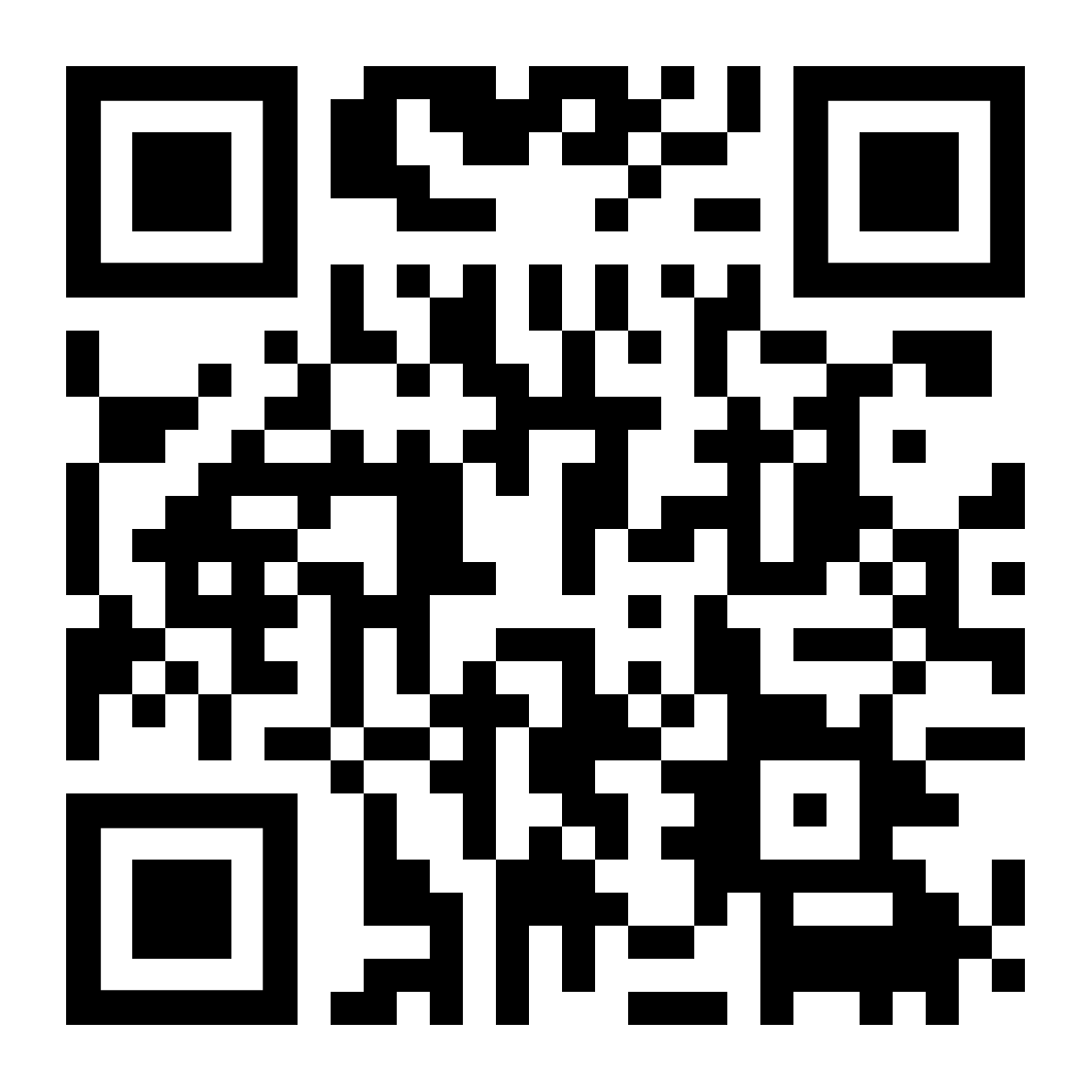
Requesting Reasonable Accommodations in Employment: A Decision Support Aid
  Guides you through the process of requesting a reasonable accommodation when applying, interviewing, or maintaining employment.
Learn more: https://accommodations.uwctds.uw.edu
Notes:
Keri:
The Decision Support Aid was developed under a grant from the National Institute on Disability, Independent Living, and Rehabilitation Research (NIDILRR). It is free to use, but you must create an account. It guides the user through several learning and reflection opportunities to help you consider whether you may have a disability that meets the Americans with Disabilities Act (ADA) disability definition, walks the user through writing a statement about their disability using ADA language, explains essential functions definition and essential duties for specific job tasks. It even helps you reflect on any risks associated with disability disclosure and much more. It's very user-friendly and would be a good tool for individuals and their support team to work on together.
Grant Disclaimer
The content of this website was developed under a grant from the National Institute on Disability, Independent Living, and Rehabilitation Research (NIDILRR grant number 90RTEM0001). NIDILRR is a Center within the Administration for Community Living (ACL), Department of Health and Human Services (HHS). The contents of this website do not necessarily represent the policy of NIDILRR, ACL, HHS, and you should not assume endorsement by the Federal Government.

Slide 24
Discover how Nebraska VR supports both individuals and businesses throughout the return-to-work process.
Notes:
Rich

Slide 25
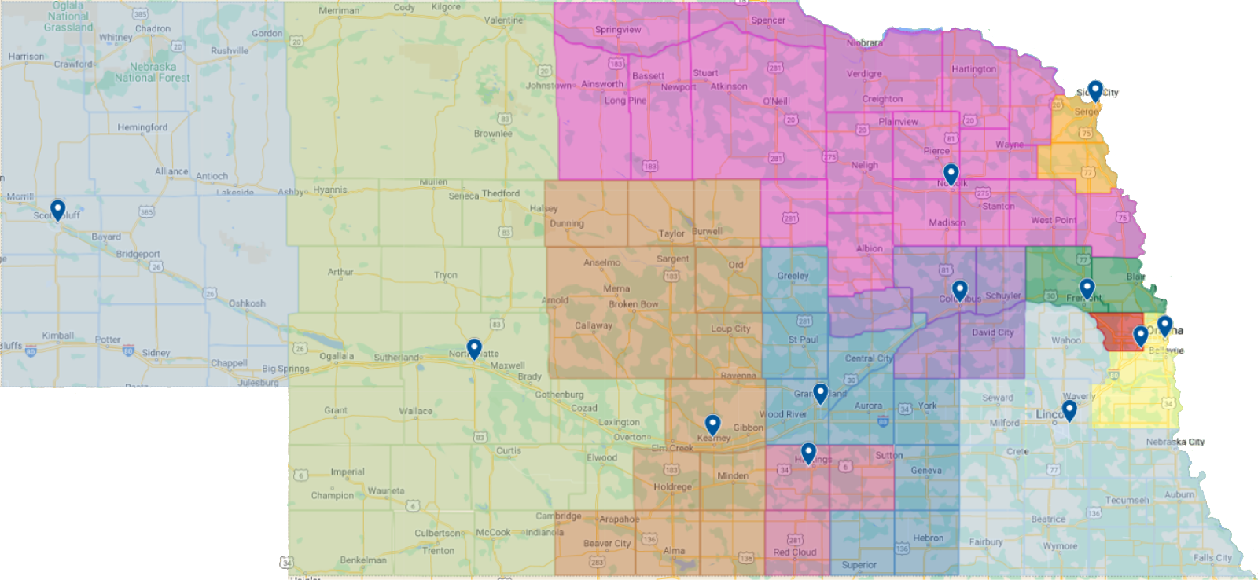
Nebraska VR: Service Offices
Columbus
Fremont
Grand Island
Hastings
Kearney
Lincoln
Norfolk
North Platte
Omaha
Omaha West
Scottsbluff
Office locator: https://vr.nebraska.gov/offices
Notes:
Rich

Slide 26
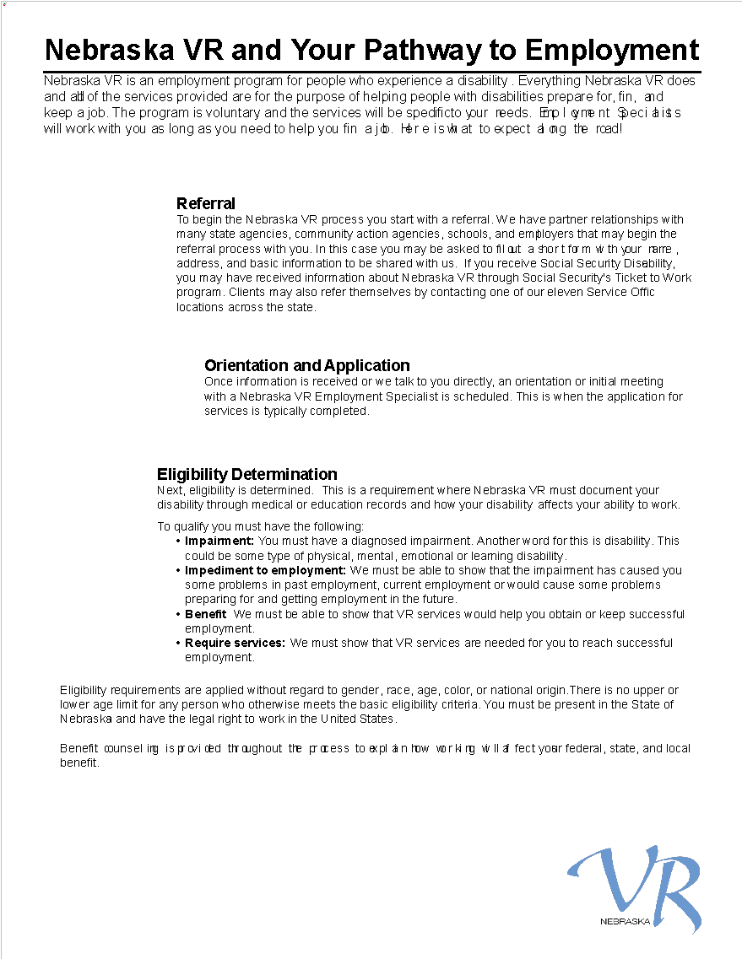
VR Pathway to Employment
Referral
Orientation and Application
Eligibility
  Impairment
  Impediment to employment
  Benefit
  Require Services
Notes:
Rich:
Nebraska VR and Your Pathway to Employment
Nebraska VR is an employment program for people who experience a disability. Everything Nebraska VR does and all of the services provided are for the purpose of helping people with disabilities prepare for, find, and keep a job. The program is voluntary and the services will be specific to your needs. Employment Specialists will work with you as long as you need to help you find a job. Here is what to expect along the road!
Referral
To begin the Nebraska VR process you start with a referral. We have partner relationships with many state agencies, community action agencies, schools, and employers that may begin the referral process with you. In this case you may be asked to fill out a short form with your name, address, and basic information to be shared with us. If you receive Social Security Disability, you may have received information about Nebraska VR through Social Security's Ticket to Work program. Clients may also refer themselves by contacting one of our eleven Service Office locations across the state.
Orientation and Application
Once information is received or we talk to you directly, an orientation or initial meeting with a Nebraska VR Employment Specialist is scheduled. This is when the application for services is typically completed.
Eligibility Determination
Next, eligibility is determined. This is a requirement where Nebraska VR must document your disability through medical or education records and how your disability affects your ability to work.
To qualify you must have the following:
Impairment: You must have a diagnosed impairment. Another word for this is disability. This could be some type of physical, mental, emotional or learning disability.
Impediment to employment: We must be able to show that the impairment has caused you some problems in past employment, current employment or would cause some problems preparing for and getting employment in the future.
Benefit: We must be able to show that VR services would help you obtain or keep successful employment.
Require services: We must show that VR services are needed for you to reach successful employment.
Eligibility requirements are applied without regard to gender, race, age, color, or national origin. There is no upper or lower age limit for any person who otherwise meets the basic eligibility criteria. You must be present in the State of Nebraska and have the legal right to work in the United States.
Benefits counseling is provided throughout the process to explain how working will affect your federal, state, and local benefits.
Individualized Plan for Employment (IPE)
After you have been determined eligible for VR services, your Employment Specialist will help you develop an individualized plan for employment or IPE.
The IPE includes:
Your job goal.
When you expect to reach it.
All the services you need to reach your job goal.
Who will provide those services.
Please know we encourage and expect your involvement in the planning process. We want to help you make informed decisions about your goals and the best way for you to achieve them.
Participate in Planned Services to Prepare for a Job
The goal of the services identified in your IPE is to prepare you for success in employment. Some services will be provided by your Employment Specialist. Other services may be provided by community partners.
Examples of Nebraska VR services include:
Evaluation to determine job skills and interests through a variety of worksite experience such as job shadows or business tours
Vocational counseling and help in setting a job goal
Assistance with training or education if needed to obtain a job
Supported employment
Help with job seeking and job interview skills
Special equipment or technology that may help you keep a job
Working with employers to find a job match for your skills
Connections with other community resources
Regular communication with Nebraska VR staff members, keeping appointments, and follow through with your responsibilities is also important. This will help us both to stay on track to help you find or keep a job.
Employment
Once you are ready to work, your Employment Specialist will help identify job openings matching your job goal. They will work with you in completing applications, creating resumes, interviewing, and advocating. Changes to the job site or assistive devices to be successful on the job will be addressed once you are hired.
After Employment
After you are hired and have worked for at least 90 days, you and your Employment Specialist will discuss successful closure of your case. Once your case is closed, if you run into any bumps on the job in the future, be sure to notify your Employment Specialist so issues can be addressed with you or your employer. A simple solution may be all that is needed to help you be successful.
Informed Choice
You have the right to take part in any decisions about your job goal, services, and service providers.
For more information or to find a Service Office, go to http://www.vr.nebraska.gov
Nebraska VR - Where your future begins
Nebraska VR and Your Pathway to Employment: English / Spanish

Slide 27
You may be eligible if you experience one or more of the following:
Issues with lifting, carrying, standing, sitting or using arms, hands or fingers
Problems relating to co-workers, customers or supervisors
Difficulty problem solving or communicating with team members
Difficulty learning work skills or learning in a classroom
Seeing a counselor for therapy and/or medication
Trouble with organization or forgetting meetings
Receive treatment for chemical dependency
Experiences emotional or physical pain
Difficulty maintaining or keeping a job
Problems with hearing
Receives SSI or SSDI
Notes:
Rich:

Slide 28
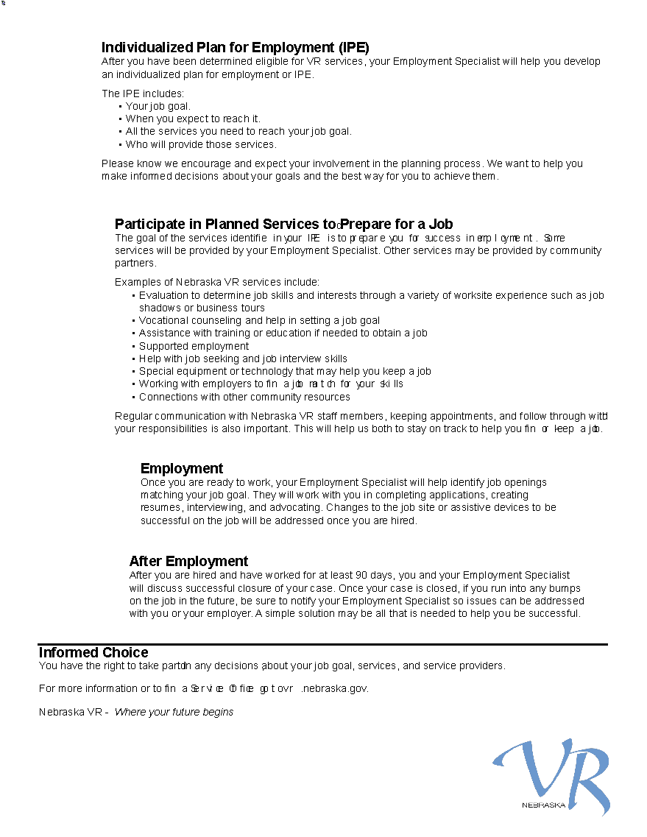
VR Pathway to Employment – Page 2
Individualized Plan for Employment (IPE)
Participate in Planned Services to Prepare for a Job
Employment
After Employment
Notes:
Rich:
Individualized Plan for Employment (IPE)
After you have been determined eligible for VR services, your Employment Specialist will help you develop an individualized plan for employment or IPE.
The IPE includes:
Your job goal.
When you expect to reach it.
All the services you need to reach your job goal.
Who will provide those services.
Please know we encourage and expect your involvement in the planning process. We want to help you make informed decisions about your goals and the best way for you to achieve them.
Participate in Planned Services to Prepare for a Job
The goal of the services identified in your IPE is to prepare you for success in employment. Some services will be provided by your Employment Specialist. Other services may be provided by community partners.
Examples of Nebraska VR services include:
Evaluation to determine job skills and interests through a variety of worksite experience such as job shadows or business tours
Vocational counseling and help in setting a job goal
Assistance with training or education if needed to obtain a job
Supported employment
Help with job seeking and job interview skills
Special equipment or technology that may help you keep a job
Working with employers to find a job match for your skills
Connections with other community resources
Regular communication with Nebraska VR staff members, keeping appointments, and follow through with your responsibilities is also important. This will help us both to stay on track to help you find or keep a job.
Employment
Once you are ready to work, your Employment Specialist will help identify job openings matching your job goal. They will work with you in completing applications, creating resumes, interviewing, and advocating. Changes to the job site or assistive devices to be successful on the job will be addressed once you are hired.
After Employment
After you are hired and have worked for at least 90 days, you and your Employment Specialist will discuss successful closure of your case. Once your case is closed, if you run into any bumps on the job in the future, be sure to notify your Employment Specialist so issues can be addressed with you or your employer. A simple solution may be all that is needed to help you be successful.
Informed Choice
You have the right to take part in any decisions about your job goal, services, and service providers.
For more information or to find a Service Office, go to http://www.vr.nebraska.gov
Nebraska VR - Where your future begins
Nebraska VR and Your Pathway to Employment: English / Spanish

Slide 29

Dual-Customer Approach
Help people with disabilities gain or retain employment
To help businesses find skilled, qualified individuals to fill their vacancies
Notes:
Cassy:

Slide 30

Job Matching and Retention
Matching qualified candidates with quality businesses.
Discover the needs of the business
Provide referrals for qualified candidates
Provide follow-up visits
Provide job coaches
Assist with worksite accommodations
Notes:
Cassy:

Slide 31
Uncertainties from Some Employers:
Increased supervisor workload
Uncertainty about training
Productivity concerns
Not knowing how benefits work for jobseekers
Not knowing where to get help
Notes:
Cassy & Team:
Ways to overcome these uncertainties
Ensure the business partner is aware of Nebraska VR

Slide 32

Questions?

Slide 33

Keri Bennett, MSEd, CBIS
Program Director for Acquired Brain Injury
Nebraska VR
Nebraska Department of Education
keri.bennett@nebraska.gov
(308) 224-7571

