Slide 1


Slide 2

Medicaid
Home and Community-Based Services (HCBS) Waiver Updates
March 19, 2026
Presented at the Nebraska Brain Injury Conference by the Division of Developmental Disabilities
Home and Community-Based Services

Slide 3
Overview of Proposed Changes to the Aged and Disabled (AD) and Traumatic Brain Injury (TBI) Waivers
Notes:
Changes may change based on public comments received.

Slide 4
Appendix C: Participant Services (1 of 4)
Generalized Updates to All Services
Updated TBI Waiver to better align with AD Waiver and CMS expectations.
Updated language to note that services may not overlap with hours set by the local school district.
Revised Service Specifications for the Following Services
Personal Care and LRI (Legally Responsible Individual) Personal Care are for needs identified by the Service Needs Assessment/SNA (Personal Care) and the Extraordinary Care Tool (LRI Personal Care).
Notes:
$92,438 x 150% = $138,657

Slide 5
Appendix C: Participant Services (2 of 4)
  Revised Service Specifications for the Following Services
Extra Care for Children with Disabilities (AD Only)
  Added a cap of 50 hours per week to the service.
  Licensed Practical Nurses (LPNs), Registered Nurses (RNs), Advanced Practice Registered Nurses (APRNs), and Certified Nursing Assistants (CNAs) are not guaranteed for service delivery, though some agencies may employ them.
Respite Care
  Expanded the definition to provide clarity and allow providers to provide respite across more than one waiver.
  Added a daily rate for out-of-home respite.
Independence Skills Building
  Limited to adults focusing on rehabilitative training of ADLs, IADLs, and home management skills and 16- and 17-year-olds, when it does not duplicate.
  May be authorized independently or in groups.
Notes:
Remote Supports and Health Maintenance Monitoring cannot be authorized for individuals with Residential Habilitation.
Transition Residential Habilitation
Shared living-Limitation on placements after July 1, 2025 of individuals under age 19
Continuous Home-Limitation on placements after July 1, 2025 of individuals under age 19
Host Home-Limitations on placement after July 1, 2025 of individuals under age 19
Youth Continuous Home-Limitation on placement of individuals over age 19.

Slide 6
Appendix C: Participant Services (3 of 4)
  Revised Service Specifications for the Following Services
Chore
  Updated and reorganized to provide support in five primary areas:
    Minor Home Repair,
    Pest Control,
    Mowing and Site Clearance,
    Snow and Ice Removal, and
    Heavy Cleaning.
  Annual cap of $3,500 per year.
Assistive Technology
  Changed the annual cap for assistive technology from $2,500 to $10,000 in a five-year period, with a maximum of $20,000 with DDD Central Office approval.
Assisted Living Service, now Supported Residential Living (AD)
  Available only through Assisted Living Facility certified providers.

Slide 7
Appendix C: Participant Services (4 of 4)
New Service Limitation on the amount of services (C-4).
Participants shall be limited to no more than 150% of the average NF institutional costs for home and community-based services only. Exceptions may be approved by DDD Clinical Team beyond this limit, if the participant’s need for personal care services provided by out-of-home caretakers exceeds the 150% service limit and is necessary to support the participant’s immediate health and safety needs.
In explanation, the modified cap will allow participants to access up to $138,657 of waiver services, including personal care services when supported by the SNA, prior to an Exception Review, which could allow additional spending to support a participant’s immediate health and safety needs when utilizing out-of-home caretakers to live independently.
Notes:
$92,438 x 150% = $138,657

Slide 8
Exception Review
Participants, living independently, may apply, and be approved for, an exception to the 150% Institutional Cost Limit on services to meet their immediate health and safety needs and allow them to continue to live independently.
These exceptions, submitted by the Service Coordinator, to the DDD Clinical Team, in DDD Central Office will review the exception based on service needs, level of care assessment, and medical diagnosis to determine the appropriateness of the exception.
The DDD Clinical Team includes RNs, BCBAs, and Psychologists.
Notes:
$92,438 x 150% = $138,657

Slide 9
Appendix C: Participant Services – New Provider Types
Direct Care Provider
  Can offer: Personal Care, Respite Care, Companion, LRI Personal Care, and Independence Skills Building.
  Required certification in CPR, Basic First Aid, and Abuse/Neglect/Exploitation Training.
Non-Care Provider
  Can offer: Chore and Home Again.
  No personal care or hands-on assistance may be provided.
  Must have the qualifications, experience, and abilities necessary to carry out services.
Community Respite Provider
  Can offer: Respite.
  Community organizations, such as religious organizations, gyms/studios, and creative organizations which provide respite, not as their primary business.
Other Providers Consolidated
  Agency PERS, specialized equipment, suppliers, and home repair companies combined.
  Certified Commercial Carrier/Common Carrier and PSC Exempt Provider combined.
Notes:
A week is defined as 12:00 a.m. Monday through 11:59 p.m. Sunday.

Slide 10
Appendix D: Participant-Centered Planning and Service Delivery
For the AD and TBI Waivers
Removed Registered Nurse from responsibility for service plan development.
Updated HCBS Settings Requirements for Service Plans.
Updated language to reflect that relevant service providers are included in the development of the person-centered plan (PCP) and must attend the PCP meeting.
Notes:
Bachelor’s Degree in a human behavioral sciences field such as human services, social work, psychology, education, sociology, or a related field; OR four years equivalent experience in services or programs for persons with intellectual or other developmental disabilities, long-term care, gerontology, rehabilitation, health/disability case management, children with special health care needs, health/medical, education, psychology, social work, sociology, human services, or a related field; and
Knowledge of: current practices in the field of community-based services for persons with intellectual disabilities and other developmental disabilities; person-centered planning; Americans with Disability Act (ADA) standards; self-direction; community integration; the principles of social role valorization; provision of habilitation services; positive behavioral supports; and, statutes and regulations pertaining to delivery of services for participants; and
Knowledge of: program resources/services available in Nebraska for persons with intellectual and other developmental disabilities; the objectives, philosophies, and functions of the Division of Developmental Disabilities (DDD); regulations governing the authorization, delivery of, and payment of community-based developmental disabilities services; Department of Education regulations; Vocational Rehabilitation services; State statutes regarding persons with disabilities; and DHHS programs, such as Protection and Safety and economic assistance programs; and
Ability to: mobilize resources to meet participant needs; communicate effectively to exchange information; develop working relationships with participants, their families, interdisciplinary team members, agency representatives, independent providers, and advocates or advocacy groups; analyze behavioral and habilitative data; monitor services and supports provided; apply Department of Health and Human Services (DHHS) program rules, policies, and procedures; and organize, evaluate and address program/operational data.

Slide 11
Overview of Proposed Changes to the Developmental Disabilities Comprehensive (CDD) and Adult Day (DDAD) Waivers
Notes:
Changes may change based on public comments received.

Slide 12
Appendix B: Participant Access and Eligibility
Updated assessment process language for evaluation and reevaluation of Level of Care (LOC):
The process for ICF/IID LOC evaluation includes an assessment and observation with the participant, and when needed the guardian or an individual with knowledge of the individual's functioning. All LOC evaluations and reevaluations are completed by DDD personnel in the Eligibility and Enrollment Unit (E&E). Documentation, such as the Person-Centered Plan (PCP), behavioral or medical service tracking, GERs, and Medicaid Eligibility maybe used to validate responses during interRAI assessment. The assessment must be held prior to the participant's waiver budget year.
No changes are being made to the process; language is being updated to better reflect the needs of our participants.

Slide 13
Appendix C: Participant Services
Removed the Consultative Assessment service.
Revised the requirement for semi-annual meetings to annual meetings.
Appendix G: Participant Safeguards
Updated process related to PRN psychotropic medication use when participant is on hospice.
Updated Behavior Support Plan (BSP) requirements to only require Functional Behavior Assessments (FBA) when a
participant is on Risk Tier.

Slide 14
Functional Behavioral Assessment Resources
Functional Behavior Assessments (FBA) are covered by Medicaid as Applied Behavior Analysis (ABA) Assessments and available through all three Managed Care Organizations (MCOs):
  Nebraska Total Care,
  Molina Healthcare, and
  United Healthcare.
Providers offering FBA services are encouraged to credential through the MCOs in order to continue providing FBA services to participants.

Slide 15
Waiver Timeline
DDD drafts changes to the waiver.
DONE
Public Comment Period
DONE
DDD considers comments and edits waivers.
IN PROGRESS
DDD submits to CMS.
Planned implementation date.
July 2026

Slide 16
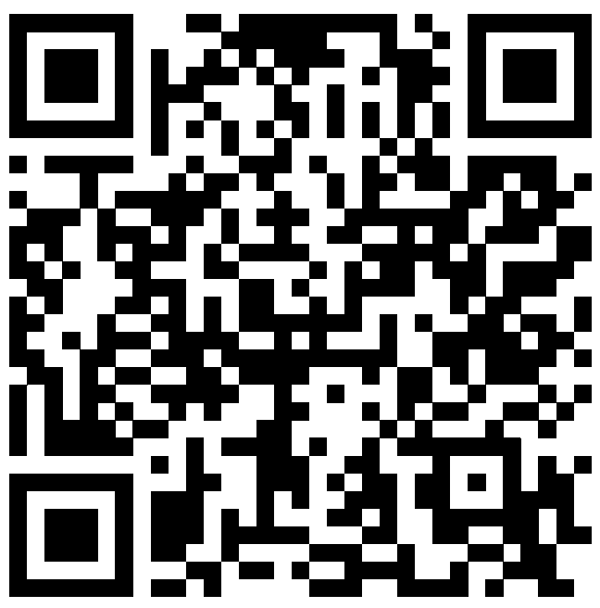
Resources
Public Comment information, including copies of HCBS waiver applications, is on the DDD website:
  https://dhhs.ne.gov/Pages/DD-Public-Comment.aspx
The Division has developed Tips for Submitting Effective Comments to support the public in submitting comments.

Slide 17
Questions
Notes:
Changes may change based on public comments received.

Slide 18
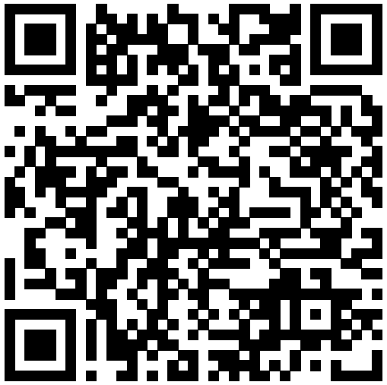


DDD Contact
Presenter
Colin Large
DHHS Policy Administrator II
Colin.Large@nebraska.gov
Request 1:1
General Information
DHHS.DDDCommunityBasedServices@nebraska.gov
(877) 667-6266
Notes:
I’ll leave you with ways to contact us.
The QR code in the green box is going to be that Resources page with our publications.
The QR code in the yellow box is going to be a form to request a 1:1 meeting/conversation.
This will take you to a form where you will enter information about your specific question/situation. You will then receive a call or email, based on what you entered, from someone who works in the area of your question, such as Eligibility or Service Coordination. That person will set up a time with you to talk 1:1 about your situation.
You are welcome to call our toll-free number, but with everyone having cell phones now, transferring calls doesn’t work quite like it used to. If you know who you’re trying to reach, the person answering can give you that person’s number.
The emails on the screen are another way to have your inquiry directed to the correct people.

