Slide 1


Slide 2
Practical Strategies and Smart Device Integration for Executive Function
Michelle Ranae Wild, M.A.
Brain Education Strategies & Technology (BEST)

Slide 3
Speaker Disclosure
Michelle Ranae Wild is the founder and CEO of Brain Education Strategies & Technology (BEST) a 501(c)(3) nonprofit organization. She does not take a salary from BEST.

Slide 4
Executive Functioning

Slide 5
Executive Function Defined
Executive function skills are the mental processes that enable us to plan, focus attention, remember, and juggle multiple tasks.¹
1.https://developingchild.harvard.edu/science/key-concepts/executive-function/

Slide 6
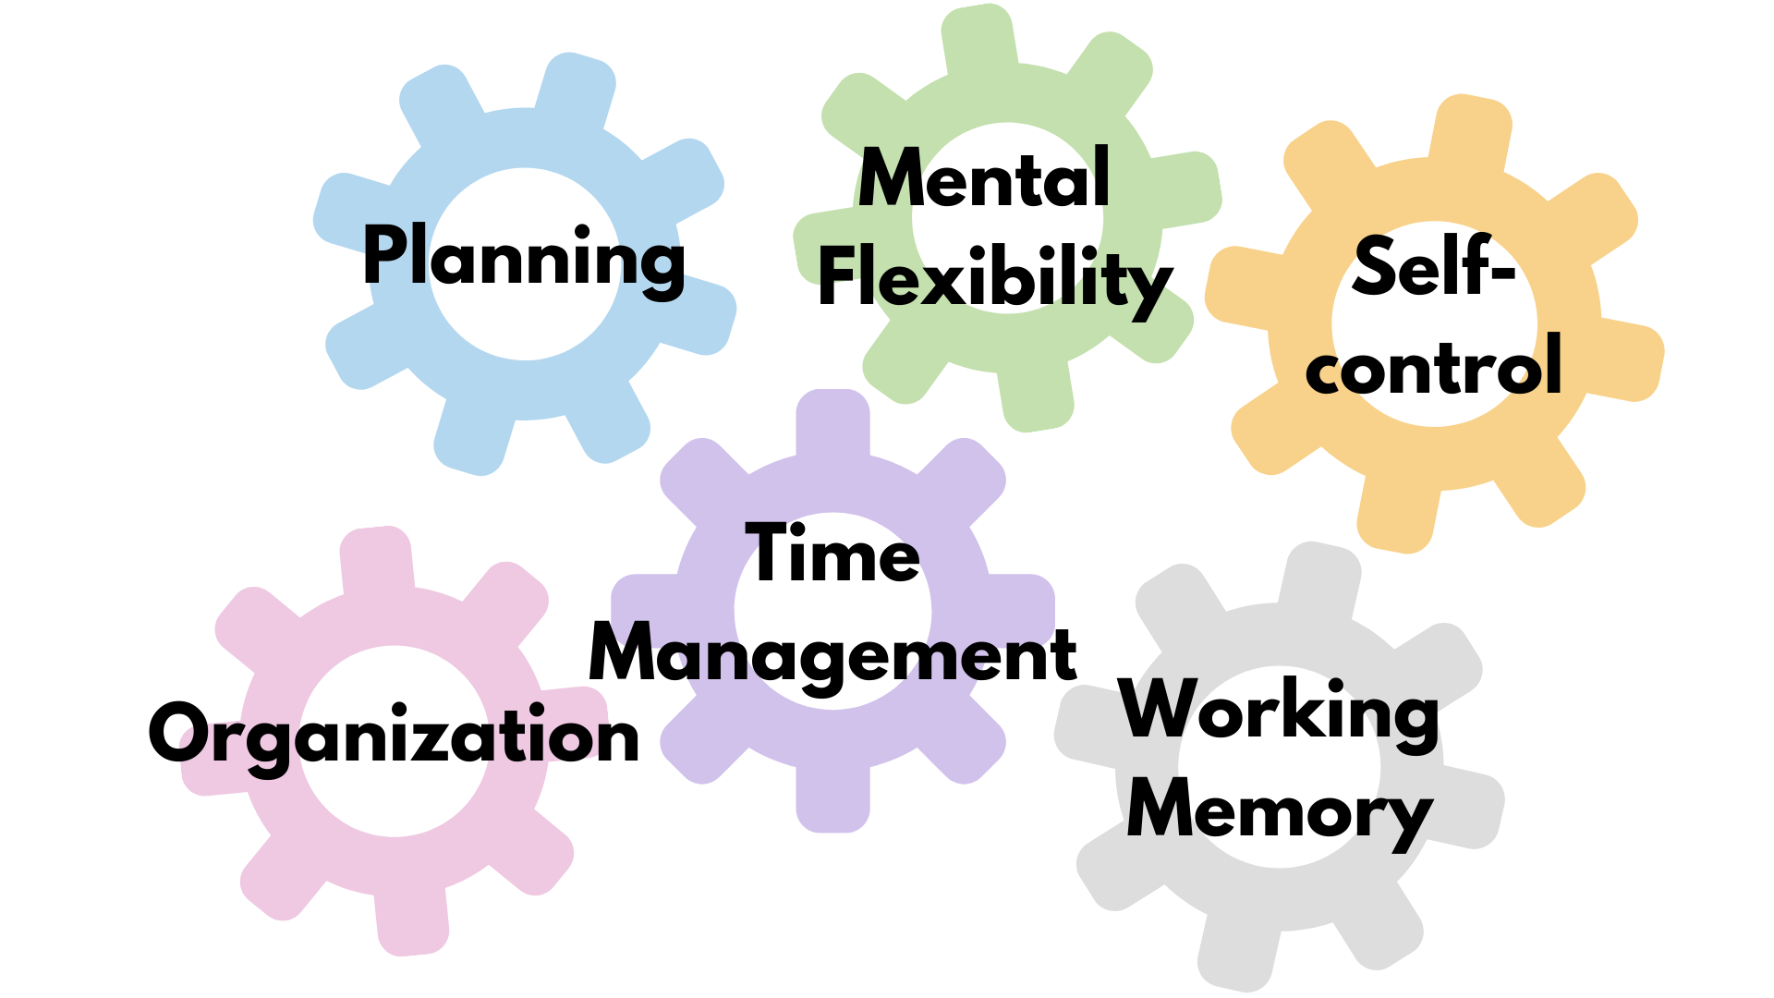
Executive Function Skills

Slide 7
Smartphones

Slide 8
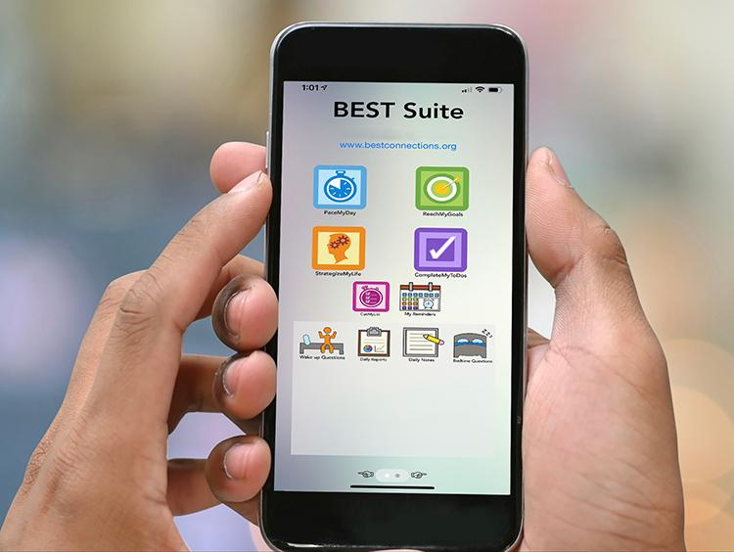
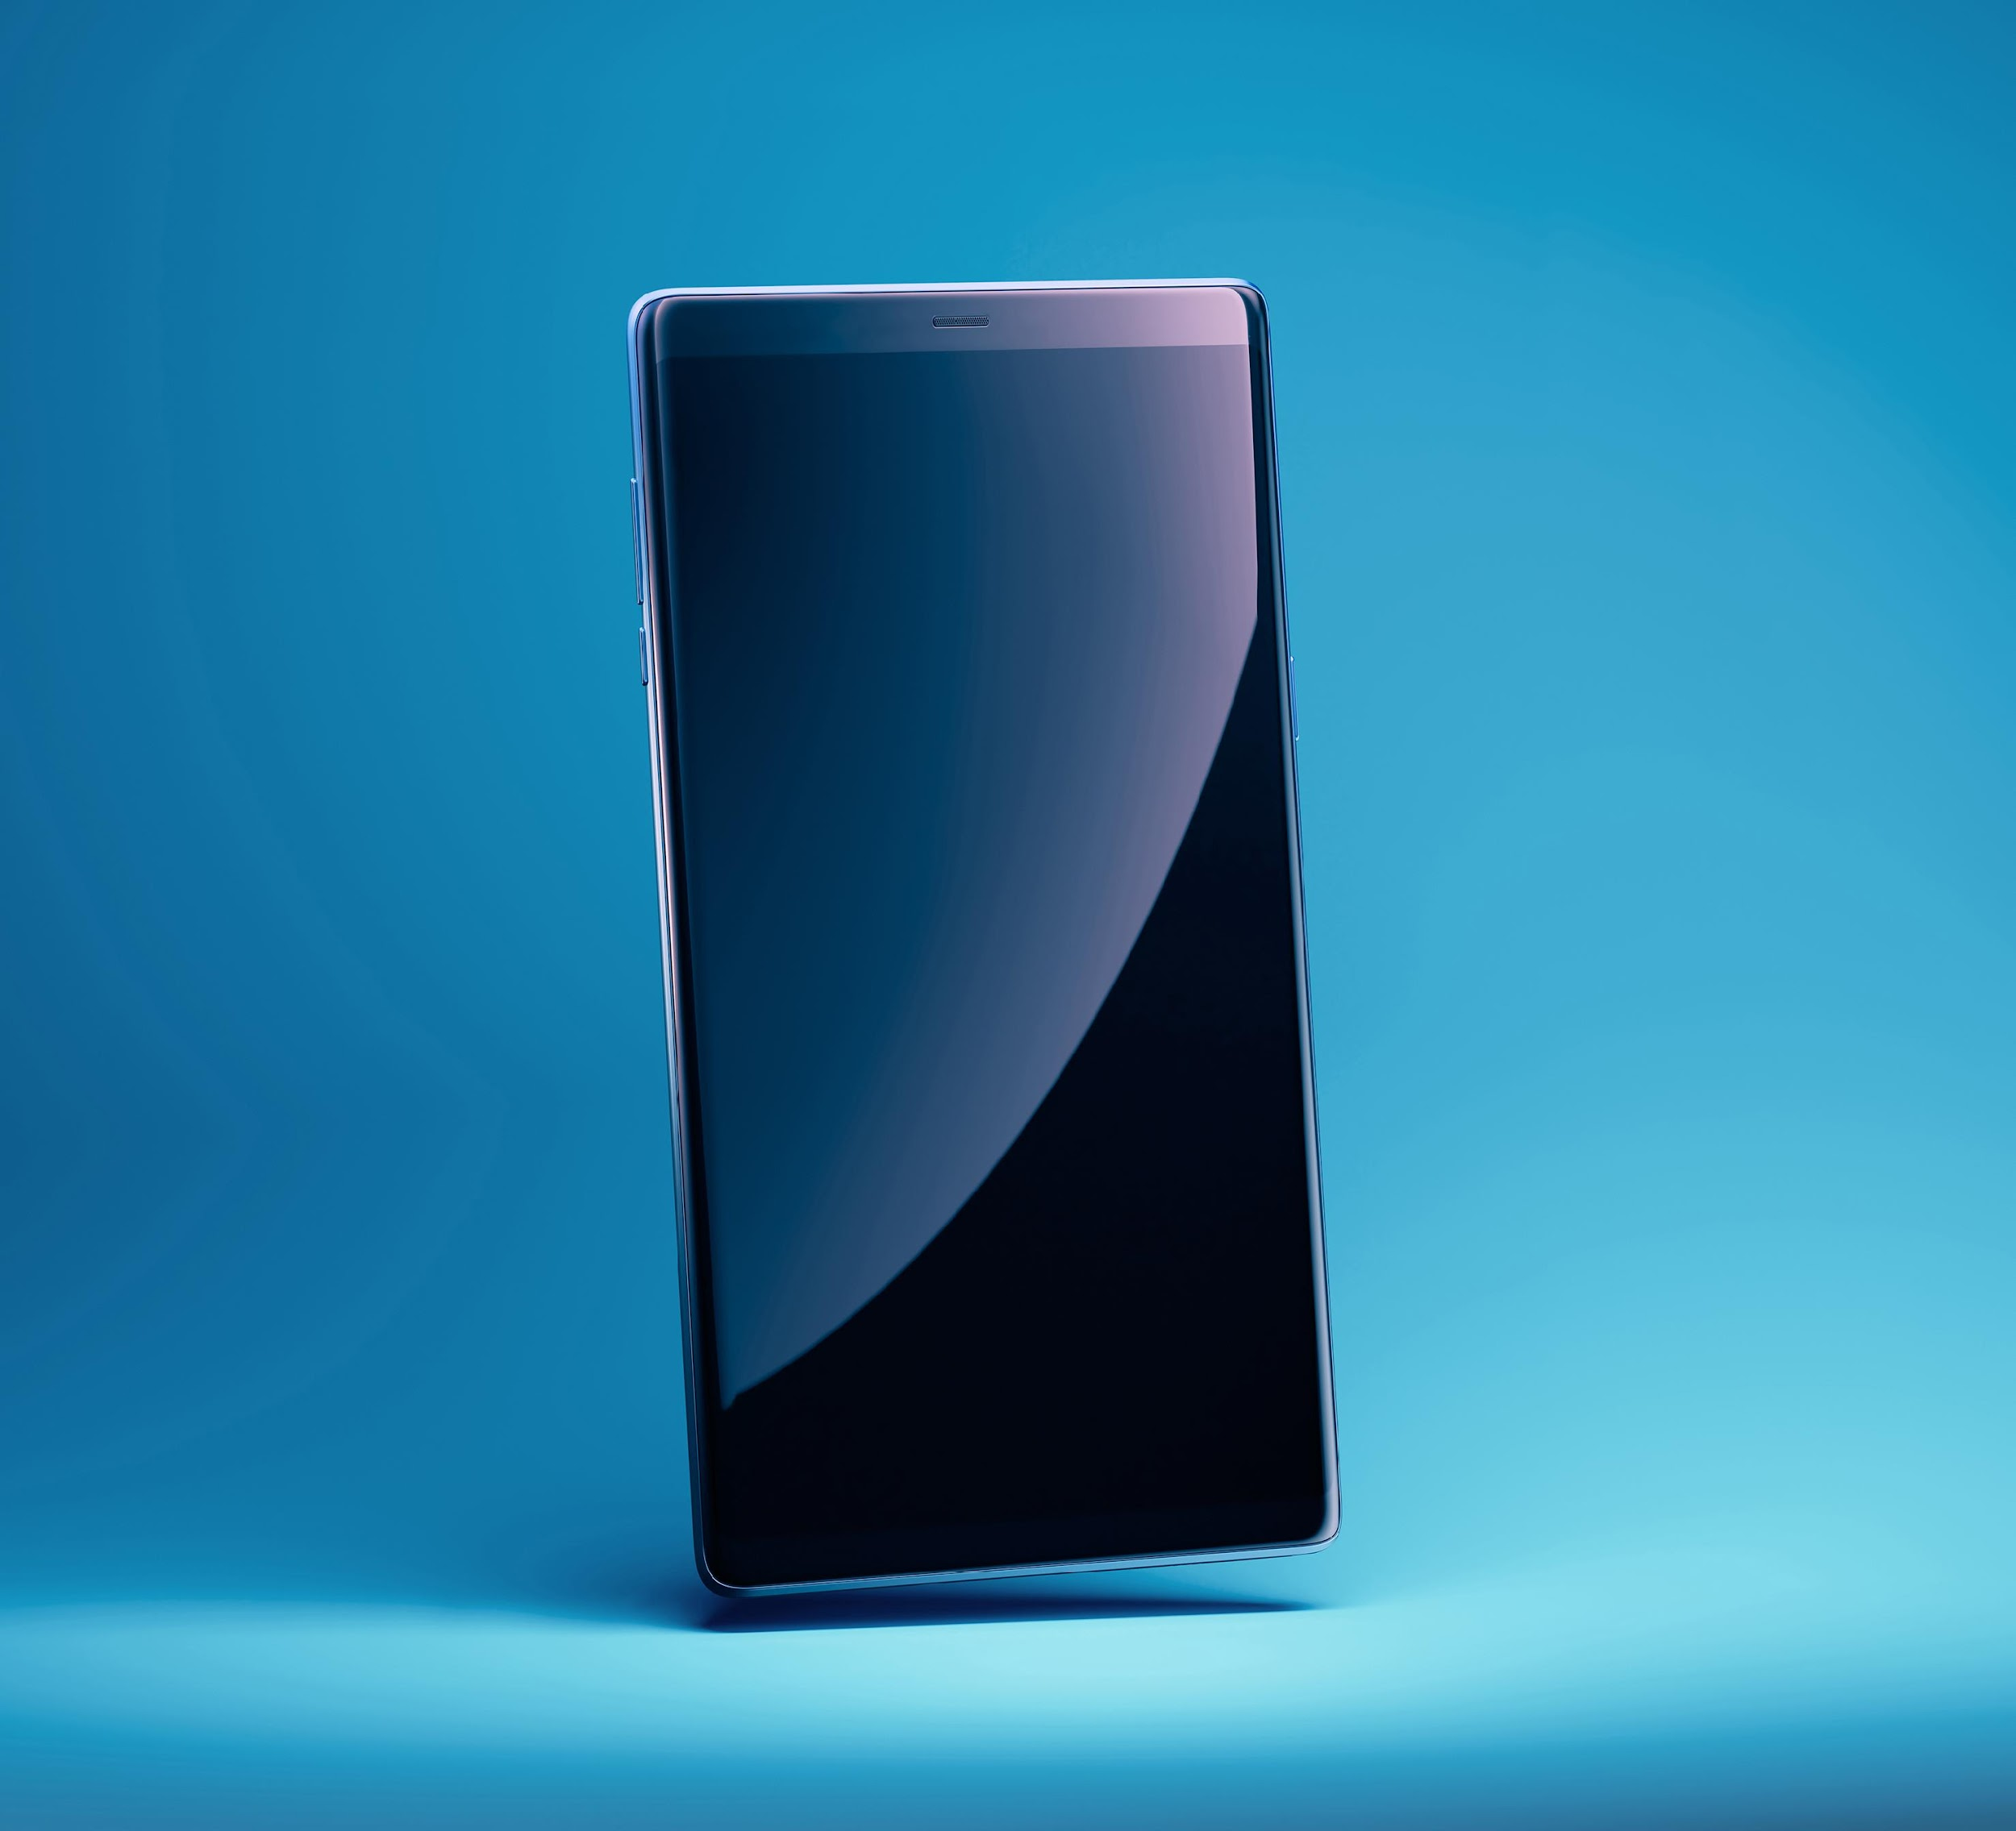
iPhone vs. Android

Slide 9

Chat & Questions (1)

Slide 10

Practical Cognitive Retraining
Notes:
Two concepts of scaffolding: 1) teach concept then step back to allow students to practice independently, 2) establish a framework for learning then build on that framework. Demonstrate, practice together, do alone.

Slide 11
Making Cognitive Connections®
An educational-based approach to help brain injury survivors identify and understand the cognitive skills impacted by brain injury, the relationships among those skills, and how their insights about the relationships can improve their cognitive function and skills development.

Slide 12
Chat & Questions (2)

Slide 13
Smart Device Accessibility

Slide 14
Accessibility Settings (1)
Appearance
Brightness
Night Shift
Auto-Lock
Zoom

Slide 15
Accessibility Settings (2)
Display & Text Size
Contrast
Color Filters
Spoken Content

Slide 16
Chat & Questions (3)

Slide 17
Focus

Slide 18
Focus Feature
Focus eliminates device-related distractions such as notifications and calls
Focus can be set for different activities
Focus can be set to allow certain calls or notifications to get through
To access Focus: Settings > Focus
To start Focus: Open Control Center > Focus > desired focus option

Slide 19
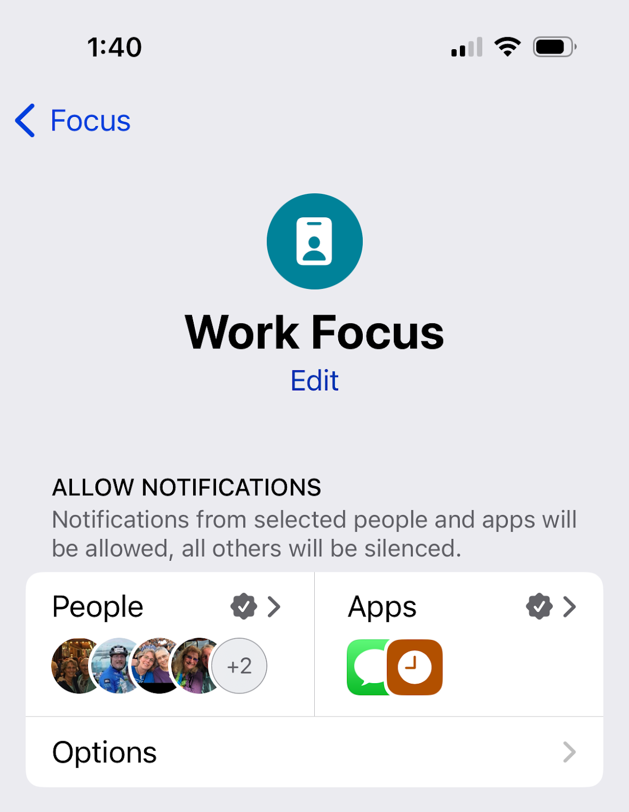
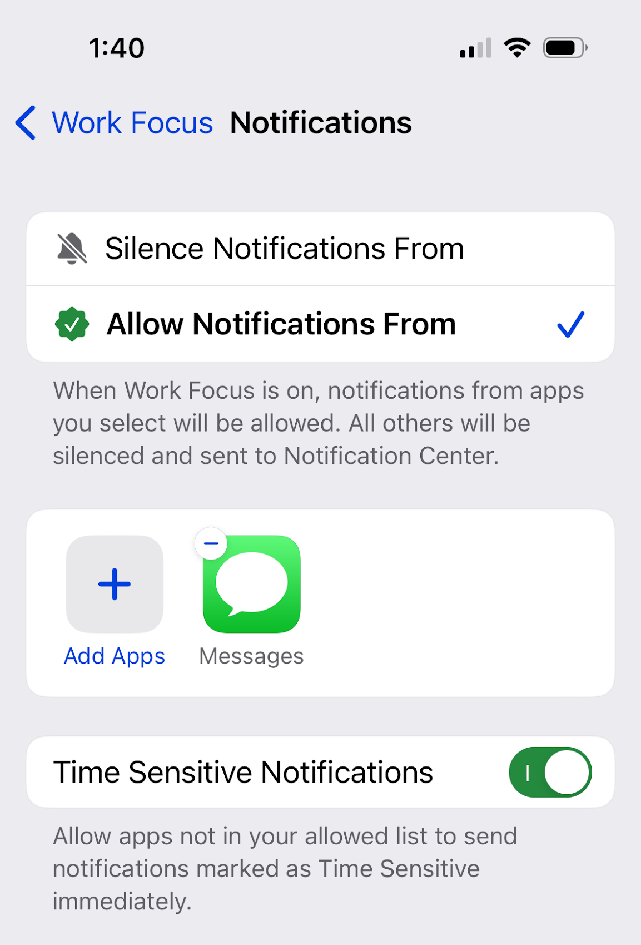
Focus Feature (1 of 2)

Slide 20
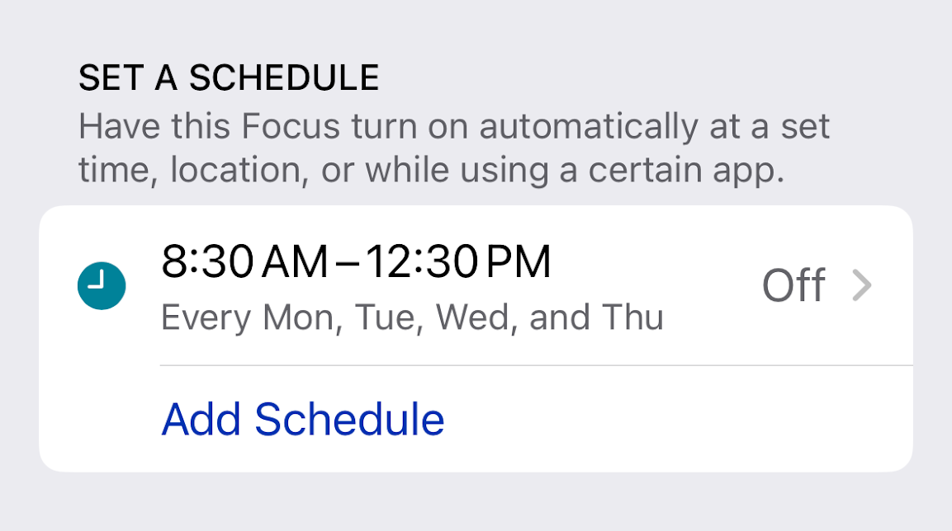
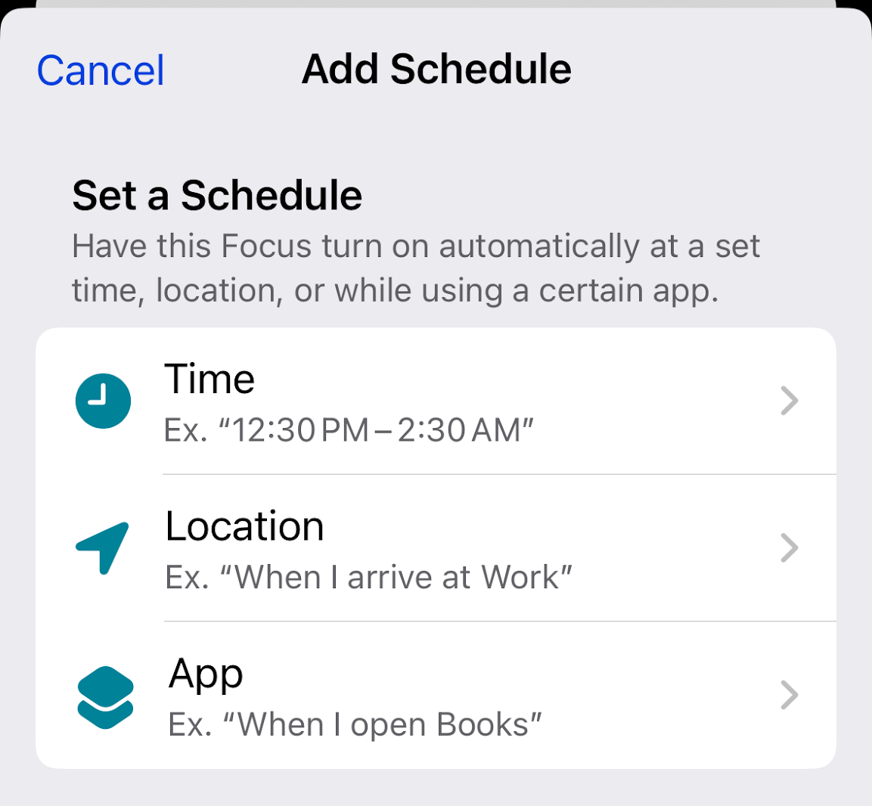
Focus Feature (2 of 2)

Slide 21
Do Not Disturb

Slide 22
Do Not Disturb Feature - Android
Do Not Disturb eliminates device-related distractions such as notifications and calls
Do Not Disturb can be set for different activities
Do Not Disturb can be set to allow certain calls or notifications to get through

Slide 23
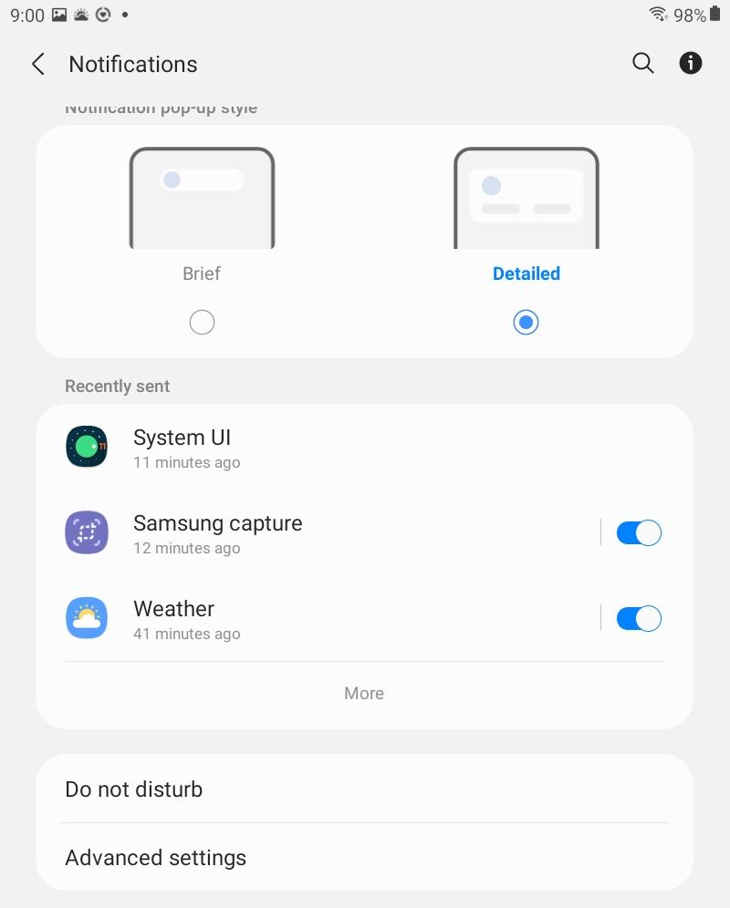
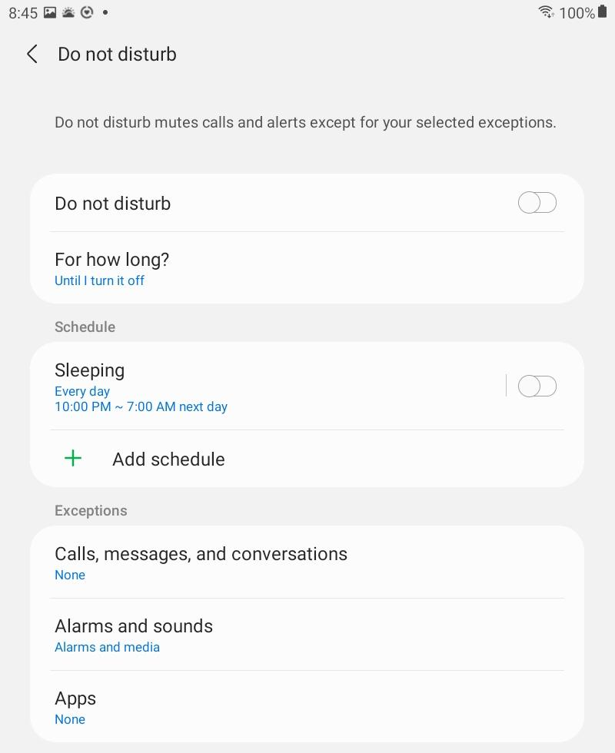
Do Not Disturb Feature (1 of 3)

Slide 24
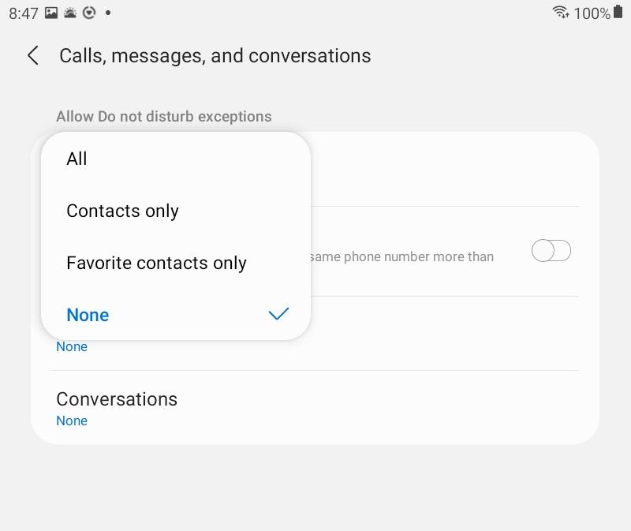
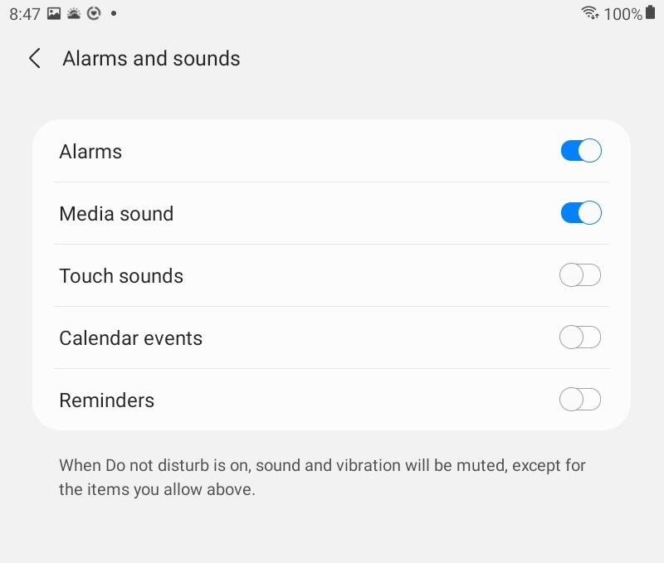
Do Not Disturb Feature (2 of 3)

Slide 25
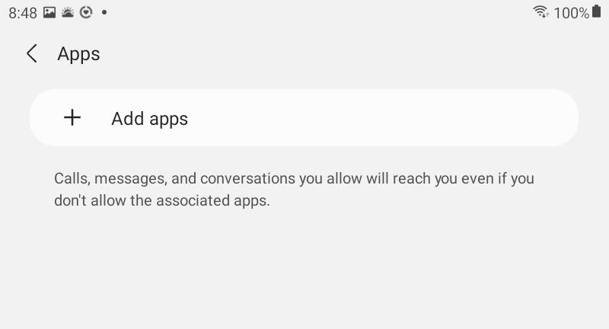
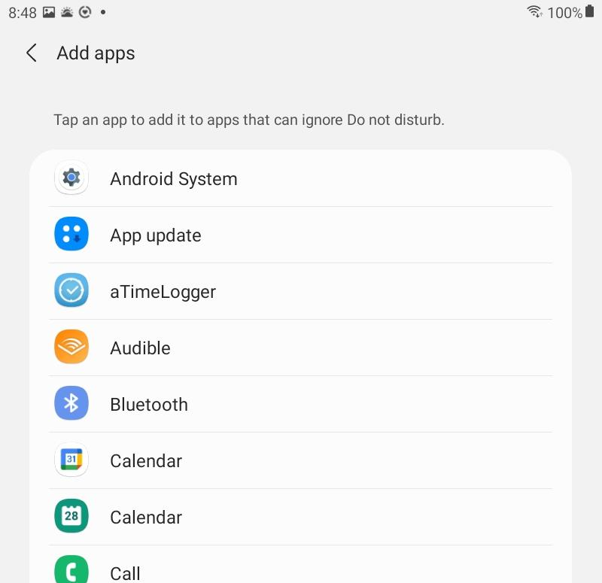
Do Not Disturb Feature (3 of 3)

Slide 26
Chat & Questions (4)

Slide 27
Medications (iOS only)

Slide 28
Medications Feature
Medications feature tracks medications, sets reminders, logs when medication(s) are taken
To access Medications: Health app > Browse > Medications

Slide 29
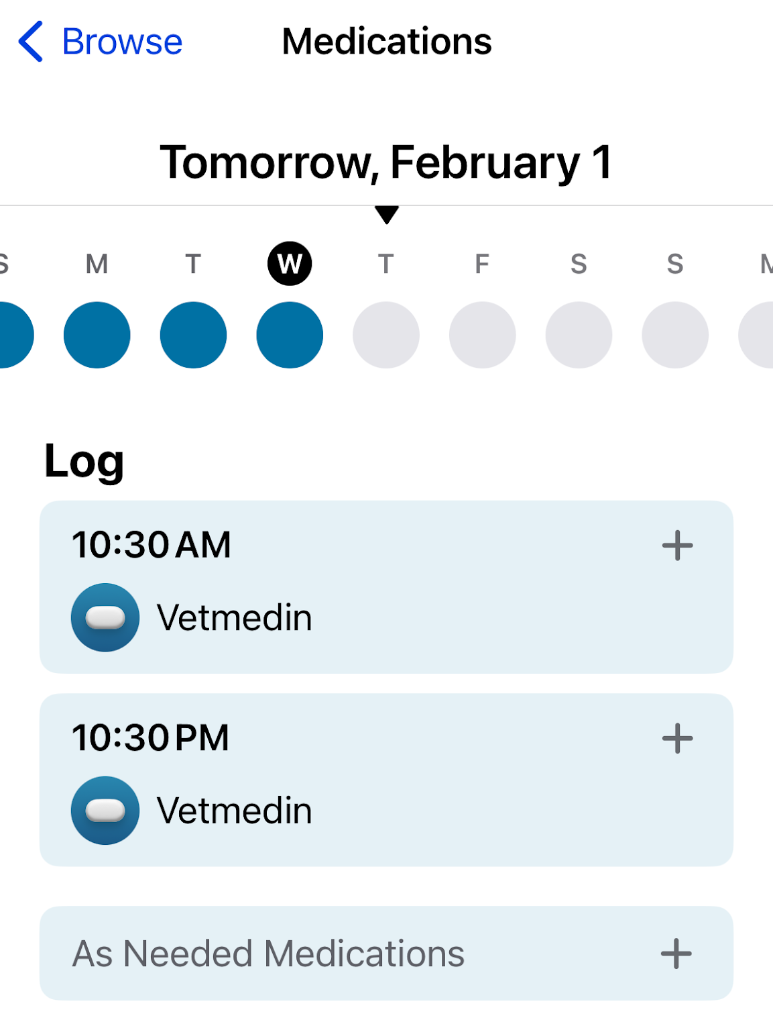
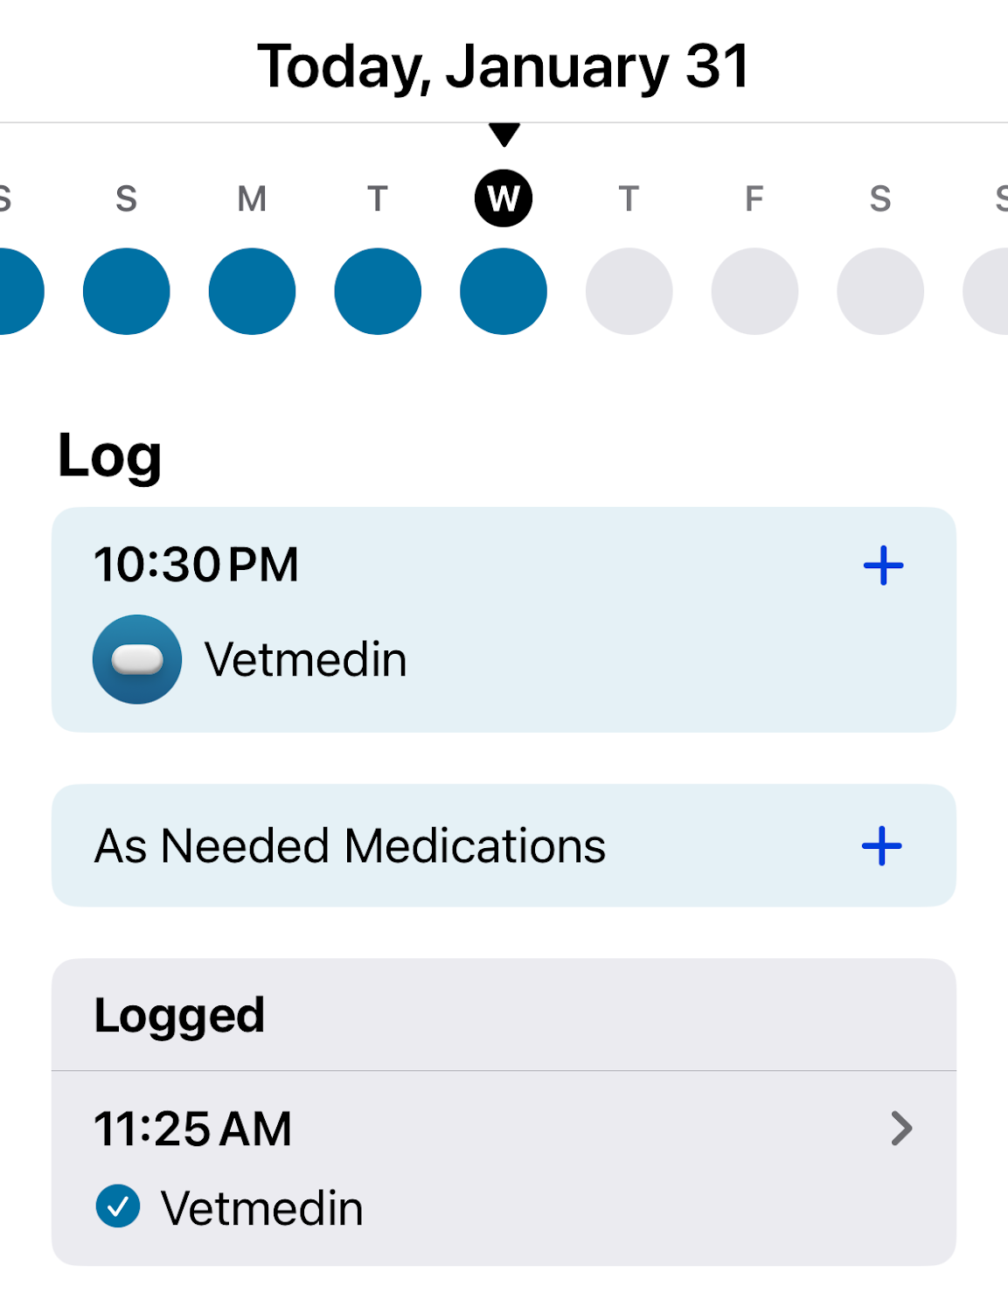
Medication Feature Log

Slide 30
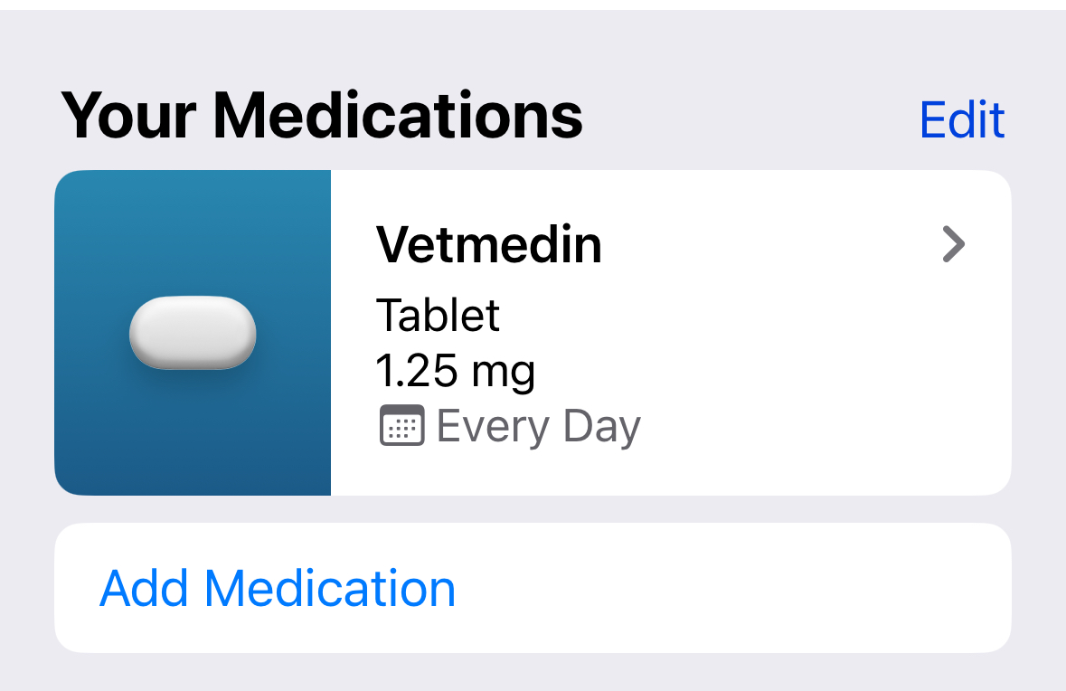
Medication Feature Medication List

Slide 31
Chat & Questions (5)

Slide 32
Calendar Apps

Slide 33
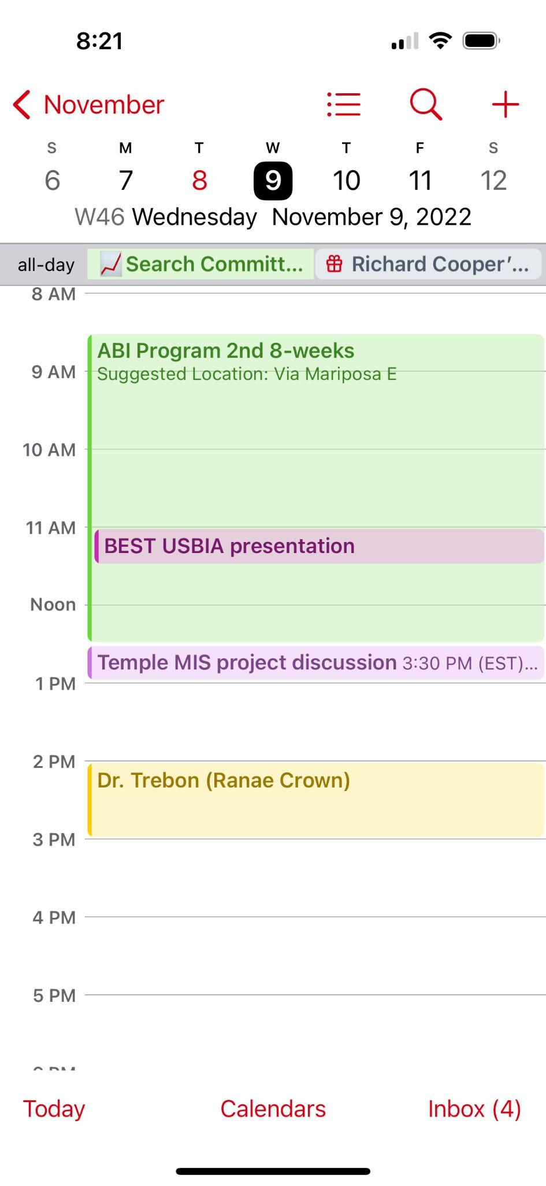
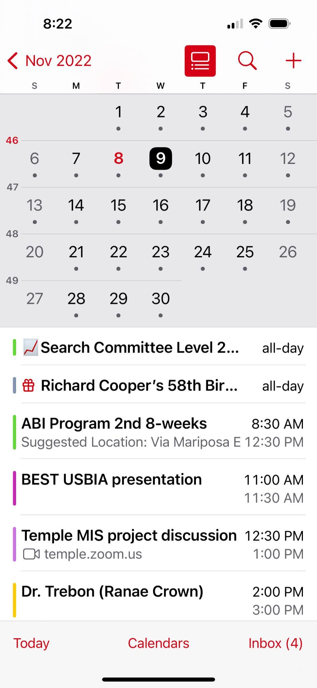
Calendar App Views

Slide 34
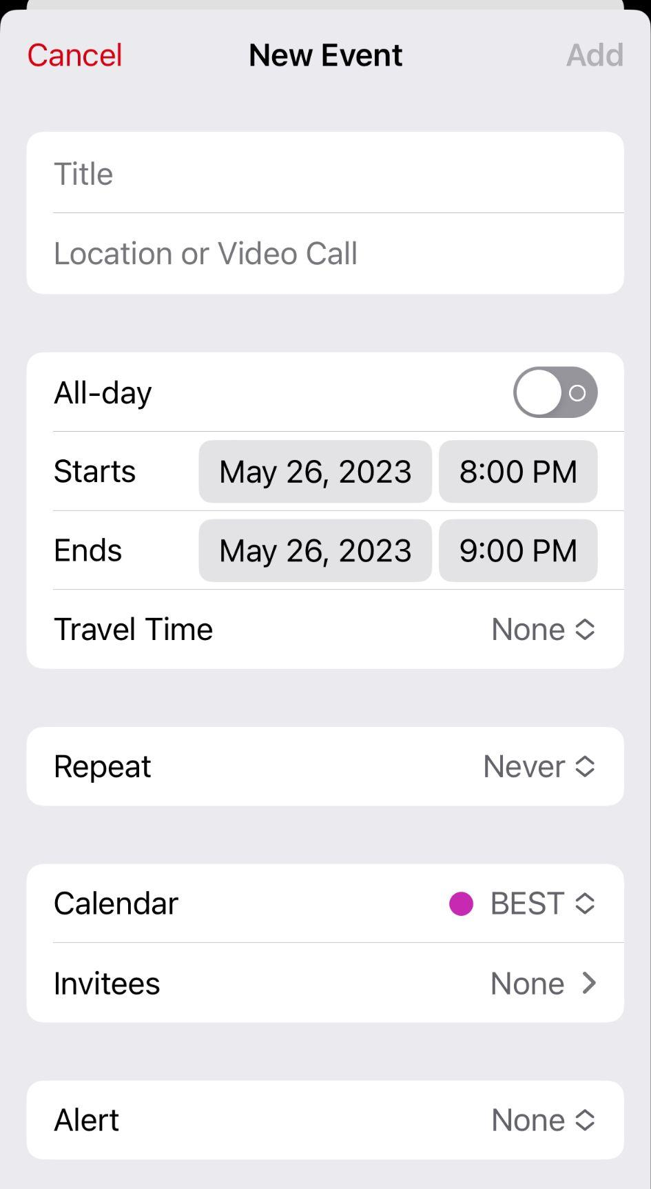
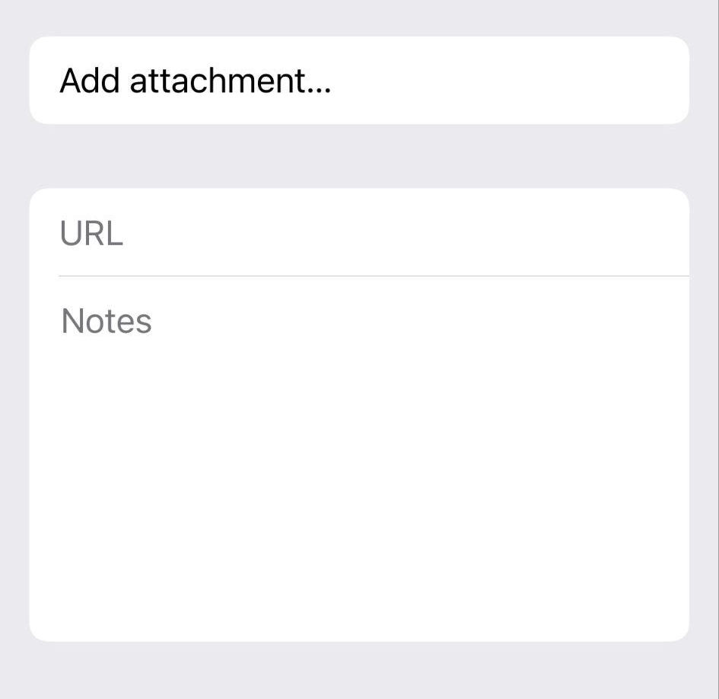
Calendar App New Event Screen

Slide 35
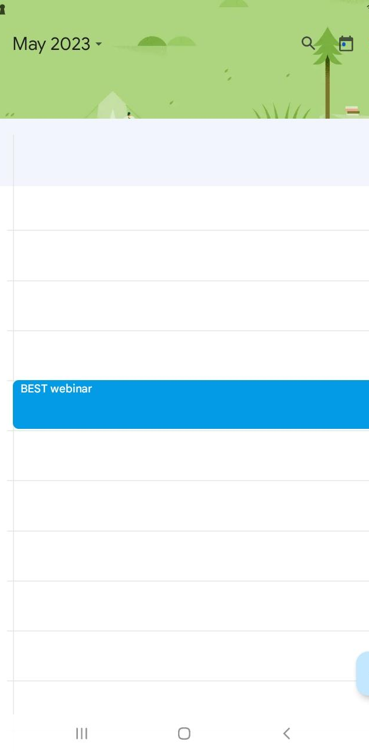
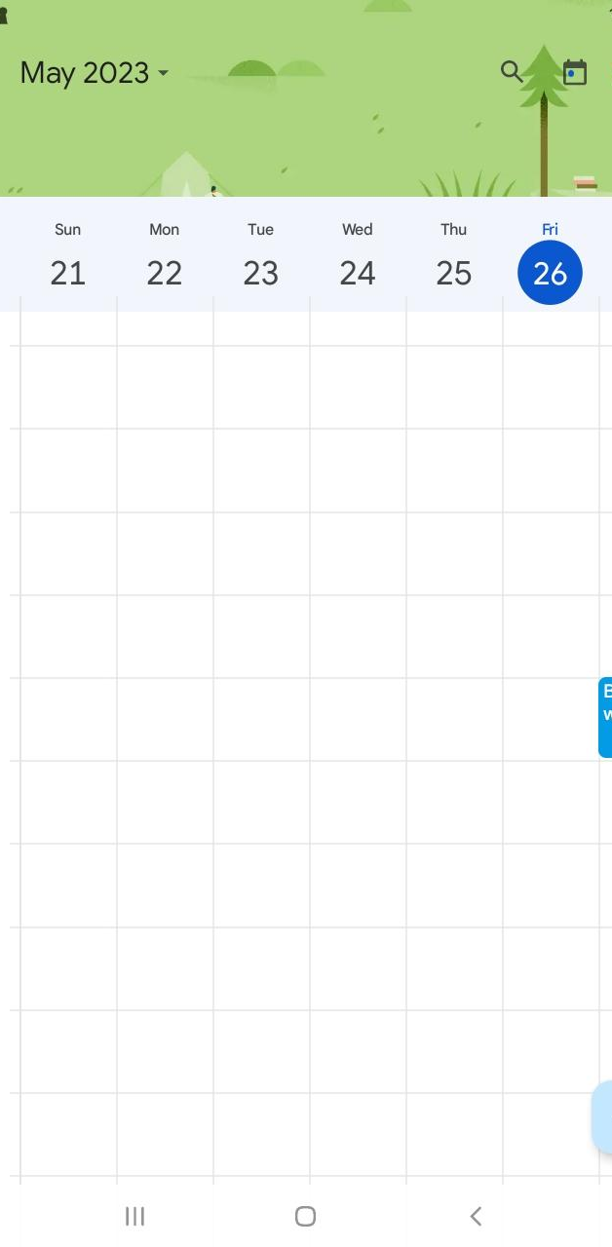
Google Calendar

Slide 36
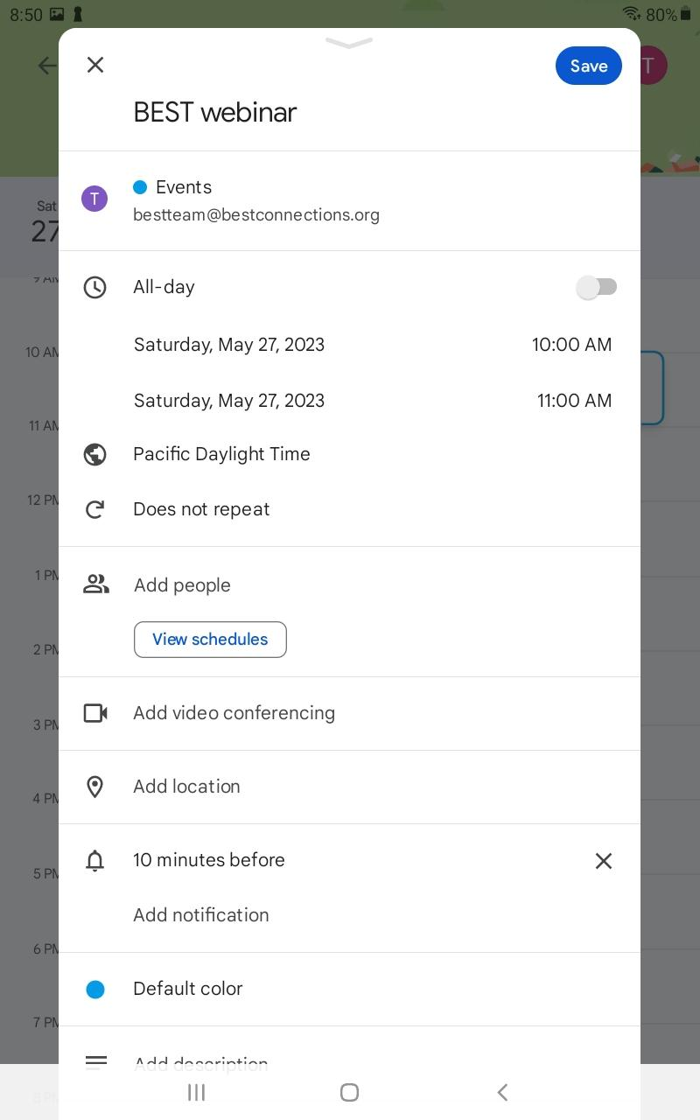
Google Calendar – New Event

Slide 37
Chat & Questions (6)

Slide 38
Web Browsers

Slide 39
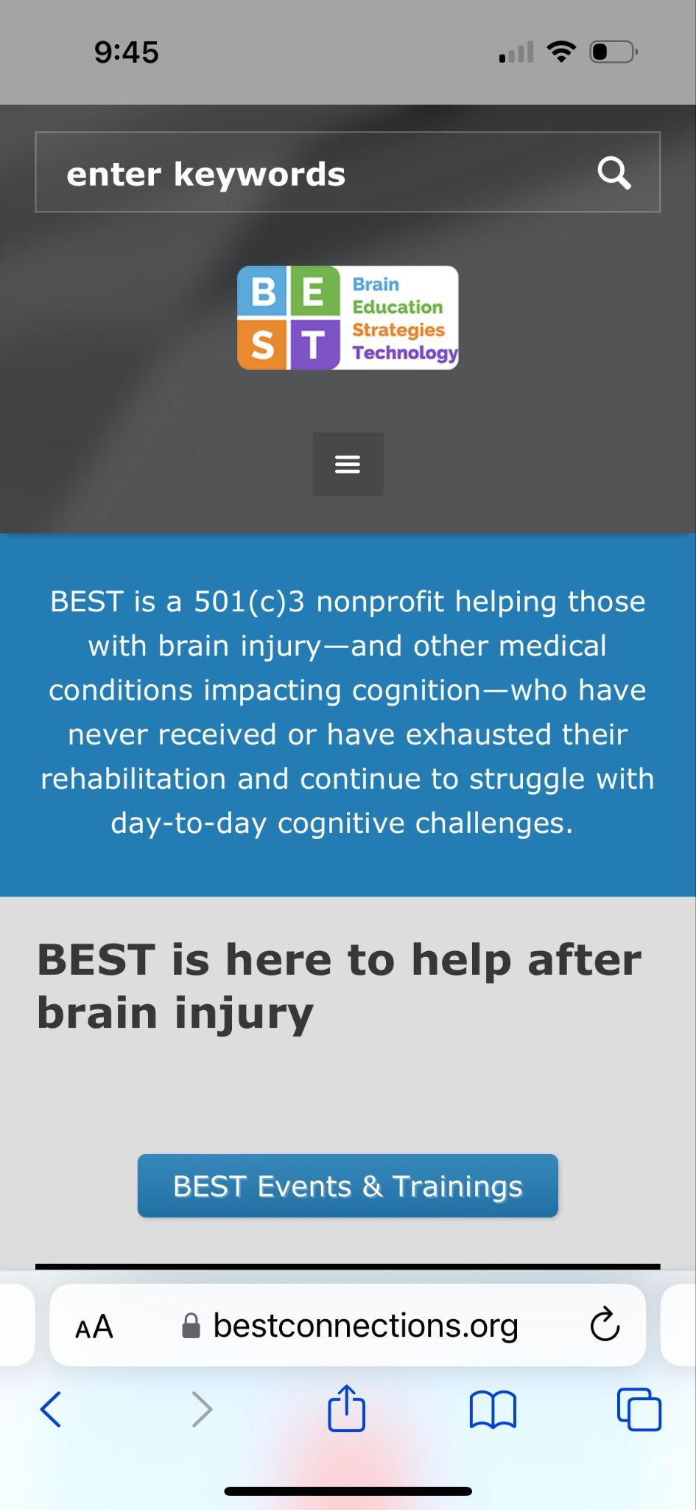
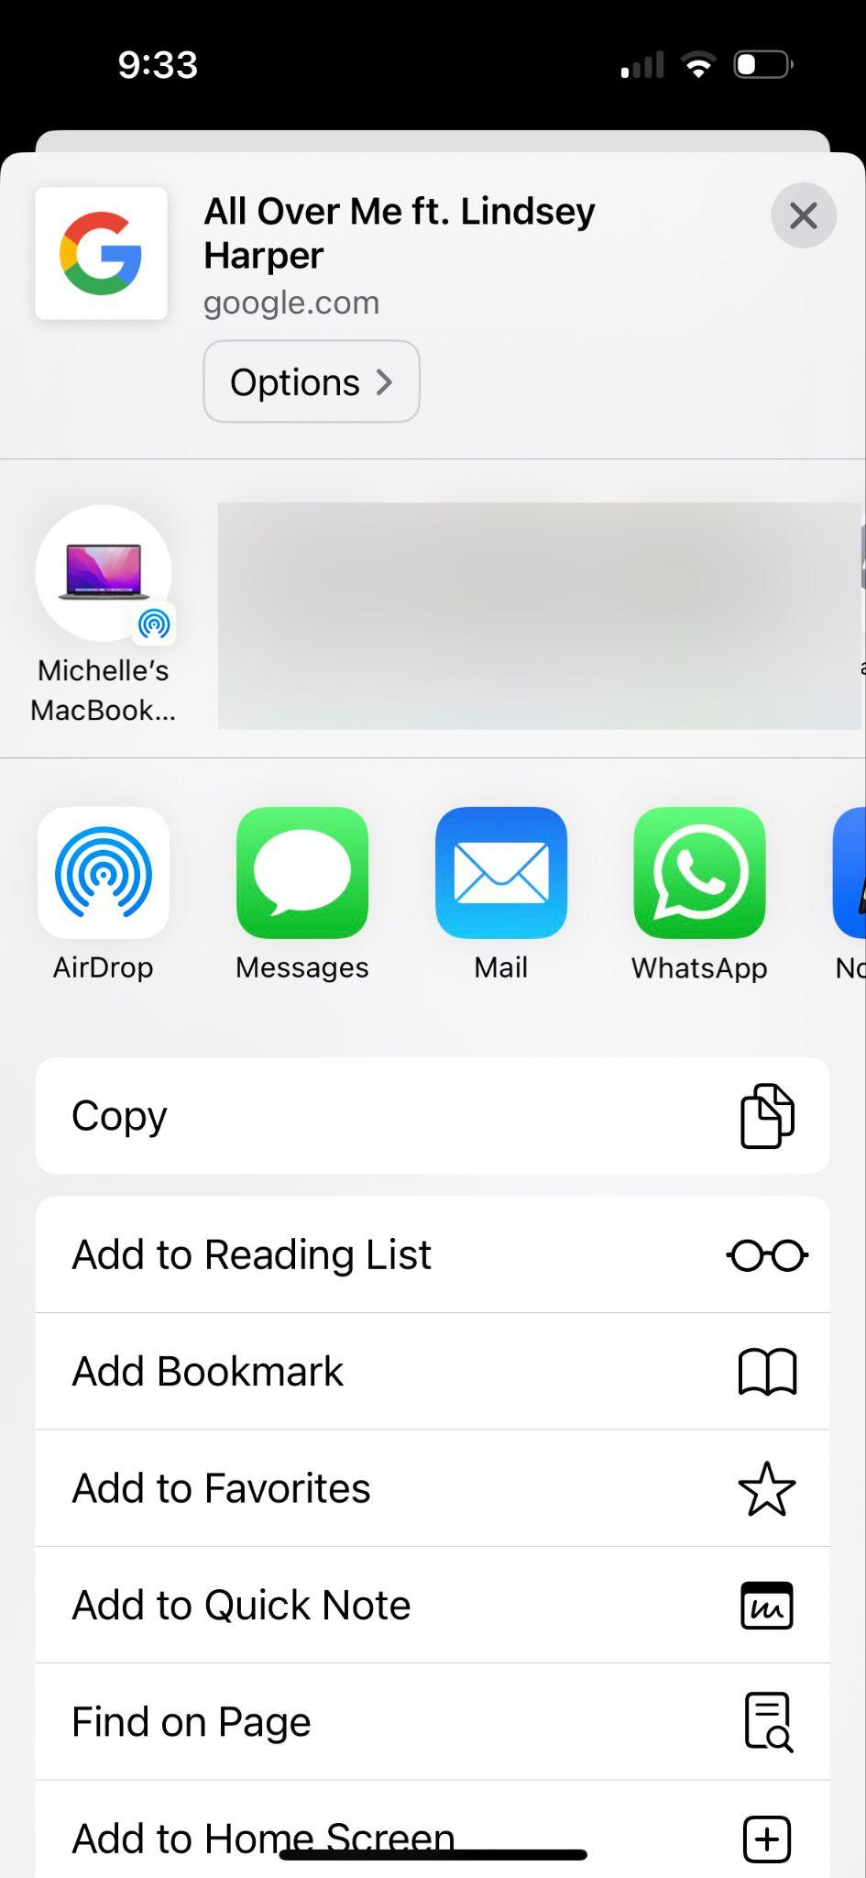
Safari

Slide 40
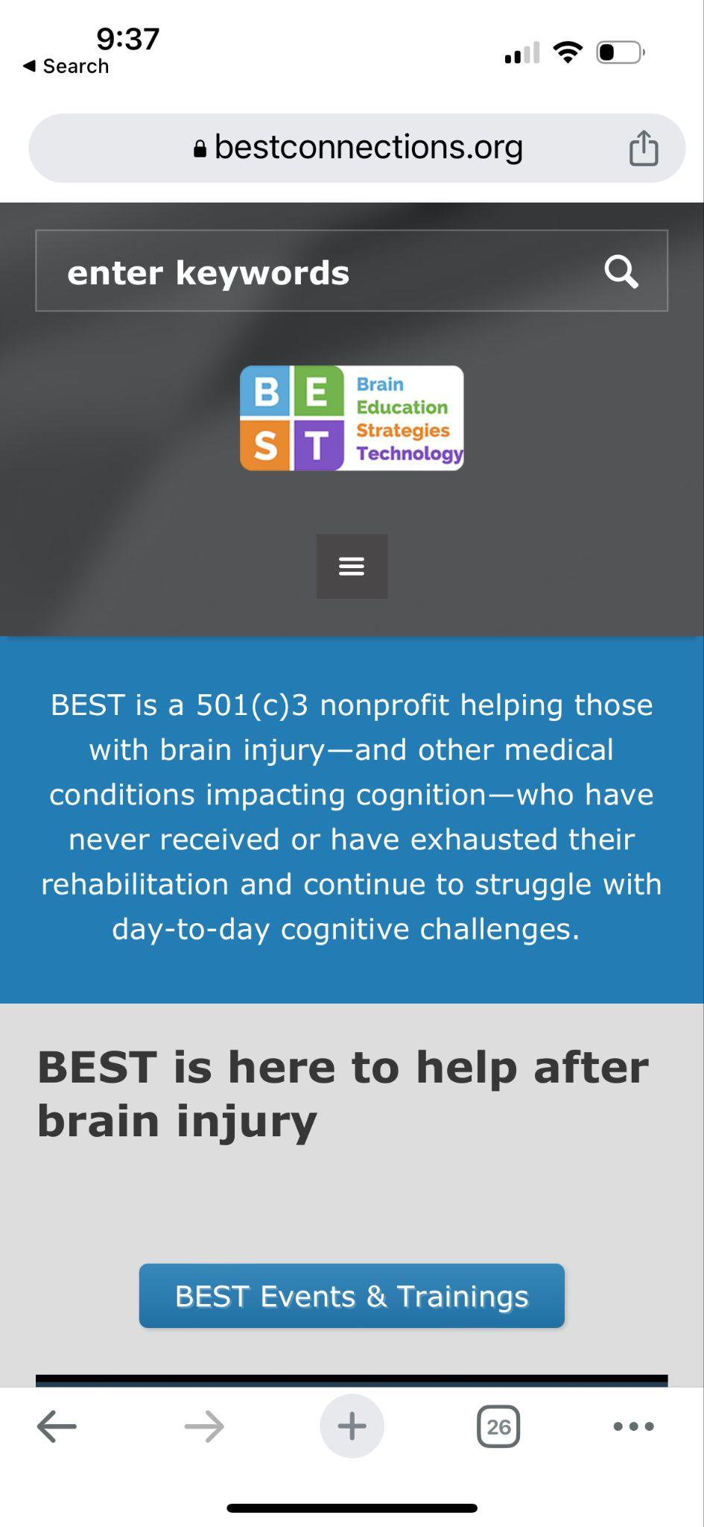
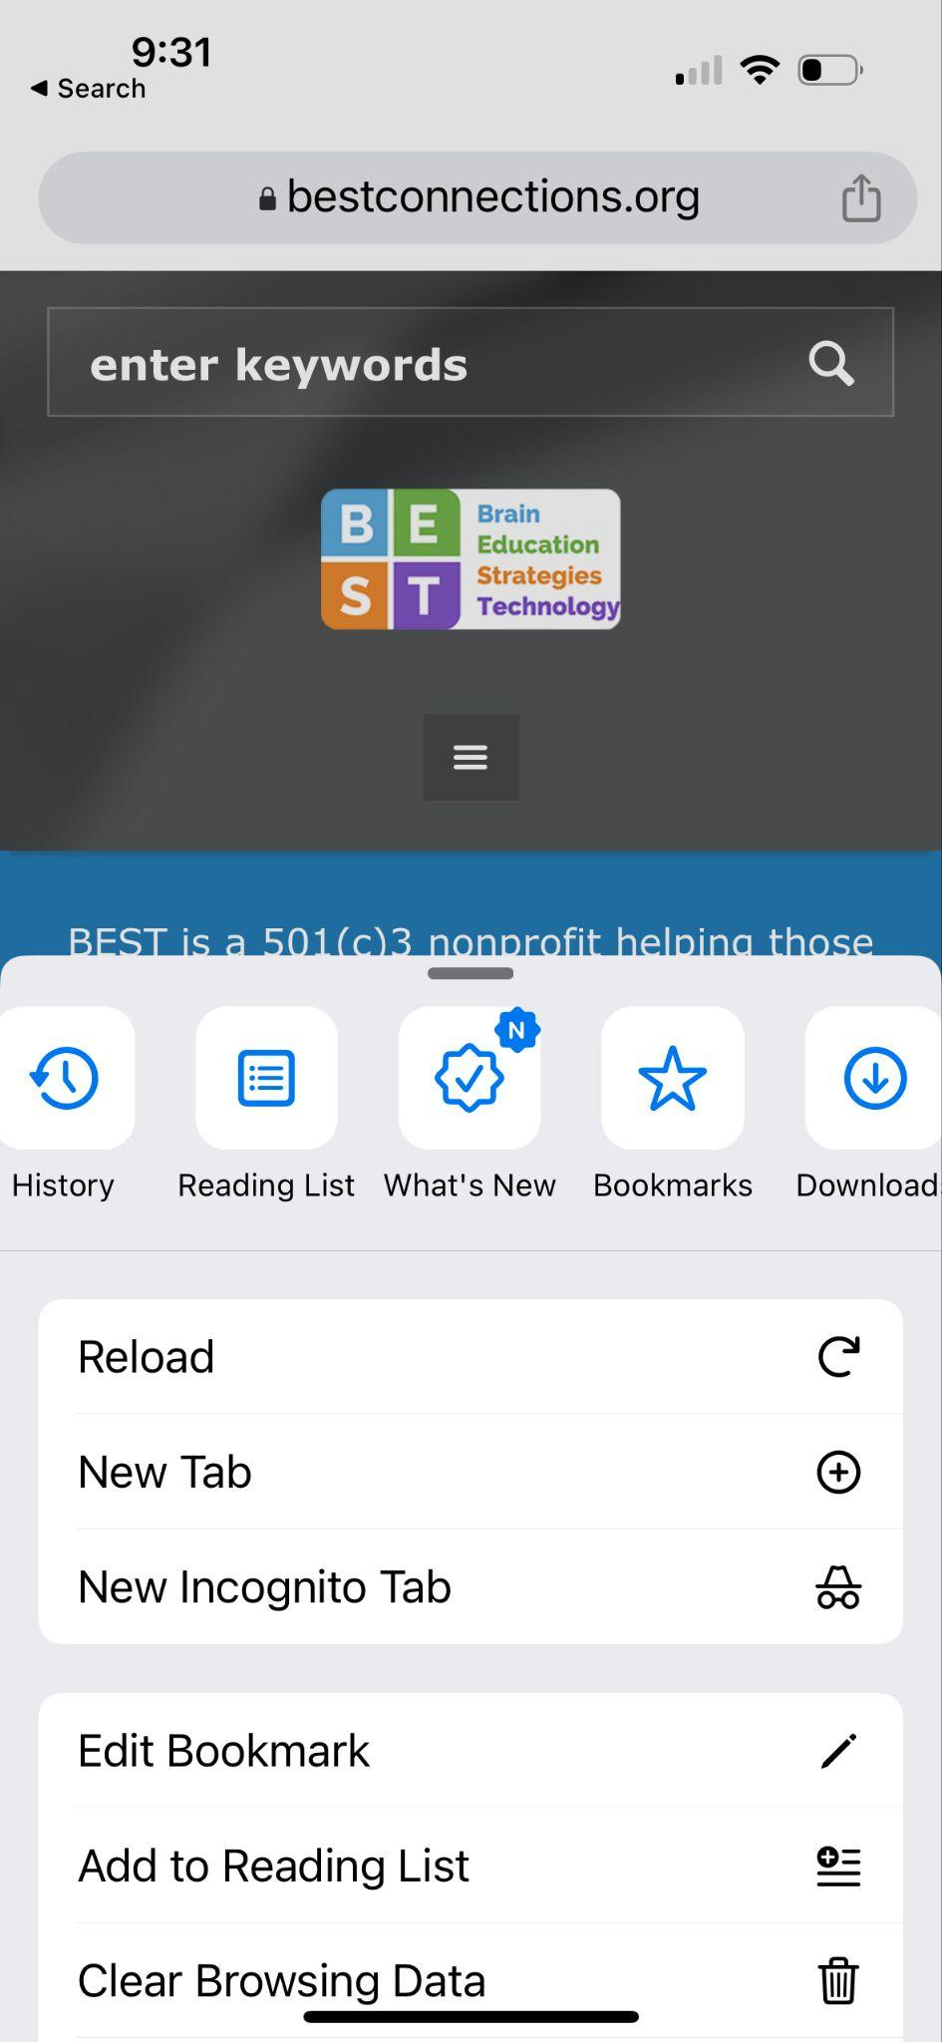
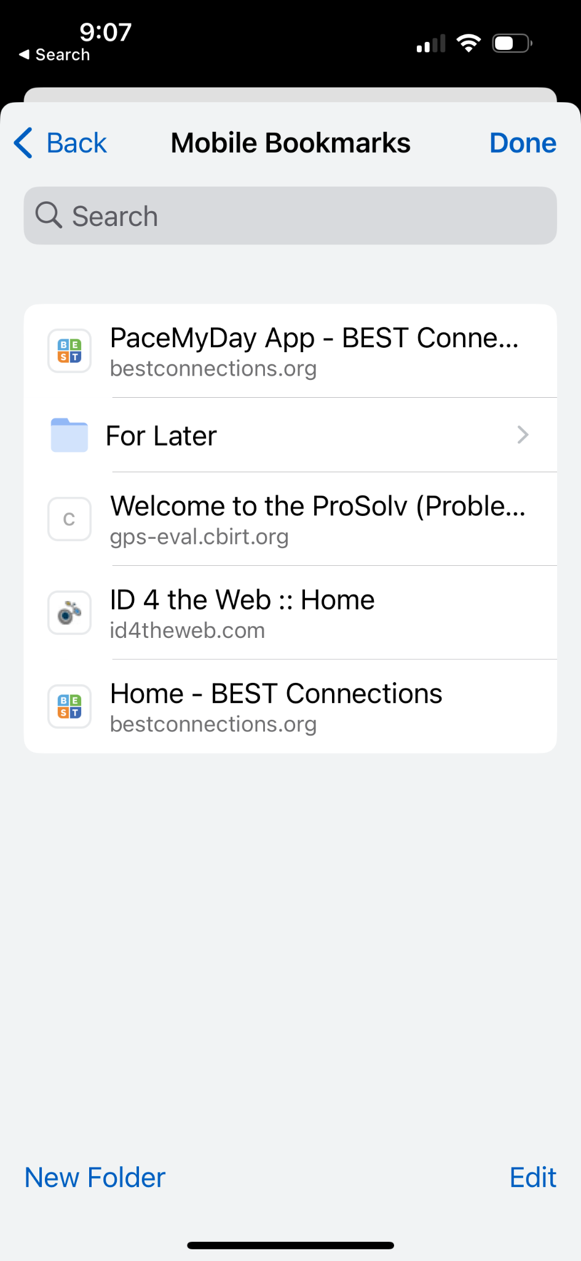
Chrome

Slide 41
Browser Reader Mode

Slide 42
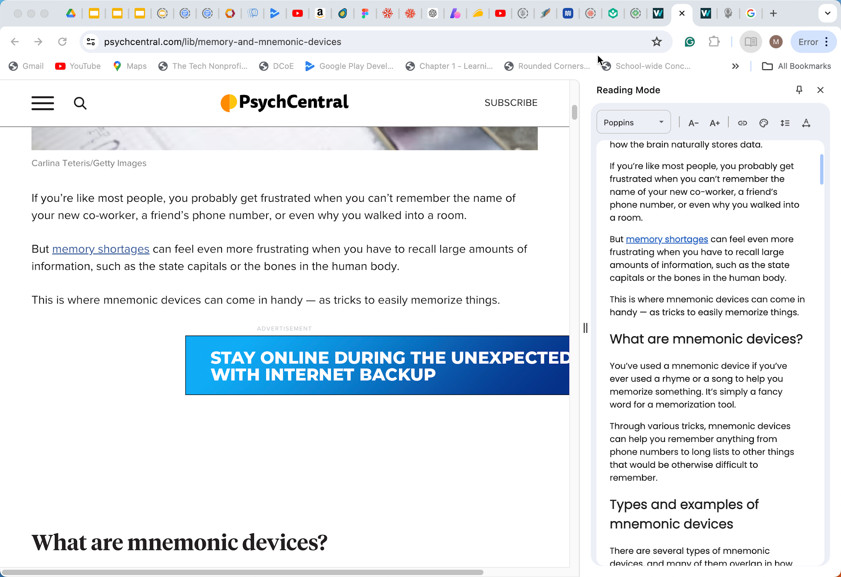
Reader Mode Chrome

Slide 43
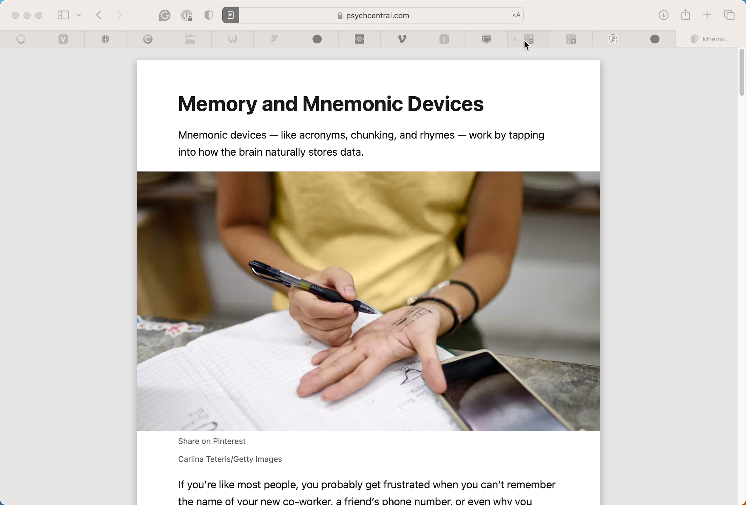
Reader Mode Safari

Slide 44
Chat & Questions (8)

Slide 45
Notes Apps

Slide 46
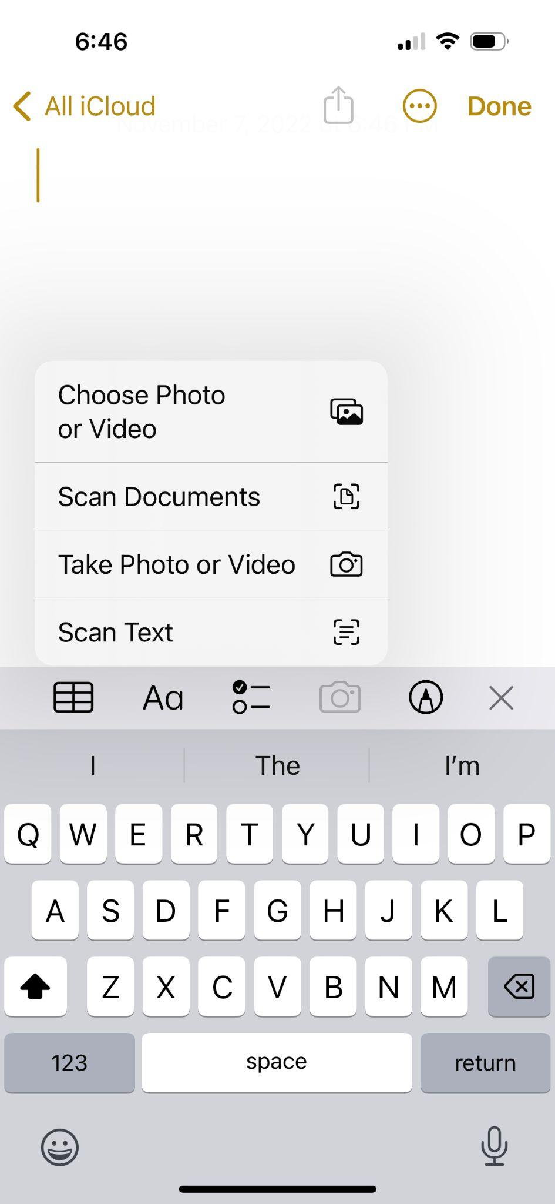
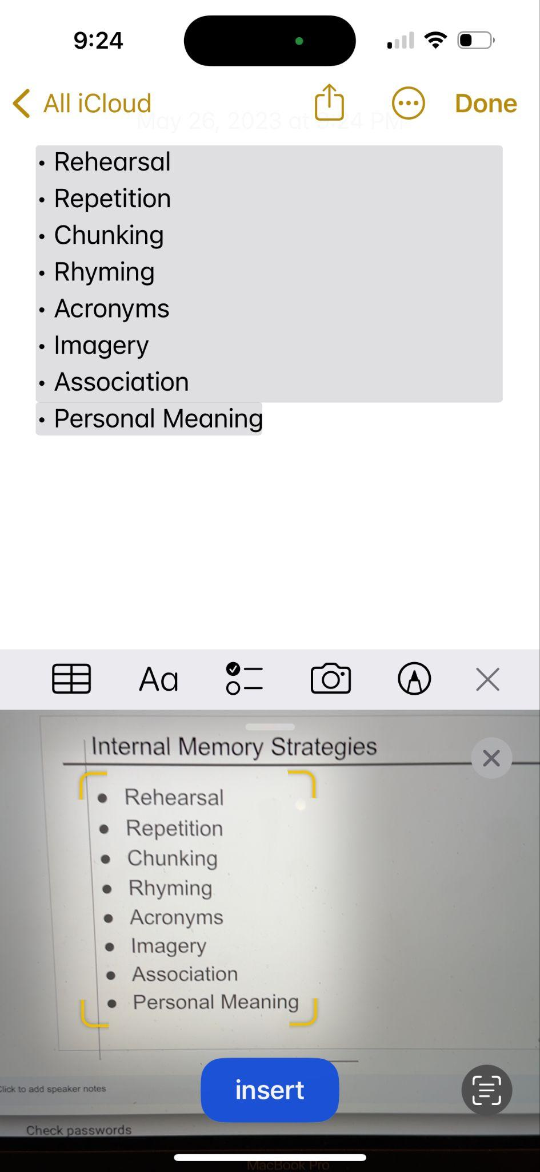
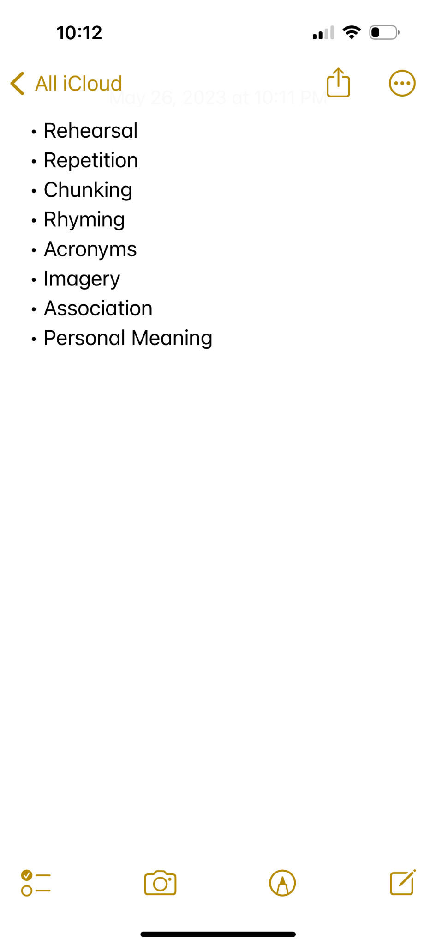
Notes app Scan Text

Slide 47
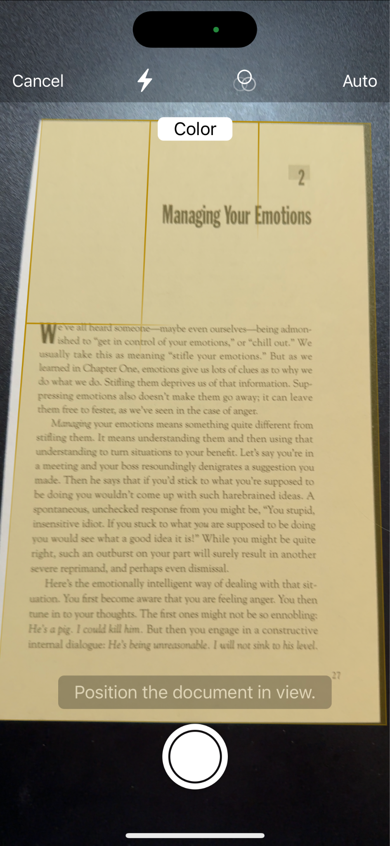
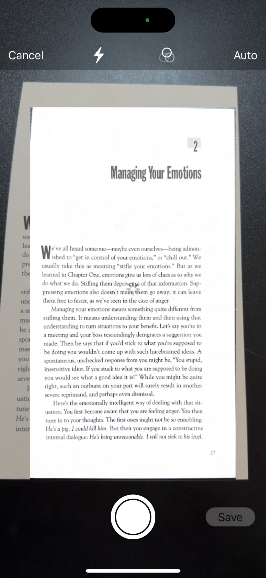
Notes app Scan Documents (1 of 2)

Slide 48
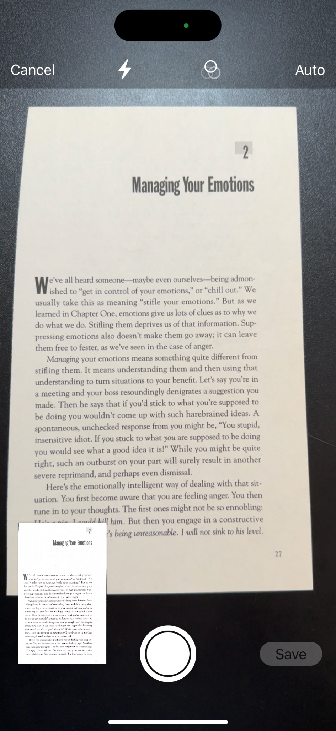
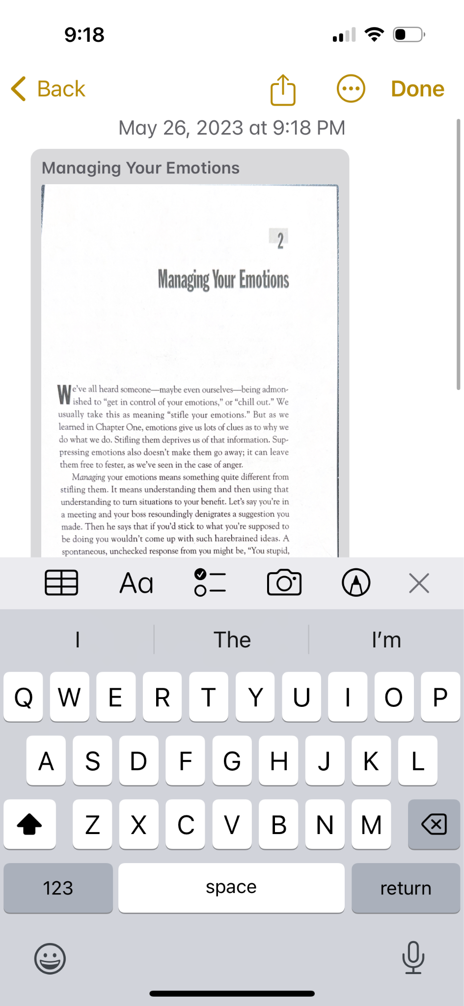
Notes app Scan Documents (2 of 2)

Slide 49
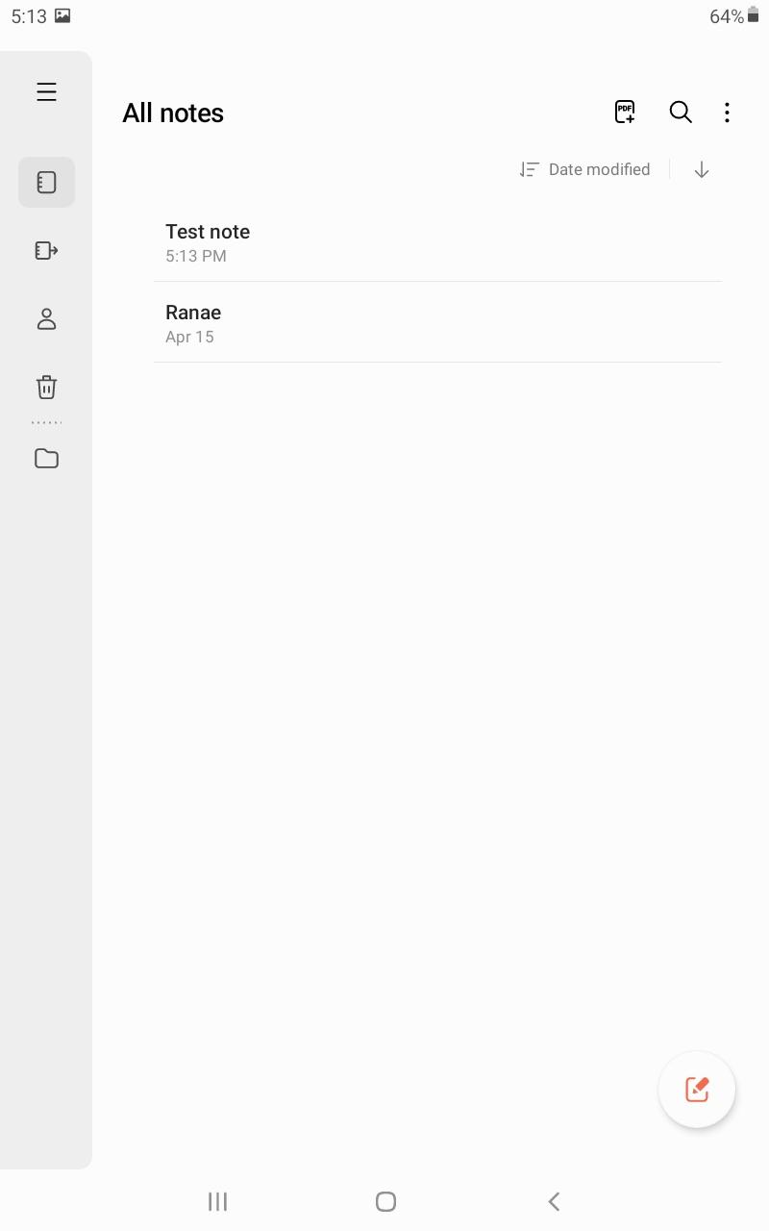
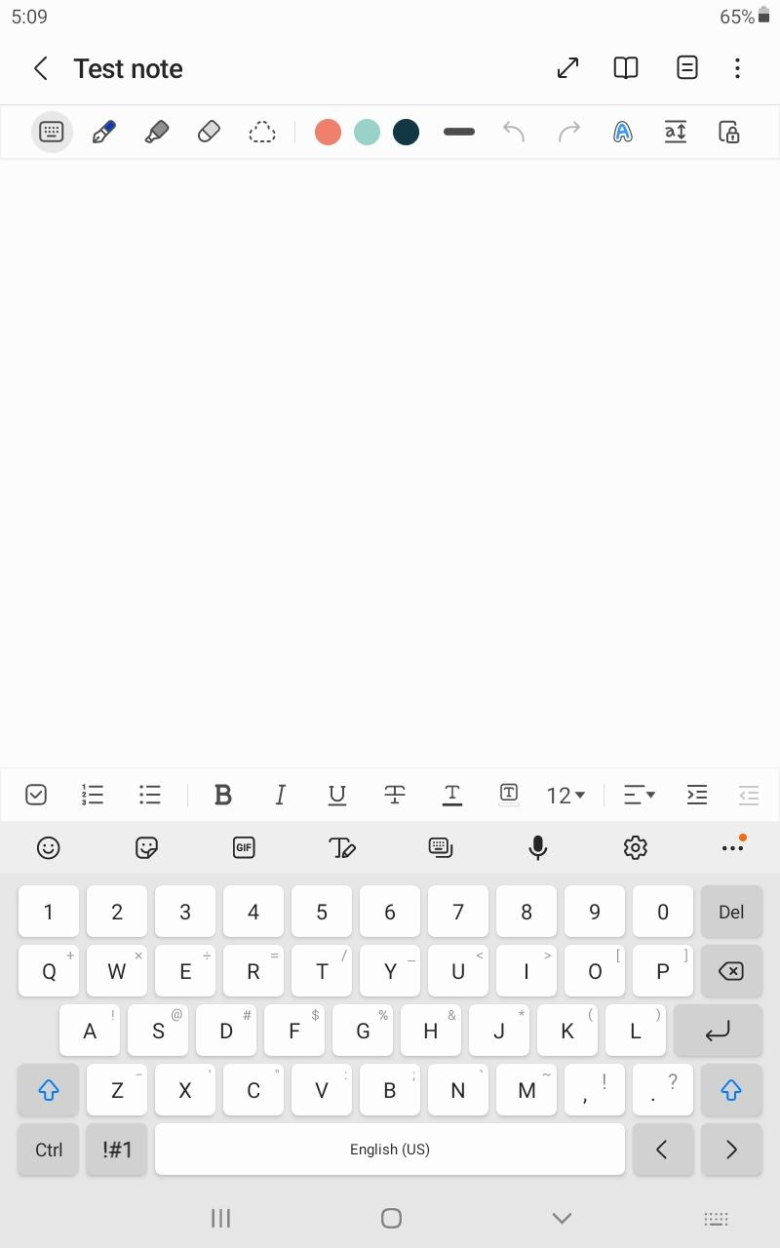
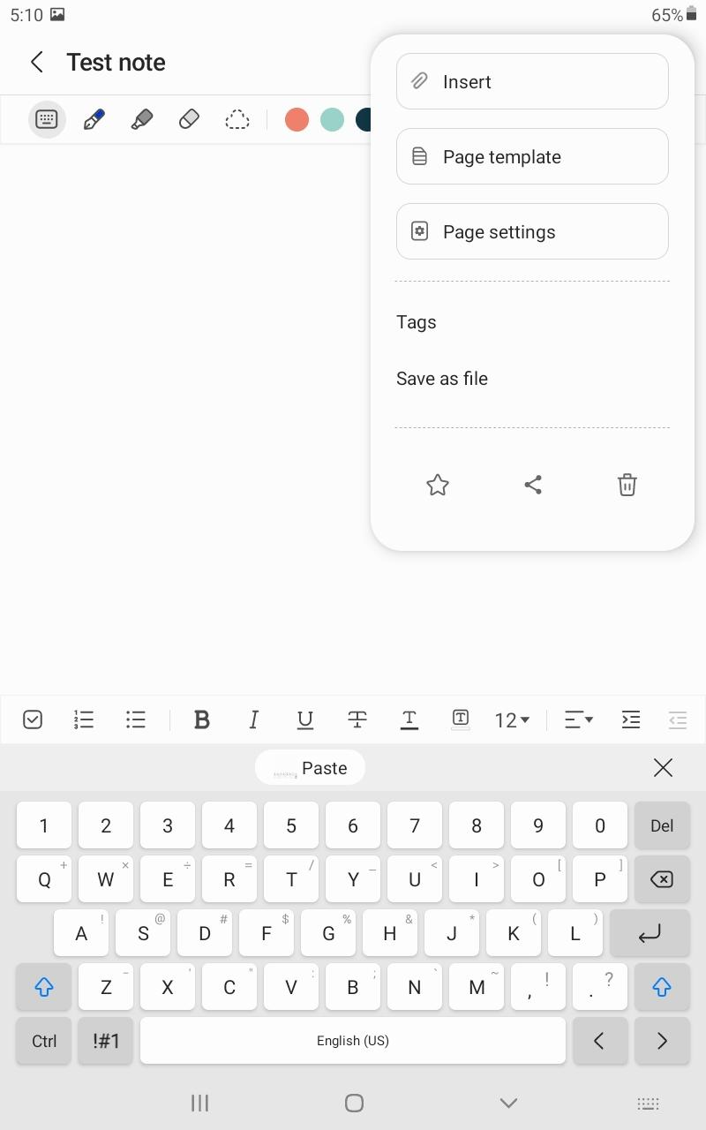
Samsung Notes (Android) (1 of 2)

Slide 50
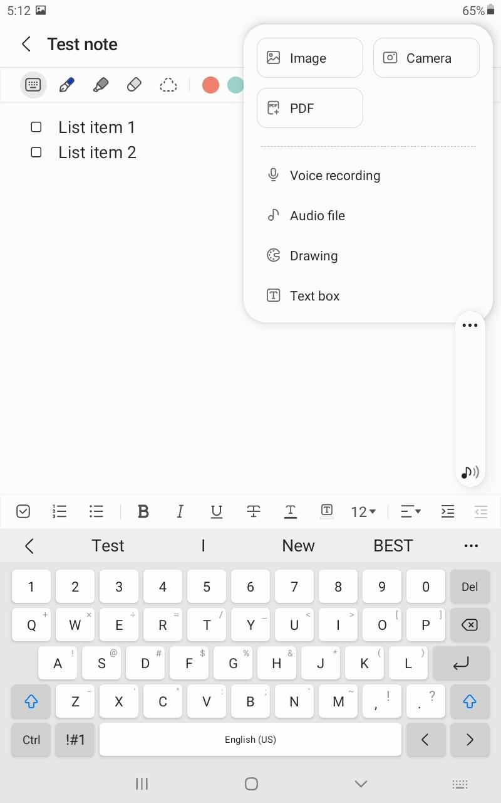
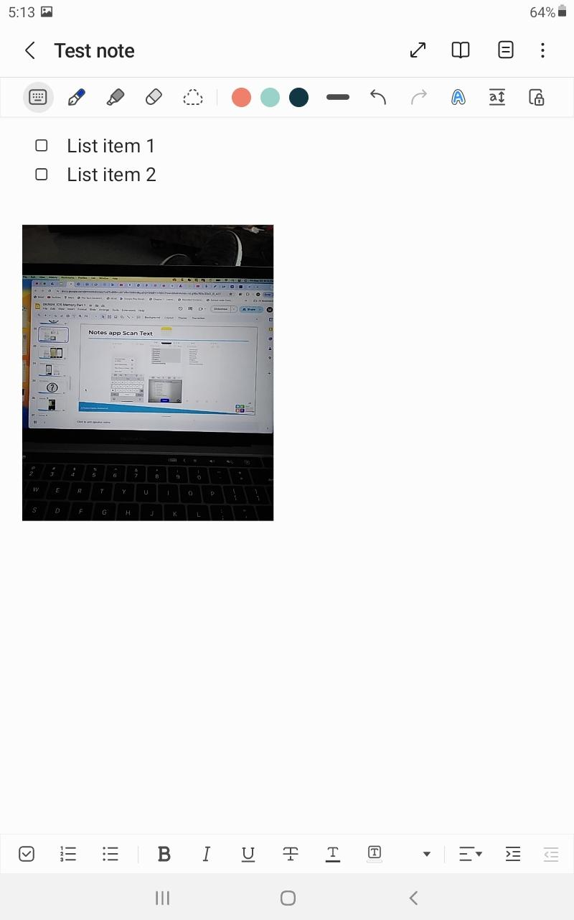
Samsung Notes (Android) (2 of 2)

Slide 51
Chat & Questions (9)

Slide 52
Camera & Photos Apps

Slide 53
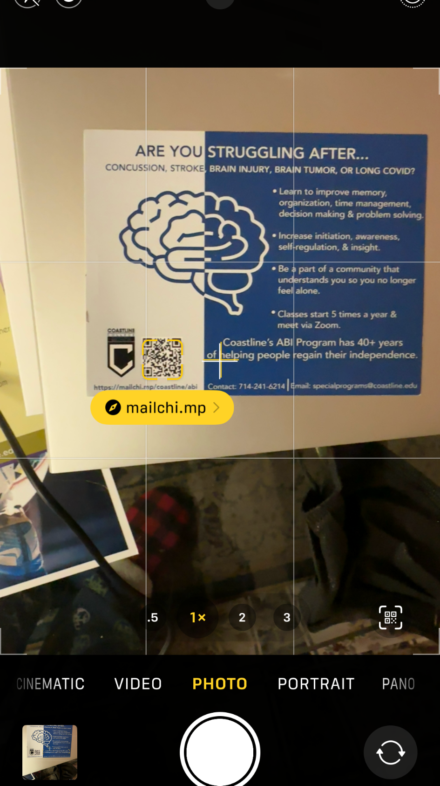
Camera App

Slide 54
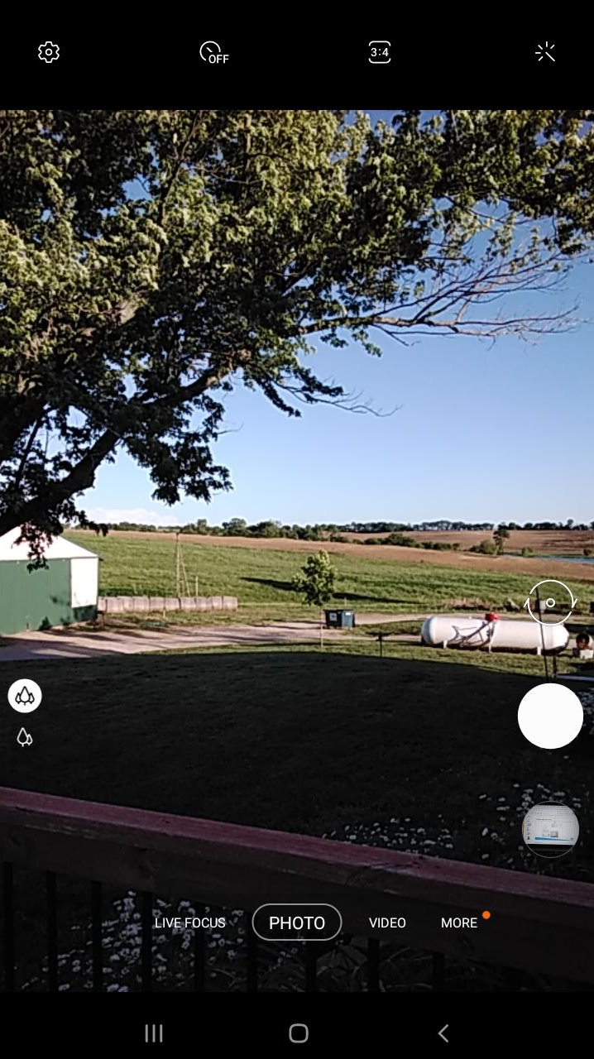
Camera App Android

Slide 55
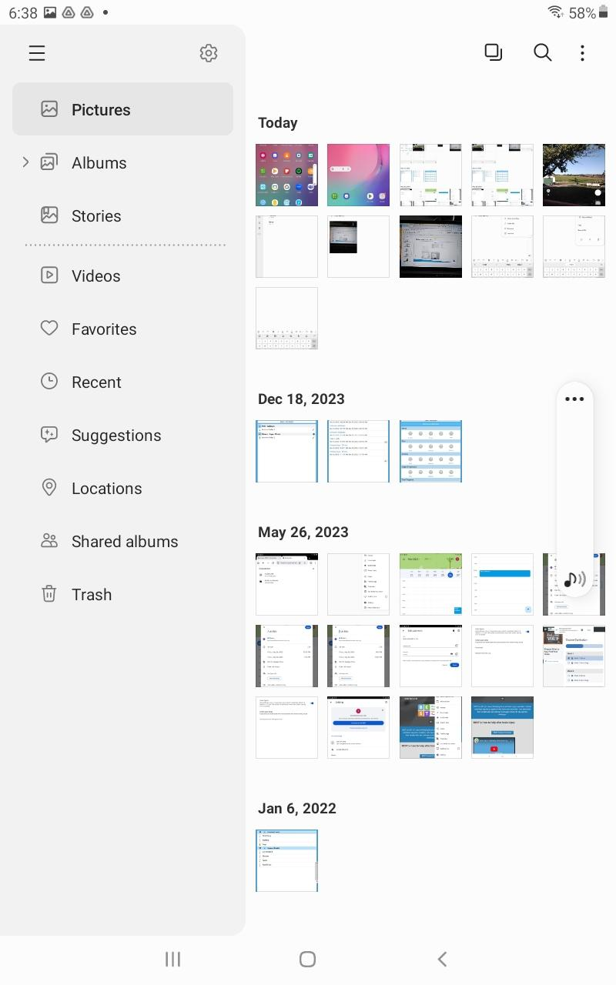
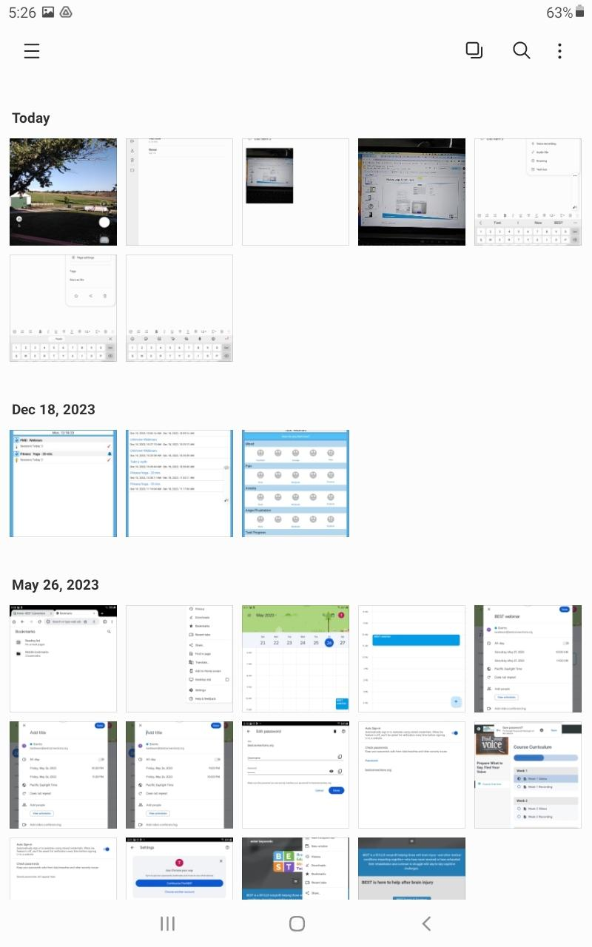
Samsung Gallery App Android

Slide 56
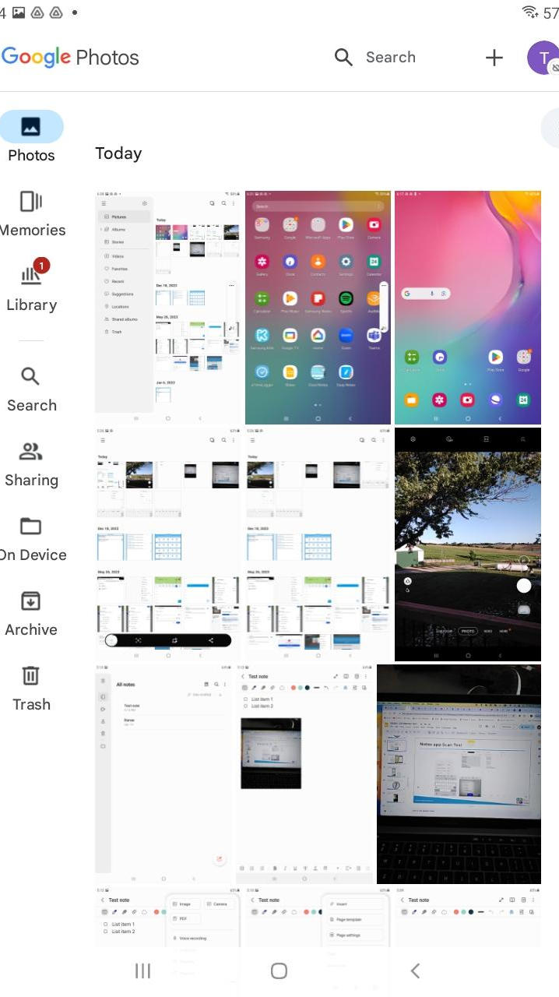
Google Photos App (Android)

Slide 57
Chat & Questions (10)

Slide 58
StrategizeMyLife App

Slide 59
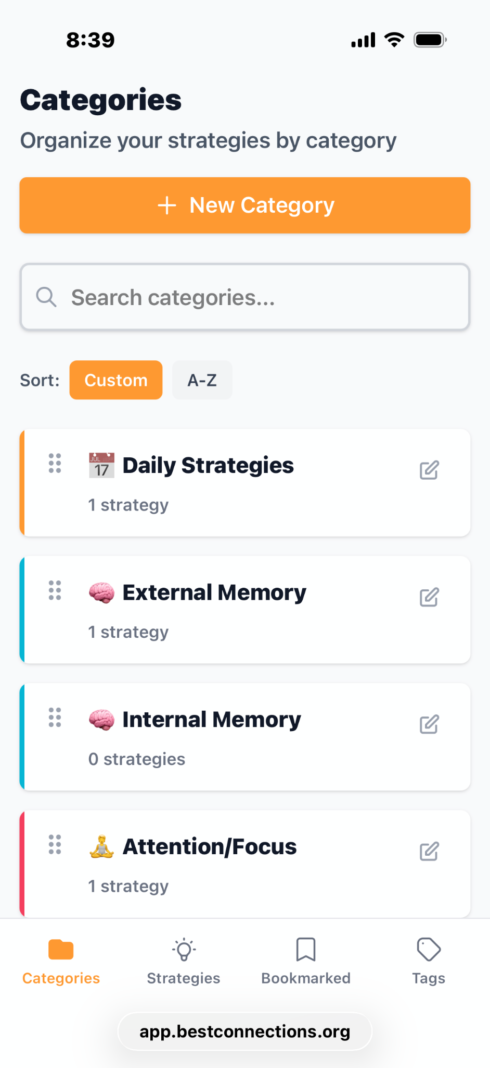
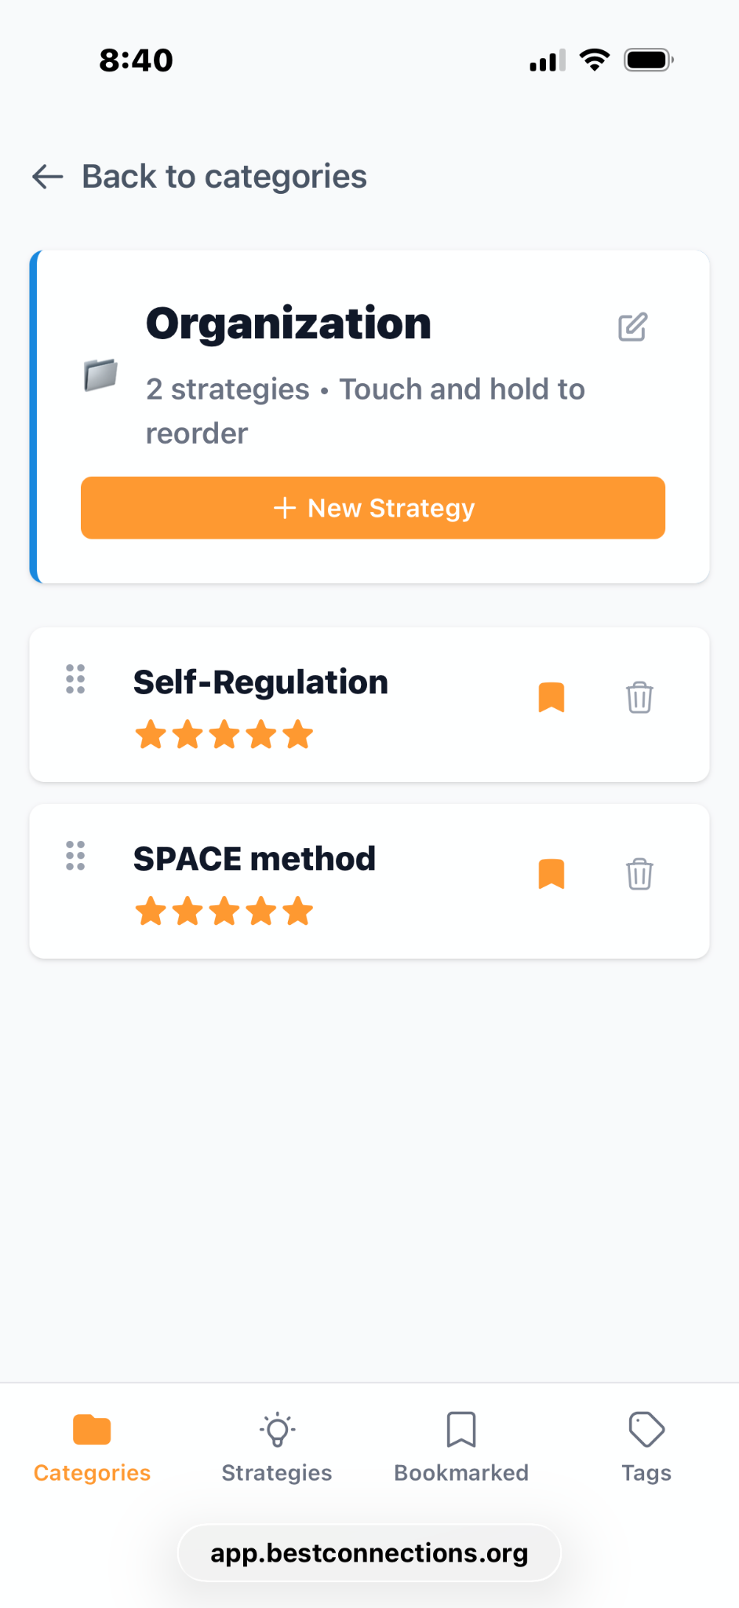
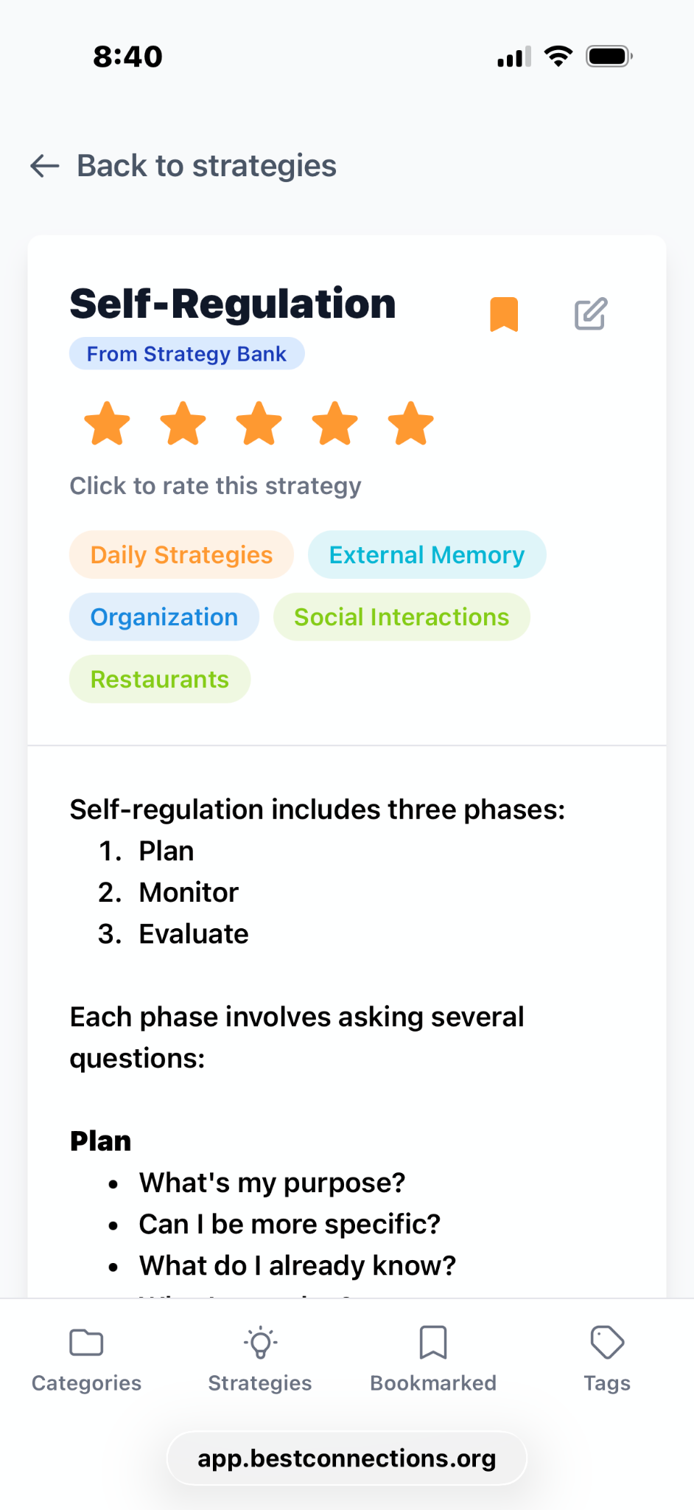
StrategizeMyLife

Slide 60
Chat & Questions (11)

Slide 61
PaceMyDay App

Slide 62


PaceMyDay (1 of 2)

Slide 63



PaceMyDay (2 of 2)

Slide 64
Chat & Questions (12)

Slide 65

Thank You!
Michelle Ranae Wild
michelle@bestconnections.org
BEST offers free Webinars & Workshops and low-cost apps
Visit bestconnections.org for more information

