Slide 1
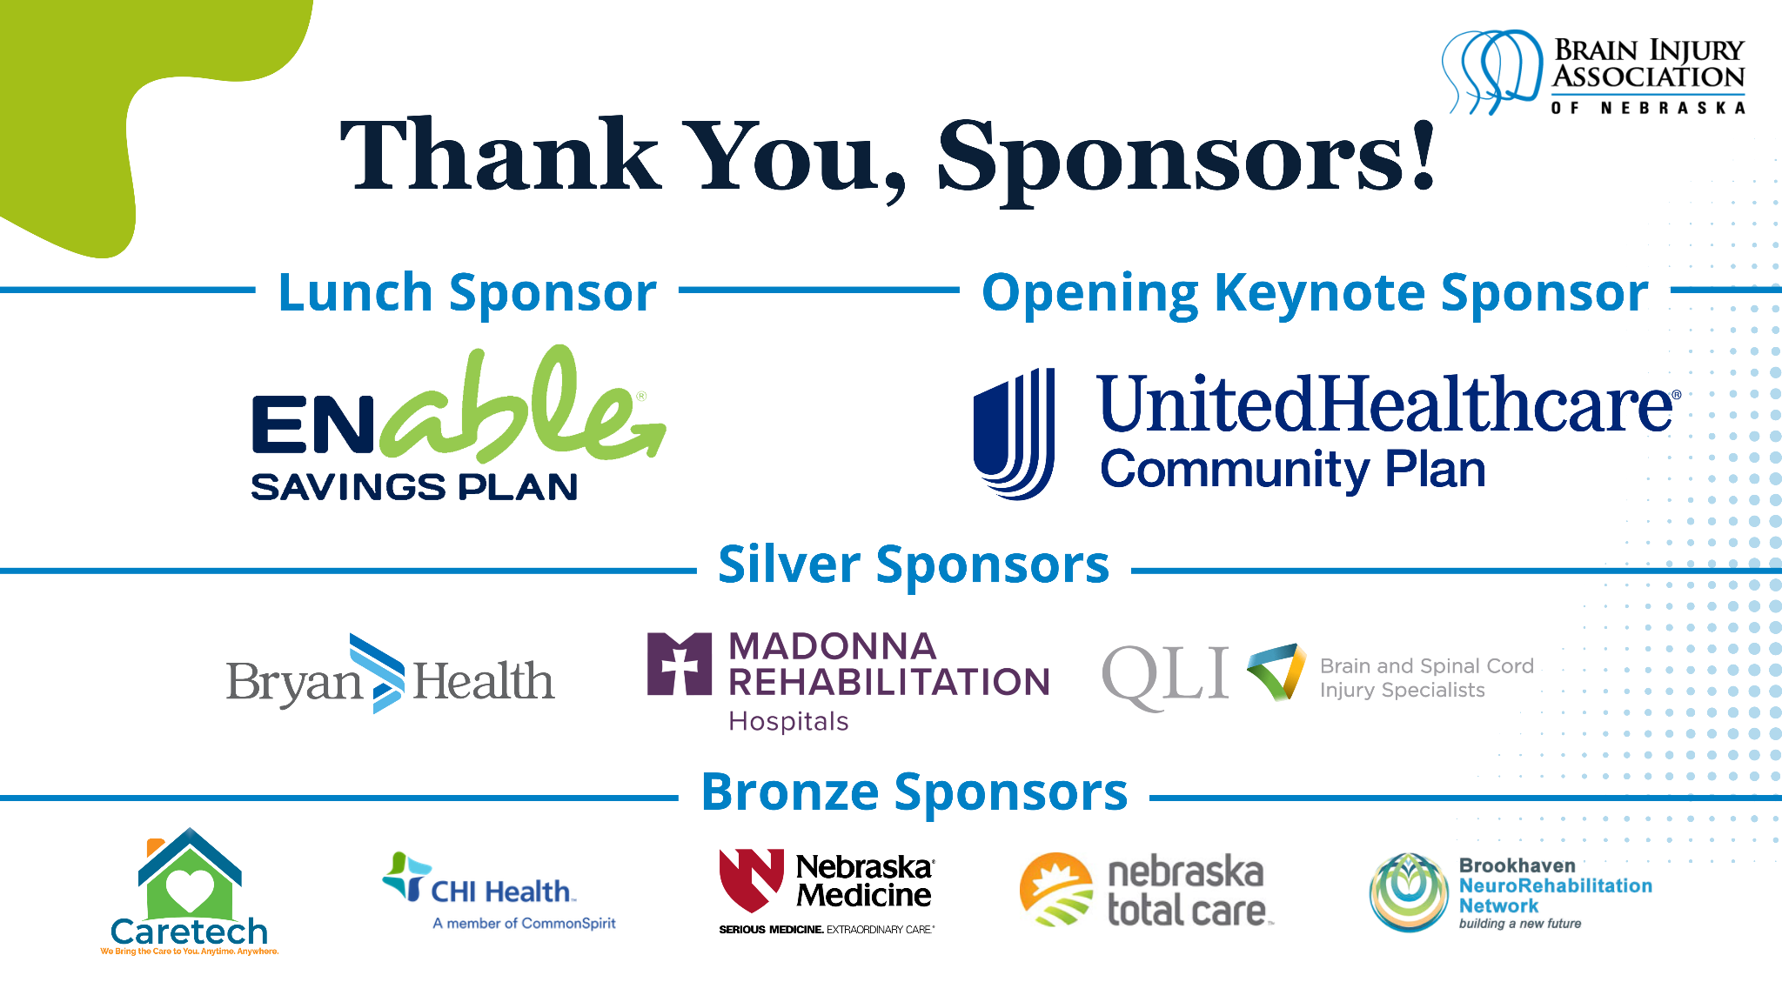

Slide 2
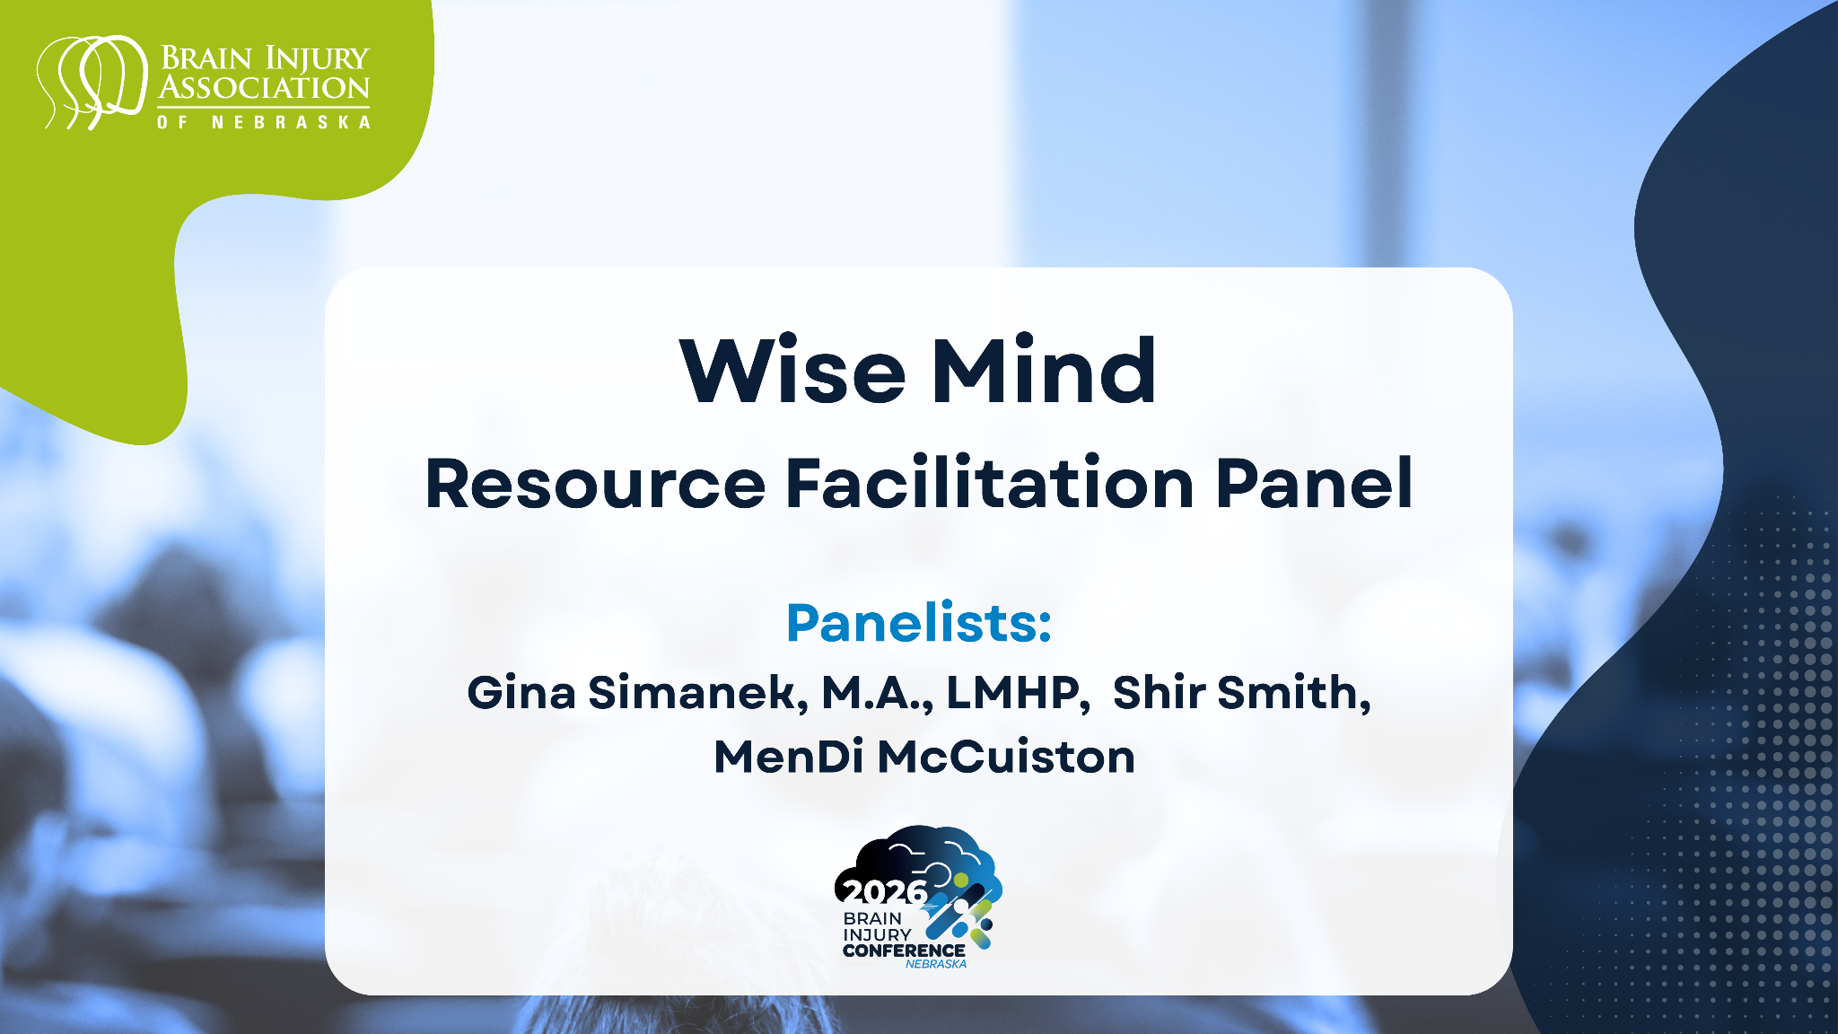

Slide 3
An Introduction to Your Wise Mind

Slide 4
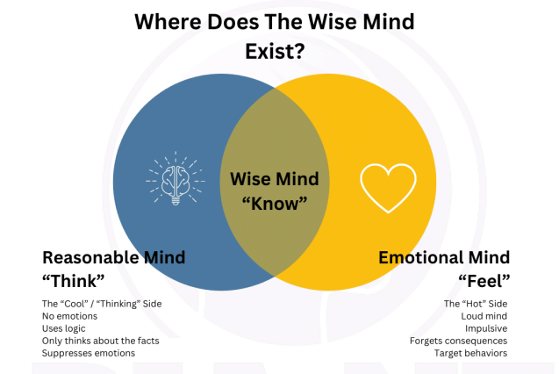
Balance of Both Emotion and Reason
Notes:
Concept by Marsha Linehan (DBT)
We practice to strategies to help create balance between the reasonable mind and the emotional mind.
Reasonable Mind: Logical, facts-driven
Emotional Mind: Feelings-driven, impulsive
Wise Mind: Calm, balanced, grounded

Slide 5
Goals of Wise Mind Training
Live in the moment
Cope with stress
Regulate emotions
Improve relationship
Notes:
Goals:
Live in the moment
Cope with stress
Regulate emotions
Improve relationships

Slide 6
Weekly Wise Mind Lessons
Qualities of a Wise Mind
Mental Models
Responding vs. Reacting
The Ladder of Inference
Acceptance of Others
Anger
Boundaries
The 4 Basic Styles of Communication
Healthy vs. Controlling Relationships
Effects on Children who Live with DV
Victim Mentality
Life Laws and Strategies Behind Them

Slide 7
Mindful Practices Used by a Wise Mind
Gratitude
Positive Self Talk
Breath work
Journaling
  Guided journal prompts
  Mental Noting level 1
  Mental Noting level 2
Meditation
  Progressive Muscle Relaxation
  Imagery practice
  Body scan

Slide 8
Qualities of the Wise Mind

Slide 9
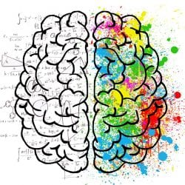
Two States of Mind
Reasonable Mind
A logical and rational state of thinking defined by facts and common sense. Essential to learning skills; you need to understand how a skill works and when to apply it. Helps you define a problem objectively and determine a solution. The more you learn and practice, the stronger the Reasonable Mind becomes.
Emotional Mind
A passionate, extreme, and intense state that makes rational, logical thinking difficult. Takes over when emotions control your thinking and behavior. Can also lead to out-of-control behavior, creating chaos, hurt feelings, and more problems.
This Photo by Unknown Author is licensed under CC BY

Slide 10
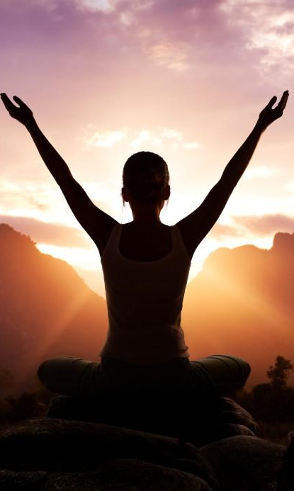
Wise Mind: Blending of Both
Wise Mind utilizes mindful practices and helps us to bring together the logic of the reasonable Mind and the sensitivity of the emotional Mind to a serene state of Mind.
By learning and practicing these skills, you will develop a Wise Mind that empowers you to change behaviors, emotions, and thinking patterns associated with problems in living, especially those causing misery and distress.
This Photo by Unknown Author is licensed under CC BY-SA

Slide 11
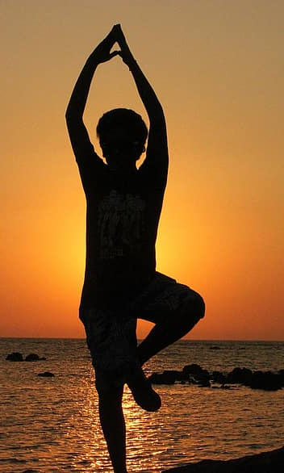
Qualities of the Wise Mind
Calmness, courage, confidence
Sees reality clearly, avoids all-or-nothing thinking
Acts with awareness and willingness
‹#›

Slide 12
Benefits of Mindfulness Practices
Reduced rumination
Stress reduction
Boosts to working memory
Focus
Less emotional reactivity
More cognitive flexibility
Relationship satisfaction
Notes:
According to the American Psychological Association:
https://www.apa.org/monitor/2012/07-08/ce-corner

Slide 13
Gratitude
Gratitude: the appreciation of what is valuable and meaningful to oneself.
Gratitude letter:
Gratitude conversation
Gratitude journal:
  Write down 3 things you are grateful for
Utilize the following apps to track your gratitude:
  https://www.gratefulness.me/
  https://the3goodthings.org/about
Notes:
Source: https://files.eric.ed.gov/fulltext/EJ1112485.pdf

Slide 14
Mental Models
(Perception vs Reality)

Slide 15
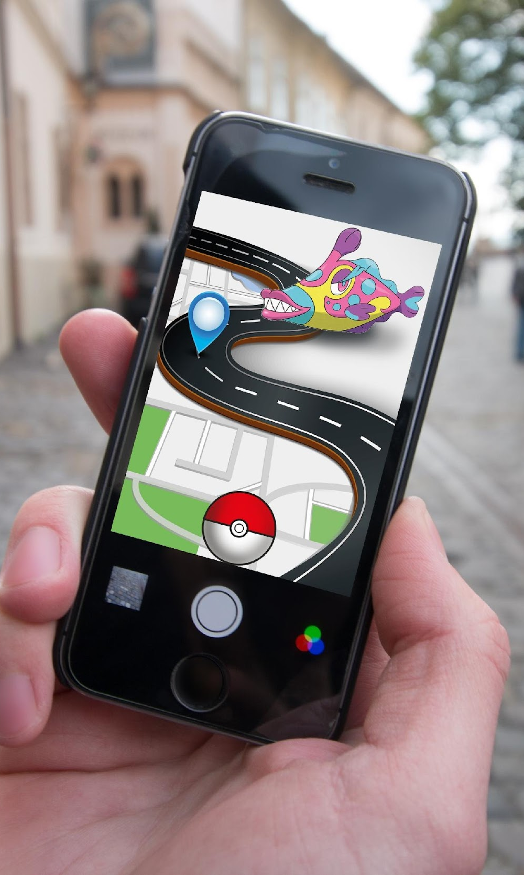
What’s a Mental Model
Deeply-held beliefs shaped by experience of how the world works.
What a person thinks is true, not necessarily what is actually true.
An explanation of someone’s thought process about how something works in the real world.
A representation of the surrounding world & their perception of it.
Shape how a person views their world & their behavior in it.

Slide 16
What Make up Mental Models
Values
Beliefs
Experiences
Concepts
Our Environment
Ideas
Assumptions
Images
Language
The Examples of Others Around Us

Slide 17
What’s a Mental Model
Mental Models can limit us to familiar ways of thinking and acting (or REACTING).
Often, we are not even consciously aware of our own Mental Models or how they affect our behaviors.
Perception ≠ Reality

Slide 18

Positive Self Talk
Positive self-talk is a strategy that we can use to help us get through anxiety provoking situations.
It helps us to break stress up and involves focusing on positive rather than negative statements.
This Photo by Unknown Author is licensed under CC BY-NC-ND
Notes:
Source: https://extension.purdue.edu/4-H/_docs/coping-skills-positive-self-talk.pdf

Slide 19
Self-talk Preparation
As we are about to enter a situation or face something that we find daunting, we can help ourselves to prepare with positive statements such as:
  “It’s not going to be as bad as I think.”
  “It won’t last long and I can cope.”
  “I am getting better and need to re-build my confidence.”
  “If I do get bad feelings, I know they won’t last long and I can cope with them.”
  “It’s better to go than not to go. Worry doesn’t help.”
  “I might enjoy it if I go.”
Notes:
Source: https://extension.purdue.edu/4-H/_docs/coping-skills-positive-self-talk.pdf

Slide 20
Self-talk Coping
In order to help us cope and stay in the situation, we can use positive statements such as:
  “Concentrate on what is going on….not how I feel.”
  “This is just anxiety; it is an unpleasant feeling, but I’ve never been ill.”
  “Concentrate on what I have to do.”
  “I know I am going to be OK.”
  “The feelings always pass.”
  “Relax and think positively.”
  “One step at a time.”
  “Anxious feelings are unpleasant, but not harmful or dangerous.”
Notes:
Source: https://extension.purdue.edu/4-H/_docs/coping-skills-positive-self-talk.pdf

Slide 21
Self-talk Review
Comments to help you review your achievement and give yourself praise:
  “I coped with that.”
  “I achieved that; I am getting better.”
  “I handled that; it should be easier next time.”
  “I can be pleased with the progress I’m making.”
  “I did that well.”
  “If I keep this up, I’m going to get really good at this.”
Notes:
Source: https://extension.purdue.edu/4-H/_docs/coping-skills-positive-self-talk.pdf

Slide 22
Responding vs. Reacting

Slide 23

Responding
Responding: taking your time to consider how you will deal with a person or situation carefully
When you respond, you control yourself and your behavior, not the other person.

Slide 24

Reacting
Reacting is a knee-jerk, spontaneous response and is done with little or no thought.
When you react, you give your control away.
Top of the list emotion: Anger. Which means your buttons got pushed. They are your buttons. You are responsible for them.
“React”- You hit me; I will hit you. You cheated; I’ll cheat. You made me mad; I’ll break your favorite doll. You yelled at me; I will yell back.

Slide 25

Feeling Triggered???
Ask yourself:
1. Is the action I am planning FAIR?
2. Who will BENEFIT from this action?
3. Would I be okay on the receiving end?

Slide 26
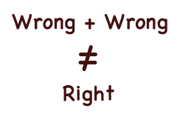
Reacting vs. Responding
You have the choice to approach it mentally or emotionally.
You have to learn when you react, you:
  Refuse to listen
  Emotionally speed up
  Attack rather than address issues
  Create confusion rather than add clarity
  Take people down a negative road
  Every time you react, you lose control of the environment and turn an opportunity into an obstacle for everyone involved.

Slide 27
Choice 1: REACTION (Broken Vase)
Your first reaction is often a flood of emotions and thougths
Acting immediately may make others feel intimidated and uncomfortable
Negative emotions won't fix the situation (the vase is still broken)
An emotional reaction can escalate a small accident into a ruined date
Creates a tense hostile environment for everyone involved
Strong reactions can damage relationships and take time to repair

Slide 28
Choice 2: RESPONDING
Responding is a positive approach
You can choose an outcome in which everyone walks away feeling good simply by putting a bit of distance between you and the event, either time or physical distance.
Ask yourself these questions:
Is this a big deal?
Was it intentional?
Is this worth ruining a relationship over?

Slide 29
Choice 2: RESPONDING
How to respond:
1. Space
2. Compassion
3. Tone
4. Let it go
Notes:
1. Space: Create a gap between you and the situation, either time or distance.
2. Compassion: Try to put yourself in the other person’s shoes.
3. Tone: Choose your tone carefully when speaking to someone over an incident that may have upset you.
4. Let it go: Once you’ve addressed the situation and have gotten your point across, let it go.

Slide 30

Overreacting
Overreacting can include anything from tears or a chip on your shoulder to a massive display of anger.
Overreacting harms you. Acting out aggressively by hitting a wall may damage a person’s hand, but negative emotions do even more damage.
Overreacting can also injure your relationships with people.
This Photo by Unknown Author is licensed under CC BY-SA

Slide 31
Awareness of Emotions/Thoughts
Awareness of Emotions:
You need to know what is happening inside your head.
Ask yourself: if the same situation happened to someone else, would the reaction be the same?
Awareness of Thoughts:
You need to figure out what triggers or magnifies your thoughts.
When someone reacts – it speaks volumes about them. If you overreact, it says volumes about you.

Slide 32
Breathwork
Techniques that help us focus on our breath!
Helps calm you down and move your body and mind out of fight-or-flight mode.
  Your sympathetic nervous system is responsible for your body’s “fight-or-flight” response. It increases when you’re stressed or in danger.
  Your parasympathetic nervous system is the “rest-and-digest” part of your brain. It relaxes your body after periods of stress or danger.
Breathwork your body’s parasympathetic nervous system and help you de-escalate and de-stress.
There are a variety of breathwork techniques you can try, all of them with a similar goal — to help you destress.
Notes:
Source: https://health.clevelandclinic.org/breathwork

Slide 33
4-7-8 Breath Practice
Place yourself into a comfortable but upright seated position, with your back straight.
Exhale completely through your mouth, making a “whoosh” sound.
Close your mouth and inhale quietly through your nose to a mental count of four.
Hold your breath for a count of seven.
Exhale completely through your mouth, making a whoosh sound to a count of eight.
That was one complete breath. Now, inhale again and repeat the cycle three more times for a total of four breaths.

Slide 34
The Ladder of Inference

Slide 35
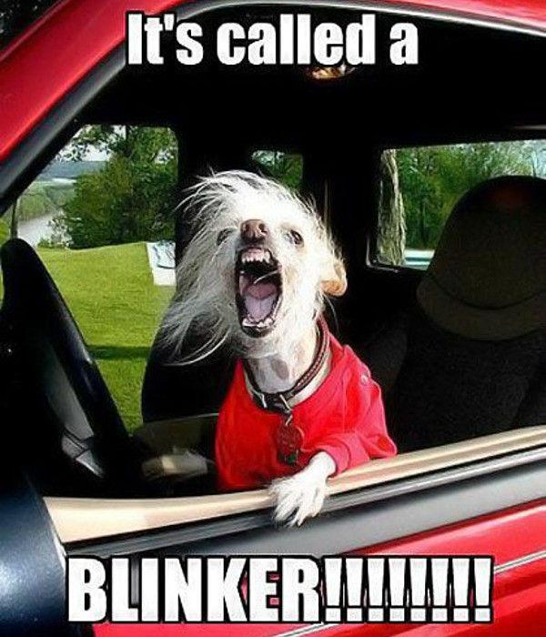
Let’s Consider this Scenario
This Photo by Unknown Author is licensed under CC BY
Notes:
Imagine driving down the road at a sedate 40 miles per hour in fairly heavy traffic. A small, beat-up sedan comes up behind you, dodging in and out of traffic, traveling far too fast for conditions. He cuts in front of you, almost taking off your front bumper. Hanging his head out the driver’s side window, he shouts something at you and speeds away, continuing to weave quickly through traffic. Your first thoughts are probably: What an Idiot! or something more forceful. Because of our culture, most of us assume it is inappropriate to flaunt traffic laws or endanger other drivers. You know from the kind of car the person was driving and the way he was behaving that this is some deadbeat nut who shouldn’t have a driver’s license. You may feel this so strongly that you offer the fellow a disparaging salute as he drives away. You have observed a situation, applied your filters and assumptions about proper highway etiquette and behavior, and have concluded about that person's character and motivation, and you have acted on your findings.

Slide 36
How the Ladder of Inference works
Observe data
Select data from observation
Add meaning to data
Make assumptions based on the meaning I have added
Draw conclusions that prompt feelings
Adopt beliefs about the world
Believe some form of action is necessary

Slide 37
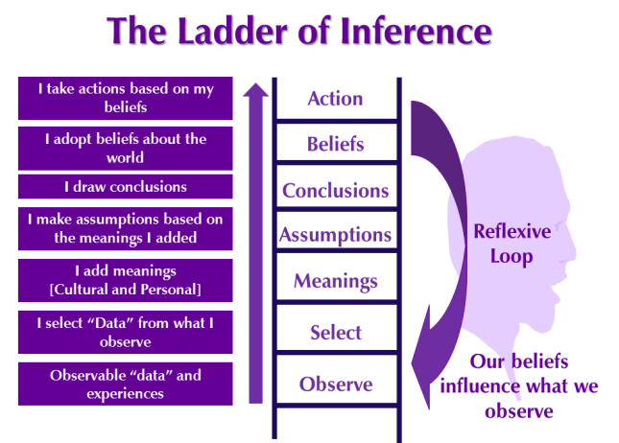

Slide 38
Wise Words to Consider
“Consider how hard it is to change yourself and you’ll understand what little chance you have in trying to change others.” ~Unknown
“What someone thinks of you is none of your business.” ~Unknown
“We judge ourselves by our intentions. And others by their actions.” ~Stephen Covey
“Judging a person does not define who they are. It defines who you are.” ~Kristen Stewart
“Be curious, not judgmental.” ~Walt Whitman
“Before you assume, learn the facts. Before you judge, understand why. Before you hurt someone, feel. Before you speak, think.” ~Unknown

Slide 39
Mental Noting – Thoughts
Noting Your Thoughts
Find a comfortable space you won’t be disturbed
Set a timer for 5 minutes
Structure your observations as: “I am thinking about X”
  Keep them short – don’t analyze your thoughts
Notes:
https://dialecticalbehaviortherapy.com/mindfulness/mental-noting/?utm_source=DialecticalBehaviorTherapy.com&utm_campaign=7c2750e53d-EMAIL_CAMPAIGN_2025_04_07_02_00&utm_medium=email&utm_term=0_fe10fb5f68-7c2750e53d-9570349

Slide 40

Examples:
I am thinking about how my work day went.
I am thinking about my dog.
I am thinking about the movie that I saw yesterday.
I am thinking about the plot of the book that I'm reading.
This Photo by Unknown Author is licensed under CC BY

Slide 41
Acceptance of Others

Slide 42
Expectations
Having expectations of others is dangerous.
Expectations of others can lead to disappointment or resentment
Be honest about unrealistic expectations (e.g., expecting others to act how you would)
Take responsibility for how your expectations shape your emotions
Ask yourself: Are you hurt because others didn’t meet your expectations?

Slide 43
People Don’t Disappoint; Expectations Do
We expect others to behave how we think they should
This projects our own values and needs onto them
Others likely won’t meet these expectations
The result: disappointment—not from them, but from our own unmet expectations

Slide 44

Expectations Get us in Trouble
Why Expectations Cause Problems
They’re often unrealistic or unfair
They’re one-sided—we set them without agreement
Others may not even know what we expect from them
This Photo by Unknown Author is licensed under CC BY-NC-ND

Slide 45
Try This
Instead of having expectations, try making requests
ASK for what you want rather then just expecting
Give choice in your request. No choice feels like an order rather than a request
Learn boundaries (week 7)
  Negotiate your requests and release expectations

Slide 46
Remember…
You must try accept the things you cannot change,
and change the things you can!

Slide 47
Mental Noting - Experiences
In this level, you will note your thoughts, emotions, observations, and physical sensations. Basically, you will note any experience that may arise in you.
Don’t analyze or judge your experiences
Simply describe them as an objective observer
Noting Your Experiences
Find a comfortable space you won’t be disturbed
Set a timer for 10 minutes
Notes:
There are several useful ways in which you can structure your observations: Notice that by describing your experiences (emotions, thoughts, events), instead of analyzing or labeling them, you can remove a layer of unnecessary suffering.
Maybe you do have an objective problem, a negative feeling or thought, or an inconvenient event. If you are being overly reactive to it, however, this can make the entire situation more difficult for yourself. This is how mental noting can bring clarity and calmness to situations (Fronsdal, 2008).

Slide 48
Structuring mental noting experiences
1. I am thinking about X.
2. I feel the emotion Y.
3. When I think about X, the emotion Y occurs in me.
4. When the event X happens, I feel Y and my thoughts are Z.

Slide 49
Examples:
I feel nervous when I think about finding a parking space tomorrow.
When I'm having an argument with my boyfriend (event), I feel extremely angry.
I am thinking about how hard it is for me to meet new people, and that makes me feel sad.
I feel irritable, and that makes me feel like arguing with my family.
After my retirement (event), I feel very lonely.
This Photo by Unknown Author is licensed under CC BY

Slide 50
Anger

Slide 51
What We’ve Been Taught About Anger
By age 5, many of us have already learned through observation, physical punishment, shaming or have having love and affection withdrawal, that anger is unexpectable.
Anger is a learned reaction, not hereditary.

Slide 52
Learning Healthy Anger Expressions
First, we must understand what we have been taught about anger:
How do you feel when someone is angry at you?
What is the first thing you want to do when you realize someone is angry at you?
Does your reaction differ depending on who is mad at you?
Is it possible to be angry without yelling, swearing, throwing things, saying mean things, etc.?
Can anger be expressed quietly?

Slide 53
Anger – the emotion
Anger is an emotion and reactive to the way we are thinking.
Emotions follow thought and are responders
What you are thinking is usually what you are feeling.
Anger is a choice.

Slide 54
5-Step Approach to Managing Anger
These five steps are straightforward when calm but much more challenging to work through when angry.
They will take practice, but will get easier with time.

Slide 55

Step 1
1. Tune into your feelings. (Self-Awareness)
What got me angry?
Why am I feeling this way?
Put into words what is making you so upset so that you can act instead of react.

Slide 56

Step 2
2. Stop and think. (Self-Control)
This is where you stop what you are doing or thinking about and give yourself time to manage your anger.
You think about what you need to do before you do it.
This Photo by Unknown Author is licensed under CC BY-SA

Slide 57
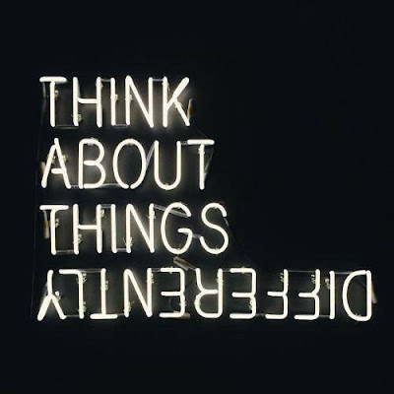
Step 3
3. Consider your options. (Think It Through)
This is where you think about what might happen if……
Think of every reaction and what is most likely to occur.
This Photo by Unknown Author is licensed under CC BY-NC-ND

Slide 58

Step 4
4. Make a decision.
(Pick One Of Your Options)
Now, take action by selecting one of the options you listed.
Once you choose your solution, then it’s time to act on it.

Slide 59

Step 5
5. Check your progress.
After the situation is over, think about how it went.
How did you do?
Are you satisfied with the choice that you made?
This Photo by Unknown Author is licensed under CC BY-SA

Slide 60
Wise Words to Consider About Anger
“Holding on to anger is like grasping a hot coal with the intent of throwing it at someone else; you are the one who gets burned.”
“Anger always comes from frustrated expectations.”
“If you are patient in one moment of anger, you will escape a hundred days of sorrow.”

Slide 61

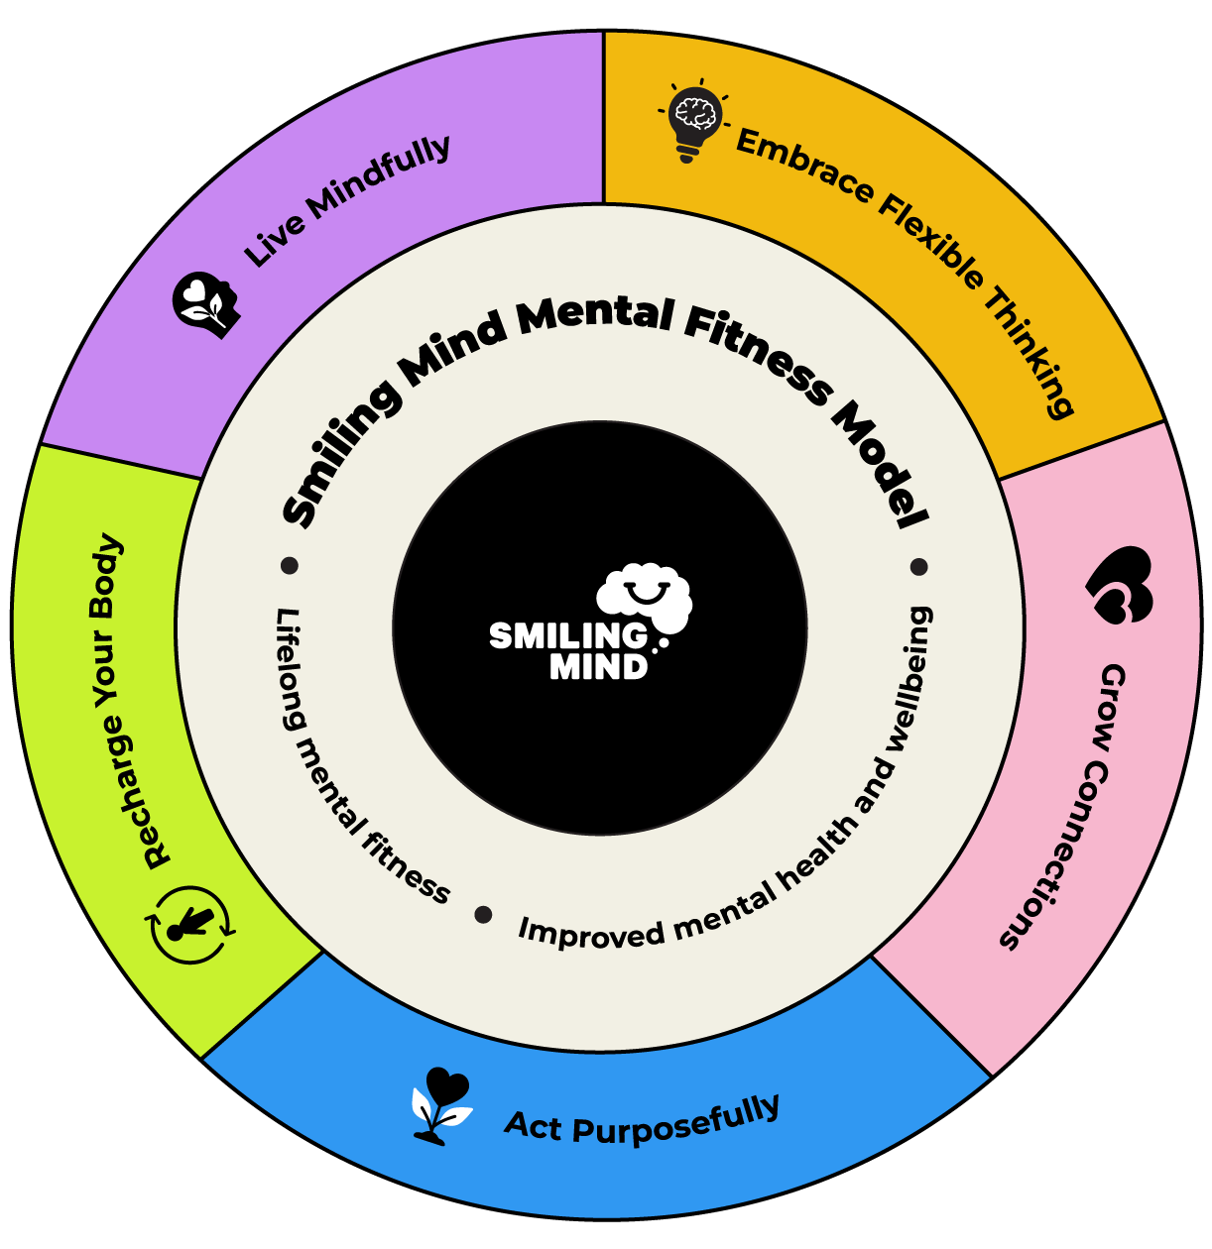
Meditation Practice – Smiling Mind
https://www.smilingmind.com.au/smiling-mind-app/
Notes:
Live Mindfully
Skills to help us be present, pay attention and respond well to the things that happen around us.
Embrace Flexible Thinking
Skills to help us make decisions, solve problems and be creative.
Grow Connections
Skills to help us build good relationships with others and ourselves.
Act Purposefully
Skills to help us understand our strengths, values and how we want to make a difference.
Recharge Your Body
Skills to support our mind and body through movement, rest, relaxation and sleep.

Slide 62
Boundaries

Slide 63
What is Respect
Respect is listening without interrupting.
Respect is taking other’s feelings into consideration.
Respect is keeping an open mind.
Respect is agreeing to disagree.
Respect is trying to understand other points of view.
Respect is loving yourself.
Respect is trust and honesty.

Slide 64
What is Respect
Respect is giving each other space.
Respect is nonviolence.
Respect is direct communication.
Respect is building a person up instead of tearing them down.
Respect is friendship.
Respect is not pressuring the other person.

Slide 65

Affirmations of Your Basic Rights
Nobody has the right to know my mind or my business or to tell me what to think, what to feel or what to do.
I have a right to my own thoughts, feelings, values, and beliefs.
What I share with others about matters that concern me is determined by what feels right to me - not what they want.
If people are abusive or disrespectful to me, I have a right to tell them so, to ask them to stop and/or to avoid them.
I will not be abused or to be disrespected.
I have a need and right to love myself, respect myself and to stand up for myself.
This Photo by Unknown Author is licensed under CC BY-NC-ND

Slide 66
Affirmations of Your Basic Rights
I have a right to be who I am and to harmlessly live my own life regardless of whether others don’t like it.
I don’t have to feel guilty for not behaving as others might want me to or for not giving other what they expect of me.
I accept myself just as I am.
I accept my right to my imperfection and shortcomings without guilt.
I believe that we should do unto others as we would have them do unto us.
I believe that if I am true to myself and live my truth, I will be okay.

Slide 67

Boundaries
Learning how to set boundaries is a vital part of learning to own yourself, of learning to respect yourself, of learning to love yourself.
If you never have to set a boundary, then you will never get in touch with who you really are, you will never learn to define yourself in a healthy way.
This Photo by Unknown Author is licensed under CC BY-NC-ND

Slide 68
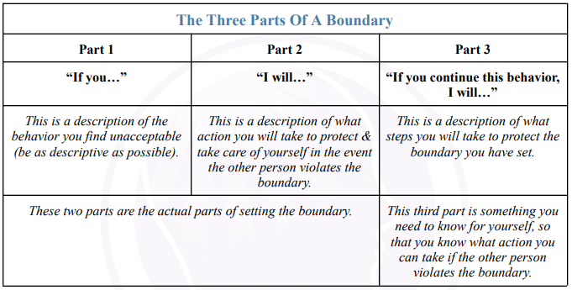

Slide 69
What Setting Boundaries are NOT
Setting a boundary is not making a threat
Setting a boundary is not an attempt to control the other person
Setting a boundary is not a more sophisticated way of manipulation

Slide 70

Setting Boundaries
Setting boundaries means that you are taking responsibility, being an adult and demanding equality and respect in a relationship.
Setting boundaries is your right to say NO to those things that aren’t right for you.
Setting boundaries is learning to take care of yourself, no matter what happens, where you go or who you are with.
Boundaries emerge as we learn to value, trust, and listen to yourself.
Boundaries emerge from a belief that what you want, need, like and dislike is important.
This Photo by Unknown Author is licensed under CC BY-SA

Slide 71
Clues to boundaries you need to set:
Anger
Rage
Complaining
Whining
Feeling threatened, suffocated, or victimized

Slide 72
Tips for setting boundaries
When you identify a need to set a boundary or a limit with someone, do it clearly, preferably without anger and in as few words as possible.
You cannot simultaneously set a limit with someone and also take care of their feelings, they may be hurt, angry or disappointed with you.
When you first begin to set boundaries, you may feel unfamiliar feelings such as shame and/ being afraid.
Be prepared to follow through by maintaining the boundaries you set.

Slide 73
Tips for Setting Boundaries cont.
You will be tested when you set boundaries.
Some people are happy to respect your boundaries.
A support system can be helpful as you strive to establish and enforce boundaries.
You will set boundaries when you are ready and not a minute sooner.
There is a satisfying side to setting boundaries - it feels good.

Slide 74
Maintaining Personal Boundaries
Ask directly for what you want. This shows who you are to others.
Be honest and truthful with yourself. This creates a sixth sense within you that lets you know when a relationship has become hurtful, abusive, or invasive.
Be objective about others' behavior toward you without getting caught in their drama.
Maintain a bottom line - a limit to how many times you will allow someone to say no, to lie to you, to disappoint you, or betray you before you will admit the painful reality and leave.

Slide 75
Journaling
Journaling can be a powerful tool for:
Self expression
Emotional regulation
Cognitive rehabilitation
Promoting a sense of control
Personal Growth

Slide 76
Journaling Prompts
Self-Reflection Prompts:
How do I feel today? Reflect on your current emotions and what might be influencing them.
What am I grateful for? List at least five things you appreciate in your life and why they matter to you.
What is my biggest lesson learned this week? Consider a recent experience and what it taught you.
Creative Exploration:
Describe yourself in three words. Explain why you chose those words.
What are five things that make you unique? Think about your interests, skills, and personality traits.
What’s a dream you’ve always had but never pursued? Explore what has held you back and how you might start pursuing it.

Slide 77
Journalling Prompts cont.
Future Aspirations:
What do I want to achieve this month? Set a goal and outline steps to reach it.
What am I looking forward to? Write about events or experiences that excite you.
How can I experience more joy in my life? Reflect on activities or changes that could enhance your happiness.
Daily Reflections:
What made me smile today? Capture moments of joy or humor from your day.
What challenges did I face today, and how did I handle them? Reflect on your problem-solving skills and resilience.
What do I need most right now? Consider your emotional or physical needs and how you can address them.

Slide 78
The Four Basic Styles of Communication

Slide 79
Passive Communicators will:
Fail to stick up for themselves
Allow others to infringe on their rights
Fail to express their feelings, needs, or opinions
Tend to speak softly or apologetically
Exhibit poor eye contact

Slide 80
Aggressive Communicators will:
Try to dominate others
Use humiliation to control others
Criticize, blame, or attack others
Speak in a loud, demanding, and overbearing voice
Not listen
Interrupt frequently
Have piercing eye contact and an overbearing posture

Slide 81
Passive-Aggressive Communicators will:
Mutter to themselves rather than confront the person or issue
Have difficulty acknowledging their anger
Use sarcasm
Deny there is a problem
Appear cooperative while purposely doing things to annoy and disrupt
Use subtle sabotage to get even

Slide 82
Assertive Communicators will:
Feel in control of self
Feel connected to others
Feel competent and in control
Express feelings and state needs and wants:
  clearly
  Appropriately
  respectfully
Communicate respect for others
Listen well without interrupting
Have good eye contact
Speak in a calm and clear tone of voice
Stand up for their rights

Slide 83
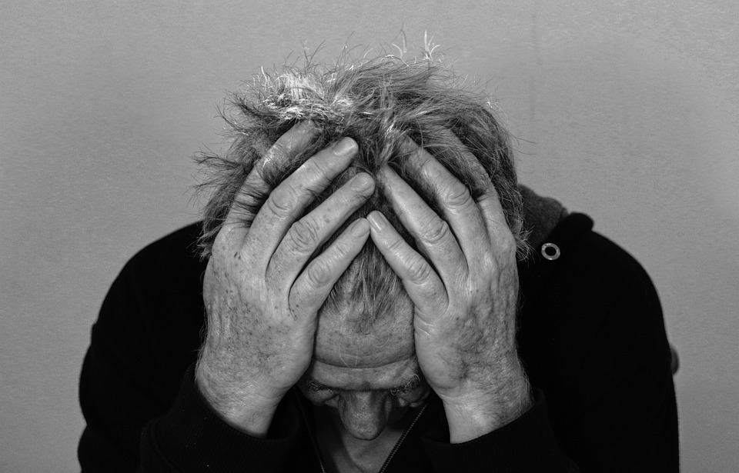
Let’s Talk About Guilt
Feeling of responsibility for negative things that happen to you or others.
Feeling of regret for your real or imagined misdeeds.
Sense of remorse for thoughts, feelings, or attitudes that were negative or non-accepting concerning yourself or others.
Feeling of obligation for not pleasing or helping another.
Feeling of bewilderment for not responding to a situation properly.
Feeling of loss or shame for not having done or said something to someone that is no longer available to you.
Accepting responsibility for someone else's misfortune or problem because of you.
Driving force producing irrational beliefs that remain hidden from others.

Slide 84
Let's Talk About Fear
FEAR is:
Fear creates limitations.
Fear feeds guilt.
Fear lies and manipulates.
Fear perpetuates worry.
Fear distorts reality.
Fear is a short-term motivator.
Fear lets the imagination run out of control.
Fear keeps us from making decisions.
Fear causes doubt.
F: false
E: evidence
A: appearing
R: real

Slide 85
Communication Tips:
Figure out what you are sticking up for.
Be ok with a bit of selfishness.
Speak deliberately and with attention.
Count to 10 before you speak.
Make “no” your favorite word.
Avoid excuses.
Remember: You deserve to be respected!
Master the art of body language.
Don’t leave it unsaid.

Slide 86

Meditation – Body Scan
A practice involving scanning your body for pain, tension, or anything out of the ordinary.
Benefits: improve sleep, pain, stress and anxiety
10 Minute Body Scan Meditation (Titled 10 Minute Mindfulness Body Scan-Becoming Aware of Sensations on Youtube)
5 Minute Guided Imagery Meditation
This Photo by Unknown Author is licensed under CC BY
Notes:
Source: https://www.healthline.com/health/body-scan-meditation#benefits

Slide 87
Healthy Vs. Controlling Relationships

Slide 88
Controlling Relationships
Does your significant other….
Lose their temper more than seems necessary?
Jealous of your friends, family or time spent with them?
Want you to spend all your time with them?
Put down your friends?
Need to know who you talk to and about what?
Say hurtful things about your family?
Blame others for everything that happens to them?
Pressure you to give up activities not done with them?
Make fun of things that are important to you?
Break or throw things when angry?

Slide 89
Controlling Relationships cont.
Does your significant other….
Get angry if you disagree or say no?
Drop in or call a lot when you are not together?
Say “I love you” shortly after meeting them?
Criticize everything you do?
Embarrass you in front of others?
Tell you they can’t live without you?
Not trust you or anyone else?
Accuse you of wanting to be with someone else?
Have a poor relationship with mother/father?
Ever mistreat a pet?

Slide 90
Controlling Relationships cont.
Do you ever:
Feel guilty about things you never felt guilty about before?
Feel like you can do nothing right?
Think about every word you say or don’t say?
Act like a different person when you are together?

Slide 91
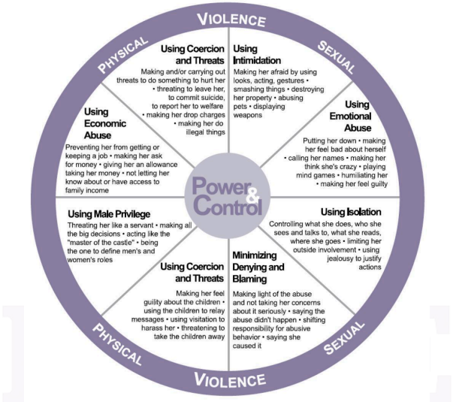

Slide 92
Characteristics Of Healthy Relationships
Trust:
Building trust requires mutual self-disclosure by sharing things about yourself.
As time passes, opportunities to test and evaluate that trust emerge.
As confidence grows, the relationship becomes a great source of comfort and security.
If you feel you must hide things from your partner, you may lack this essential trust.

Slide 93
Characteristics Of Healthy Relationships
Openness and Honesty
What matters most is whether each partner feels comfortable sharing their hopes, fears, and feelings if they choose.
Healthy couples don’t need to be together all the time or share everything.
Healthy boundaries in a relationship allow you to still do the things that are important to you, while still sharing important things with your partner.
A partner with unhealthy expectations of openness and honesty might expect to know every detail of where you are and what you’re doing, restrict who you can spend time with, or demand access to your social media accounts.

Slide 94
Characteristics Of Healthy Relationships
Good Communication
One study found that a couple’s communication style was more important than stress, commitment, and personality in predicting whether married couples would eventually divorce.
Knowing how to argue and effectively resolve differences of opinion is more important than simply avoiding arguments to keep the peace.
When conflicts arise, those in healthy relationships can avoid personal attacks and remain respectful and empathetic as they discuss their thoughts and feelings and work toward a resolution.

Slide 95
Characteristics Of Healthy Relationships
Give-&-Take
It isn’t about keeping score or feeling that you owe the other person.
Give-and-take in a relationship is not always 100% equal.
At times, one partner may need more help and support.
In other cases, one partner may prefer to be a caregiver.
Such imbalances are fine as long as each person is ok with the dynamic and both partners get the support they need.

Slide 96

Characteristics of Healthy Relationships
Mutual Respect:
In close, healthy relationships, people have a shared respect for one another.
They don’t demean or belittle one another and offer support and security.

Slide 97
Ways of Showing Respect:
There are several different ways that couples can show respect for one another.
Listening to one another.
Not procrastinating or stalling when your partner asks you to do something.
Being understanding and forgiving when one person makes a mistake.
Building each other up, not tearing each other down.
Creating room in your life for your partner.
Taking an interest in the things your partner enjoys.
Allowing your partner to have their individuality.
Supporting and encouraging your partner’s pursuits and passions.
Showing appreciation and gratitude for one another.
Having empathy for one another.

Slide 98
Characteristics of Healthy Relationships
Affection:
Research has shown that the initial passion that marks the start of a new relationship tends to decline, but this does not mean the need for affection, comfort, and tenderness lessens.
This passionate love eventually transforms into compassionate love, which is marked by feelings of affection, trust, intimacy, and commitment.
It is essential to remember that physical needs differ for each individual.
There is no “right” amount of affection or intimacy.
The key to a healthy relationship is that both partners are content with the level of affection that they share with their partner. A nurturing partnership is characterized by genuine fondness and affection for one another, expressed in various ways

Slide 99
Progressive Muscle Relaxation Practice
Progressive muscle relaxation (PMR) is an actively engaging relaxation technique developed by Edmund Jacobson in the 1920s.
It can be useful in reducing stress.
It has a positive influence on depression and anxiety.
Try it:
  https://www.youtube.com/watch?v=intVpw4LhMY&t=28s
  Progressive Muscle Relaxation (Titled Progressive Muscle Relaxation - A 5 minute Guided Mindfulness Meditation on Youtube)
Notes:
https://pmc.ncbi.nlm.nih.gov/articles/PMC8272667/

Slide 100
The Effects on Children Who Live with Domestic Violence

Slide 101
How children are affected by DV
Living in a violent home is deeply traumatic for children.
These experiences leave lasting imprints on memory and development.
Every part of a child's life is shaped by this trauma.
Children in abusive homes are silent victims
Long-term emotional, behavioral, and physical consequences

Slide 102

Early Warning Signs
As Early as Infancy:
Failure to thrive
Over-compliance and fearfulness
Early signs of aggression or violence toward siblings or a parent

Slide 103

Emotional & Behavioral Effects
Low self-esteem
Poor impulse control
Fear and distrust of close relationships
Conflicted loyalty between parents
Confusion over correct behavior
Psychosomatic symptoms: stomachaches, headaches, anxiety
Night terrors, bedwetting
Suicidality at higher rates than other children

Slide 104

Cognitive and academic impacts
Academic difficulties
Frequent disruptions due to fleeing the home
PTSD symptoms
Difficulty concentrating or engaging in school
This Photo by Unknown Author is licensed under CC BY-SA-NC

Slide 105
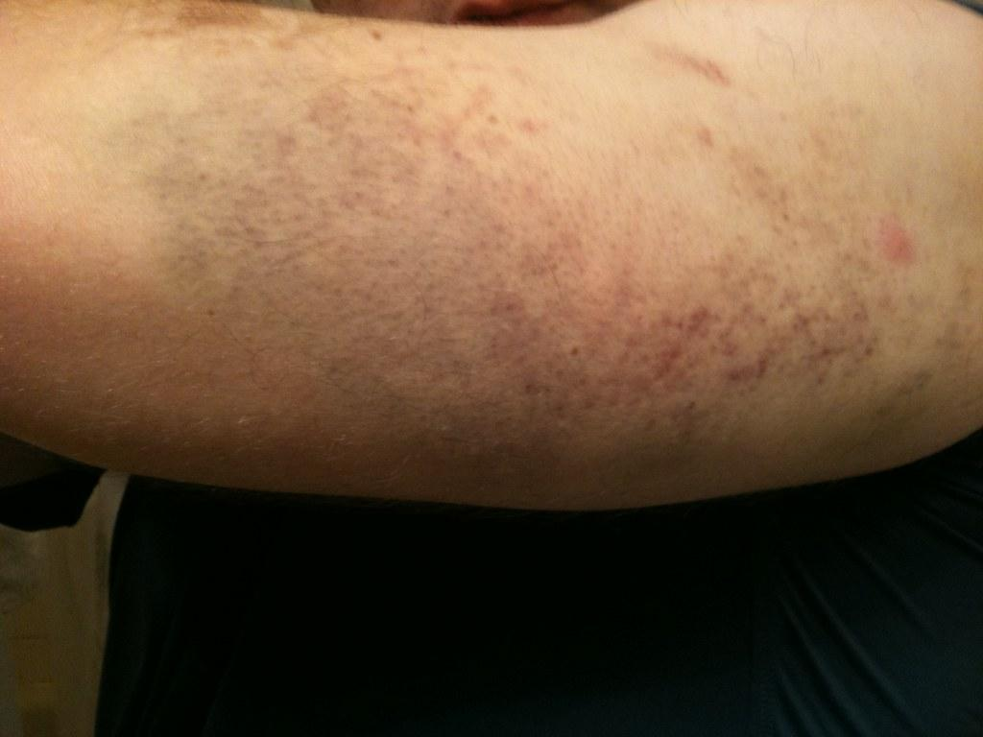
Health & Safety Risks
Poor general health
Physical injuries from violent incidents
Higher risk of abduction by abuser parent
Higher likelihood of being victims of physical and sexual abuse
This Photo by Unknown Author is licensed under CC BY-SA-NC

Slide 106

Social and Legal Outcomes
Four times more likely to be arrested
More likely to abuse alcohol and drugs
Increased risk of antisocial behavior
Higher likelihood of committing crimes or sexual assault

Slide 107
Homelessness and Instability
Frequent displacement due to fleeing abuse
Nearly 40% of U.S. homeless population are mothers and children escaping domestic violence

Slide 108

Vicious Cycle of Violence
Exposure to abuse can normalize violence
Without intervention, children may repeat abusive behaviors as adults
Violence is learned behavior—but it can be unlearned

Slide 109
The Hidden Legacy of Anger & Trauma
Anger may surface as bullying, rage, or interpersonal violence
Difficulty forming healthy relationships
Unseen emotional damage follows children into adulthood

Slide 110
Breaking the Cycle
The cycle of violence can be interrupted
Support, awareness, and trauma-informed care are critical
Healing is possible with the right intervention

Slide 111
Hydration and Sleep
Sleep:
  Crucial for maintain mental clarity and reducing risk of cognitive decline.
  7 to 8 hours of sleep is important
  Try this: go to bed and wake up around the same time, turn off all devices 1 hour before bedtime, make bedroom dark and cool.
Hydration:
  Regulates body temperature, prevents infections, and delivers nutrients to cells.
  Improves sleep quality, cognition and mood.
  Tips: Carry a reusable water bottle. Freeze water in freezer-safe bottles for ice-cold water all day. Choose water over sugary drinks. Opt for water when eating out. Serve water during meals. Add a wedge of lime or lemon

Slide 112
Victim Mentality

Slide 113
What Is Victim Mentality?
A belief that the world is conspiring against you
Constant gathering of “evidence” to prove this belief
Difficult to see truth—because it’s always being resisted
Common thoughts:
  “Woe is me”
  “Nothing ever works out”
  “It’s not my fault”
Notes:
A belief that the world is conspiring against you
Constant gathering of “evidence” to prove this belief
Difficult to see truth—because it’s always being resisted
Common thoughts:
“Woe is me”
“Nothing ever works out”
“It’s not my fault”

Slide 114
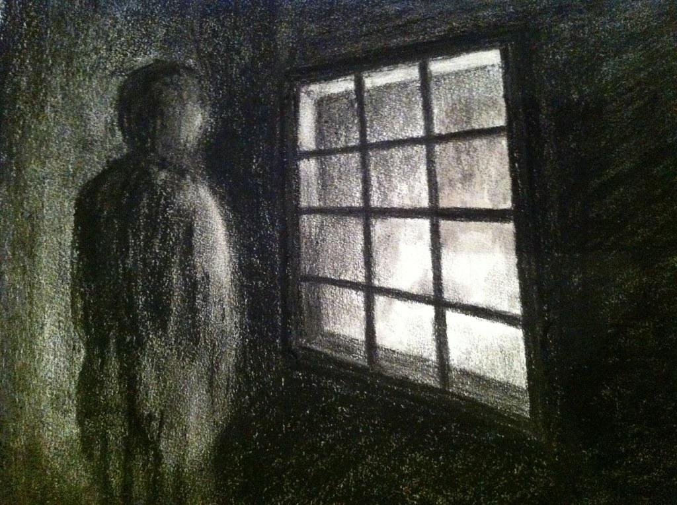
Patterns of Victim Mentality
Condemning Self – “I’m useless,” “Too many forces against me”
Separation from Responsibility – Avoids ownership or solutions
Blame & Rationalization – Blames others, justifies actions
Isolation – Waits for change instead of taking initiative
This Photo by Unknown Author is licensed under CC BY

Slide 115
The Trap of Victim Thinking
Victims feel:
  Always right
  Never responsible
  Entitled to sympathy
Belief: “Bad things always happen to me”
This mindset prevents healing and personal growth

Slide 116
Breaking Free From Victimhood
You are not what happened to you
You are what you choose to become
Key Shift: Take responsibility for your response
“I can’t control what happens, but I can control how I respond”

Slide 117
Victim vs. Proactive Mindset
Victim Mindset | Proactive Mindset
Blames others | Takes responsibility
Focuses on what’s wrong | Focuses on what can be done
Feels powerless | Believes in choice
Driven by environment | Driven by values

Slide 118
Signs of a Victim Mentality
Avoids personal responsibility
Constantly blames others
Feels helpless and stuck
Lives in self-pity
Obsesses over the past
Fixates on problems
Uses “If only” or “What if” thinking

Slide 119
Remember…
Victim mindset delays healing
Healing starts when you stop waiting and start choosing
Choose to respond intentionally, not reactively
Your life is shaped by your responses, not your circumstances
Notes:
Victim mindset delays healing
Healing starts when you stop waiting and start choosing
Choose to respond intentionally, not reactively
Your life is shaped by your responses, not your circumstances

Slide 120
Meditation - Guided Imagery
A method for treating stress and anxiety in which one replaces disturbing memories with positive mental imagery.
Sensory and contextual engagement are a key focus of this technique.
Improves relaxation and reduces stress levels.
Try this: 5 Minute Guided Imagery Meditation
Notes:
https://pmc.ncbi.nlm.nih.gov/articles/PMC8272667/

Slide 121
Life Laws and the Strategies Behind Them

Slide 122
Life Law #1:
You either get it or you don’t.
Strategy: Become one of those who gets it.
Life is a strategic game
Winners understand the rules, sharpen their skills
Stay informed and avoid misinformation
Notes:
Picture this: Life is the ultimate board game, and each decision is like making a move on the grand chessboard of destiny. The winners are the ones who've read the manual, sharpened their skills, and strategically planned their path. Meanwhile, the puzzled players might be holding the board upside down, wondering why the pieces won't cooperate. So, let's be the savvy players who tune in, gather the intel, and approach life with a winning strategy. It's like being the James Bond of your own story, armed with knowledge and a debonair sense of style. And remember, in this game of life, misinformation is the ultimate villain – so watch out for those cunning plot twists

Slide 123
Life Law #2:
Create your own space.
Strategy: Acknowledge and accept accountability for your life.
Your life is shaped by your choices
Happiness is created, not accidental – setp out of the victims script
Stop blaming, start building – Take charge with every choice you make
Notes:
Strategy: Take accountability
Your life is shaped by your choices
Happiness is created, not accidental
Stop blaming, start building

Slide 124
Life Law #3:
People do what works.
Strategy: Identify the payoffs that drive your behavior and that of others.
Behavior is driven by reward
Use self-awareness to uncover motives
Break unhealthy patterns by trying new responses
Notes:
Picture this: You're the master detective of your own behavior, hunting down those elusive payoffs. They might be hiding in the shadows, dressed as acceptance, approval, or love. But fear not, because you've got the magnifying glass of self-awareness to expose them!
Imagine your behaviors as characters in a thrilling drama. There's the protagonist seeking immediate gratification, tempted by the alluring aroma of a quick payoff. But wait! Is there a subplot of self-punishment or distorted self-importance lurking in the background? The plot thickens! Now, let's sprinkle in a dash of courage. It's time to try something new, my fearless friend! Break out of the routine, put yourself on the line – it's the daring plot twist that leads to character development and personal growth. And here's a cliffhanger for you: Could it be that your behavior is secretly controlled by the fear of rejection, that sneaky antagonist trying to keep things status quo? Don't be fooled – change might seem daunting, but it's the hero's journey toward a brighter future! So, grab your popcorn (or a healthier snack if you're watching those payoffs), sit back, and enjoy the thrilling adventure of unraveling your behavior's hidden motives. It's a blockbuster in the making!

Slide 125
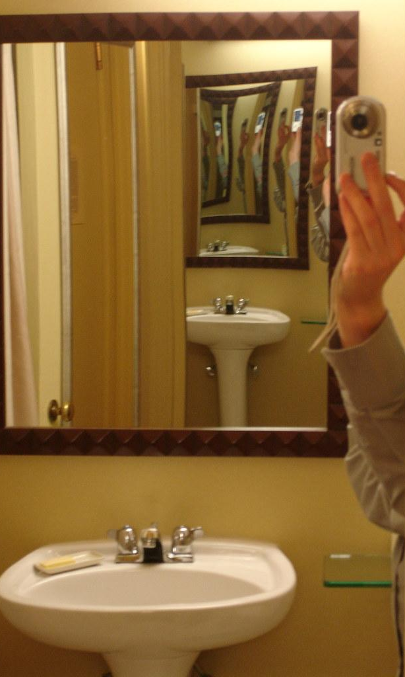
Life Law #4:
You cannot change what you do not acknowledge
Strategy: Get real with yourself about life and everybody in it.
Face the truth without excuses
Awareness is the first step toward change
Ditch the, “I can’t!” and embrace the, “I will!”
This Photo by Unknown Author is licensed under CC BY
Notes:
Remember, your life is like a DIY project – it might need a bit of fixing, but hey, that's where the magic happens!

Slide 126
Life Law #5:
Life rewards ACTION.
Strategy: Make careful decisions and then take action
Thoughts are great, actions are greater
Pain fuels your growth story
Step out of your comfort zone
Notes:
! Imagine this: the world is like a giant dance floor, and your thoughts are the music. But guess what? People are tired of just hearing the beats – they want to see some epic dance moves! Talk may be cheap, but your actions? That's where the real show begins. Picture this: You're the director of the blockbuster film that is your life. Don't just write a script full of intentions and words; bring in the action heroes! Measure success in results, not just in the awesome lines you wrote. Now, about that pain you're feeling – turn it into your superhero origin story. Use it to swing from one challenge to the next, like the superhero you were born to be. Your dreams? Non-negotiable. Don't put them on the clearance rack – they're VIP, front-row tickets to the life you deserve. Ready for the grand finale? Take that leap, break out of your comfort zone, and let the world witness your spectacular performance. The familiar is cozy, but the unknown? That's where the real adventure begins! Lights, camera, action – your life is the blockbuster hit of the century!

Slide 127
Life Law #6:
There is no reality, only perception.
Strategy: Identify the filters in which you view the world
Perception shapes your world
Challenge distorted thinking
Update your inner lens with awareness
Notes:
In this grand concert of existence, you hold the power to choose the vibes you want to groove to. Those past events? They're like the old tracks on the playlist. You can either let them dictate the beat, or you can hit shuffle, remix the melody, and create a dancefloor of fresh perspectives! Filters are like funky glasses you wear, and sometimes they're a bit smudged. But fear not! You've got the lens cleaner of self-awareness. Wipe away those fixed beliefs, challenge the status quo, and suddenly, the world becomes a dazzling kaleidoscope of possibilities! So, let's dance to the rhythm of change, challenge those filters, and embrace the vibrant remix of your perspective!

Slide 128

Life Law #7:
Life is managed, not cured.
Strategy: Learn to take control of your life and hold on
You’re the captain of your life
Build resilience and adapt to changes
Use emotional regulation and planning
This Photo by Unknown Author is licensed under CC BY-SA

Slide 129
Life Law #8:
We teach people how to treat us.
Strategy: Own, rather then complain about, how people treat you
Set clear boundaries
Stop rewarding poor behavior
Redefine unhealthy dynamics
Notes:
You're not just in control; you're the maestro orchestrating a symphony of healthy relationships. So, declare your relationships open for negotiation whenever you fancy – you're the negotiator-in-chief. Even relationships that have been collecting dust for 30 years can get a fresh coat of paint. Remember, it's not about fear and self-doubt; it's about the power stance, the superhero pose. Take back control, demand the respect and dignity you deserve, and renegotiate your relationships to be the blockbuster hits you want them to be. Because, my friend, you teach people how to treat you – and it's time for the Oscar-winning performance of a lifetime!

Slide 130
Life Law #9:
There is power in forgiveness.
Strategy: Open your eyes to what resentment and anger are doing to you.
Forgiveness is for you, not them
Let go of emotional baggage
Claim emotional freedom
Notes:
Let's be real, holding onto grudges is like carrying a bag of rocks. Not only does it mess with your heart and soul, but it's also terrible for your back. I mean, who needs extra back spasms in their life? It's like your body saying, "Hey, maybe it's time to let go of that emotional baggage." But fear not, for forgiveness is your superhero sidekick. It's the spandex-clad liberator here to set you free from the chains of negativity. Rise above the drama, take the moral high ground, and forgive like it's the ultimate power move. It's not about the other person—no cape required for them—it's all about you and your emotional sovereignty. Think of forgiveness as a gift to yourself. You don't need the other person's cooperation; they don't have to be sorry or admit anything. It's like you're handing yourself a beautifully wrapped present labeled "Freedom." And guess what? You deserve it!

Slide 131
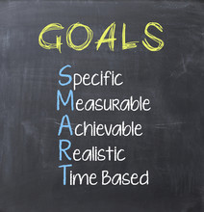
Life Law # 10
You have to name it before you can claim it!
Strategy: Get clear about what you want and take your turn
Clarity gives direction
The universe needs your GPS
Don’t let your dreams go unclaimed!
Notes:
Wise words! It's like navigating through a buffet without a hunger map – you might end up with a plate full of mixed metaphors and indecision. Life goals are like ordering from a cosmic menu; the more specific you are, the more likely the universe won't serve you a surprise dish of confusion. Being specific is like giving your GPS coordinates to the universe. It's saying, "Hey, I want this, not that," and avoiding detours to the land of "what-ifs." It's like telling the cosmic waiter, "I'll have success with a side of fulfillment, please." So, let's be as specific as ordering your favorite pizza – no pineapple unless that's your thing. Specificity is your compass, guiding you away from the buffet of uncertainty and toward the feast of your goals. And hey, if you don't claim that slice of life, someone else might snag it. Don't let your dreams get pizza'd away!

Slide 132
References/Citations
NEED TO ADD -RB

