Slide 1
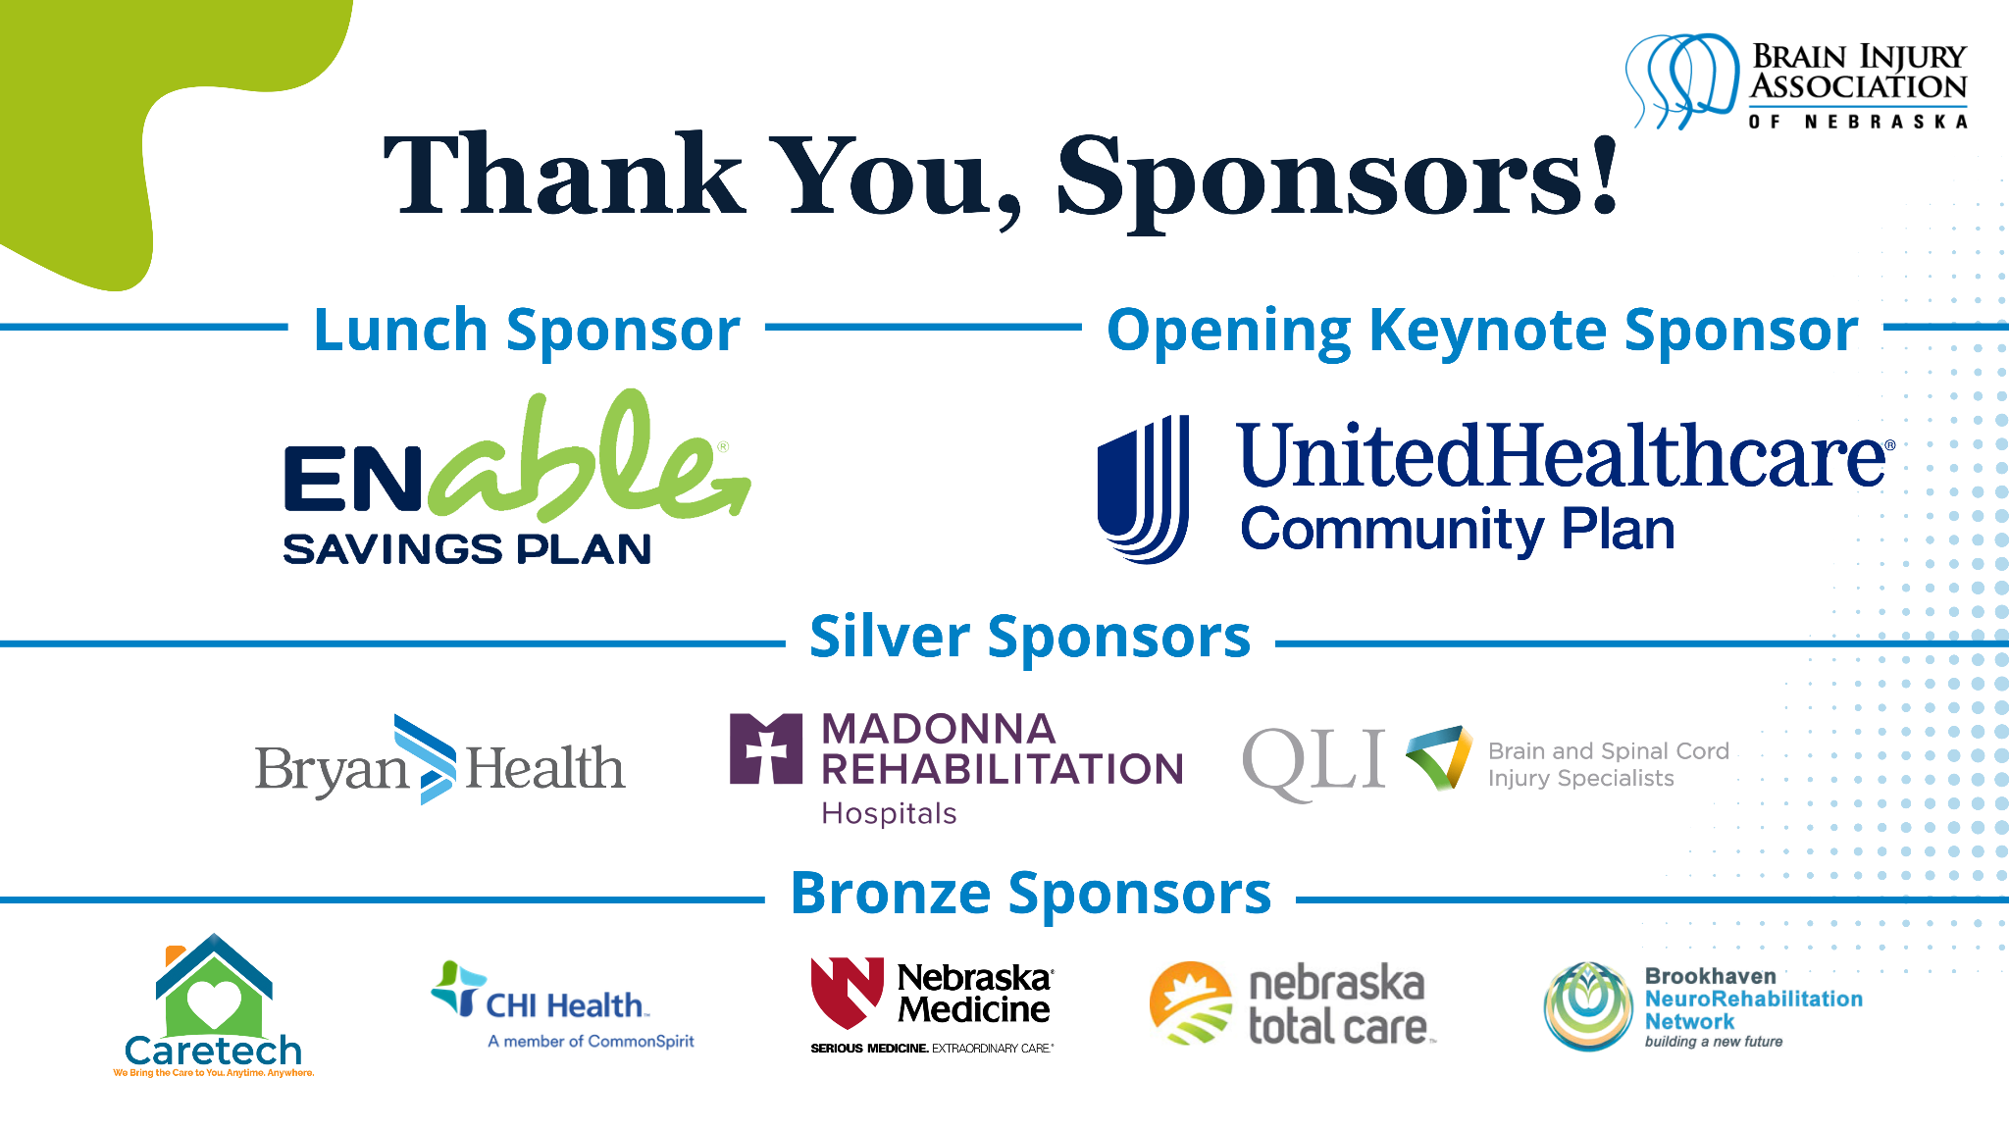

Slide 2
Breaking Barriers, Building Futures: Harnessing Behavioral Health for Justice-Involved Youth
Erika Franta, PhD, LP, NCSP
Abril Rangel-Pacheco, PhD
Notes:
Erika

Slide 3
Objectives
Describe the prevalence and impact of brain injury among justice‑involved youth at a national and local level.
Apply best‑practice strategies for screening, accommodations, and treatment.
Examine system‑level approaches that strengthen identification, intervention, and support.
Notes:
Erika
Data on brain injury prevalence in justice-involved youth and adults
Best practices for screening, accommodations, and diversion strategies
System-level considerations: training staff, embedding screening into processes, and linking to services
Brain injury (especially BI) is significantly overrepresentedin justice systems (Davidson & Reed, 2024). Symptoms areoften misinterpreted, leading to punitive responses (BI &Social Justice Lab, n.d.). We are going to

Slide 4


Meet your presenters…
Erika Franta, PhD
Assistant Professor
Licensed Psychologist
Nationally Certified School Psychologist
Abril Rangel-Pacheco, PhD
Psychology Fellow
Licensed Mental Health Practitioner
Notes:
Erika & Abril
Introduce ourselves
Name, Degree, License, Position
Training
Past Practical experience working with justice involved youth and brain injury
Current practice working with justice involved youth and brain injury
Before we get started – we wanted to be sure to align us all around two definitions. First…

Slide 5

What do we mean by "brain injury"?
Any documented or likely traumatic or acquired injury identified through structured screening of a person’s life events and resulting symptom
Event history (external force, oxygen loss, medical events)
Symptoms & functional challenges linked to injury history
(OBISSS, 2025)
Notes:
Erika
First… as a reminder… Peggy and explained this in the previous presentation. So, this is just a reminder – to keep us all aligned ☺ As a BH provider – and when we think about the crossover of symptoms across various diagnostic categories, including BI, DSM V, medical – I think it is so helpful to view brain injury in this condensed way – there needs to be an EVENT and Symptoms/functional callenges LINKED to those events.

Slide 6

What do we mean by "behavioral health"?
The integration of students’ emotional well‑being, social relationships, and behavioral patterns as they influence learning and day‑to‑day functioning.
Understanding functions of behavior, teaching skills within environments that are responsive to neurodevelopment, and support overall executive functioning and flexible problem-solving.
(NASP, 2022; PBIS, 2022; US Dept of Ed, 2021)
Notes:
Erika
Second, we will be discussing behavioral health. From our lens, theoretical orientation, and theory of change… Behavioral health is the integration of students’ emotional well‑being, social relationships, and behavioral patterns as they influence learning and day‑to‑day functioning. In schools, it means understanding the function of behavior and teaching skills within environments that are responsive to neurodevelopment—recognizing that children’s and adolescents’ brains are still maturing in areas that support attention, working memory, planning, emotion regulation, and flexible problem‑solving

Slide 7
Justice-Involved Youth Populations
Notes:
Abril

Slide 8
Children with neurodevelopmental differences are overrepresented in the JJ system.
ADHD
ASD
IDD
General population prevalence 5%; 18.5% for females and 11.7% for males in detention (Holland, 2023).
General population prevalence ~ 1.2 to 2.8%; estimated 15% prevalence in youth detention (Hughes et al., 2012).
General population prevalence ~2 to 3%; ~7 to 25% in the youth detention (Hughes et al., 2012).
Notes:
Abril

Slide 9
Neurodevelopmental Considerations
Youth with ASD are more likely than their neurotypical peers to be charged for school-based incidents such as disturbing the school, carrying a weapon, assault and battery, or threatening a school employee (Cheely et al. 2012).
ADHD and temperamental difficulties (i.e., effortful control and negative emotionality) are significantly related to continued offending in justice-involved youth (Baglivio et al., 2017).
Notes:
Abril

Slide 10
Learning Considerations
Justice involved youth tend to experience disruptions in their education (e.g., truancy, being detained), which may impact their academic learning and ability to engage with grade-level material.
The academic achievement level of justice-involved youth has been consistently reported as 1 to 5 years below grade level in both reading and math (Cavendish et al., 2014).
Students with disabilities are overrepresented in the juvenile justice system, especially those with EBDs and OHIs (Kincaid & Sullivan, 2019).
Justice-involved youth with disabilities are significantly less likely to earn a high school diploma than their peers without disabilities (Cavendish, 2014).
Notes:
Abril

Slide 11
Trauma Considerations
Up to 90% of justice-involved youth report exposure to some type of traumatic event; 70% of youth meet criteria for a mental health disorder; 30% of youth meeting criteria for PTSD (Dierkhising et al., 2013).
~65% of youth are first exposed to trauma within their first 5 years of life.
Early age of onset of trauma exposure is associated with mental health problems and related risk factors (e.g., substance use).
Notes:
Abril

Slide 12
Brain Injury Considerations
Up to 67% of justice-involved youth report brain injury (Tennessee Disability Coalition, 2025)
Justice-involved youth are over 3x more likely to have had a prior BI than adolescents not involved in the justice system (Farrer et al., 2013).
Children with a BI history are 2x likely to have behavioral health issues, social and academic difficulties, and ACE exposure compared with peers with no history of BI (Haarbauer-Krupa et al., 2015).
Notes:
Abril

Slide 13
Developing brains are vulnerable & symptoms may be misinterpreted as "defiance" or "disengagement"
Executive dysfunction, emotional dysregulation, memory impairments impact compliance and decision-making (Reddy, 2025).
Notes:
Abril
Expand on cognitive and behavioral symptoms and their relevance in justice settings.

Slide 14
Justice-Involved Youth in Nebraska
Notes:
Erika

Slide 15
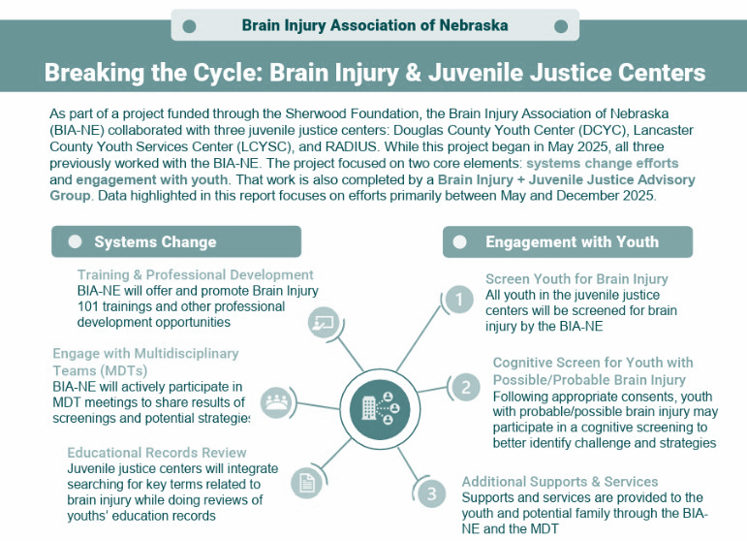
Notes:
Peggy reviewed the 2023 pilot data and I am going to provide an update on our current project across multiple sites and multiple organizations

Slide 16
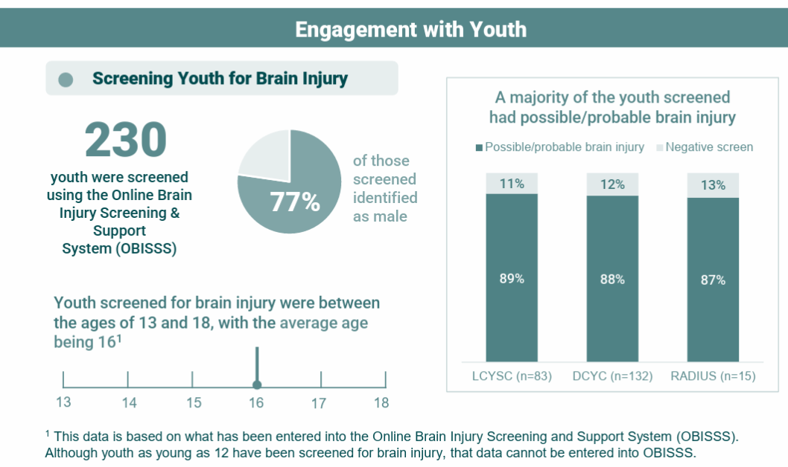

Slide 17
Application for Behavioral Health Providers
Notes:
Abril

Slide 18
Best Practices:
Screening and Assessment
Notes:
Abril

Slide 19

Screening
Validated Screening Tools
  Use brief, validated tools like the OBISS for efficient BI screening in early sessions.
Trauma-Informed Language
  Introduce screening with nonjudgmental, trauma-informed language to normalize questions and reduce stigma.
Early Screening Benefits
  Embed screening early to ensure timely BI identification and avoid misinterpreting symptoms as behavioral issues.
Follow-up and Intervention
  Document findings and consider referrals or tailored interventions based on screening outcomes.
Notes:
Abril
Effective screening for traumatic brain injury (BI) requires behavioral health providers to adopt brief, validated tools that can be integrated seamlessly into existing intake or early-session workflows.
Two well-established screening instruments, the HELPS Screening Tool and the Ohio State University Traumatic Brain Injury Identification Method (OSU–BI–ID), offer structured ways to capture injury history, symptom patterns, and functional impacts. These tools are designed to be administered quickly and with minimal burden on youth or families, making them suitable for high‑volume community and justice‑related settings. Providers should introduce screening using trauma‑informed, nonjudgmental language, normalizing questions so youth do not perceive injury disclosure as stigmatizing.
Examples of effective phrasing include explaining that head injuries are common and can affect memory, emotions, and behavior, and that staff ask everyone these questions regardless of background. Embedding screening early—ideally at intake or within the first two sessions—helps ensure timely identification and prevents misinterpretation of neurological symptoms as behavioral issues. Using structured screeners also increases reliability across providers, reducing inconsistencies that arise from informal questioning. When a screener suggests possible BI, providers should document findings carefully and consider referrals for neuropsychological evaluation, speech‑language pathology, or occupational therapy as appropriate.
If specialized assessment is not readily available, frontline providers can still use screener results to begin tailoring interventions, adapting session structure, and informing cross‑system communication with schools, probation officers, or medical providers. Consistent use of validated tools enhances equity, ensuring youth with cognitive vulnerabilities are identified and supported early.

Slide 20

Reframing Behavioral Symptoms Through a Neurocognitive Lens
Understanding Behavioral Origins
  Distinguish between intentional misconduct and behaviors caused by neurological impacts of traumatic brain injury.
Common Cognitive Impairments
  BI affects planning, inhibition, attention, working memory, & processing speed, impacting daily tasks and emotional regulation.
Neurocognitive Reframing Benefits
  Reframing behaviors neurocognitively avoids punitive responses and promotes practical support for youth and families.
Recognizing Variability and Triggers
  Youth with BI experience good and bad days; recognizing this reduces misinterpretation of behaviors as lack of effort.
Notes:
Abril
Behavioral health providers working with justice‑involved youth must distinguish between behaviors that reflect intentional misconduct and those that stem from neurological limitations associated with traumatic brain injury (BI).
Cognitive impairments following BI commonly affect executive functions such as planning, inhibition, attention control, working memory, and processing speed. As a result, youth may struggle with tasks like remembering appointments, following multi‑step instructions, transitioning between activities, or regulating emotional responses, especially in stressful environments. These difficulties can manifest as irritability, impulsivity, missed curfews, shutdowns, or escalations that appear oppositional but are actually symptoms of cognitive overload or fatigue. Interpreting these behaviors neurocognitively allows providers to avoid punitive or moralizing responses and instead focus on practical support strategies.
Recognizing variability is essential—youth with BI often experience “good days” and “bad days,” depending on sleep quality, environmental triggers, and cognitive fatigue. Providers should encourage families and justice partners to anticipate fluctuations and avoid attributing inconsistency to lack of effort.
Examples of neurocognitively informed interpretations include understanding that slow response times may reflect processing delays, that forgetting tasks may stem from working‑memory deficits rather than irresponsibility, and that emotional escalation may be triggered by sensory overload.
This reframing supports more effective treatment planning, aligns expectations across systems, and reduces conflict between youth and caregivers or authority figures. By shifting the lens from “won’t” to “can’t,” providers help create an environment that enables growth and reduces risks of further justice involvement.

Slide 21
Example Assessment Battery
Self-Report Rating Scales
  Minnesota Multiphasic Personality Inventory – Adolescent (MMPIA)*
  Behavior Rating Inventory of Executive Function – 2 (BRIEF-2)*
  Behavior Assessment System for Children, Self-Report*
Caregiver/Teacher Rating Scales
  Behavior Assessment System for Children – 3
  Adaptive Behavior Assessment System – 3
  Strengths and Difficulties Questionnaire
  Behavior Rating Inventory of Executive Function – 2 (BRIEF-2)*
  Autism Spectrum Rating Scales*
  Conners-3*
Screening Measures
Child and Adolescent Trauma Screen (CATS/CATS-2)
Youth Pediatric Symptom Checklist – 17 (YPSC-17)
Ohio State University BI Screen
Generalized Anxiety Disorder – 7 (GAD-7)
Patient Health Questionnaire – 9 (PHQ-9)
Notes:
Abril
We highlighted here what we add/consider more strongly based in our evaluations following our increase in awareness and udnerstanding of brain injury within the population that we are working with.

Slide 22
Example Established Standard of Practice
Detention unit staff, therapist,probation, education team and caregiver to identity concerns/obtain consent.
Screening measures clinical interview with youth (and caregiver when possible).
Standardized tests and rating scales.
Differential diagnosis and recommendation development.
Sharing results and recommendations to MDT and caregiver; coordination of referrals.
Consultation
Testing
Conceptualization
Coordination
Notes:
Abril

Slide 23
Best Practices:
Recommendations & Treatment
Notes:
Abril

Slide 24

Behavioral Health Recommendations
Consider the learning needs of key areas of functioning: academic, social, emotional, physical, behavioral, adaptive skills.
Emphasize areas of growth and existing strengths
Name specific and discreet skills
Connect challenging behaviors to interventions that are intended to target specific outcomes
Consider neurodevelopmental differences
Identify behavioral interventions or empirically supported approaches for youth with neurodevelopmental differences
Notes:
Abril

Slide 25
Example Recommendations
Individualized Education Support
  Academic accommodations to support executive functioning and learning
  Reteaching and presentation of academic content that is at current level until mastery
Individual and Family Therapy
  Trauma-focused/informed therapeutic services
  Individual social skills training/ communication training
  Parent management training
Notes:
Abril

Slide 26
Behavior Based Interventions
  Establishing routines
  Clear contingencies
  Increased practice opportunities to demonstrate expected behaviors
  Frequent reinforcement
Psychiatry Referral
  Medication management
  Psychoeducation related to medication and identification of motivations for compliance (internal and external)
Re-Assessment of Symptoms
  Assessing symptoms, functioning, and adaptive skills once education and home settings have stabilized
Notes:
Abril

Slide 27

Adapting Clinical Interventions for Cognitive Impairment
Session Structure Adaptations
  Shortening sessions and scheduling breaks help prevent cognitive overwhelm among youth with brain injuries.
Simplified Communication
  Using simple, concrete language and delivering one instruction at a time supports comprehension and reduces confusion.
Visual Supports and Repetition
  Checklists, diagrams, and color-coded cues reinforce memory; repetition strengthens skill acquisition.
Sensory Environment Management
  Minimizing noise, lighting, and distractions reduces sensory overload and improves focus during sessions.
Notes:
Abril
Therapeutic interventions for justice‑involved youth with traumatic brain injury must be structured to accommodate cognitive challenges while preserving the integrity of evidence‑based modalities.
Behavioral health providers can enhance treatment efficacy by modifying pacing, language complexity, sensory environment, and task structure.
One foundational strategy involves shortening sessions or incorporating scheduled breaks to prevent cognitive overwhelm. Providers should deliver one instruction at a time, using simple, concrete language and avoiding abstract or metaphorical phrasing that may be confusing for youth with processing limitations.
Visual supports—such as checklists, written summaries, diagrams, and color‑coded cues—reinforce memory and aid comprehension. Repetition and rehearsal are key: skills taught in modalities like CBT or DBT may need to be practiced more frequently, with explicit modeling and overlearning built into the intervention. Motivational interviewing can be adapted by using slower pacing, confirming understanding with reflective summaries, and incorporating visual decisional‑balance tools that externalize abstract concepts. Safety planning should be made highly concrete using visual templates, wallet cards, or caregiver copies stored in accessible places.
Providers should also minimize sensory overload by managing noise, lighting, and visual distractions within the session environment. When cognitive fatigue arises, therapists can pivot to less demanding activities or grounding techniques until engagement returns. Co‑creating a personalized “best‑help list” with the youth—identifying strategies that support regulation or comprehension—further enhances collaboration and autonomy. These accommodations maintain therapeutic fidelity while ensuring that neurocognitive barriers do not impede progress.

Slide 28
Best Practices:
Crossing Systems
Notes:
Erika

Slide 29
Systems-Level Considerations
Pathways
  Behavioral dysregulation, social vulnerability & "invisible" disability (Riccardi & Ciccia, 2023).
Policy
  Universal screening, staff training, cognitive accommodations & cross-system collaboration (Davidson & Reed, 2024)
Gaps
  Lack of screening, limited staff training & inconsistent accommodations (Davidson & Reed, 2024).
Rehabilitation & Reentry
  BI impairs program participation; youth with BI 69% more likely to reoffend (Tennessee Disability Coalition, 2025).
Notes:
Erika
Explain behavioral, social, and invisible disability pathways linking BI to justice involvement.

Slide 30

Engaging Families & Coordinating Across Systems
Family Education and Support
  Psychoeducation helps families understand BI effects on memory, emotions, and behavior for better home support.
Caregiver Strategies
  Caregivers implement routines, simplified instructions, visual aids, and calm responses to improve youth functioning.
Cross-System Collaboration
  Coordinated efforts among schools, probation, medical, and behavioral teams ensure consistent BI-informed interventions.
Academic Advocacy and Consistency
  Advocating for accommodations and aligning expectations across settings reduces confusion and improves outcomes.
Notes:
Erika
Family engagement and cross‑system collaboration are essential for supporting justice‑involved youth with traumatic brain injury. Many families are unaware that past injuries—sometimes mild or long forgotten—may be contributing to present‑day behavioral or academic struggles. Behavioral health providers should supply accessible psychoeducation explaining how BI affects memory, emotional regulation, processing speed, and stress tolerance. At home, caregivers can implement strategies such as using consistent routines, simplifying instructions, creating visual schedules, reducing sensory triggers, and responding with calm, regulated communication. Providers can coach caregivers on cueing techniques, positive reinforcement, and predictable structure to reduce conflict and improve functioning. Beyond the family unit, coordination among schools, probation officers, medical providers, and behavioral health teams is crucial. Sharing screening findings, with appropriate consent, allows all stakeholders to adopt BI‑informed approaches and prevents behavioral symptoms from being misinterpreted as defiance within school or justice settings. Advocating for academic supports—such as 504 plans or individualized education programs—ensures youth receive appropriate accommodations. Providers should help align expectations across environments, reducing confusion and ensuring responses to behavior are consistent and supportive. Systemwide BI education for justice partners also strengthens outcomes by reducing reliance on punitive measures. When multiple systems understand a youth’s cognitive profile and collaboratively adjust demands and interventions, recidivism risks decrease and treatment engagement improves.

Slide 31

Supporting Transitions and Long-Term Stability
Proactive Transition Planning
  Effective transition starts before reentry, using step-by-step checklists and rehearsal to prepare youth for new routines.
Community Coordination and Warm Handoffs
  Behavioral health professionals enhance care continuity by connecting youth with community BI, mental health, and educational services.
Supportive Strategies for Youth
  Using memory aids, daily routines, and managing sleep and symptoms supports youth stability post-release.
Monitoring and Emotional Support
  Gradual exposure to new environments and monitoring during early reentry helps emotional regulation and reduces reoffending risk.
Notes:
Erika
Reentry and transition periods pose elevated risks for justice‑involved youth with traumatic brain injury due to the cognitive and environmental demands associated with shifting routines, expectations, and support systems. Effective planning begins well before reentry, incorporating step‑by‑step checklists, repeated rehearsal of expectations, and structured coordination with community providers. Behavioral health professionals can strengthen continuity of care by ensuring warm handoffs to community services specializing in BI, mental health, or educational support. Pre‑scheduling follow‑up appointments and supplying receiving providers with accommodation summaries and relevant screening findings facilitate seamless transitions. Youth with BI may benefit from explicit instruction in organization and memory strategies, such as using planners, phone reminders, visual calendars, and structured daily routines. Providers should also address sleep hygiene, headache management, and co‑occurring mental health symptoms, all of which influence post‑release stability. Because youth with BI often experience difficulty adapting to novel environments, gradual exposure to new expectations paired with consistent support from caregivers and systems partners enhances emotional regulation and compliance. Monitoring progress during the initial weeks after reentry is critical, as challenges are most likely to emerge during this adjustment period. Through proactive planning, clear communication, and consistent accommodations across settings, providers can help youth maintain treatment gains and reduce the likelihood of reoffending.

Slide 32

Cross-System Workforce Development
Build Core, Shared Knowledge on Pediatric Brain Injury
  Equip professionals across mental/behavioral health, education, juvenile justice, medical, child welfare, and community services with a baseline understanding
Establish Consistent Screening, Identification, and Referral Pathways
  Create uniform cross-agency protocols to screen youth with possible brain injury early
Develop a Shared Cross-System Communication & Coordination Framework
  Cross-agency case conferencing practices, clear data‑sharing agreements (FERPA/HIPAA compliant); defined points of contact in each system, processes for warm handoffs between agencies
Provide Skills Training in Brain-Informed, Strength-Based Interventions
  Train staff across sectors to apply practical, brain-based strategies with evidence-informed tools/

Slide 33
Example Post-Evaluation Collaboration
Conduct feedback is conducted with appropriate care team members: a youth’s caregiver, probation officer, and attorney (if applicable).
Consultation with detention center school to implement accommodations (e.g., academic and behavioral).
Consultation with detention center therapists to inform services (e.g., bolstering motivation for change, medication compliance).
Collaboration with care team and agencies to support community re-entry (e.g., psychiatry, education rights advocacy group).
Notes:
Erika

Slide 34
Q + A
Discussion
Notes:
Abril

Slide 35
References & Resources
Davidson, M., & Reed, K. (2024). Mind matters: Building a justice system that is inclusive and responsive to brain injury. Council of State Governments Justice Center.​
Riccardi, J., & Ciccia, A. H. (2023). Training on brain injury for juvenile justice professionals: Findings from pre- and post-training surveys and focus groups. Journal of Applied Juvenile Justice Services.​
Nagele, D., Vaccaro, M., Schmidt, M. J., & Myers, J. (2021). Brain injury in justice-involved youth: Findings and implications for juvenile service professionals. Brain Injury Association of Pennsylvania.​
Tennessee Disability Coalition. (2025). Brain injury and the juvenile justice system [Infographic].​
BI & Social Justice Lab, McMaster University. (n.d.). Traumatic brain injury and youth justice. BI Youth Justice.​
Brainkind. (n.d.). Brain injury and the criminal justice system. https://brainkind.org/about-brain-injury/brain-injury-and-the-criminal-justice-system/​
Centers for Disease Control and Prevention. (n.d.). Traumatic brain injury: A guide for criminal justice professionals. BrainLine. https://www.brainline.org/article/traumatic-brain-injury-guide-criminal-justice-professionals​
Kelley, L. (2025). Study finds link between brain injury and criminal behavior. University of Colorado Anschutz Medical Campus News.​
Reddy, K. J. (2025). Traumatic brain injury and criminal justice. In Foundations of criminal forensic neuropsychology (pp. 271–298). Springer.​
Schubmehl, S. (2025). Overrepresentation of individuals with traumatic brain injury in the criminal justice system. Brain Injury Association of Colorado.
Dierkhising, C. B., Ko, S. J., Woods-Jaeger, B., Briggs, E. C., Lee, R., & Pynoos, R. S. (2013). Trauma histories among justice-involved youth: Findings from the National Child Traumatic Stress Network. European Journal of Psychotraumatology, 4, 10.3402/ejpt.v4i0.20274. https://doi.org/10.3402/ejpt.v4i0.20274
Haarbauer-Krupa, J., Daugherty, J., Nagele, D., Dettmer, J., Gorgens, K., Lyman, H., Ashley, C., Medina, A., Tomita, I., & Lambert, L. (2025). History of Childhood Traumatic Brain Injury and Potential Risk Factors for Future Incarceration 8268. Archives of Physical Medicine and Rehabilitation, 106(4), e12. https://doi.org/10.1016/j.apmr.2025.01.031
Farrer, T. J., Frost, R. B., & Hedges, D. W. (2013). Prevalence of traumatic brain injury in juvenile offenders: a meta-analysis. Child neuropsychology : a journal on normal and abnormal development in childhood and adolescence, 19(3), 225–234. https://doi.org/10.1080/09297049.2011.647901
Cavendish, W. (2014). Academic Attainment During Commitment and Postrelease Education–Related Outcomes of Juvenile Justice-Involved Youth With and Without Disabilities. Journal of Emotional and Behavioral Disorders. https://doi.org/10.1177/1063426612470516
Holland, L., Reid, N. & Smirnov, A. Neurodevelopmental disorders in youth justice: a systematic review of screening, assessment and interventions. J Exp Criminol 19, 31–70 (2023). https://doi.org/10.1007/s11292-021-09475-w
Baglivio, M. T., Wolff, K. T., Piquero, A. R., DeLisi, M., & Vaughn, M. G. (2017). Multiple Pathways to Juvenile Recidivism: Examining Parental Drug and Mental Health Problems, and Markers of Neuropsychological Deficits Among Serious Juvenile Offenders. Criminal Justice and Behavior. https://doi.org/10.1177/0093854817714810
Cheely CA, Carpenter LA, Letourneau EJ, Nicholas JS, Charles J, & King LB (2012). The prevalence of youth with autism spectrum disorders in the criminal justice system. Journal of Autism and Developmental Disorders, 42, 1856–1862.

